Slide 3
What gets digested??
Complete the table….
Macromolecule | Monomers
Starch/glycogen
 | Fatty acids & glycerol
Nucleic acids (DNA/RNA)
 | Amino acids
Cellulose
Why?

Slide 4
Absorption in the small intestine
Identify the layers of tissue in the small intestine
Describe how the small intestine is adapted for absorption
Describe different mechanisms of absorption in the small intestine

Slide 5
Lumen
Serosa

Slide 6
Let’s have a look..

Slide 7
Ingestion Digestion Absorption
The process of taking substances into cells and then the blood
The rate of absorption depends on the surface area of the epithelium
What is absorbed?
Water
Glucose
Amino acids
Nucleotides
Glycerol
Fatty acids
Mineral ions
Vitamins

Slide 8
Adaptations for absorption
How is the small intestine adapted for efficient absorption?
- Villi/microvilli provide a large SA
- Wall one cell thick = short diffusion pathway
Network of capillaries to maintain concentration gradient
Capillaries carry glucose/amino acids away
- Lacteal carries fatty acids away
Many mitochondria to produce ATP (for active transport)

Slide 9
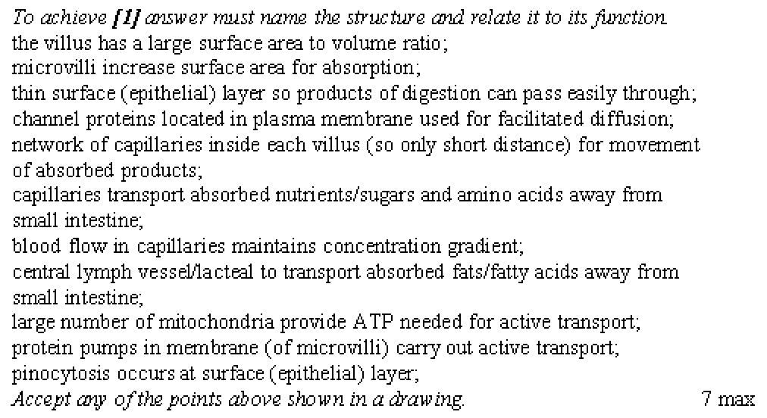

Slide 10
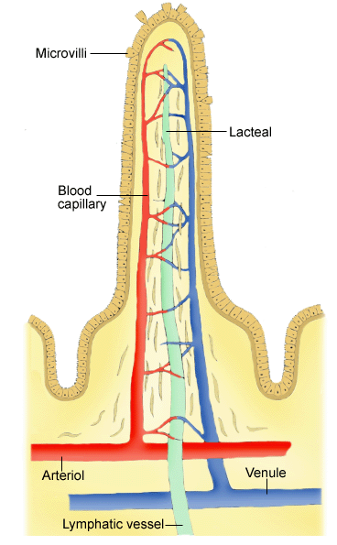
Methods of absorption into villi
PASSIVE (No ATP):
Simple diffusion
Facilitated diffusion
ACITVE (ATP used):
Active transport
Endocytosis
Notes:
Increase surface

Slide 11
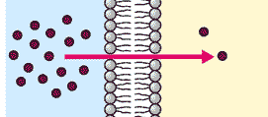
Passive
Simple diffusion
Down concentration gradient
Small molecules/non-polar molecules
Fatty acids
Notes:
Increase surface

Slide 12
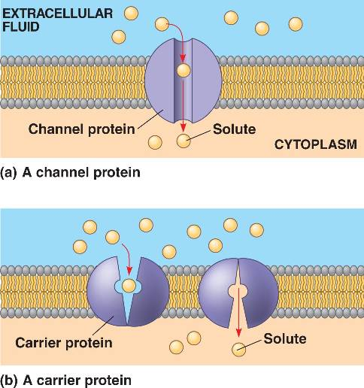
Passive
Facilitated diffusion
Down concentration gradient
Protein also used due to size/polarity
Glucose and amino acids
Notes:
Increase surface

Slide 13
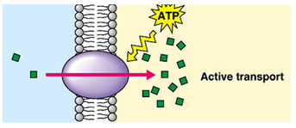
Active
Active transport
Uses membrane pumps
Move against concentration gradient
Use ATP
Glucose and amino acids (under certain circumstances.
Such as??)
Notes:
Increase surface

Slide 14
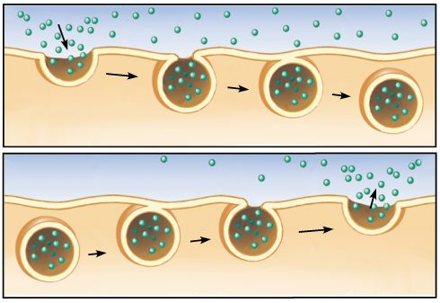
Active
Endo/Exocytosis
Molecules trapped in an infolding of the membrane
Pass through to the other side as a vesicle
Macromolecules that have not yet been fully digested
Notes:
Increase surface

Slide 15
How are specific molecules absorbed??
Separate statements into glucose and triglycerides.
Order all glucose statements
Order all triglyceride statements
Annotate diagram (key on the back)

Slide 16
HW
Summerise the digestion and absorption of starch
Due..

