Slide 1
How does this paramecium get the nutrients and oxygen that it needs?
How does it get rid of waste?

Slide 3
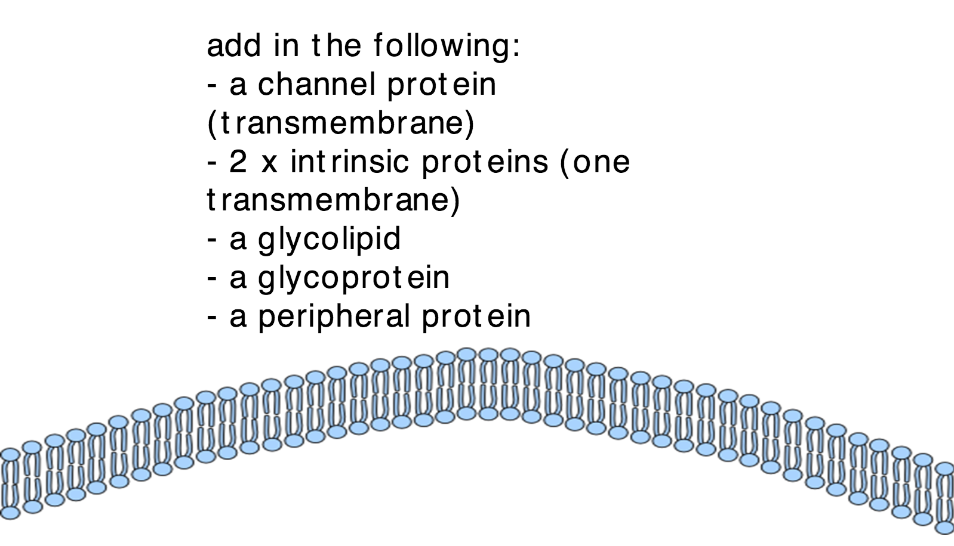
On your sheet…..
X 2
then…...
Define diffusion and osmosis
What molecules move by simple diffusion, facilitated diffusion and osmosis?
Show this movement on your diagram

Slide 5
Facilitated
Diffusion

Slide 7
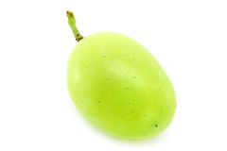
Peel the grape
What do you think will happen if you put it in distilled water?
How could you measure any changes?

Slide 11
Osmosis

Slide 13
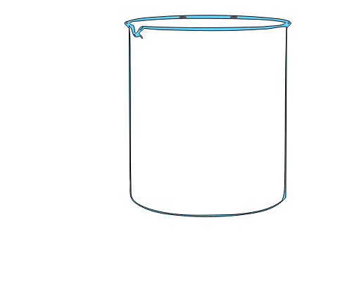
Distilled water
What will happen?

Slide 14
What solution? Why?

Slide 16
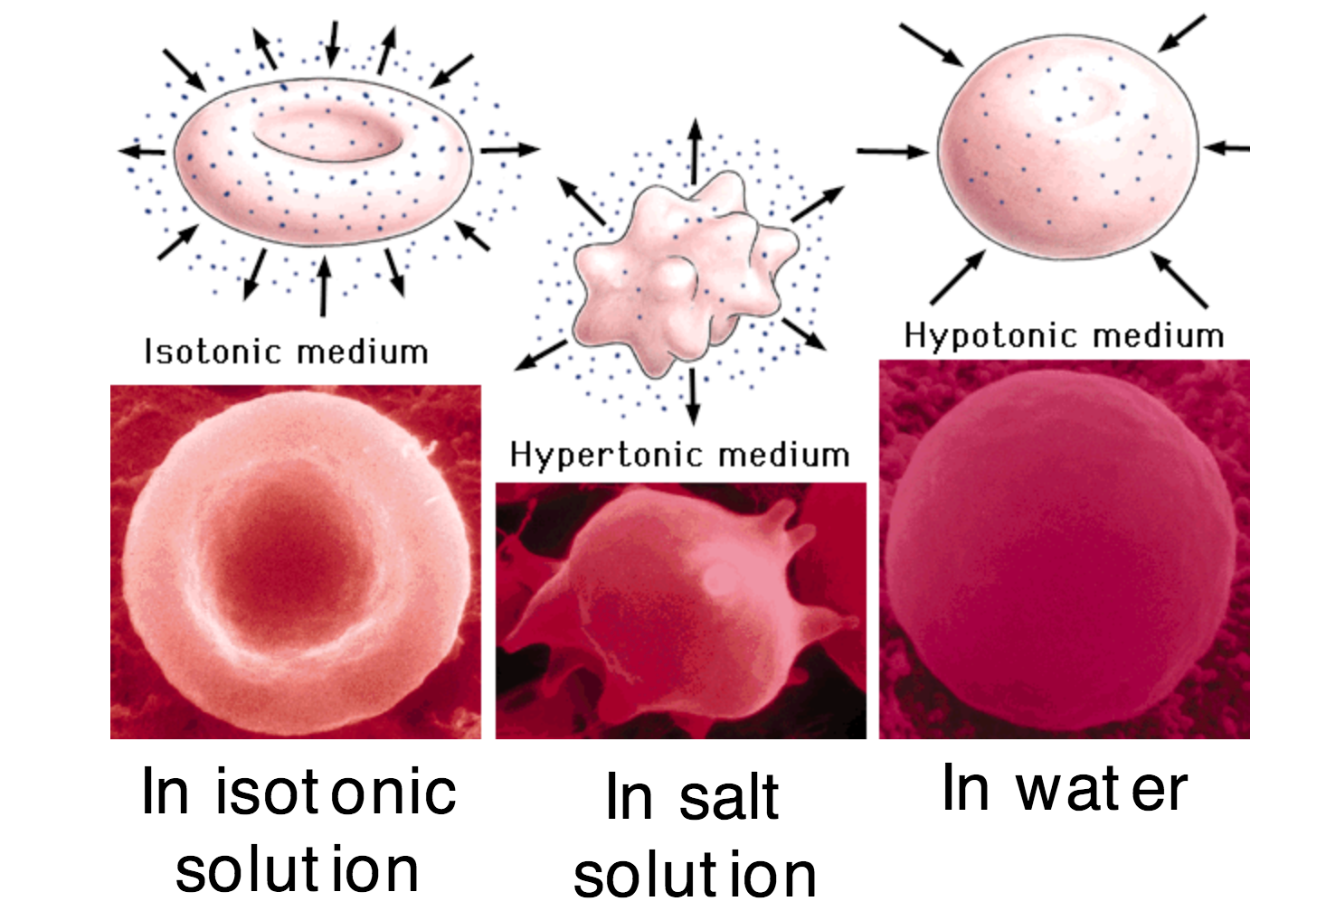

Slide 19
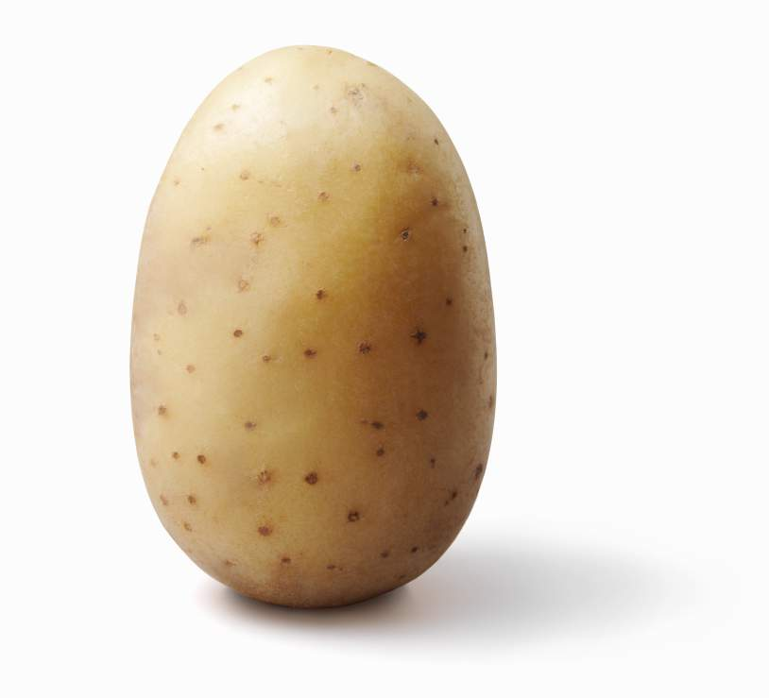
Designing an osmosis experiment

