Slide 1
7.3 Translation
Understanding:
Initiation of translation involves assembly of the components that carry out the process
Synthesis of the polypeptide involves a repeated cycle of events
Disassembly of the components follows termination of translation
Free ribosomes synthesize proteins primarily within the cell
Bound ribosomes synthesize proteins primarily for secretion or for use in lysosomes
Translation can occur immediately after transcription in prokaryotes
The sequence and number of amino acids in the polypeptide is the primary structure
The secondary structure is the formation of alpha helixes and beta pleated sheets
The tertiary structure is the further folding of the polypeptide
The quaternary structure exists in proteins with more than one polypeptide chain
Applications:
tRNA-activating enzymes illustrate enzyme-substrate specificity and the role of phosphorylation
Skills:
The use of molecular visualization software to analyse the structure of eukaryotic ribosomes and a tRNA molecule
Identification of polysomes in an electron micrograph
Nature of science:
Developments in scientific research follow improvements in computing

Slide 2
Translation (HL)
Describe the structure of a ribosome and tRNA
Explain how tRNA gets activated and an amino acid attaches
Describe the three stages of translation
State the roles of free ribosomes and bound ribosomes
Identify polysomes from an electron micrograph

Slide 3
The mature mRNA has left the nucleus…....
…..and heads for the ribosome.
Free ribosomes make intracellular proteins (proteins for that cell)
RER bound ribosomes make extracellular proteins. The RER and golgi package them up to send out of the cell

Slide 4
Ribosome
Made from proteins and ribosomal RNA (rRNA)
A site
5’
3’

Slide 5
rRNA

Slide 6
tRNA
H bonds between bases
CCA amino acid binding site of 3’ end of tRNA
Triplet of bases used in translation is the anticodon

Slide 7
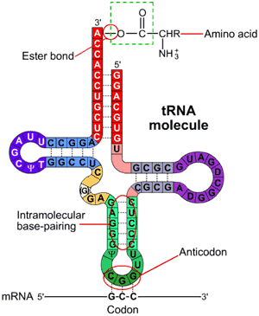
tRNA activating enzymes
An amino acid is attached to the 3’ end of the tRNA.
This is done by tRNA activating enzymes.
There are 20 different tRNA activating enzymes each specific to one anticodon/amino acid

Slide 8
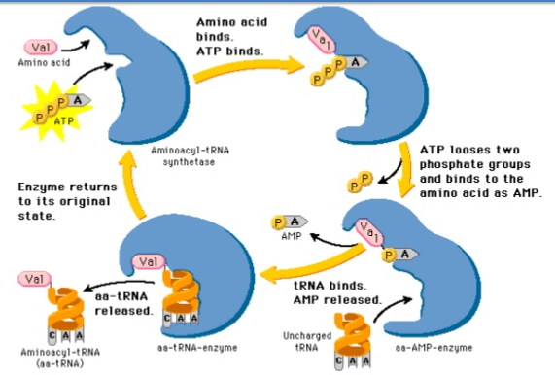
tRNA activating enzyme

Slide 9
tRNA activating enzymes

Slide 10
Small ribosomal subunit
3’
5’
polypeptide
mRNA
Large ribosomal subunit
Amino acid
Methionine
Translation now begins..
tRNA
Stop codon
P site
Start codon
Peptide bond
E site
A site
Complementary base pairing

Slide 11
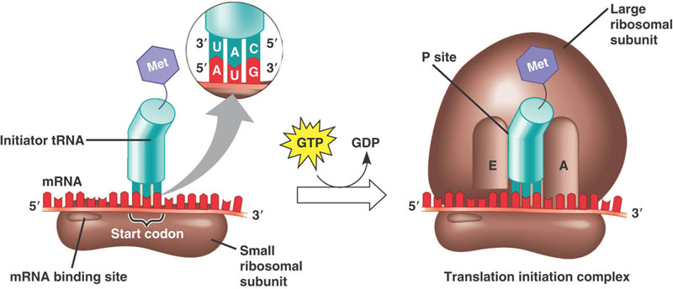
Stage 1 – Initiation
The mRNA binds to the small subunit of the ribosome on the mRNA binding site
An initiator tRNA carrying methionine binds at the start codon ‘AUG’
The large ribosomal subunit then attaches (where the tRNA binding sites are)
The initiator tRNA is at the P site
A second codon signals another tRNA to bind and occupy the A site. A peptide bonds forms between the two amino acids.

Slide 12
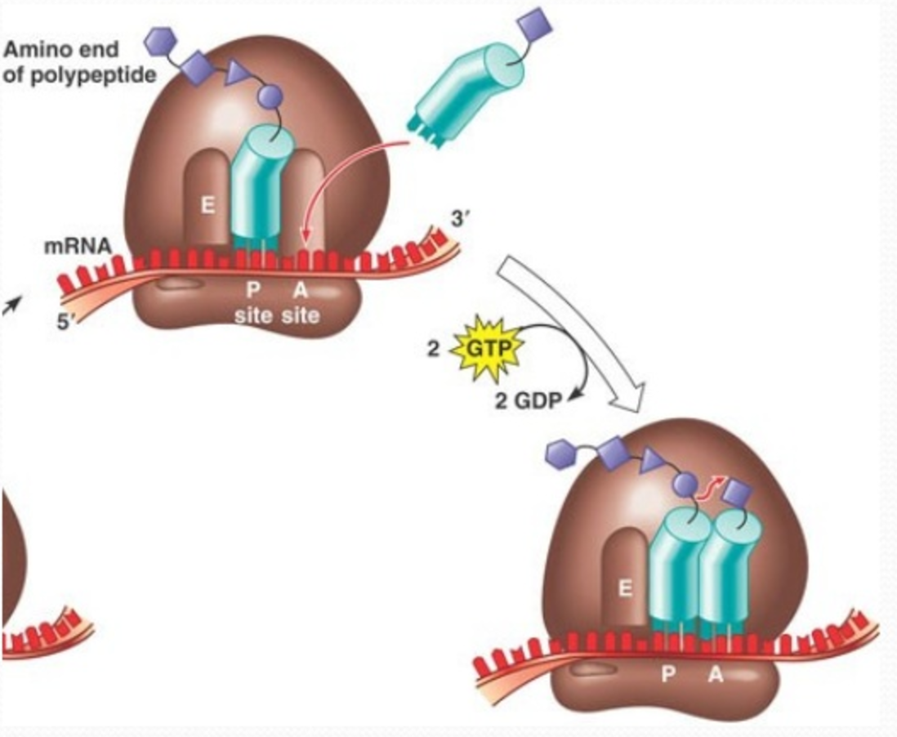
Stage 2 - Elongation
Elongation occurs in repeated steps
The ribosomes translocates (moves) three bases along the mRNA moving the tRNA in the P site into the E site, releasing it.
This makes the next A site available for a tRNA to bind

Slide 13
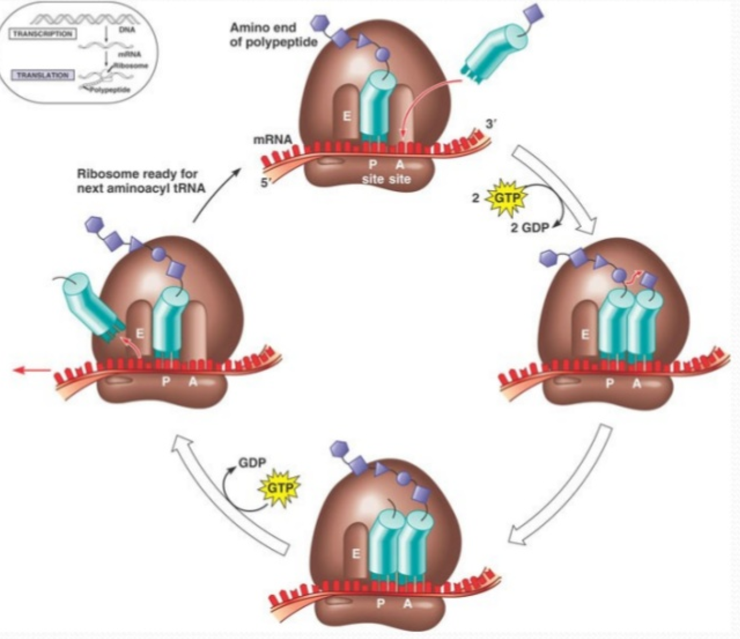
Translation occurs from 5’ to 3’ on the mRNA

Slide 14
Degenerate code

Slide 15
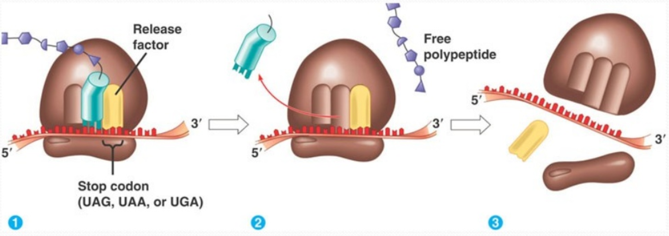
Protein Synthesis
Stage 3 - Termination
Transcription and Translation
Translations occurs until a stop codon is reached
A release factor releases the polypeptide chain
The ribosome, release factor and tRNA disassemble

Slide 16
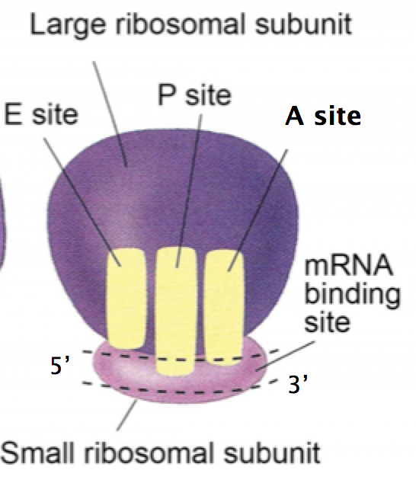
Binding sites
A site – Aminoacyl site
Holds the tRNA carrying the next amino acid to be added to the polypeptide chain
P site – Peptidyl site
Holds the tRNA carrying the growing polypeptide chain
E site – Exit site
Site from which the tRNA that has lost its amino acid is released

Slide 17
Protein synthesis in…

Slide 18
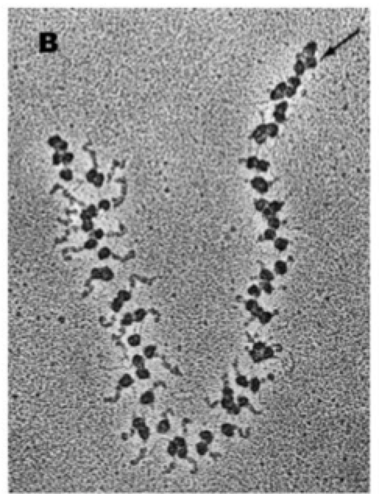
5’
This is a polysome – one mRNA with many ribosomes attached
3’
What changes between 5’ and 3’?

Slide 19
Polysomes – multiple ribosomes on on mRNA strand
Protein Synthesis

Slide 20
B
D
3. 5' to 3' (direction of movement along mRNA); (small subunit of) ribosome binds to mRNA; moves along mRNA until it reaches the start codon / AUG / translation starts at AUG; tRNA binds to ribosome / mRNA; large subunit binds to small subunit; two tRNAs bound to ribosome at the same time; binding of tRNA with anticodon complementary to codon on mRNA; tRNAs carry an amino acid; anticodon / codon codes for an amino acid; amino acid linked by a peptide bond to the polypeptide / to another amino acid; ribosome moves on along the mRNA; tRNA displaced and another attaches to vacant binding site; stop codon reached; polypeptide / protein is released / tRNA and mRNA detached from ribosome; ribosome splits into (large and small) subunits;
[9]

