Slide 1
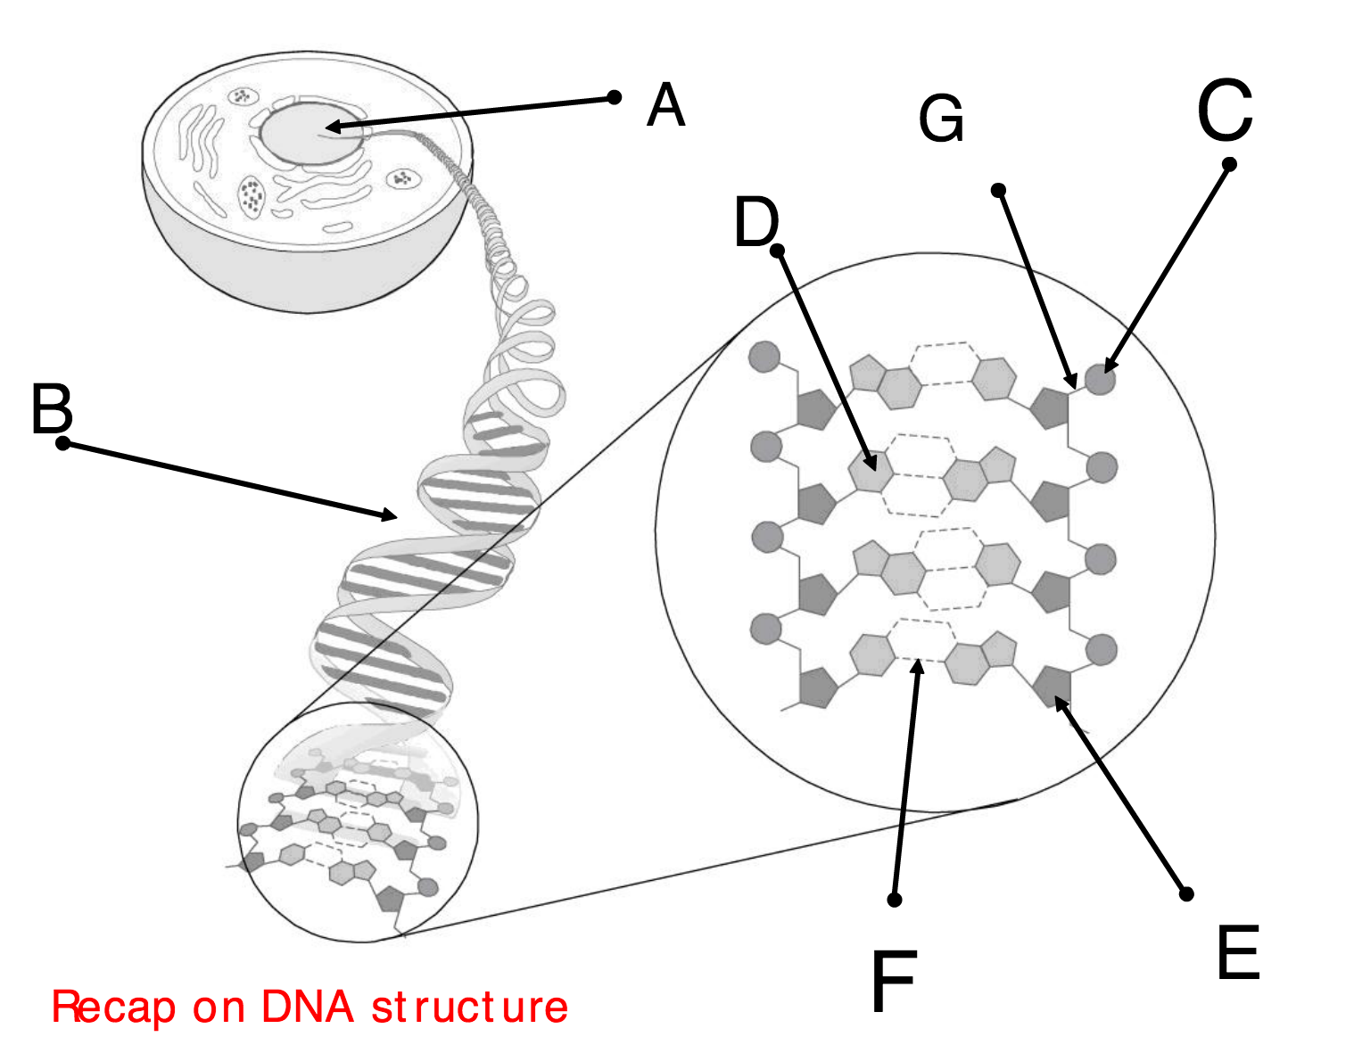

Slide 2
A
B
C
D
E

Slide 3
Protein Synthesis Transcription
Describe the stages in transcription
Describe the differences between DNA and RNA

Slide 8
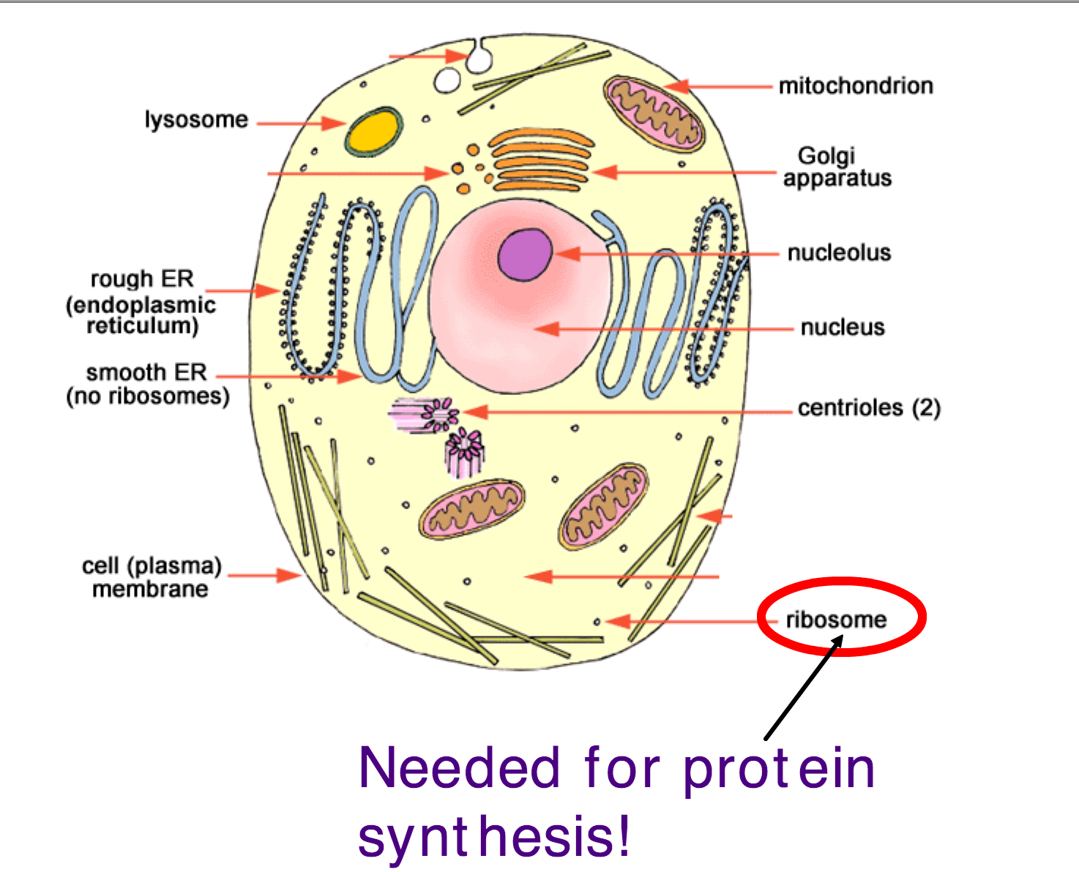

Slide 9
Transcription
Translation
RNA polymerase binds to a site on the DNA which is the start of a gene.
RNA polymerase moves along the gene separating the DNA into single strands and pairing up RNA nucleotides with complementary bases on the DNA template strand. U with A, G with G
RNA polymerase forms covalent bonds between RNA nucleotides
The mRNA detaches from the DNA and the double helix reforms
Transcription stops at the end of the gene
The mRNA is released and leaves the nucleus

Slide 10
Transcription
Translation
U – A and G - G
Free nucleotides
Covalent bonds
RNA polymerase
Unwinds
Uracil
Complimentary base pairing
Unzips
mRNA
Template strand

Slide 12
You will be given a written description of the events that take place in transcription.
Represent the events diagrammatically
(like you would see in a text book)

