Slide 1
Understand how the ears work
Label the key parts of the ear
Bronze
Describe function of each part of the ear
Silver
Explain what stereophonic hearing is
Gold

Slide 3
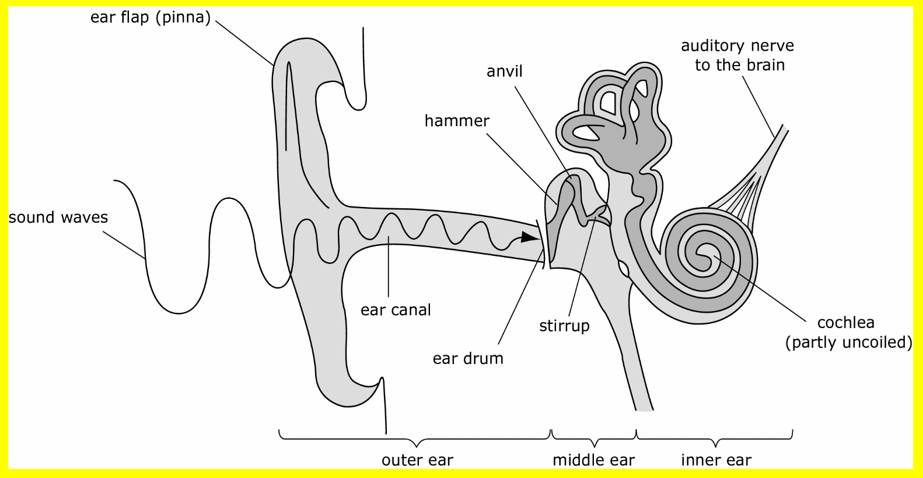

Slide 7
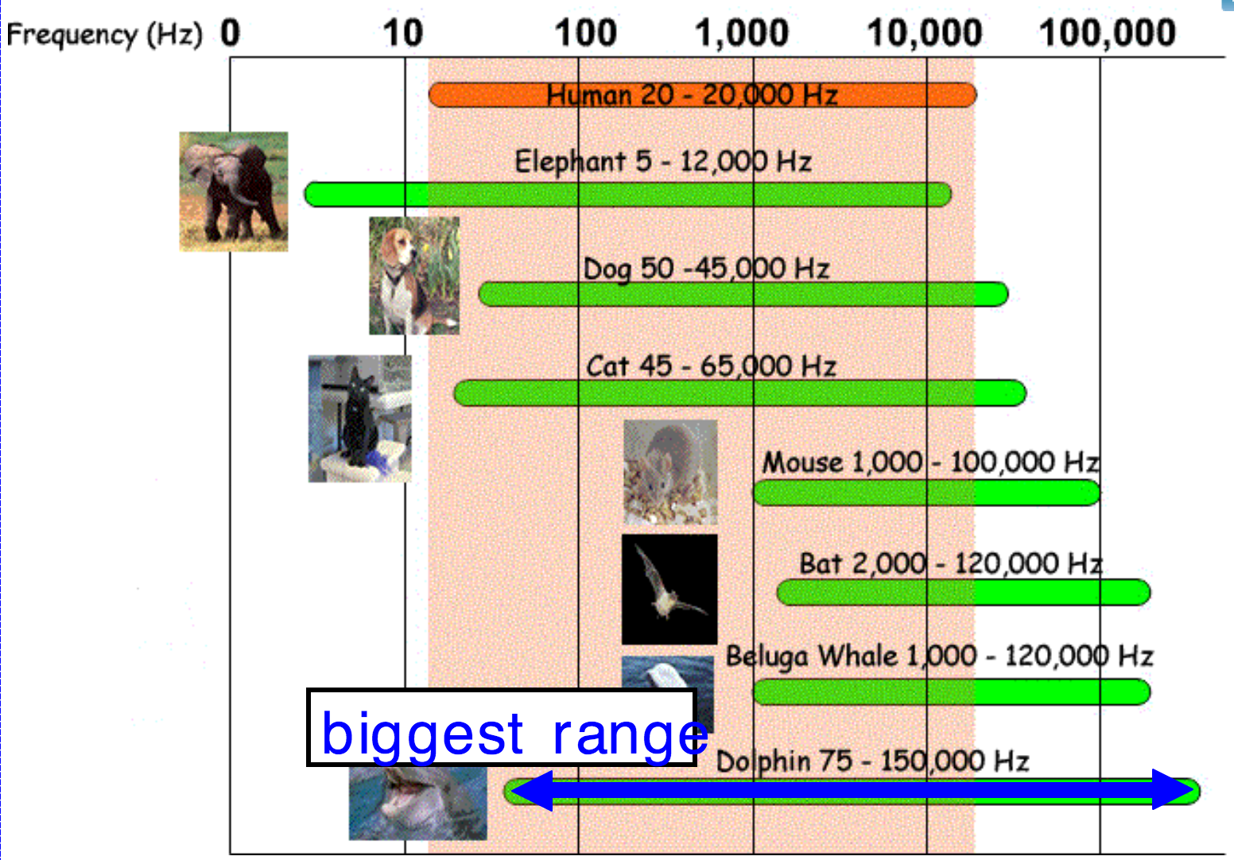

Slide 8
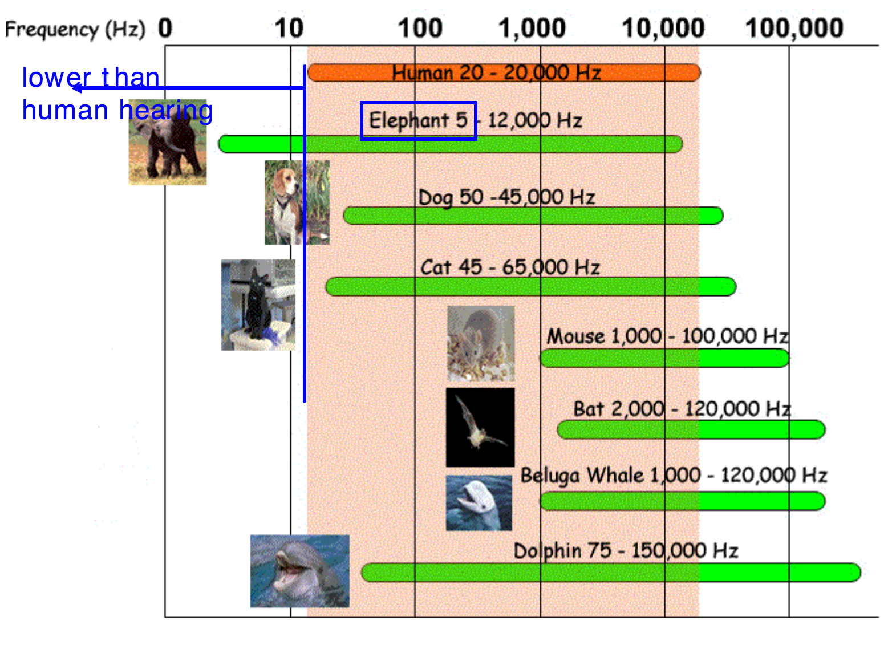

Slide 9
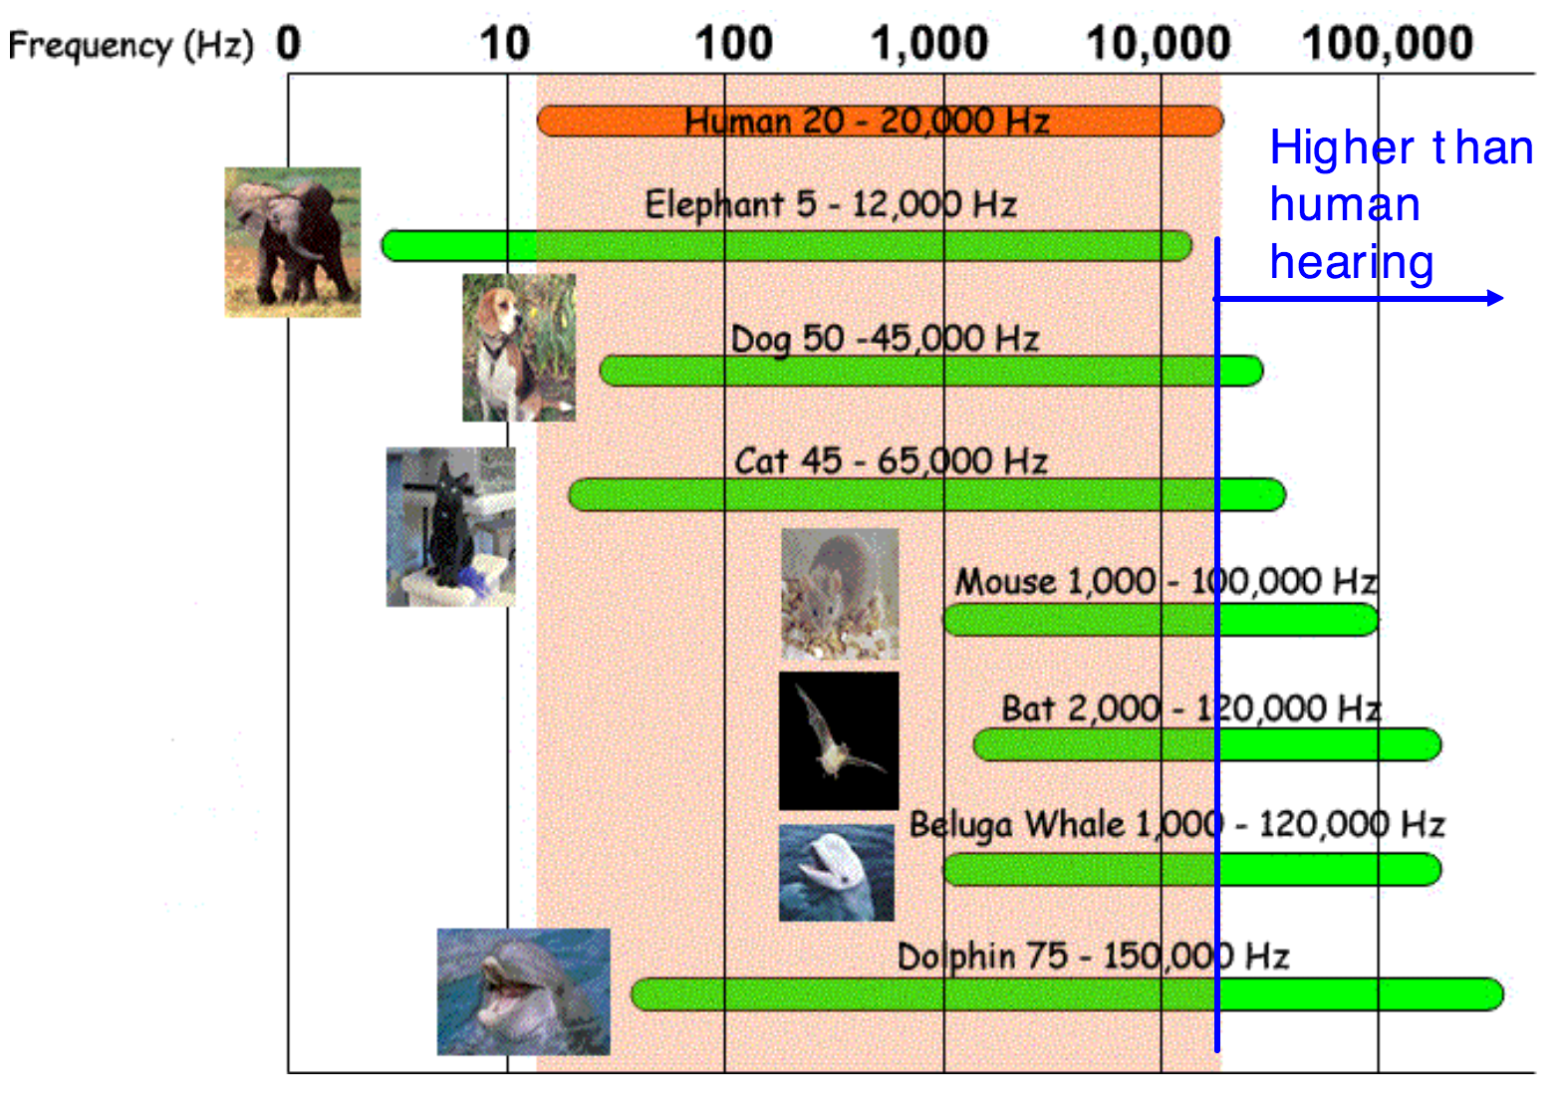

Slide 10
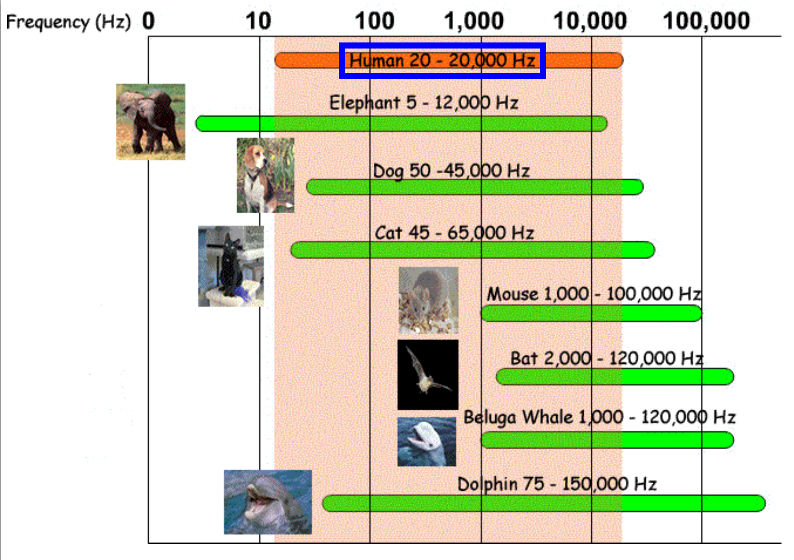
Hearing test

Slide 11
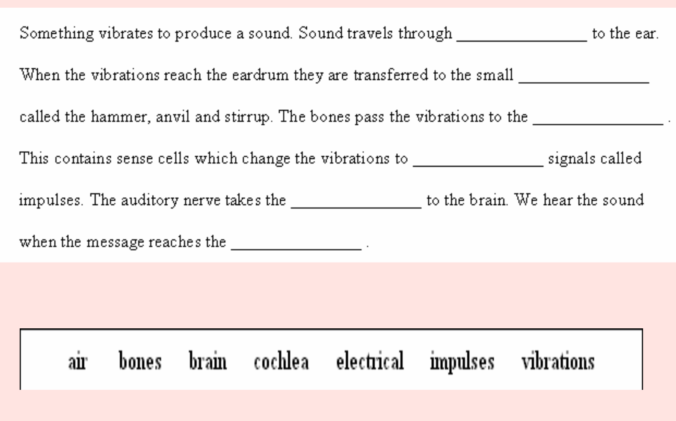

Slide 12
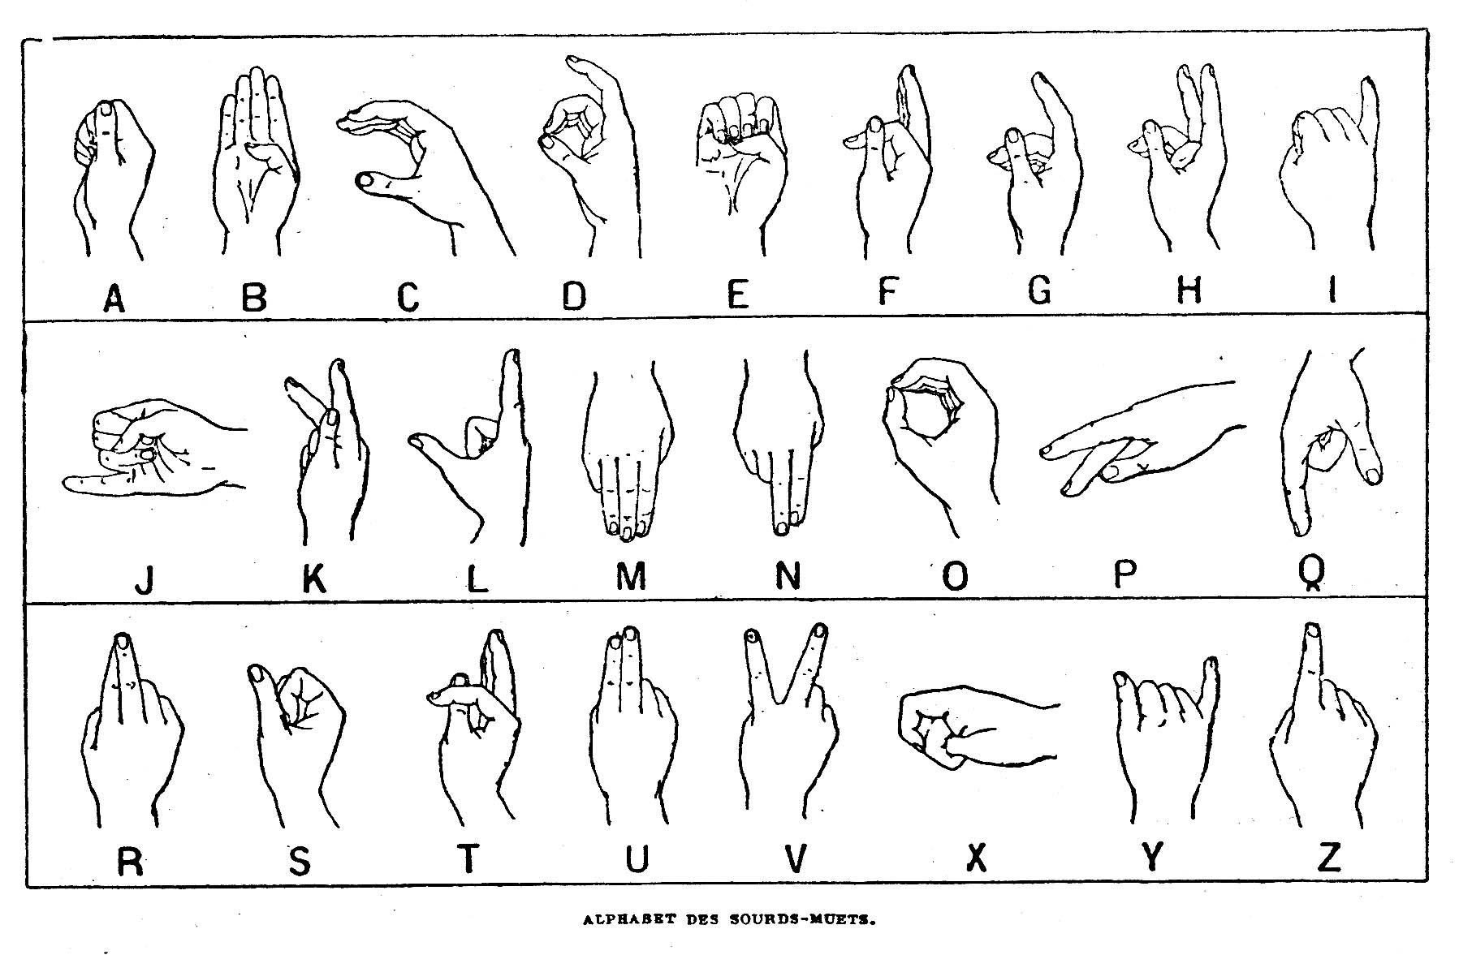
Sign your name to your partner!

