Slide 1
Synapses
Label a synaptic cleft
Describe how an impulse is generated in a post synaptic neuron

Slide 2
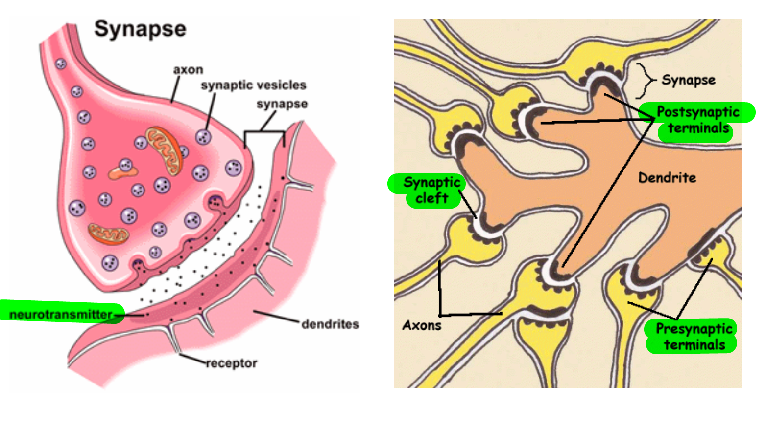

Slide 3
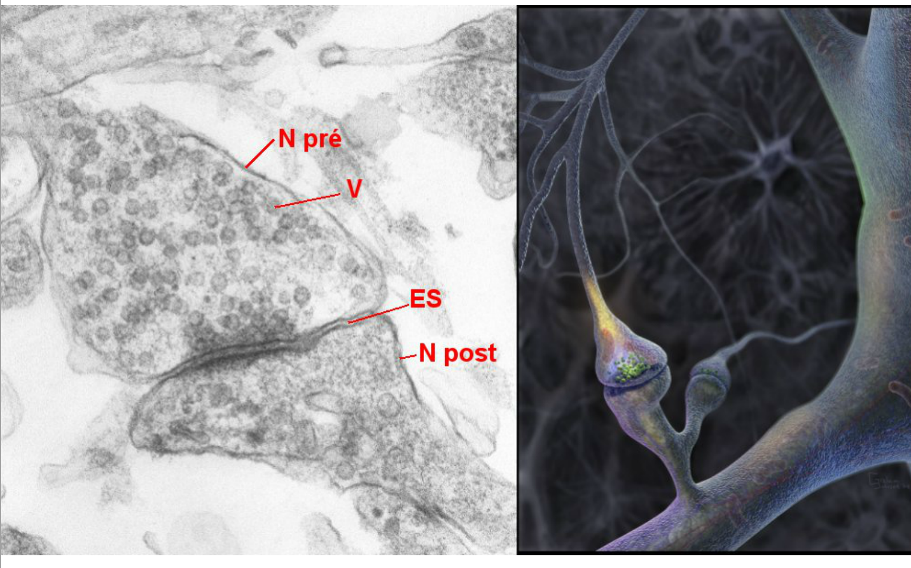

Slide 4
