Slide 1
"I frequently and seriously bethought me, and long revolved in my mind, what might be the quantity of blood ....
I began to think whether there might not be a motion, as it were, in a circle."

Slide 2
Structure of the heart
Label a diagram of the heart
Identify the main features of the heart
Describe how blood flows through the heart
Explain how the structure of the heart is related to its function

Slide 3
Use your text books to label the diagram of the heart

Slide 4
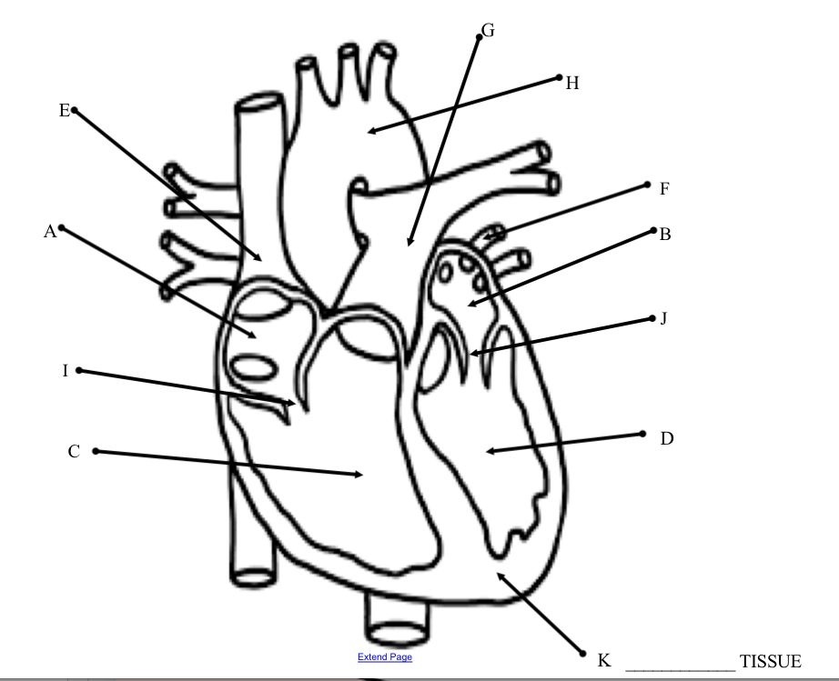
L

Slide 6
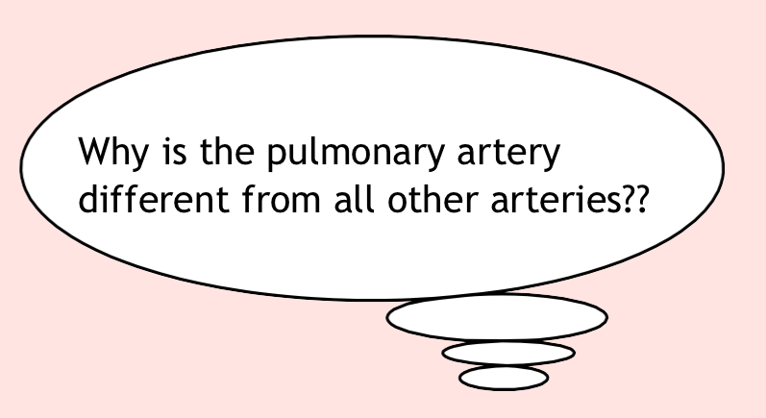

Slide 7
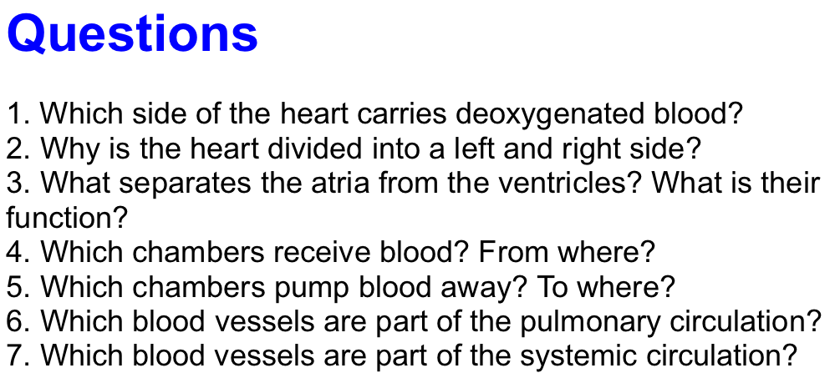

Slide 8
