Slide 1
Movement is brought about my muscles controlling a Skelton
But crabs don’t have bones!!

Slide 3
Structure of Muscles
Skeletal muscle fibres are multinucleate and contain specialised endoplasmic reticulum
Muscle fibres contain many myofibrils
Each myofibril is made up of contractile sarcomeres

Slide 6
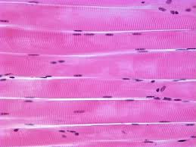
Structure of muscle fibres
Muscles attached to bone = skeletal muscles
(by tendons)
stripes are visible
Striated muscle

Slide 7
A muscle fiber is a cell. What is a muscle?
This is what we are interested in
The muscle cell/fiber

Slide 8
A muscle fiber. This is a single cell
If you finish…
What is myoglobin?
Use your textbook to give a brief account of: Sarcolemma, Sarcoplasm, Mitochondria, Sarcoplasmic reticulum.

Slide 9
Components of a muscle fiber/cell
Sarcolemma
The cell membrane of the muscle cell
Sarcoplasm
The cytoplasm of the muscle cell
Sarcoplasmic reticulum
Specialised type of endoplasmic reticulum – stores calcium to be used in contraction
Mitochondria
Provide ATP for muscle contraction
Myoglobin
Similar to haemoglobin. Bonds to oxygen. Releases the oxygen when the muscle has insufficient oxygen for aerobic respiration

Slide 10
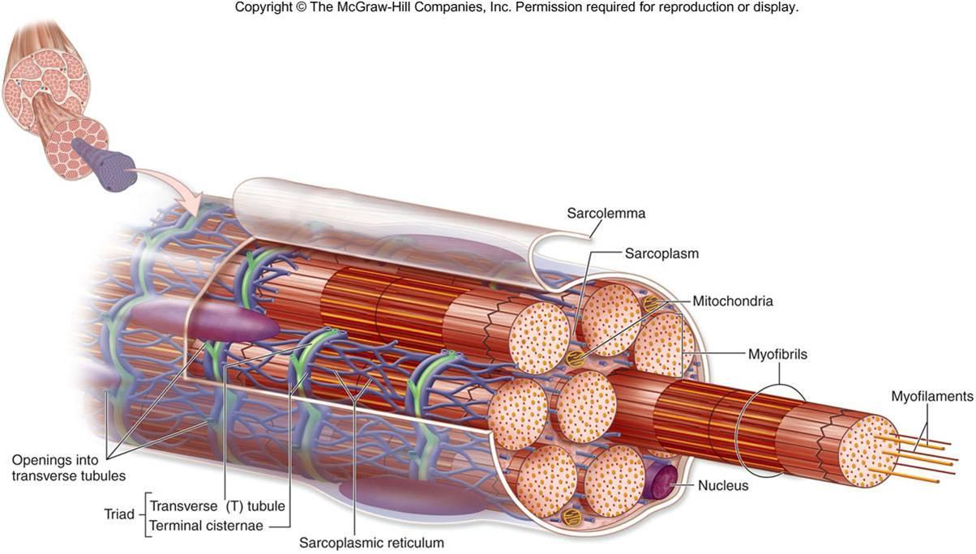
Myofibrils within the muscle cell

Slide 11
my
actin
myosin
Muscles look striped due to a series of light and dark bands
The repeating unit in a myofibril is a sarcomere
The Z-line appears at the centre of each light band

Slide 12
Syllabus: Draw a labelled diagram of a sarcomere
Tips:
Myosin must be shown with heads
Actin should be connected to the Z lines
Light bands should be labelled around the Z line
The dark band should be indicated
Label the sarcomere as extending from one Z line to the next

Slide 14
When muscle fibers contract, the myosin pulls the actin inwards, shortening the sarcomeres

Slide 15
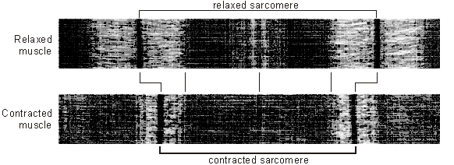
Muscle contractions
Notes:
Thinner light bands
Light bands closer together
Light part in middle gone (M line)

Slide 17
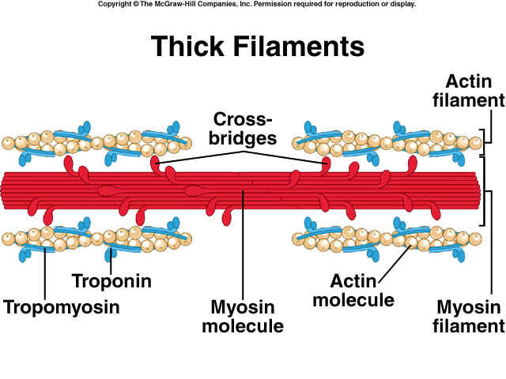
Control of contraction
Contraction of skeletal muscle occurs by the sliding of actin and myosin filaments
Myosin filaments have heads that can bind to special sites on actin filaments, creating cross bridges.

Slide 18
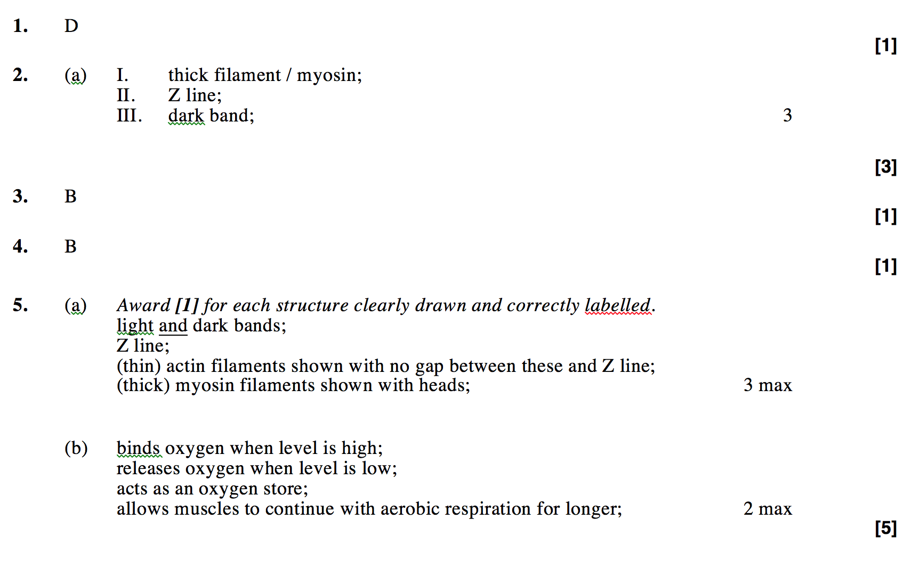
Qs
Muscle contraction

