Slide 2
2.6 Structure of DNA and RNA
Understanding:
The nucleic acids and DNA and RNA are polymers of nucleotides
DNA differs from RNA in the number of strands normally present, the base composition and type of pentose
DNA is a double helix made of two antiparallel strands of nucleotides linked by hydrogen bonding between complementary base pairs
Applications:
Crick and Watson’s elucidation of the structure of DNA using model-making
Nature of science:
Using models as representation of the real world: Crick and Watson used model-making to discover the structure of DNA
Skills:
Drawing simple diagrams of the structure of single nucleotides and of DNA and RNA, using circles, pentagons and rectangles to represent phosphates, pentoses and bases

Slide 3
Structure of DNA
Understand that the nucleus of a cell contains chromosomes and that genes are found on chromosomes
Describe DNA as being a double helix
State the components of a nucleotide
Discovery of DNA

Slide 4
Log onto my Weebly and watch the video on DNA, genes and chromosomes
vsa-tkitwood.weebly.com/
Where are chromosomes?
How many chromosomes does a human have?
In terms of chromosomes, what is the difference between males and females?
What shape DNA?
A section of DNA is called a _______. This codes for a ________.
DNA, GENES AND CHROMOSOMES

Slide 5
Double Helix

Slide 6
How may chromosomes? How many pairs? Where do they come from?
Male or female?

Slide 7
DNA Proteins
The instructions build proteins
All living things are made from and controlled by proteins
The set of instructions for making all living things

Slide 8
Bases (4 different types)

Slide 9
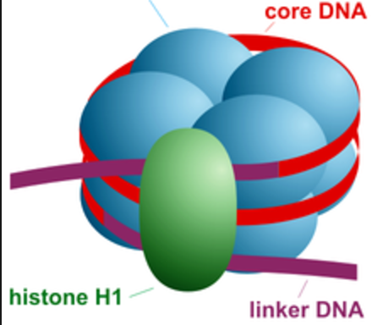
Supercoiling of DNA
Allows 3m of DNA to be packed into each cell
133
AU (Astronomical Units)

Slide 11
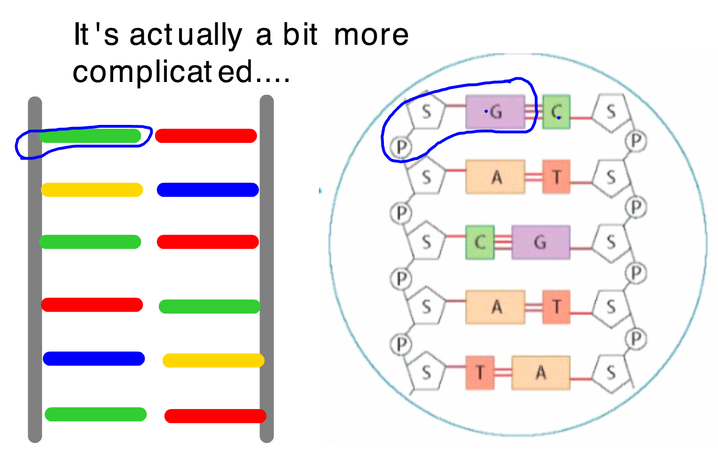
DNA start at 3 mins

Slide 12
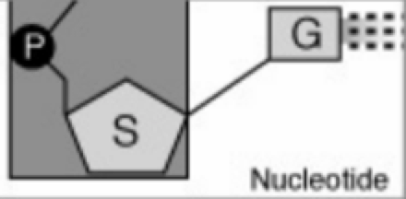
Deoxyribose Sugar
A nucleotide
Glyosidic bond (covalent)
Phosphate
Base (A,T,C,G)
Phosphodiester bond
(Covalent)

Slide 13
Bases are held together with hydrogen bonds.
Can you see any differences?

Slide 15
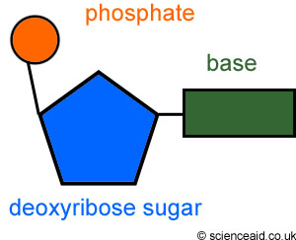
C
C
C
C

Slide 16
Calculating the number of bases
If 15% of bases in a gene are adenine, What is the % of cytosine bases in the gene?

Slide 17
V
W

Slide 18
D
C

Slide 19
A

Slide 20
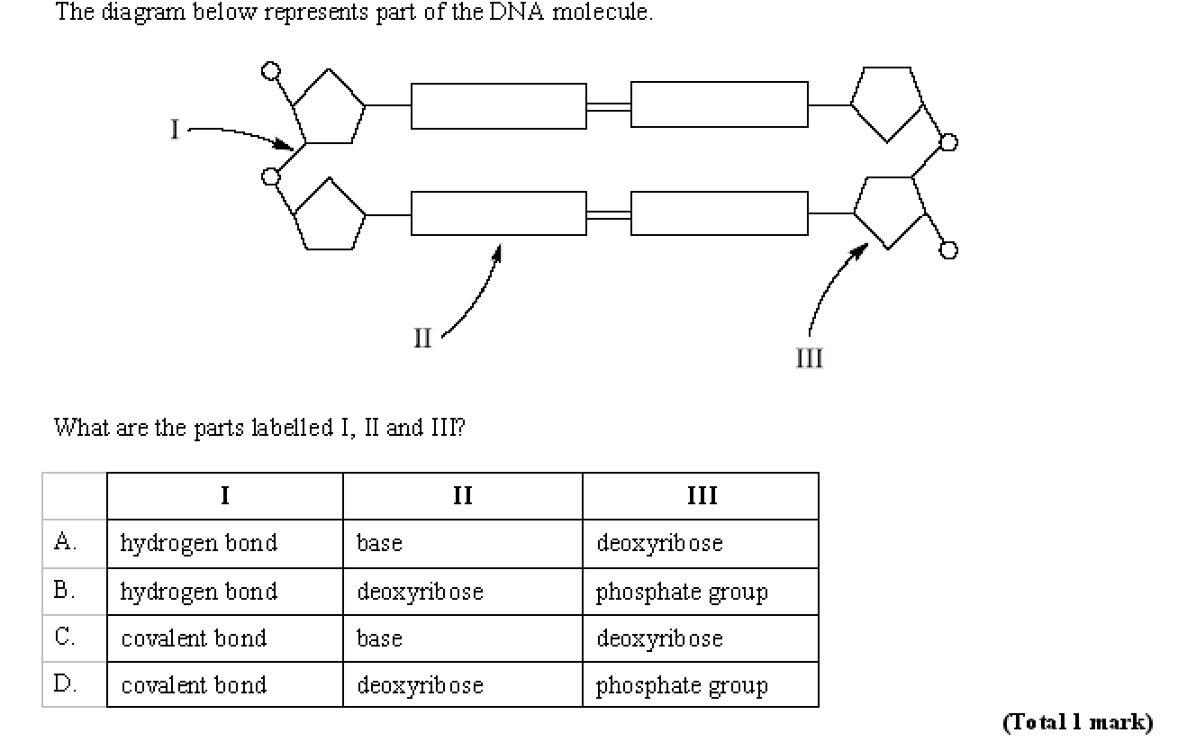
C

Slide 21
Hydrogen bonds
Phosphodiester
bond
A
T
C
G
phosphate
Base
Deoxyribose sugar
What is wrong with this diagram?

Slide 22
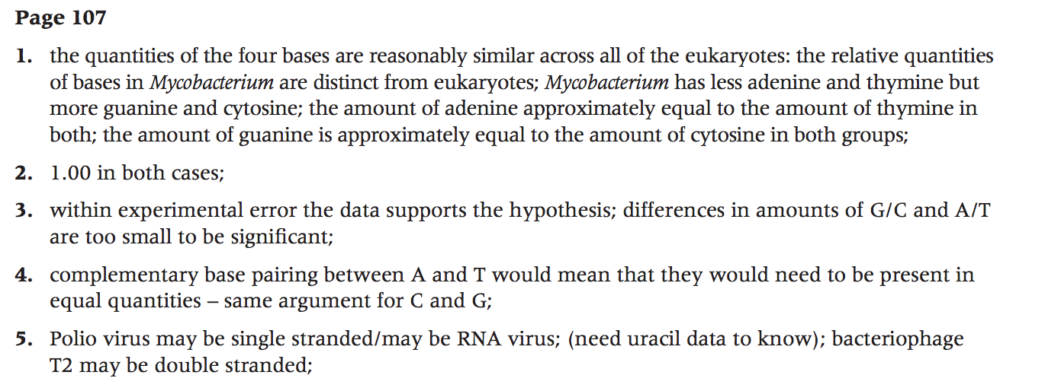
DNA structure
Data based questions page 107

Slide 23
Model DNA
You have 30 minutes to produce the following..
A model of DNA
A4 poster including:
- Diagram of the model
- Pros and cons of your model
e.g. We could not represent the number of hydrogen bonds between the bases
e.g. We were able to represent DNA as a double helix

