Slide 1
1.1 Introduction to cells
Applications:
Questioning the cell theory using atypical examples, including striated muscle, giant algae and aseptate fungal hyphae.
Investigation of functions of life in Paramecium and one named photosynthetic unicellular organism.
Use of stem cells to treat Stargardt’s disease and one other named condition.
Ethics of the therapeutic use of stem cells from specially created embryos, from the umbilical cord blood of a new-born baby and from an adult’s own tissues.
Understanding:
According to the cell theory, living organisms are composed of cells.
Organisms consisting of only one cell carry out all functions of life in that cell.
Surface area to volume ratio is important in the limitation of cell size.
Multicellular organisms have properties that emerge from the interaction of their cellular components.
Specialized tissues can develop by cell differentiation in multicellular organisms.
Differentiation involves the expression of some genes and not others in a cell’s genome.
The capacity of stem cells to divide and differentiate along different pathways is necessary in embryonic
Skills:
Use of a light microscope to investigate the structure of cells and tissues, with drawing of cells. Calculation of the magnification of drawings and the actual size of structures and ultrastructures shown in drawings or micrographs. (Practical 1)
Nature of science:
Looking for trends and discrepancies—although most organisms conform to cell theory, there are exceptions. (3.1)
Ethical implications of research—research involving stem cells is growing in importance and raises ethical issues. (4.5)

Slide 2
Stem Cells
Describe stem cells an undifferentiated
Explain how cells can become specialised through gene expression
Describe the therapeutic uses of stem cells

Slide 3
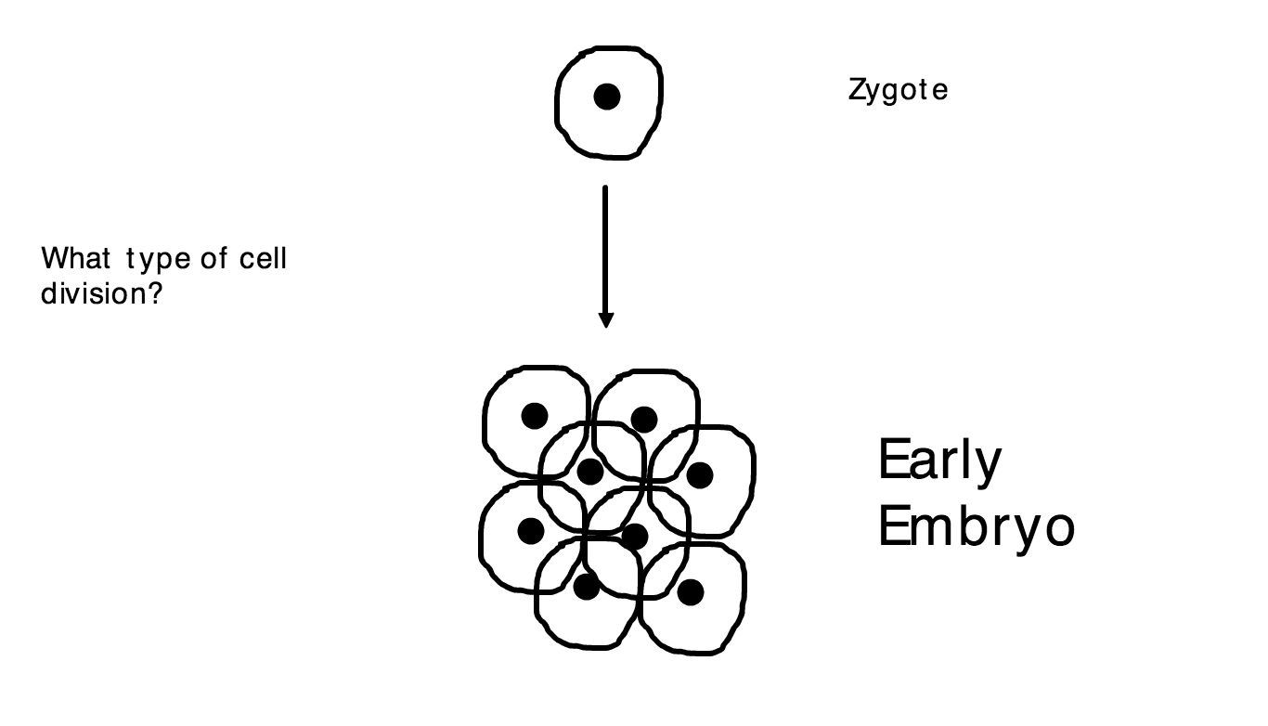
Stem Cells

Slide 4
Some questions…
What is a zygote?
What is an embryo?
What does totipotency mean?
How is this different from pluripotency?
How do specialised cells develop?

Slide 6
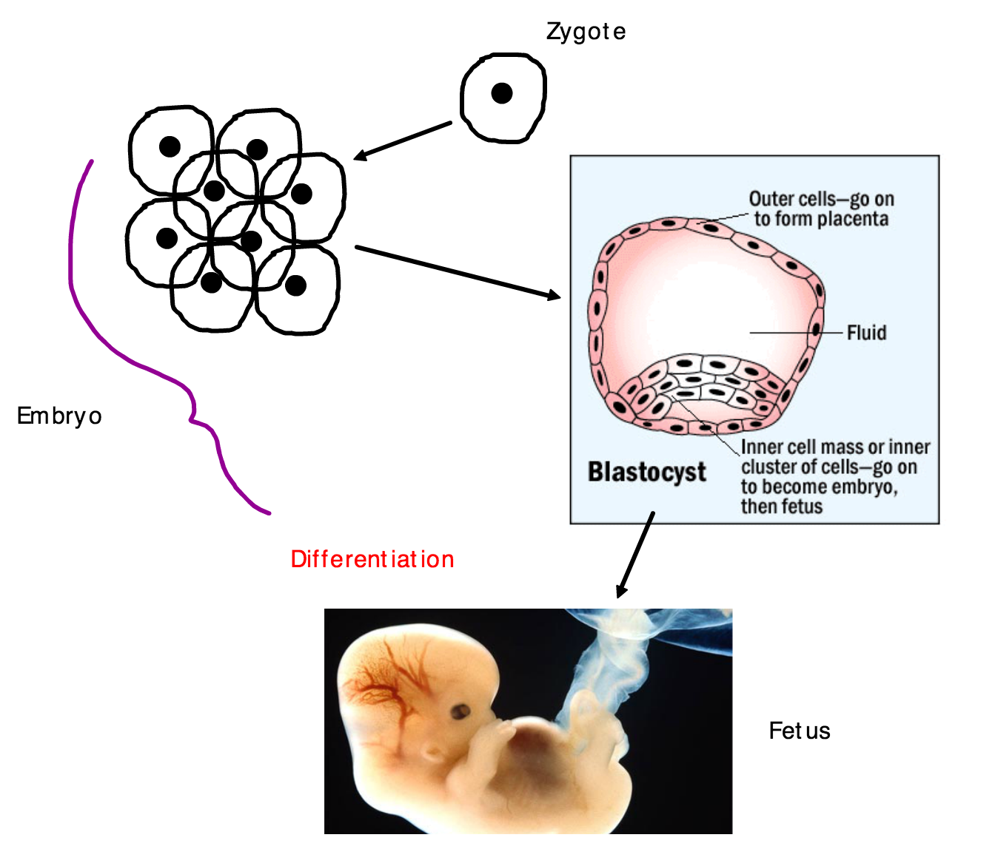

Slide 8
e.g. bone marrow stem cells

Slide 9
totipotent
pluripotent

Slide 10
Multipotency
What are stem cells?

Slide 11
Uses of stem cells
Therapeutic Uses
Regenerate tissue
Grow organs
Cure diseases caused by a loss of cell function (diabetes)
Non-therapeutic Uses
Growing meat in the lab
Uses of stem cells

Slide 12
‘Poster’ for the eye hospital
Skill:
Summerising information
With the following information..using the mark scheme provided
What are stem cells? What do they have the ability to do? Include the keywords
Where can you get stem cells from?
What do you do to stem cells to get them to grow into the desired type of tissue?
What are the problems with using stem cells that aren’t your own?
How can you overcome this problem using drugs?
How can stem cells be used to treat Stargardt’s disease?
REMEMBER – this is a ‘Poster’ that is meant to be easy to understand, has pictures and not too many words

Slide 13
stem cells are cells that retain the capacity to divide and have the ability to differentiate into all types of cells / are pluripotent / totipotent;
stem cells are derived from blastocysts / human embryos, left over from IVF / placenta / umbilical cord / some adult tissues;
develop biochemical solution that will cause cells to differentiate into desired cell type;
Replacing diseased / dysfunctional cells with healthy / functioning ones;
Implanting cells into patient’s own tissues so that they function with the body’s natural cells;
danger of rejection of cells therefore need to suppress immune system using drugs;
must make sure new cells do not become overgrown / develop into cancerous tumours;
eg retinal cells; replace dead cells in retina to cure presently incurable diseases such macular degeneration (Stargardt’s disease);
eg graft new skin cells; to treat serious burn victims; 6 max

Slide 14
Examples of Posters

Slide 15
Examples of Posters

Slide 16
Ethics of Stem Cell Use (pg 15/16)
For
Against

Slide 17
Induced Pluripotency (iPSCs)
The dream is to create a pluripotent stem cell from a fully differentiated (specialised) adult cell (patients own cell).
Why is this the dream??
Avoid rejection
Avoid the use of embryonic stem cells (ethical issues)
iPSCs
What are stem cells?
TED iPSCs

