Slide 1
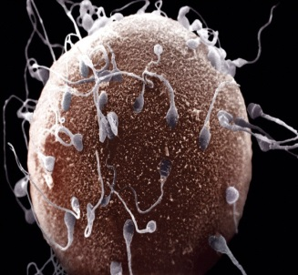
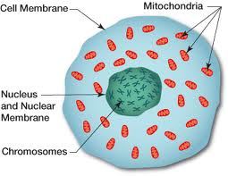
Specialised Cell
1
Egg Cell
aka the ‘Ovum’

Slide 2
Specialised Cell
Picture:
What is my name? Egg Cell, aka the ‘Ovum’
Where am I found? I am found only in females. I am made in the ovaries
What is my job (aka function)? I am the female sex cell and my job is to be fertilised by a male sperm cell so that I can develop into a foetus (baby). I contain the mothers genes and pass these onto her offspring (child).
What do I look like? I am one of the largest cells in the female body. I have a round shape and have a nucleus. I have lots of mitochondria and cytoplasm.
How am I specialised to carry out my job?
I have lots of mitochondria which carry out respiration to release energy.
My nucleus contains half a set of genes from the mother.
Xtra Interesting facts: When a girl is born, her ovaries contain over 2 million immature egg cells. After a girl reaches puberty, her ovaries release 1 egg every month. This travels down her fallopian tube into her uterus (womb). If the egg cell is not fertilised by a sperm on this journey then it passes out of her body during the woman’s period (menstruation).
Things to discuss with your date:
Why is it important that the nucleus contains the mother’s genes?
Why does the nucleus only contain half of the mother’s genes?
Why is it important that the cell contains lots of mitochondria?

Slide 3
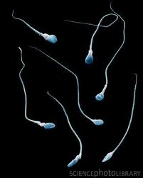
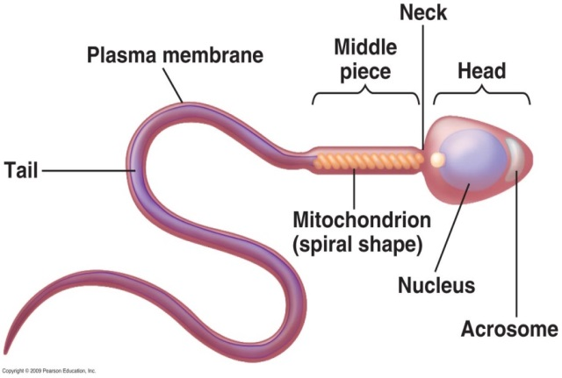
Specialised Cell
2
Sperm Cell

Slide 4
Specialised Cell
Picture:
What is my name? Sperm cell
Where am I found? I am found only in males. I am made in a man’s testis. During sexual intercourse I am released out of the man’s penis into the woman’s vagina where I try to swim and find the woman’s egg.
What is my job (aka function)? I am the male sex cell and my job is to fertilise a female egg cell so that it can develop into a foetus (baby). I contain the father genes and pass these onto the offspring (child).
What do I look like? I am the smallest cell in a man’s body. I have a streamline shape and have a flagellum (tail). My head has an acrosome which contains many digestive enzymes. I have lots of mitochondria.
How am I specialised to carry out my job?
I have a flagellum (tail) for swimming
I have lots of mitochondria which carry out respiration to release energy
My nucleus contains half a set of genes from the father
I have an acrosome head containing digestive enzymes. The enzymes digest the cell membrane of the egg cell so that I can swim inside!
Xtra Interesting facts: During sexual intercourse, men release around 200 million sperm cells into the woman’s vagina. Also, sperm cells need to be kept 7°c colder than normal body temperature. This is why testes hang outside of the man’s body. If the testes get too hot then the sperm cells die or become deformed.
Things to discuss with your date:
Why does the nucleus only contain half of the father’s genes?
Why does the sperm cell have a flagellum for swimming?
Why is it important that the cell contains lots of mitochondria?
Why does the sperm cell have an acrosome containing digestive enzymes?

Slide 5
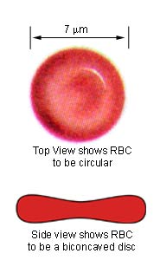
Specialised Cell
3
Red Blood Cell
Aka ‘Erythrocyte’

Slide 6
Specialised Cell
Picture:
What is my name? Red blood cell, aka Erythrocytes
Where am I found? I am found in your circulatory system. I travel around inside blood vessels.
What is my job (aka function)? I collect oxygen from the lungs and carry it around the body to cells so that it can be used for respiration. I also collect carbon dioxide from cells and carry it back to the lungs to be removed.
What do I look like? I am very small and bright red because I contain a chemical called haemoglobin. I am round and have a biconcave shape (see the picture). I have no nucleus!
How am I specialised to carry out my job?
I contain a chemical called haemoglobin which sticks to oxygen molecules.
I have a biconcave shape which helps me travel through small blood vessels without becoming stuck. This shape means that I can bend!
The shape also means I have a large surface area for absorbing oxygen
Xtra Interesting facts: The average red blood cell only lives for 120 days. During those 120 days, the red blood cell will have travelled over 300 miles and will have passed through the heart more than 170,000 times! Every second your body produces 2 million red blood cells to replace the 2 million red blood cells that die every second.
Things to discuss with your date:
Why does a red blood cell contain haemoglobin?
Why does a red blood cell have a biconcave shape?

Slide 7
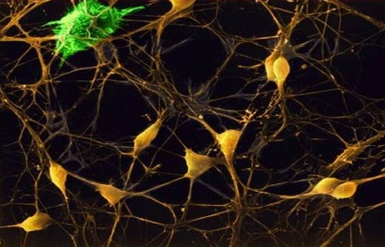
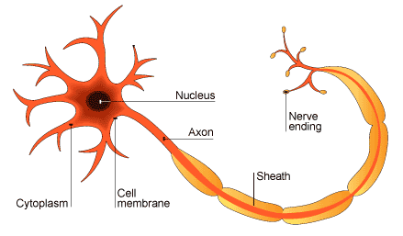
Specialised Cell
Nerve Cell
aka‘Neuron’
4

Slide 8
Specialised Cell
Picture:
What is my name? Nerve cell, aka Neuron
Where am I found? I am found in your nervous system which is spread across your whole body. I am mostly found in your brain and in your spinal cord.
What is my job (aka function)? I quickly send and receive electrical
messages to and from the brain and nervous system.
What do I look like? My cytoplasm is stretched out to form a long and thin axon. My axon is covered in a fatty sheath (myelin sheath). At both ends I have millions of nerve endings called dendrites. The dendrites look like branches on a tree.
How am I specialised to carry out my job?
I have a long thin shape which makes it faster to send electrical messages.
My axon is covered by rings of myelin sheath. This is an insulator like plastic that covers wires in your computer charger.
Xtra Interesting facts: The brain is made up of approximately 100 billion neurons. This means that there are as many neurons in the human brain as stars in the Milky Way. Electrical messages can be sent along the nerve cells at speeds up to 250 miles per hour. The longest neuron in the human body stretches all the way from the end of your big toe to the bottom of your spine!
Things to discuss with your date:
Why does the long thin shape make sending electrical messages faster?
Why is the axon covered in a myelin sheath?

Slide 9
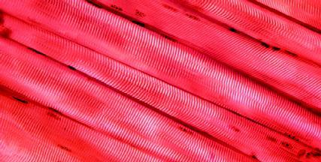
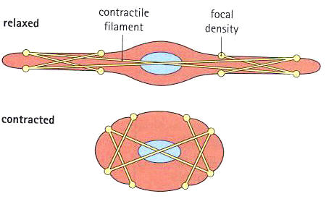
Specialised Cell
5
Muscle Cell

Slide 10
Specialised Cell
Picture:
What is my name? Muscle cell
Where am I found? I make up all of the muscles in your body. Even your heart is made up of muscle cells.
What is my job (aka function)? When I contract I get shorter and if I relax I get longer. When I contract and relax I control all of the movements in your body.
What do I look like? I have a long thin shape when I am relaxed but when I contract, the filaments inside of me tighten and I become a short, fat cell.
How am I specialised to carry out my job?
I have many mitochondria. This is where respiration happens and is how energy is released. I need lots of mitochondria because I make up all of the muscles in your body and I am always working very hard.
Xtra Interesting facts: Muscle cells normally carry out a type of respiration called aerobic respiration. Aerobic respiration can only happen when the muscle has lots of oxygen. Muscle cells can still work if there is not much oxygen, but they carry out a different type of respiration called anaerobic respiration. Anaerobic respiration releases a chemical called lactic acid into your body and this is what gives you cramp! When you shiver, your muscles contract involuntarily. This releases energy that keeps your body warm. Your heart muscle never stops from the minute you are born to when you die.
Things to discuss with your date:
Why does muscle cell contain many mitochondria?
Why does the muscle cell contain filaments?

Slide 11
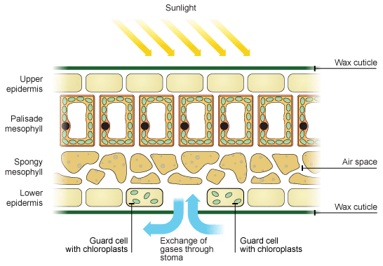
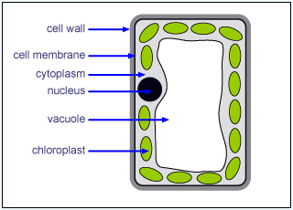
Specialised Cell
6
Palisade Cell

Slide 12
Specialised Cell
Picture:
What is my name? Palisade cell
Where am I found? I am a specialised cell found only in plants. I am found on the top half of a leaf.
What is my job (aka function)? I carry out photosynthesis for the plant. Photosynthesis is how plants make their own food.
What do I look like? I have a tall narrow shape with many chloroplasts. I have a large vacuole and all of the organelles that you would expect to find in a plant.
How am I specialised to carry out my job?
I have many chloroplasts. Photosynthesis happens within the chloroplasts of the palisade cell.
I have a tall thin shape.
I am found on the top half of the leaf.
Xtra Interesting facts: Plants can use energy from light to change carbon dioxide and water into food! This process is called photosynthesis and it happens inside the chloroplasts of palisade cells. Inside chloroplasts is a green chemical called chlorophyll. It is the chlorophyll that gives plants their green colour. The food that the plant produces is a sugar called glucose. Athletes sometimes take glucose tablets as it gives them lots of energy!
Things to discuss with your date:
Why do palisade cells contain many chloroplasts?
Why are palisade cells found on the top half of a leaf?
Why are palisade cells not found in the roots of a plant?

Slide 13
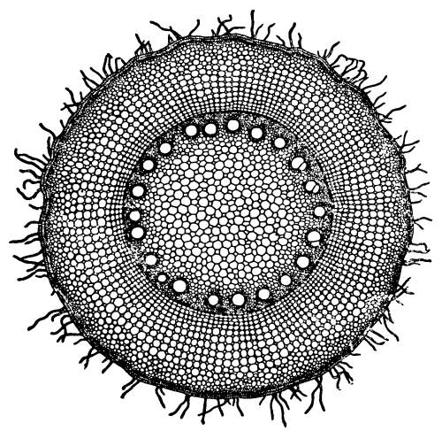
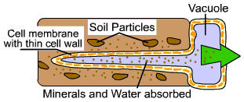
Specialised Cell
7
Root Hair Cell

Slide 14
Specialised Cell
Picture:
What is my name? Root hair cell
Where am I found? I am a specialised cell found only in plants. I am found underground in the roots of a plant.
What is my job (aka function)? I absorb water and nutrients from the soil.
The water and nutrients are then sent from the root hair cell, up through
the roots, to the rest of the plant.
What do I look like? I have a long thin extension called my root hair. I have a large vacuole and contain many of the organelles that you would expect to find in a plant cell. I don’t have any chloroplasts!
How am I specialised to carry out my job?
I have a long thin hair that extends from my cell. This gives me a larger surface area for absorbing water and nutrients from the soil.
I have a very thin cell wall to make it easier for water to pass into my cell.
I have a large vacuole for temporarily storing water that I have absorbed from the soil before it is transported up through the plant.
Xtra Interesting facts: Root hair cells are found only in plant roots and are
not the specialised cell that forms the hair on our bodies. Root hair cells
absorb water because of a process called osmosis. The water is then carried around the plant in thin tubes called xylem. Lots of water is taken to the
leaves where it is needed for photosynthesis.
Things to discuss with your date:
Why does a root hair cell have no chloroplasts?
Why does the root hair cell need a very thin cell wall?
Why does the root hair cell have a long thin hair extending from the cell?

Slide 15
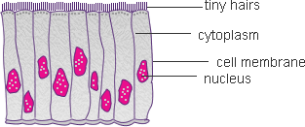
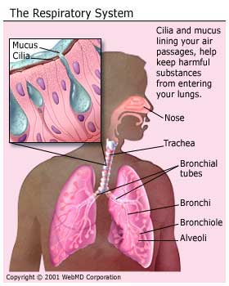
Specialised Cell
8
Ciliated Epithelial Cell

Slide 16
Specialised Cell
Picture:
What is my name? Ciliated epithelial cell
Where am I found? I am found lining the nose, the trachea and the bronchi in the respiratory system. I am also found in the reproductive system where I line the inside of the fallopian tubes.
What is my job (aka function)? I have tiny hairs called cilia that wave and help move things. In the respiratory system the cilia are covered in mucus (snot!) and they trap any dust and bacteria that are trying to enter the body. They then wave back and forth that carries the mucus containing the dust and bacteria up to the mouth where it is swallowed. The cilia lining the fallopian tubes move the egg cell through the female reproductive system to the uterus (womb).
What do I look like? I have tiny hairs called cilia on my surface. I contain many of the organelles that you would expect to see in an animal cell.
How am I specialised to carry out my job?
I have tiny hairs called cilia that move and help to carry things along inside of my body.
Xtra Interesting facts: When someone smokes a cigarette, the hot fumes damage the cilia that line the inside of the respiratory system. This means that there is nothing to stop dust and bacteria getting inside their bodies. This is why people who smoke are much more likely to have bad coughs and get regular chest infections.
Things to discuss with your date:
Why do ciliated epithelial cells have cilia?

Slide 17
Specialised Cell
Quiz!
 |  | True | False
1 | Another name for the egg cell is the ‘ovum’
2 | When the filaments in muscle cells contract the muscle cell gets longer and when the filaments in the muscle cell relax the muscle cell gets shorter.
3 | The function of a red blood cell is to carry oxygen and carbon dioxide around the body.
4 | Palisade cells are found in the roots of plants.
5 | The nerve cell has a long thin axon which makes it faster to send electrical messages around the body.
6 | The scientific name for a sperm cell tail is the flagellum.
7 | Root hair cells contain no chloroplasts.
8 | Red blood cells contain a chemical called chlorophyll which sticks to oxygen molecules.
9 | Ciliated epithelial cells in the respiratory system help to trap and get rid of dust and bacteria before they get into our bodies.
10 | Egg cells contain a full set of genes from the mother which are then passed on to the offspring.
11 | The function of a nerve cell is to quickly send and receive electrical messages to and from the brain and nervous system.
12 | One adaptation of a sperm cell is that it has an acrosome head containing digestive enzymes. The enzymes digest the cell membrane of the egg cell so that it can break into and fertilise the egg cell.
13 | The function of the palisade cell is to carry out photosynthesis. It has many chloroplasts because this is where photosynthesis happens within a cell.
14 | Ciliated epithelial cells have many tiny hairs called microfibrils.
15 | Root hair cells form the hair on our heads.
16 | The heart is mostly made up of muscle cells.
/16

