Slide 1
Could you live on Mars?
How would you breathe?
How would you eat?
How would you drink?
What would
you take
with you?

Slide 2
4.1 Species, communities and ecosystems
Skills:
Classifying species from knowledge of their nutrition
Testing for association between 2 species using statistical tests
Recognising and interpreting statistical significance
Setting up sealed mesocosms to try to establish sustainability
Understanding:
Species are groups of organisms that can potentially interbreed to produce fertile offspring
Members of a species may be reproductively isolated in separate populations
Species have either an autotrophic or heterotrophic method of nutrition
Consumers are heterotrophs that feed on living organisms by ingestion
Detritivores are heterotrophs that obtain organic nutrients from detritus by internal ingestion
Saprotrophs are heterotrophs that obtain organic nutrients from dead organic matter by external digestion
A community is formed by populations of different species living together and interacting with each other
A community forms an ecosystem by its interactions with the abiotic environment
Autotrophs and heterotrophs obtain inorganic nutrients from the abiotic environment
Nature of science:
Looking for patterns, trends and discrepancies: plants and algae are mostly autotrophic but some are not
Understanding:
The supply of inorganic nutrients is maintained by nutrient cycling
Ecosystems have the potential to be sustainable over long periods of time

Slide 3
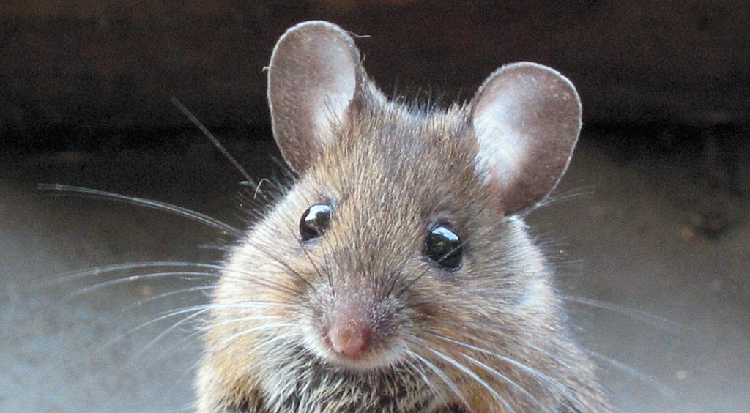
Topic 4 - Ecology

Slide 4
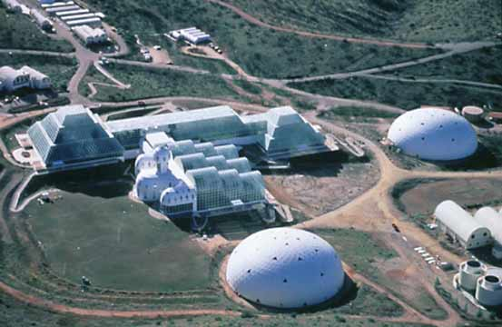
Biosphere II
1990s
Sealed living space in the Arizona desert
Rainforest, mini ocean, land for food, livestock for eggs and milk
Two year experiment – find balance within a closed system
MISSION TO MARS!

Slide 5
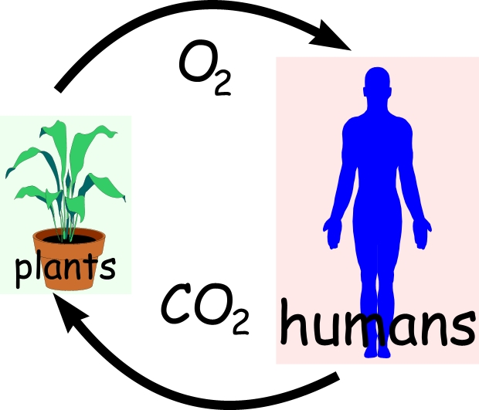
Interdependence of organisms
Ecosystems are very fragile
Smallest thing can change the balance
We will find out how everything within an ecosystem relies on something else

Slide 6
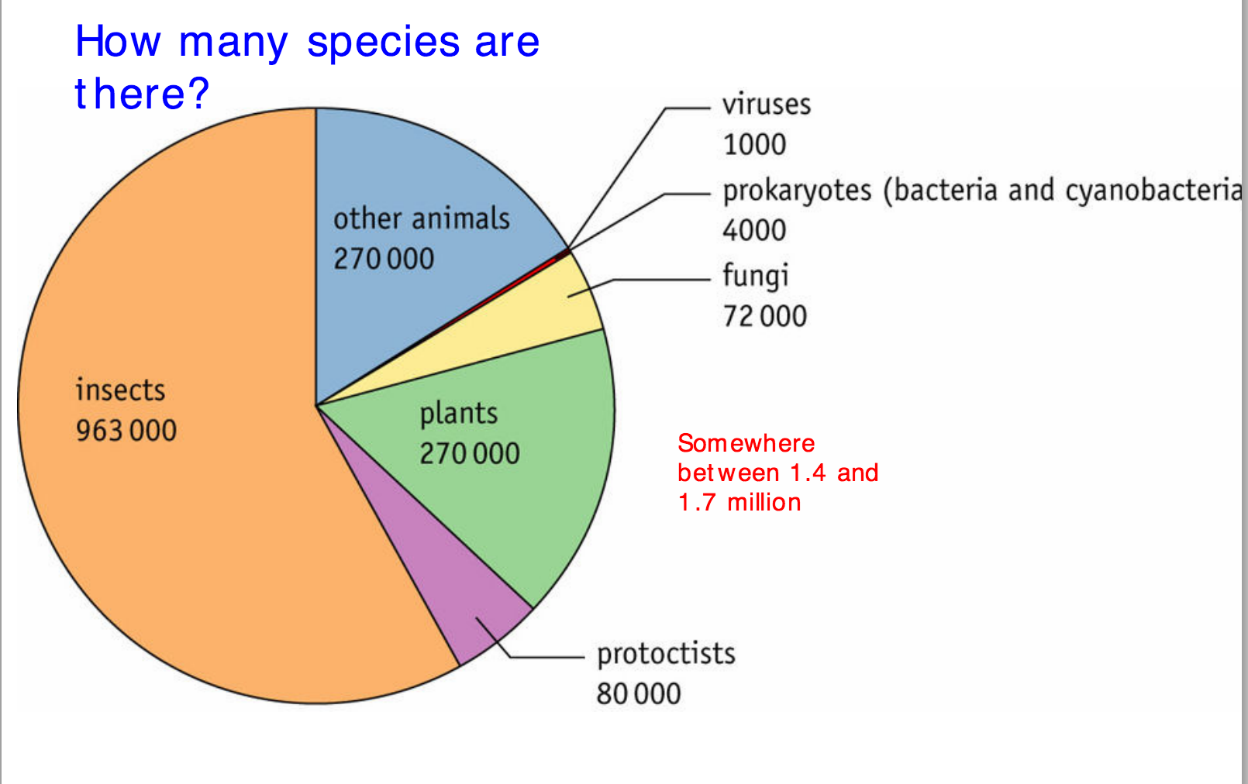

Slide 7
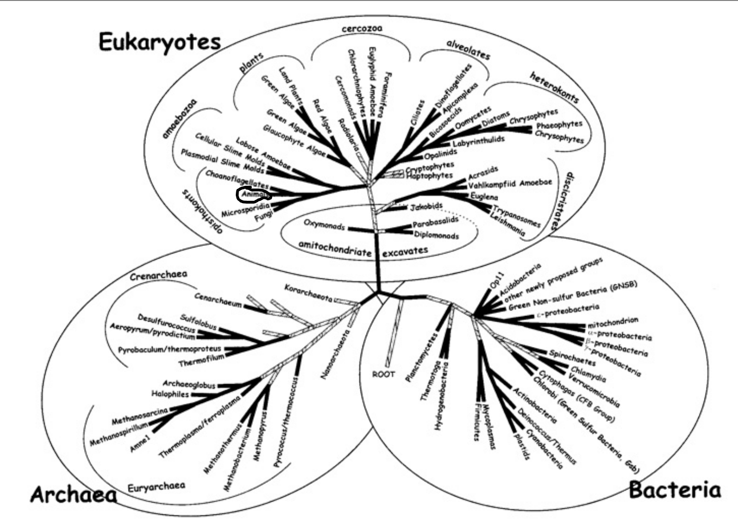

Slide 8
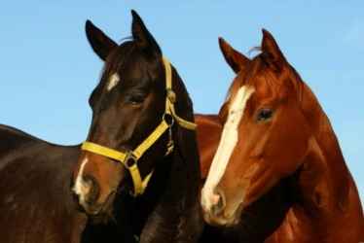
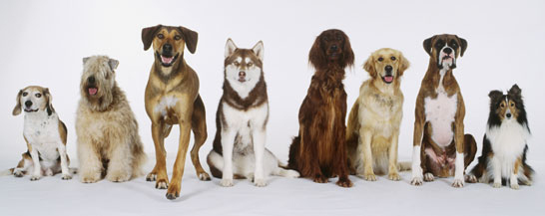
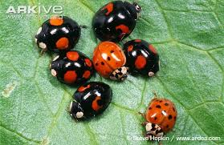
Species
Group of organisms that can interbreed and produce fertile offspring.

Slide 9
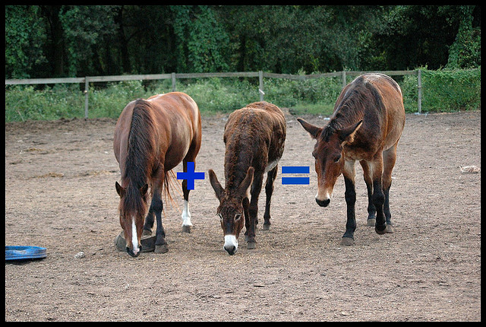
Interspecific hybrid
Cannot create a population as they can only have one generation

Slide 10
Isolated species
If a small group of a species is separated from the rest, it can start to evolve differently.
HOW?
Mice started to adapt to their surroundings over time and pass on genes through generations.
Over time this can lead to speciation (the formation of a new species)

Slide 11
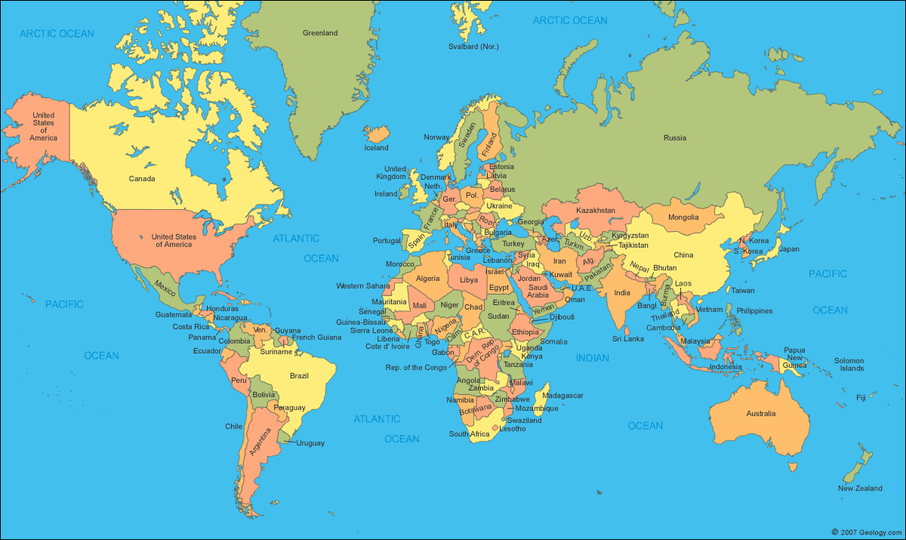

Slide 13
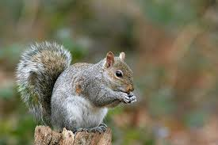
Populations
A group of organisms of the same species who live in the same area at the same time.
There are different populations of grey squirrels in the UK. They are the same species.
When would there be dispute about whether these populations have become different species?

Slide 14
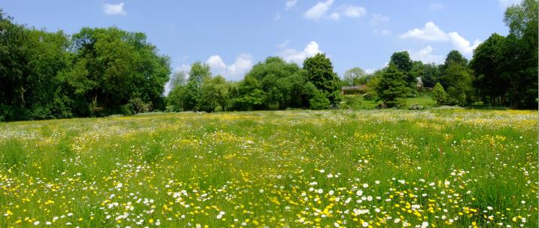
Biotic and Abiotic factors
Find out…....
What is meant by abiotic factors and biotic factors in an ecosystem?
Give examples of these factors here..
Ecosystems

Slide 15
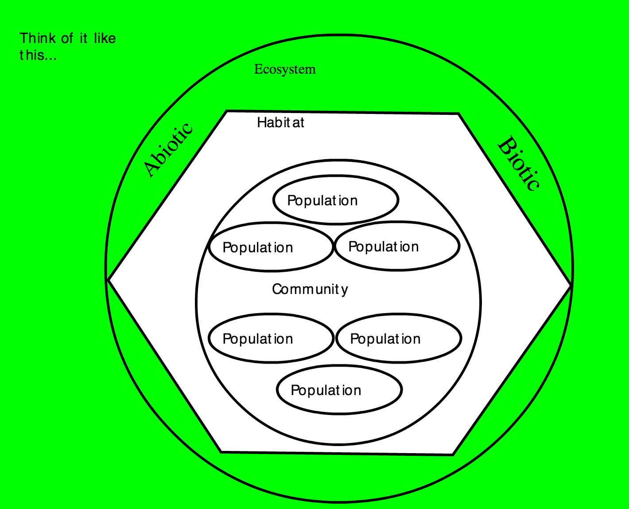
Define…
Community
Habitat
Ecosystem

Slide 16
