Slide 1
6.6 Hormones, homeostasis and reproduction
Applications:
Causes and treatment of type I and type II diabetes
Testing of leptin on patients with clinical obesity and reasons for the failure to control the disease
Causes of jet lag and use of melatonin to alleviate it
The use in IVF of drugs to suspend the normal secretion of hormones, followed by the use of artificial doses of hormones to induce superovulation and establish a pregnancy
William Harvey’s investigation of sexual reproduction in deer
Understanding:
Insulin and glucagon are secreted by alpha and beta cells in the pancreas to control blood glucose concentration
Thyroxin is secreted by the thyroid gland to regulate the metabolic rate and help control body temperature
Leptin is secreted by cells in adipose tissue and acts on the hypothalamus of the brain to inhibit appetite
Melatonin is secreted by the pineal gland to control circadian rhythms
A gene on the Y chromosome causes embryonic gonads to develop as testes and secrete testosterone
Testosterone causes prenatal development of male genitalia
Estrogen and progesterone cause prenatal development of female reproductive organs and female secondary sexual characteristics during puberty
The menstrual cycle is controlled by negative and positive feedback mechanisms involving ovarian and pituitary hormones
Nature of science:
Developments in scientific research follow improvements in apparatus: William Harvey was hampered in his observational research into reproduction by lack of equipment.
The microscope was invented 17 years after his death
Skills:
Annotate diagrams of the male and female reproductive system to show names of structures and their functions

Slide 2
Reproduction
Identify the parts of the human male and female reproductive systems
Describe the functions of structures in the human reproductive systems

Slide 3
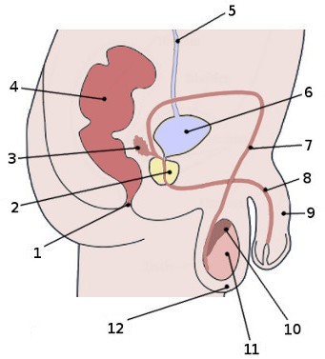
What do you know?

Slide 4
5 minutes to learn the labels
Which team can remember the most?

Slide 5
Functions

Slide 7
Questions..
Why do you think the testes are outside the body?
Why does seminal fluid contain carbohydrates?
Why do sperm cells have many mitochondria?

Slide 8
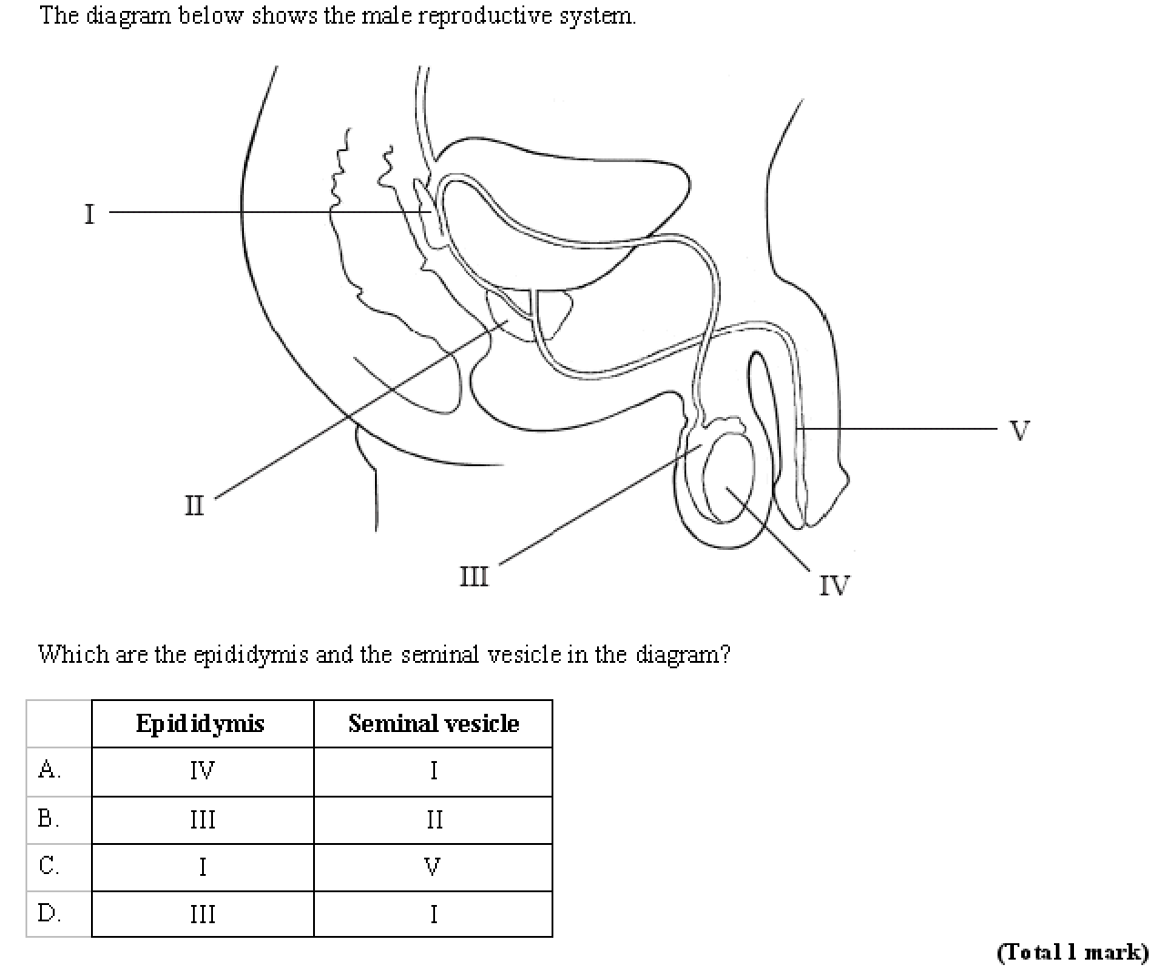

Slide 9
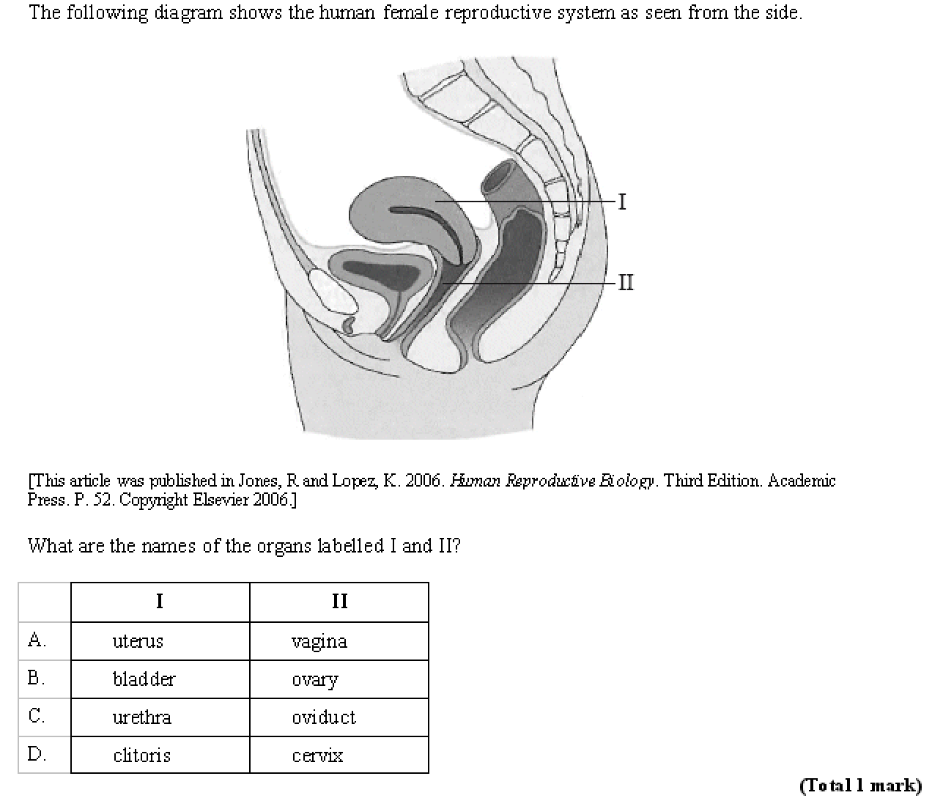

Slide 11
Sex Determination
Up to 8 weeks embryonic development is the same in males and females
The development after this is determined by the presence or absence of one gene
SRY gene is found on the Y chromosome so only present in 50% of embryos
SRY codes for the DNA binding protein, TDF (Testes Determining Factor). This proteins activates other genes that lead to testes development
If the protein is absent the embryo develops into a female
X
Y

Slide 12
Testosterone
The testes develop at week 8.
They produce testosterone until week 15
This stimulates the development of the male genitalia.
During puberty there is an increase of testosterone production, leading to development of the male primary and secondary sexual characteristics

Slide 13
Estrogen and Progesterone
If the SRY gene is absent testosterone is not produced
Estrogen and progesterone are always present (produced by the mother’s ovaries)
Estrogen and Progesterone lead to the development of the female sex organs
During puberty the secretion of estrogen and progesterone increases leading to the female secondary sexual characteristics….

Slide 15
Menstrual Cycle
Ovulation
Ovary

Slide 16
Follicle stimulating hormone (FSH)
Luteinizing hormone (LH)
Progesterone
Estrogen

Slide 17
Menstrual cycle
FSH rises towards the end of the menstrual cycle
Stimulates development of follicle
Stimulates estrogen secretion from follicle wall in ovary
Estrogen rises towards the end of the follicular phase
Thickens endometrium
Increase FSH receptors on the follicle
Follicle now more receptive to FSH so develops
Produces more estrogen (positive feedback)
When at high levels estrogen inhibits FSH secretion (negative feedback) and stimulates LH production
LH rises at the end of the follicular phase
Stimulates completion of meiosis in oocyte and break down of follicle all – bursts – ovulation
After ovulation LH stimulates the development of the follicle wall into the corpus luteum which secretes estrogen (positive feedback) and progesterone
Progesterone rise at the start of the luteal phase
Promotes thickening and maintenance of endometrium
Inhibits FSH and LH by pituitary (negative feedback)
Estrogen

Slide 18
Some couples have problems getting pregnant
These couples often try IVF
(In Vitro Fertilisation).

Slide 19
IVF
IVF animation
IVF proceedure
Use the links to answer the IVF exam Q

