Slide 1
What is sound?

Slide 3
oscilloscope

Slide 4
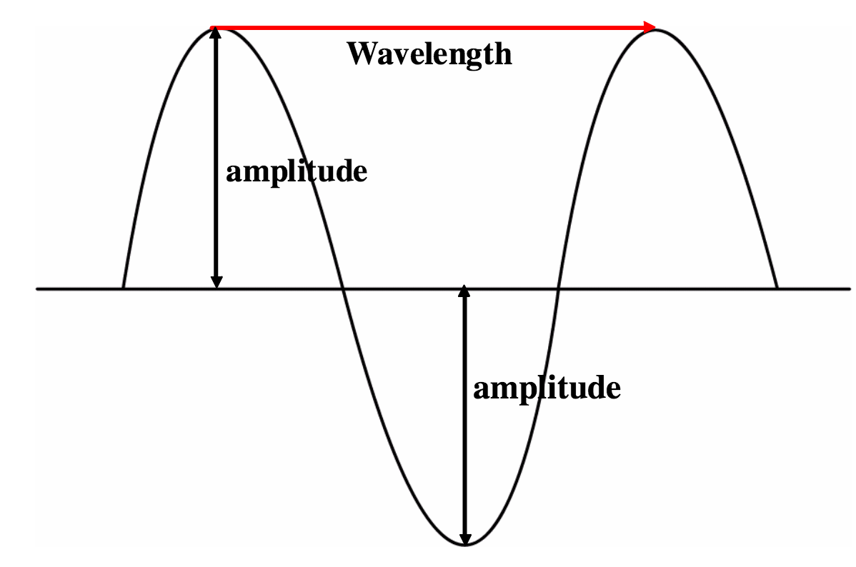

Slide 7
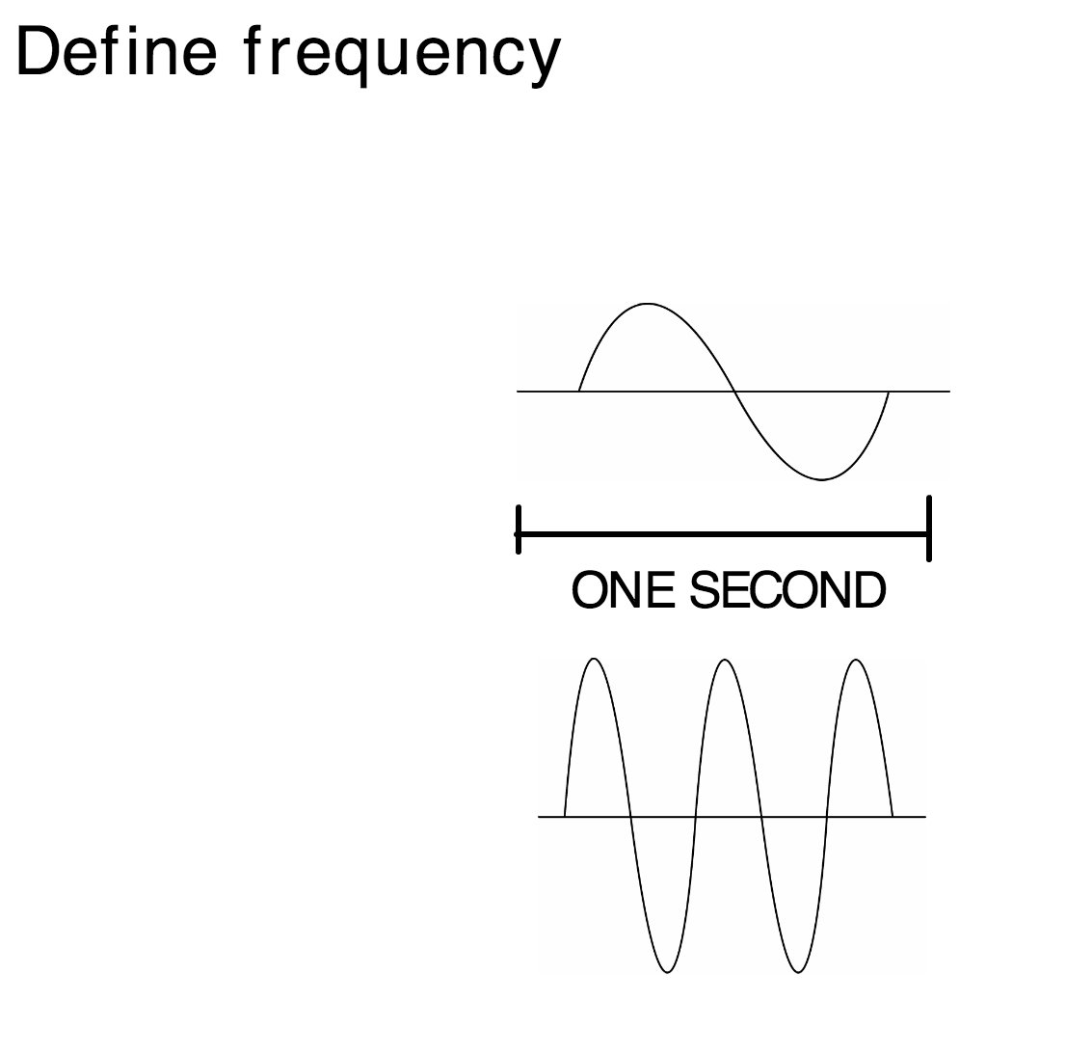
Number of waves per second

Slide 8
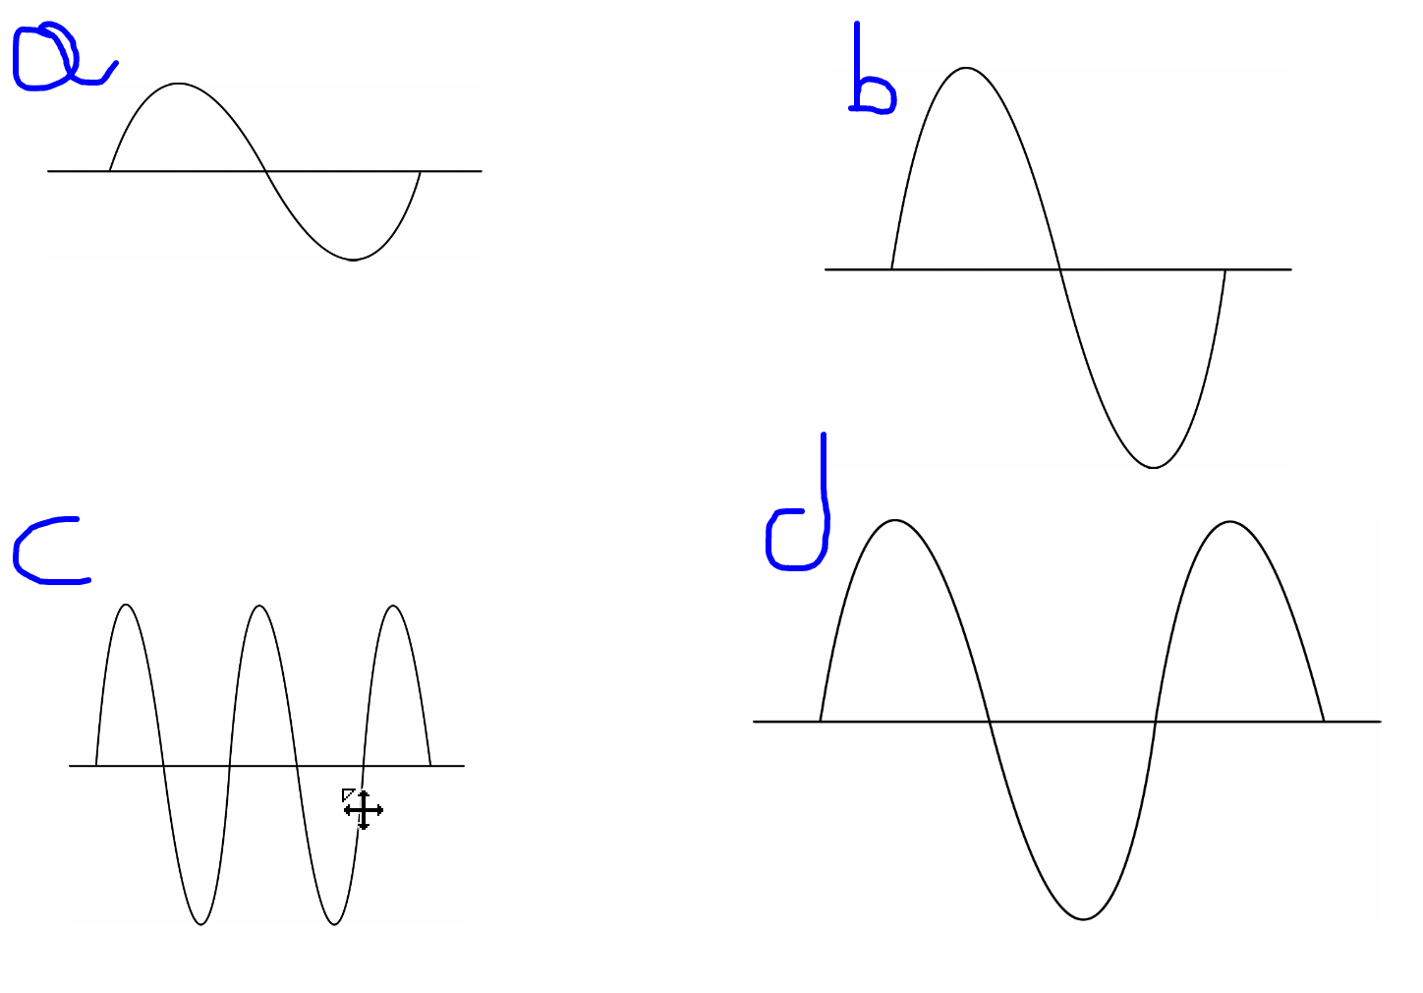

Slide 9
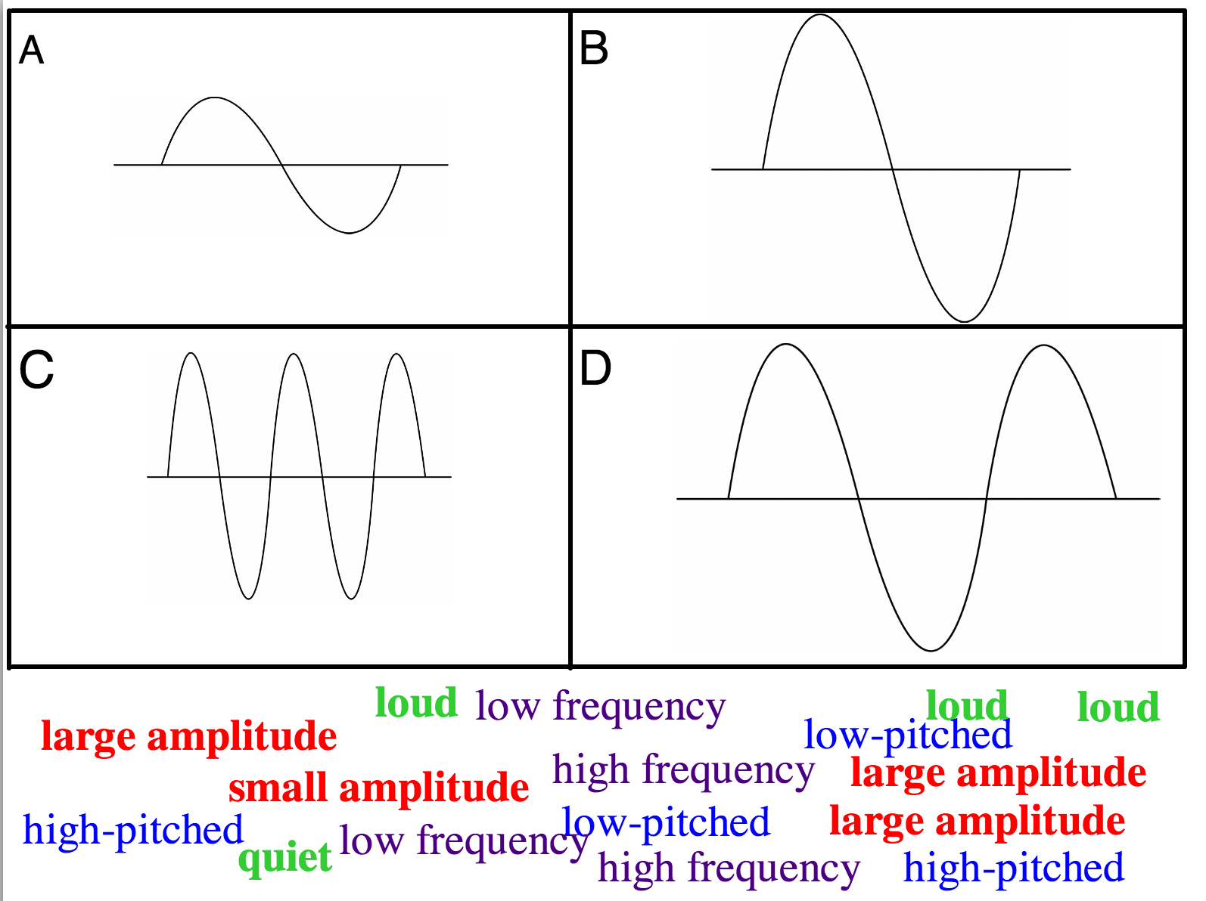

Slide 10
