Slide 1
Draw the structure of an amino acid
How do you they join together?
When do they join together?
Which one is first in the chain?

Slide 2
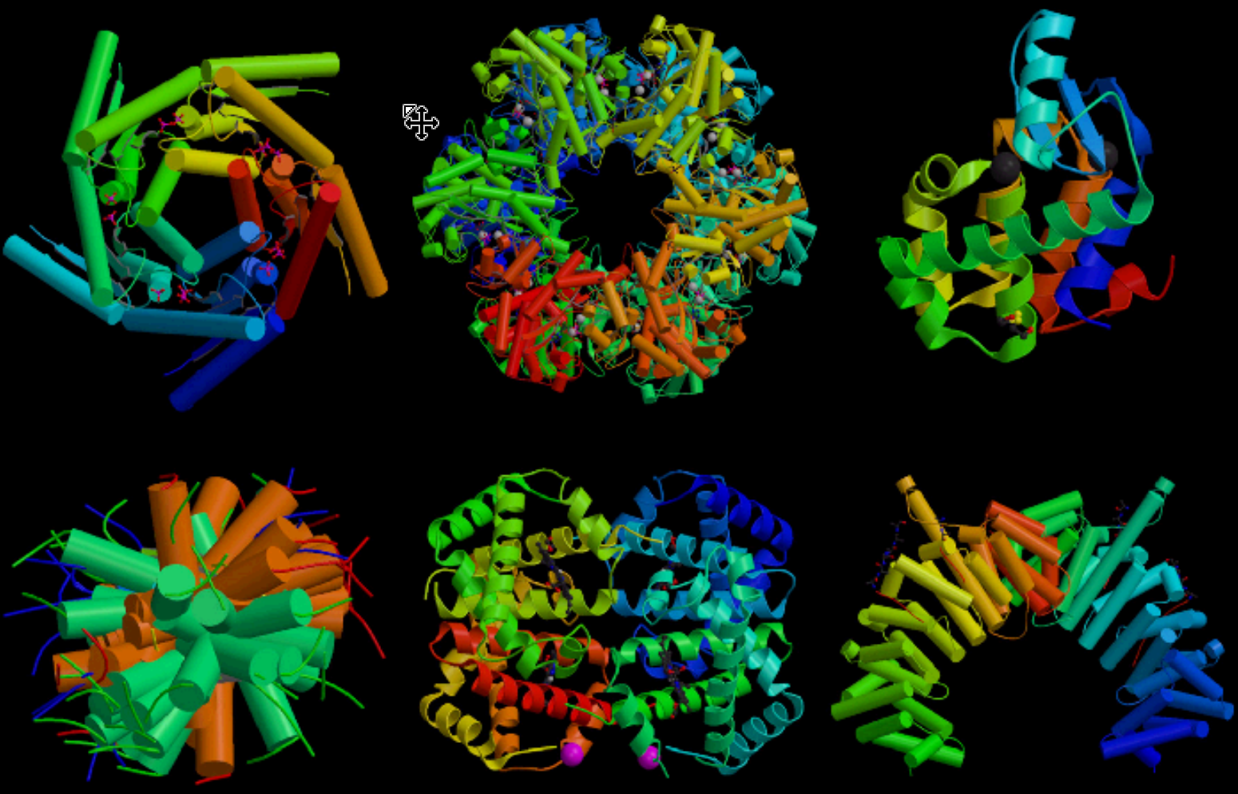

Slide 3
7.3 Translation
Understanding:
Initiation of translation involves assembly of the components that carry out the process
Synthesis of the polypeptide involves a repeated cycle of events
Disassembly of the components follows termination of translation
Free ribosomes synthesize proteins primarily within the cell
Bound ribosomes synthesize proteins primarily for secretion or for use in lysosomes
Translation can occur immediately after transcription in prokaryotes
The sequence and number of amino acids in the polypeptide is the primary structure
The secondary structure is the formation of alpha helixes and beta pleated sheets
The tertiary structure is the further folding of the polypeptide
The quaternary structure exists in proteins with more than one polypeptide chain
Applications:
tRNA-activating enzymes illustrate enzyme-substrate specificity and the role of phosphorylation
Skills:
The use of molecular visualization software to analyse the structure of eukaryotic ribosomes and a tRNA molecule
Identification of polysomes in an electron micrograph
Nature of science:
Developments in scientific research follow improvements in computing

Slide 4
Proteins (HL)
Describe the functions of some common proteins
Draw the structure of an amino acid
Show how amino acids join together during condensation reactions
Explain how genes are responsible for determining amino acid sequence
Explain how amino acid sequence determines the overall structure of proteins

Slide 5
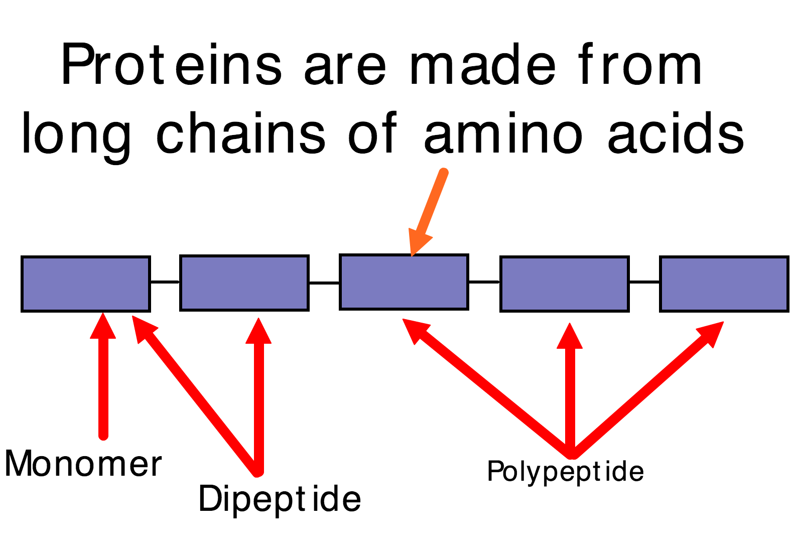

Slide 8
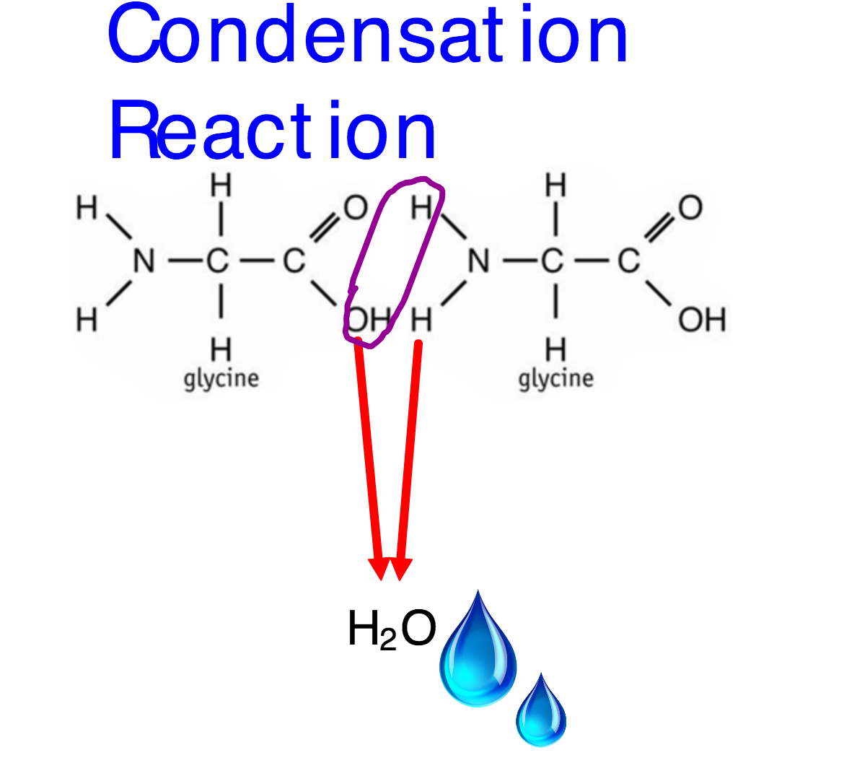

Slide 9
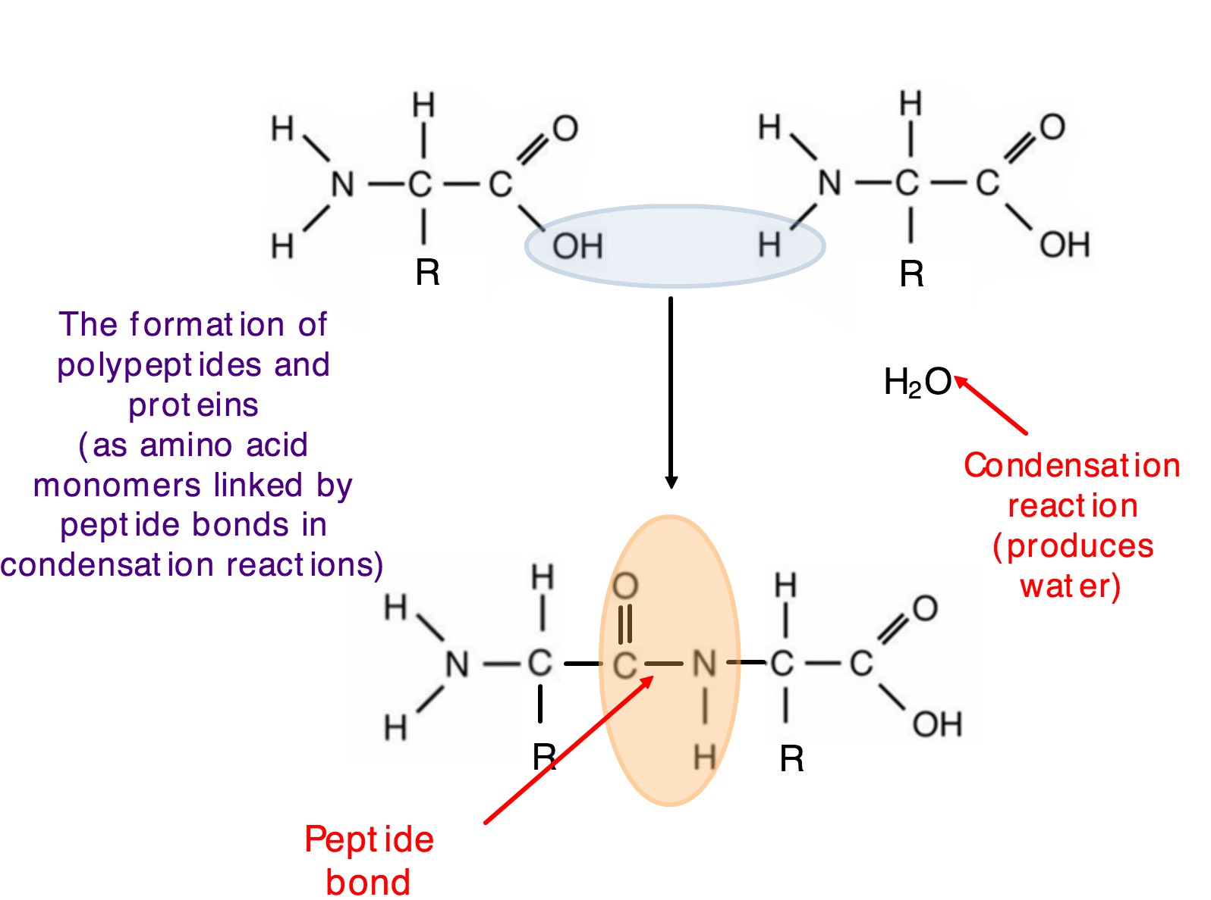

Slide 11
Draw a dipeptide of serine and alanine

Slide 12
Where does all this happen?

Slide 13
Using the equipment provided produce a document to illustrate the following…
The primary structure of a protein and definition.
What determines this sequence of amino acids?
Secondary structures. What bonds are present?
Tertiary structure. What bonds are present? What determines the location of these bonds? How do polar/non-polar/hydrophilic/hydrophobic amino acids determine the tertiary structure?
The quaternary structure. What does this mean? Give an example of a globular/enzyme and a fibrous quaternary strcture.
Use text book, internet and the video on my weebly for help

Slide 14
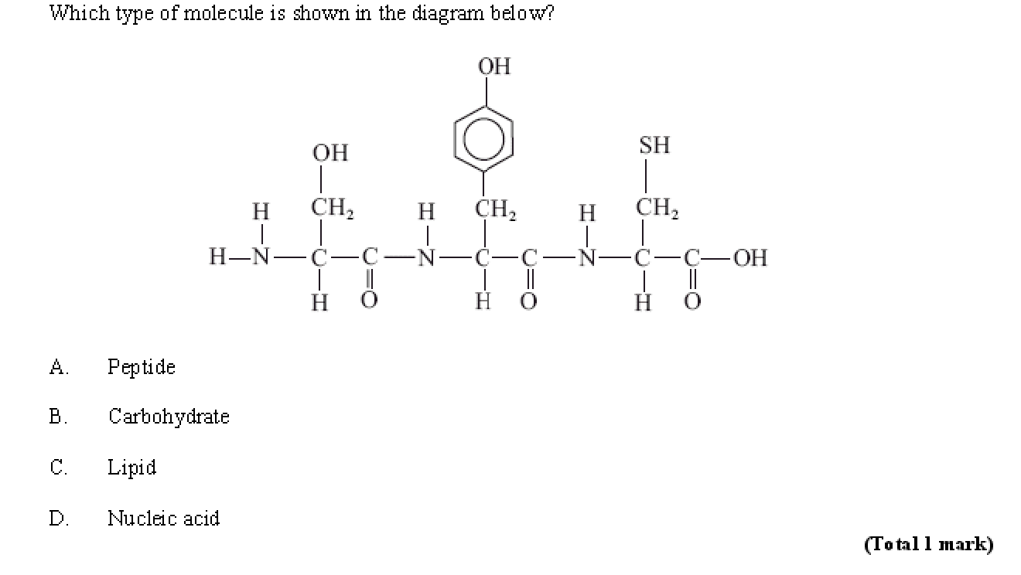

Slide 15
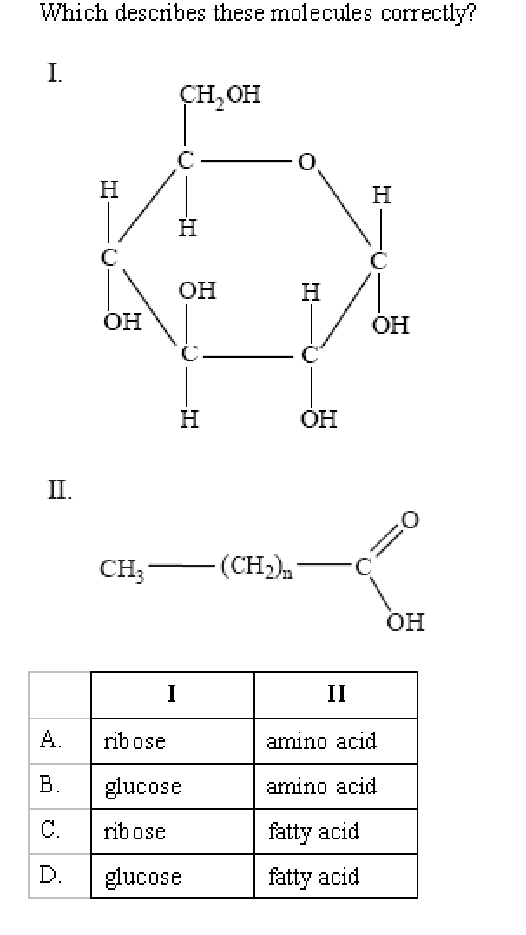

Slide 16
Primary Structure

Slide 19
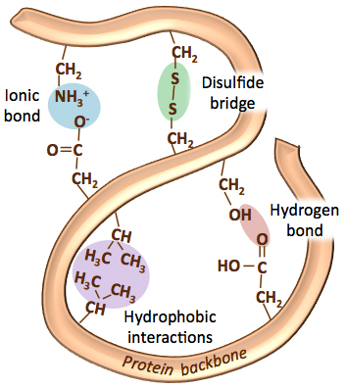
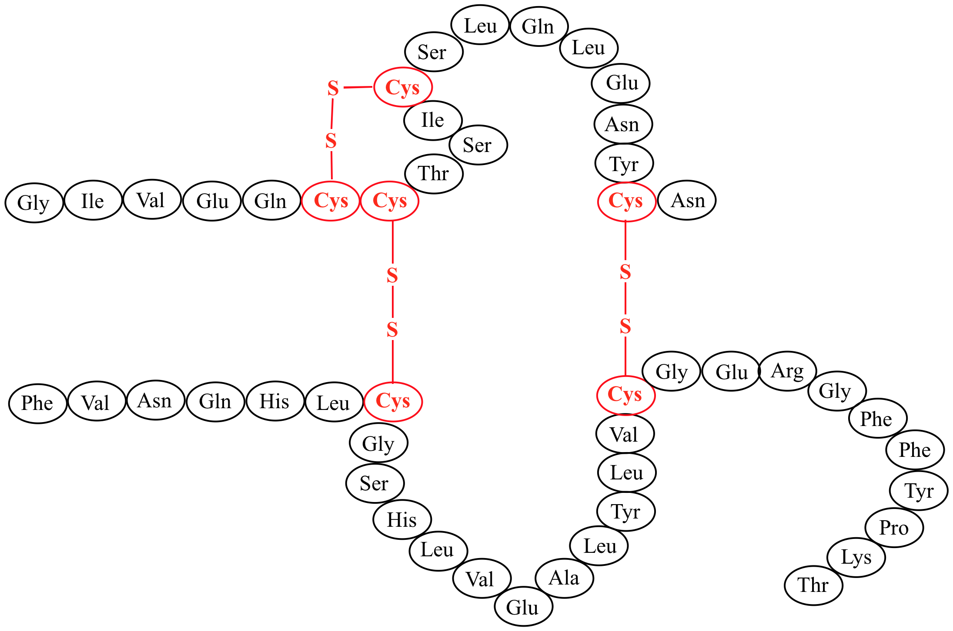
Tertiary Structure
Positively charged R groups with interact with negatively charged R groups
Hydrophobic R groups will be orientated towards the center of the protein
Polar R groups will form H bonds with other polar R groups
The R group of aa cysteine forms a covalent bond with another cysteine. This is a disulphide bridge

Slide 20
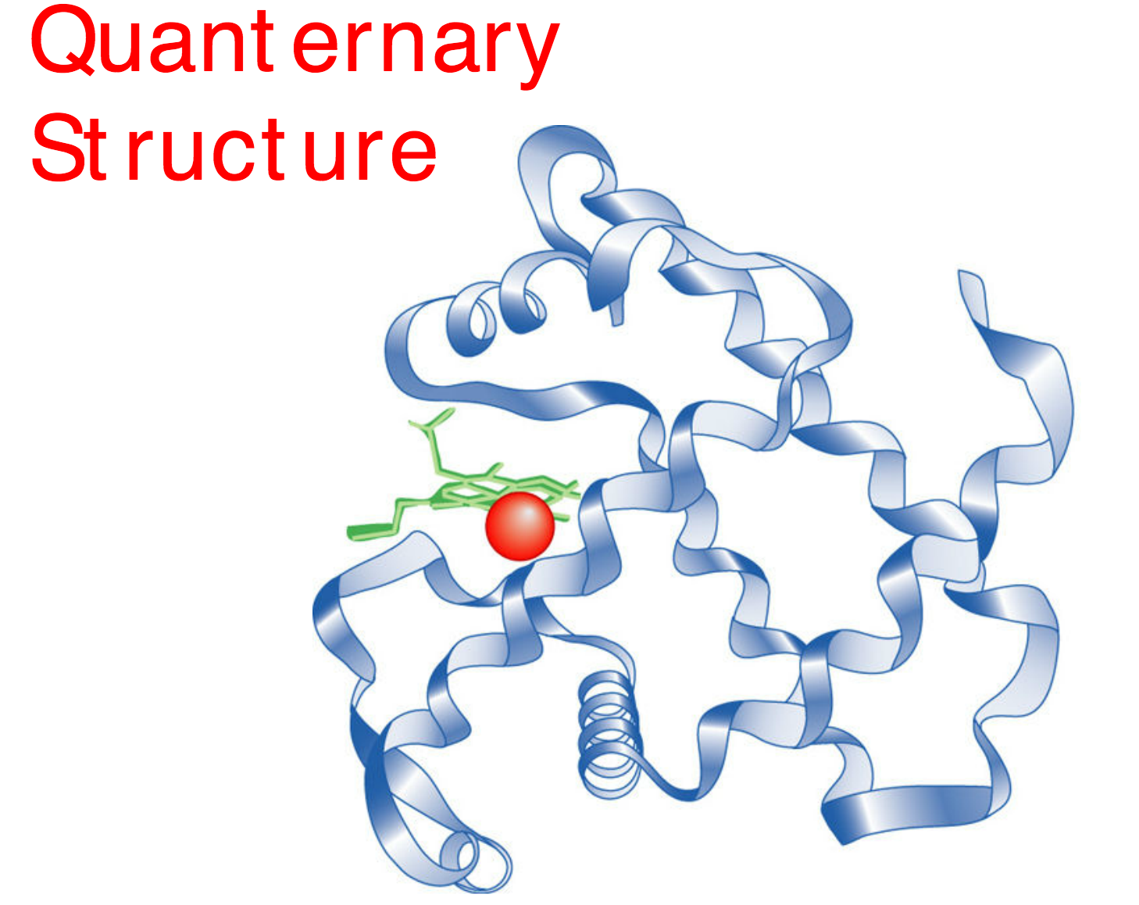
What is meant by the quaternary structure of a protein?

Slide 22
Globular vs Fibrous proteins (SL)
 | Globular | Fibrous
Example
Structure
Function

Slide 23
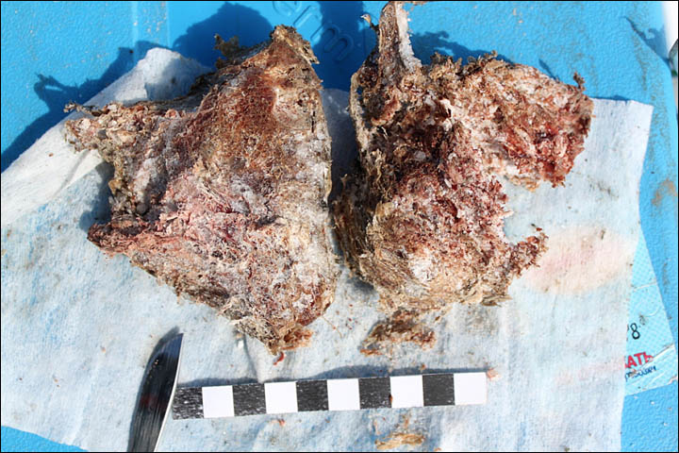
If I get a cell….
….from some unidentified tissue. The DNA has all decomposed. How can I get information on the genetic make up of the organism?

Slide 24
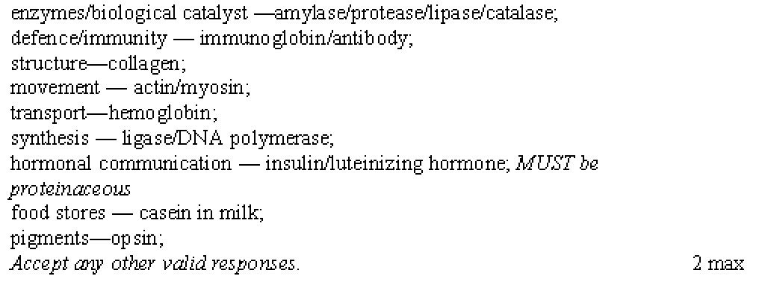

Slide 25
State four functions of proteins and give a named example for each

Slide 26
