Slide 1
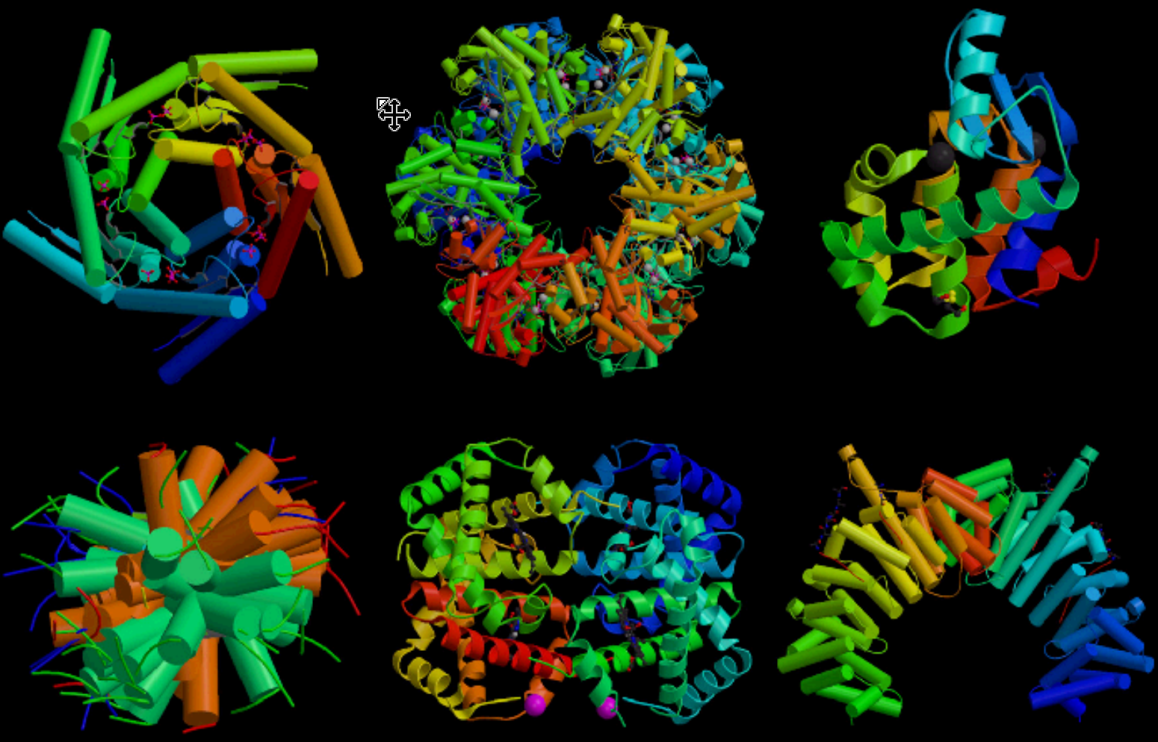

Slide 2
What is it? Where is it found? What does it do?
Rubisco
Insulin
Immunoglobulin
Rhodopsin
Spider Silk
Collagen

Slide 3
2.4 Proteins
Applications:
Rubisco, insulin, immunoglobulins, rhodopsin, collagen and spider silk as examples of the range of protein functions
Denaturation of proteins by heat or deviation of pH from the optimum
Understanding:
Amino acids are linked together by condensation to form polypeptides
There are twenty different amino acids in polypeptides synthesized on ribosomes
Amino acids can be linked together in any sequence giving a huge range of possible polypeptides
The amino acid sequence of polypeptides is coded for by genes
A protein may consist of a single polypeptide or more than one linked together
The amino acid sequence determines the three dimensional conformation of a protein
Living organisms synthesize many different proteins with a wide range of functions
Every individual has a unique proteome
Nature of science:
Patterns, trends and discrepancies: most but not all organisms assemble polypeptides from the same amino acids
Skills:
Draw molecular diagrams to show the formation of a peptide bond

Slide 4
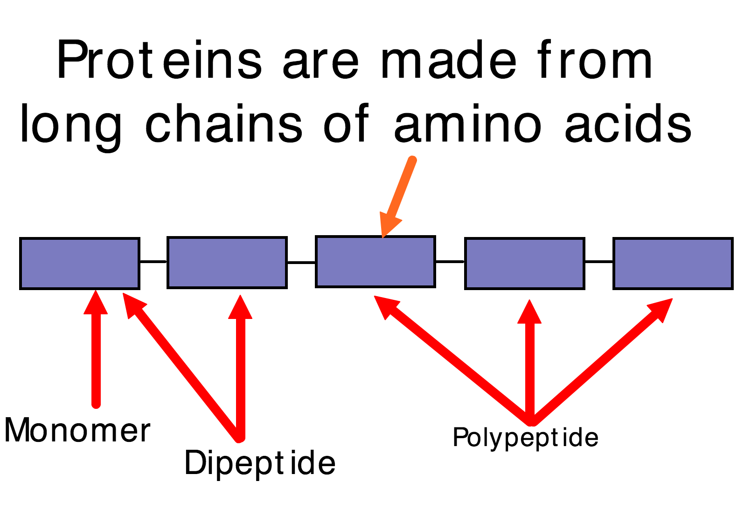

Slide 5
Draw the structure of an amino acid
How do you think they join together?

Slide 7
20 Amino Acids
8 are ‘essential’ amino acids.
We cannot synthesis the essential amino acids themselves.
Amino acids pre-date life

Slide 8
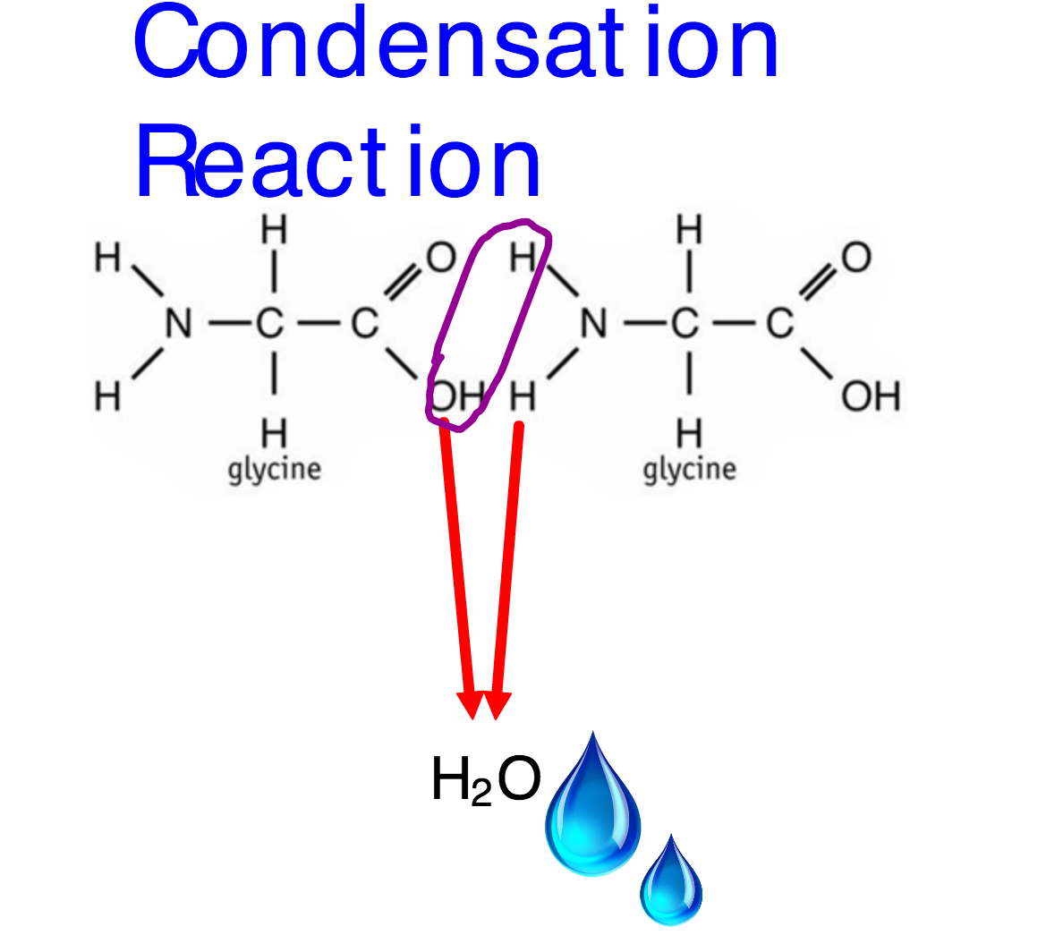

Slide 9
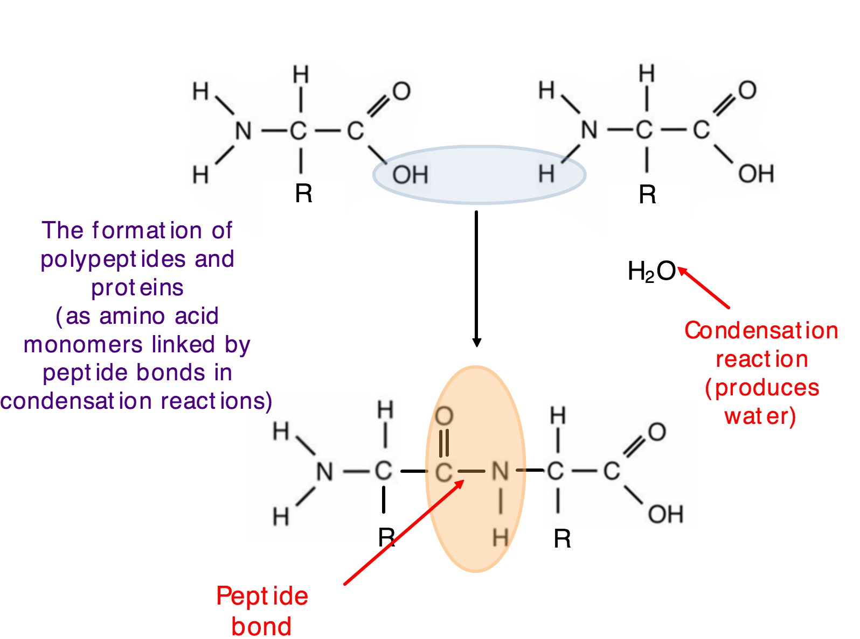

Slide 11
Draw a dipeptide of serine and alanine

Slide 12
Where does all this happen?

Slide 13
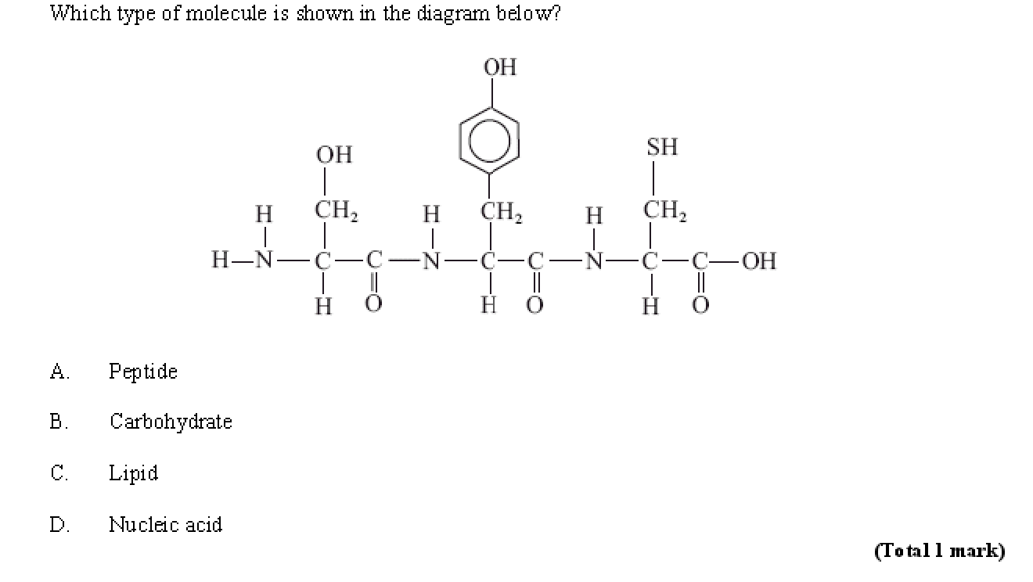

Slide 14
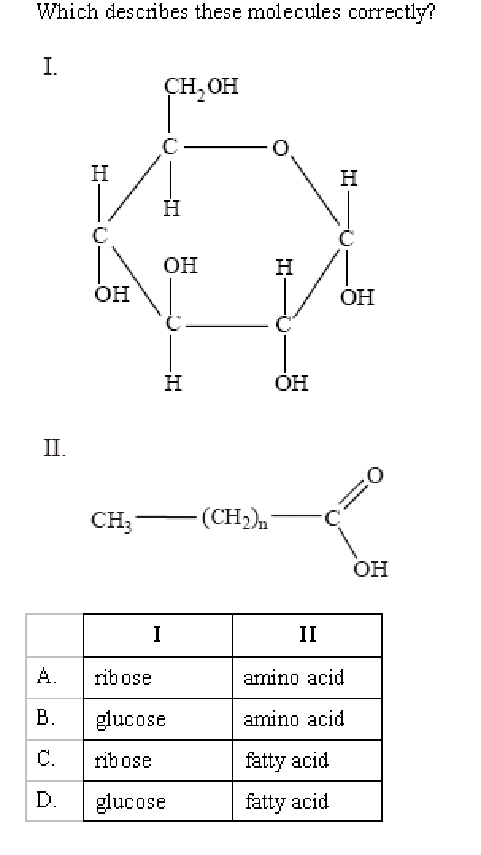

Slide 15
Huge number of possible sequences of AA
Number of amino acids | Number of possible amino acid sequences
1 | 20¹
2 | 20² | 400
3 |  | 8000
4
 | 20⁶ | 64 million
 |  | 10.24 trillion
What determines the sequence of amino acids in a poly peptide?

Slide 17
Haemoglobin

Slide 18
Globular vs Fibrous proteins
The sequence determines the structure
 | Globular | Fibrous
Example
Structure
Function

Slide 19
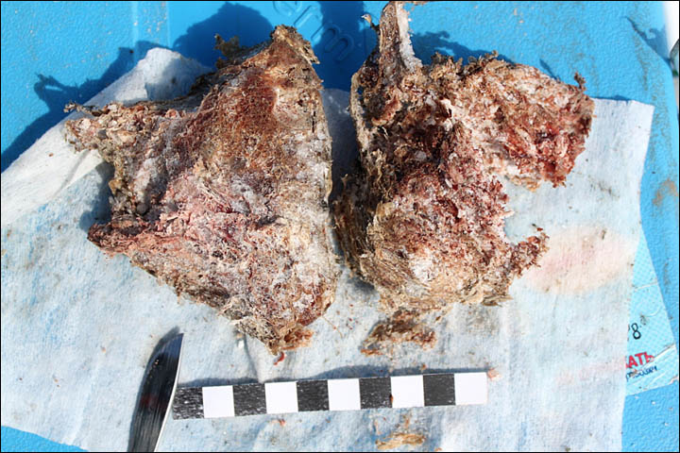
If I get a cell….
….from some unidentified tissue. The DNA has all decomposed. How can I get information on the genetic make up of the organism?

Slide 20
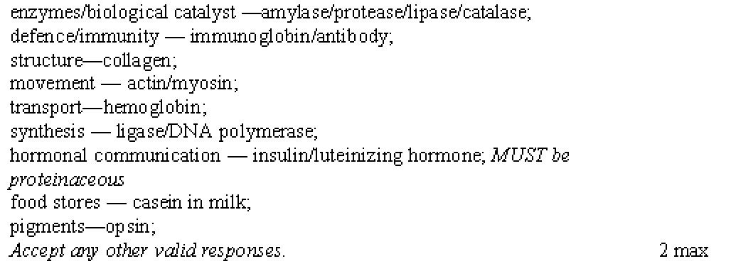
State four functions of proteins and give a named example for each

Slide 21
Denaturation

Slide 22
Proteomes

Slide 24
