Slide 1
Questions
Write the word and symbol equations for photosynthesis
State two photosynthetic pigments
What colours of light does chlorophyll a absorb?
What are the units of wavelength?

Slide 2
Products of photosynthesis
Recall the equation of photosynthesis
Describe the effects of oxygen production on the earth's early atmosphere
State that the carbohydrate production be plants is an endothermic reaction

Slide 3
Oxygen Production
Oxygen is produced from the photolysis of water
Water is split (electrons are formed, which are used for other processes (HL))
H₂O 4e⁻ + O₂

Slide 4
Use page 134-135 to complete a timeline graph of events which shows the changes in oxygen levels in the atmosphere
% oxygen in atmosphere
Now
4,000 mya
converter
O2 in atmosphere

Slide 5
Production of Carbohydrates
What happens to this glucose?

Slide 6
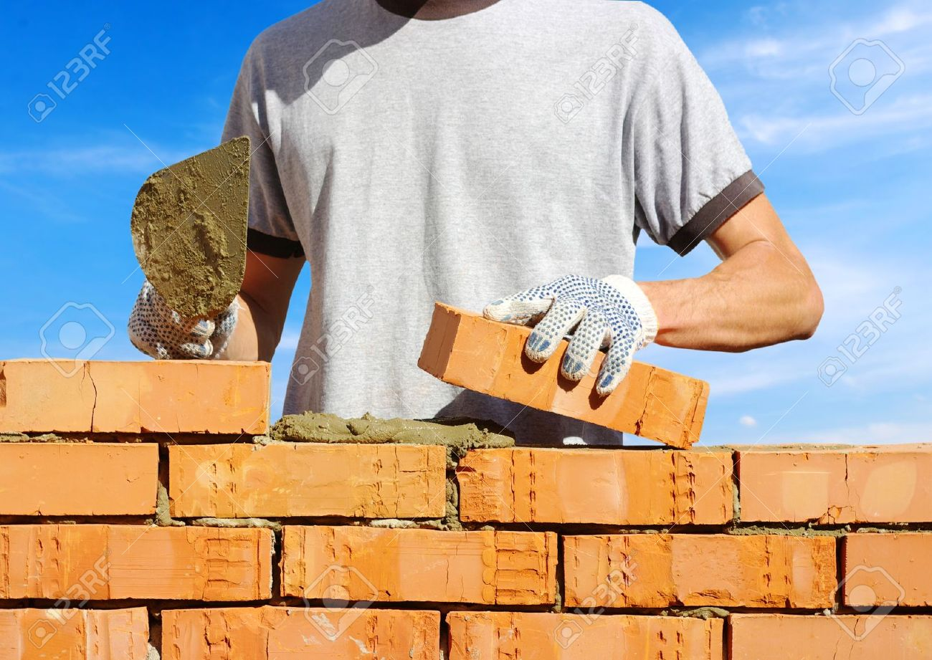
Production of Carbohydrates
Requires energy
A chemical reaction that involves putting energy IN is described as an endothermic reaction

