Slide 1
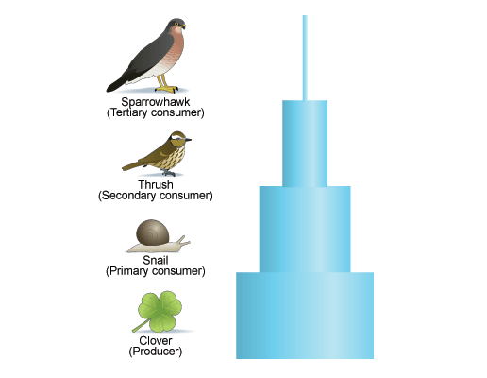
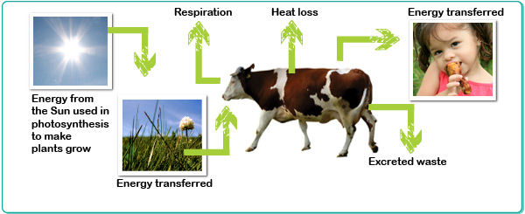
Why don’t food chains go on forever?

Slide 2
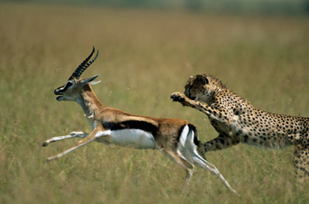
Predator/Prey Relationships

Slide 3
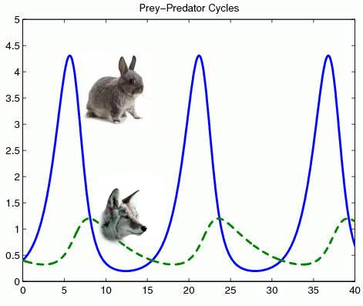
Population (thousands)
Years

Slide 4
Predator/Prey cycles
Watch the video, it will help you with your next task
Q. Why are prey populations higher than predator populations?

Slide 5
