Slide 1
1.1 Introduction to cells
Applications:
Questioning the cell theory using atypical examples, including striated muscle, giant algae and aseptate fungal hyphae.
Investigation of functions of life in Paramecium and one named photosynthetic unicellular organism.
Use of stem cells to treat Stargardt’s disease and one other named condition.
Ethics of the therapeutic use of stem cells from specially created embryos, from the umbilical cord blood of a new-born baby and from an adult’s own tissues.
Understanding:
Understandings:
According to the cell theory, living organisms are composed of cells.
Organisms consisting of only one cell carry out all functions of life in that cell.
Surface area to volume ratio is important in the limitation of cell size.
Multicellular organisms have properties that emerge from the interaction of
their cellular components.
Specialized tissues can develop by cell differentiation in multicellular
organisms.
Differentiation involves the expression of some genes and not others in a
cell’s genome.
The capacity of stem cells to divide and differentiate along different
pathways is necessary in embryonic
Skills:
Use of a light microscope to investigate the structure of cells and tissues, with drawing of cells. Calculation of the magnification of drawings and the actual size of structures and ultrastructures shown in drawings or micrographs. (Practical 1)
Nature of science:
Looking for trends and discrepancies—although most organisms conform to cell theory, there are exceptions. (3.1)
Ethical implications of research—research involving stem cells is growing in importance and raises ethical issues. (4.5)

Slide 3
Observing and Drawing Cells
Label a diagram of a light microscope
Practice using a light microscopes on pre-prepared slides.
Practice drawing cells from microscope images

Slide 4
Practical 1.1
Observing cells, drawing cells and calculating magnification

Slide 5
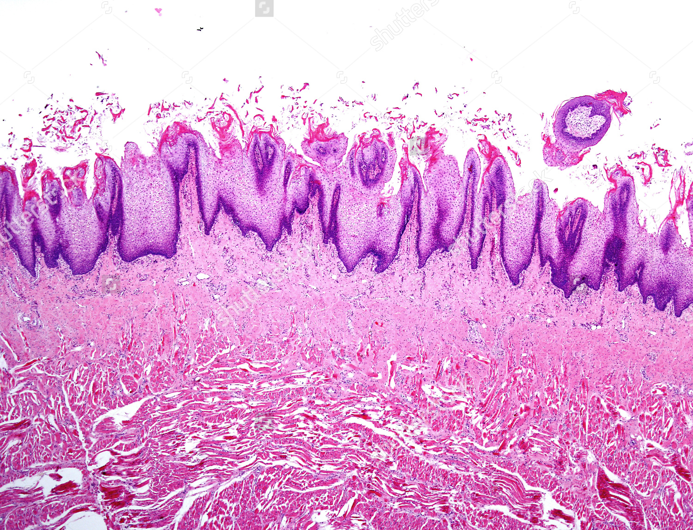
Light Microscope
Microscopes

Slide 6
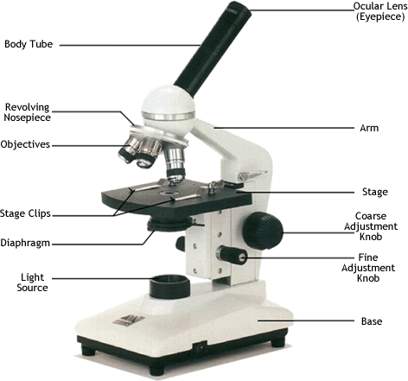

Slide 7
Using the light microscope
1. Use page 3 to label the microscope
2. Use page 4 in the textbook to view the pre-prepared slides
View the slides on using all objective lenses. Practice focusing using both course and fine focusing knobs
Then we will make our own slides

Slide 8
Making Slides

Slide 9
Rules when drawing cells
Sharp pencil
Draw single lines not sketches
No shading
Label each structure with a straight line
Include a title
Include the magnification

Slide 11
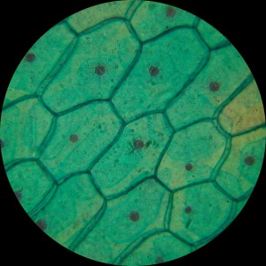
Animal cell
Plant Cell

