Slide 1
10.2 Inheritance
Skills:
Calculation of the predicted genotypic and phenotypic ratio of offspring of dihybrid crosses involving unlinked autosomal genes
Identification of recombinants in crosses involving two linked genes
Use of a chi-squared test on data from dihybrid crosses
Understanding:
Unlinked genes segregate independently as a result of meiosis
Gene loci are said to be linked if on the same chromosome
Variation can be discrete or continuous
The phenotypes of polygenic characteristics tend to show continuous variation
Chi-squared tests are used to determine whether the difference between an observed and expected frequency distribution is statistically significant
Nature of science:
Looking for patterns, trends and discrepancies: Mendel used observations of the natural world to find and explain patterns and trends. Since then, scientists have looked for discrepancies and asked questions based on further observations to show exceptions to the rules. For example, Morgan discovered non-Mendelain ratios in his experiments with Drosophia
Applications:
Completion and analysis of Punnett squares for dihybrid traits
Morgan’s discovery of non-Mendelian ratios in Drosophia
Polygenic traits such as human height may also be influenced by environmental factors

Slide 2
Variation – Differences within a species
Discrete/Discontinuous
e.g blood types
AB B A O
No in between!
Phenotypes controlled by a single gene

Slide 3
Variation
Continuous Variation = range in variation
Usually creates a normal distribution
Polygenic inheritance – phenotype controlled by multiple genes
Phenotypes controlled by polygenic inheritance are also influenced by the environment
What groups of people are useful to study?

Slide 4
Environmental Influence

Slide 5
Qs

Slide 6
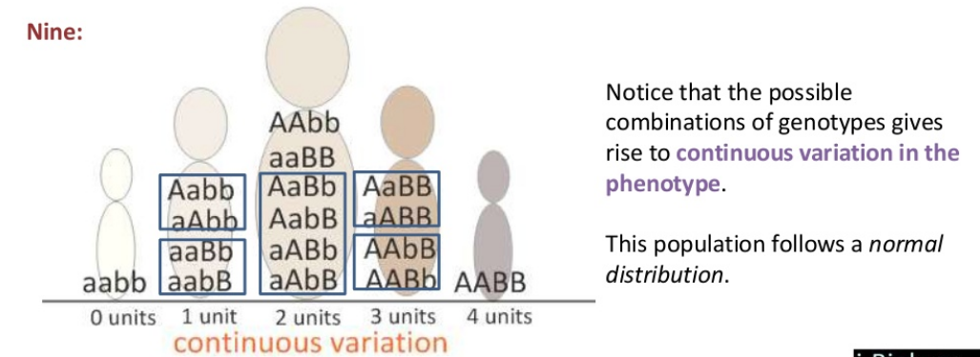
9
How many units of melanin do they add?
AaBb same as AabB

Slide 7
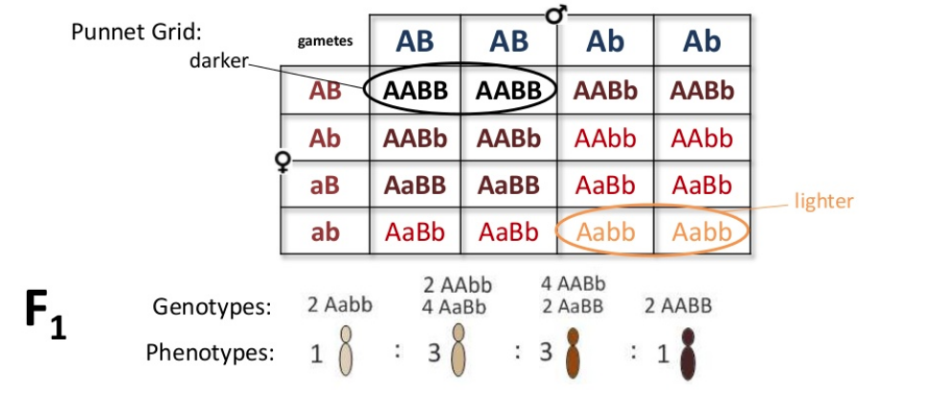
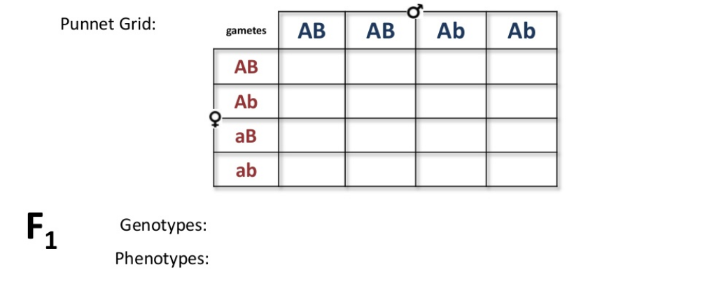

Slide 8
TED

