Slide 1
Find out…
Where are the areas of growth in plants?
What property do the cells have in these areas?

Slide 2
Plant Growth

Slide 3
Meristems are areas of continuous growth in plants
They are found at the tips of stems/shoots and roots
They contain undifferentiated (totipotent) cells and are the sites of continual growth = indeterminate growth

Slide 5
Shoot Apex
At the shoot apical meristem there is continuous cell division (mitosis) of undifferentiated cells (like stem cells)
One cell will differentiate into a shoot or leaf cell and the other will remain undifferentiated (meristematic)
Apical meristem

Slide 6
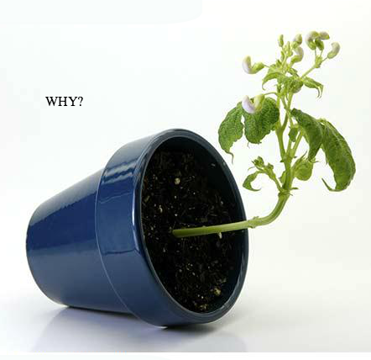
Directional Growth

Slide 7
Plant Hormones
Plant hormones are called auxins.
There are many different types.
Auxins
Growth
Development of fruits
Regulating leaf production
Auxins control directional growth in plants (Tropisms).
How does the environment affect directional growth in plants?

Slide 8
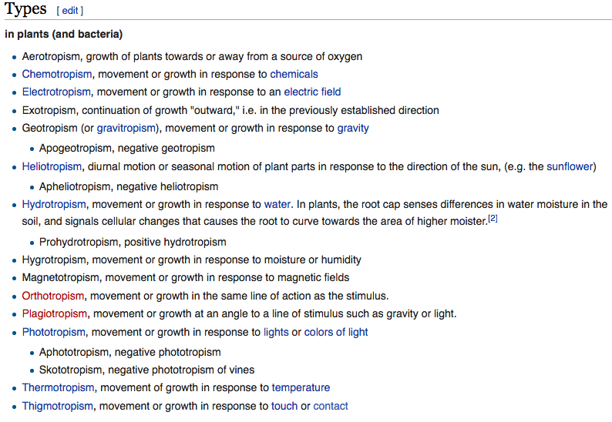
Tropisms
Growth or movement in response to a directional external stimuli
Positive or Negative

Slide 9
Investigate Plant Tropisms
Mung bean seeds
Cotton wool
Cups
Petri dishes
Water
Boxes
Lamps
Plant tropisms – Writing qualitative observations
Decide on a plant tropism you would like to investigate.
Research the conditions required to germinate seeds
Germinate mung beans (Vigna radiata). Will you have more than one group? Control group?
Once germinated, expose your young plants to your chosen tropism.
Note qualitative observations.
It’s your responsibility to keep your plant alive!

Slide 10
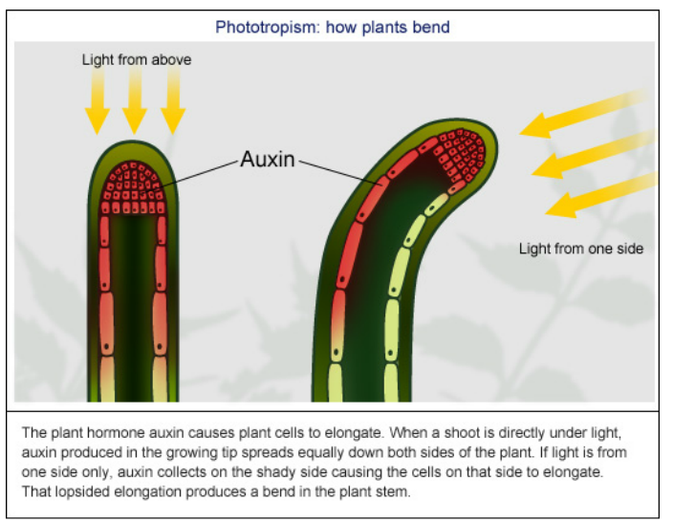

Slide 12
Positive Phototropism
Use the pictures and textbook extract provided to explain how a plant shoot grows towards the light.

Slide 13
Auxin (IAA) produced in the tip of a shoot.
Auxin efflux pumps (membrane proteins) move auxin out of the cells closest to the light using ATP
Creates a high concentration of auxin in the intercellular space
There is a low concentration of auxin in adjacent cells
Auxin diffuses into adjacent cells (auxin influx) on the dark side
Lateral movement of auxin
This causes cell elongation on the dark side
HOW?

Slide 14
Auxin is produced in cells that face the light
Through efflux pumps and influx auxin diffuses into cells on the dark side
Auxin enters the nucleus
The auxin and a receptor in the nuclei activate a proton pump
Auxin itself can also activate the proton pump
The pump moves hydrogen ions from the cytoplasm into the cell wall
Reduced pH
H bonds break in cellulose
Cell walls becomes more elastic/softens
The auxin stimulates the cell to grow by gene expression

Slide 15
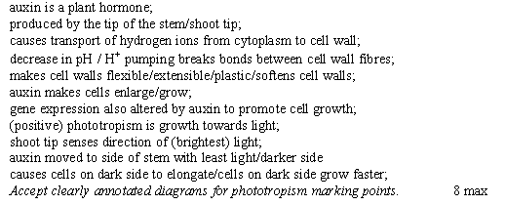

Slide 16
Micropropagation
A small cutting is made from a plant (an explant)
Agar is put into a petri dish containing nutrients and auxins
The explant is placed in the sterile nutrient agar in a petri dish
These explants grow into tiny plantlets
These plantlets are transferred to soil
The plantlets grow into identical copies of the original plant

Slide 17
Micropropagation
sterile
Cytokinins
Gibberellins

Slide 18
1. Outline the roles of auxin in plants.
when a shoot is illuminated from one side; auxin is transported laterally to the other side; where it causes greater growth on one / dark side; by stimulating cell elongation;
2. Outline the techniques used in cloning plants by micropropagation.
small piece of plant/explant removed;
Sterile; tissue is placed on sterile nutrient agar gel containing high auxin concentration; cytokinin; gibberellin are sometimes added; plantlets are separated and transferred to soil;
[4]

Slide 20
What are the advantages and disadvantages of micropropagation
Advantages
Disadvantages
As a monoculture comprises a single crop, its cultivation is simpler and more efficient than simultaneously farming multiple crops in the same area.
There is more pressure from diseases and pests in a monoculture because they can spread more effectively as it is easy for them to find a host plant.
The lack of biodiversity of a monoculture makes it less adaptable to changes in the environment, so a single threat can destroy an entire crop.
Monocultures are less effective than mixed plant communities when it comes to exploiting all the nutrients available in soil, water, light and fertilizer.
Qs

