Slide 1
Photosynthesis
?

Slide 2
2.9 Photosynthesis
Understanding:
Photosynthesis is the production of carbon compounds in cells using light energy
Visible light has a range of wavelengths with violet the shortest wavelength and red the longest
Chlorophyll absorbs red and blue light most effectively and reflects green light more than other colours
Oxygen is produced in photosynthesis from photolysis of water
Energy is needed to produce carbohydrates and other carbon compounds
Temperature, light intensity and carbon dioxide concentration are possible limiting factors on the rate of photosynthesis
Applications:
Changes to the Earth’s atmosphere, oceans and rock deposition due to photosynthesis
Skills:
Design of experiments to investigate limiting factors on photosynthesis
Separation of photosynthetic pigments by chromatography
Drawing an absorption spectrum for chlorophyll and an action spectrum for photosynthesis
Nature of science:
Experimental design: controlling relevant variables in photosynthesis experiments is essential

Slide 3
Photosynthesis
This tree takes in a gas and a liquid and turns it into a solid.
Where does the energy come from?

Slide 4
Photosynthesis Equation
Any problems?
What is the energy conversion here?
Light to Chemical

Slide 5
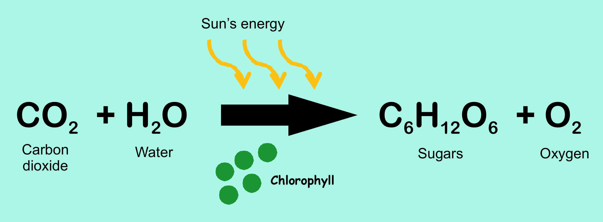
What happens to the products of photosynthesis?
Glucose:
Used in respiration
Stored as starch (insoluble)
Use to synthesis other organic molecules: lipids/proteins/cellulose
Oxygen:
Used in respiration
Let back out into atmosphere
Photosynthesis

Slide 6
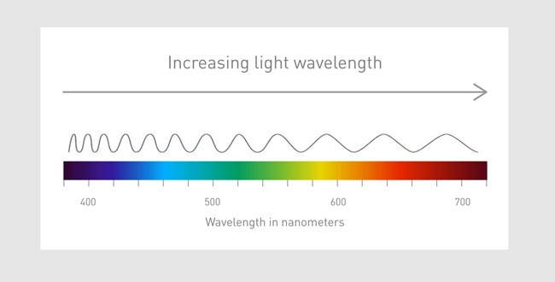
Wavelengths of light
Light is made up of many wavelengths
Some wavelengths are invisible to us

Slide 7
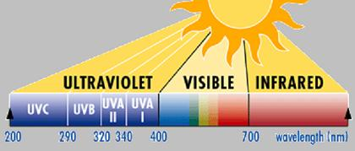
Wavelengths of light
Too short to see: X-rays, UV rays
Too long to see: Infrared
Visible light range from 400 to 700 nanometres
So why don’t plants just use high energy wavelengths?
High energy
Low energy

Slide 8
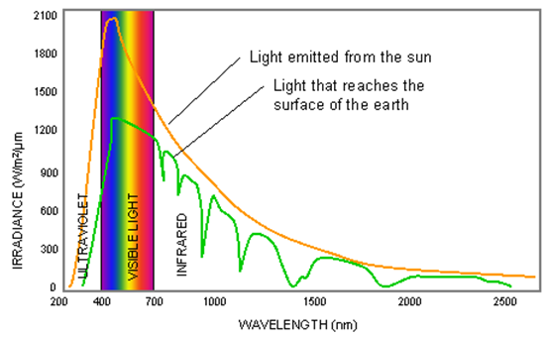
Wavelengths of light
Why are the wavelengths of light that we see the same as the wavelengths of light a plant uses?
These are the wavelengths that get through to the earth
Evolution!!
Adaptation!!

Slide 9
What colours does this reflect?

Slide 10
What colours does this reflect?

Slide 11
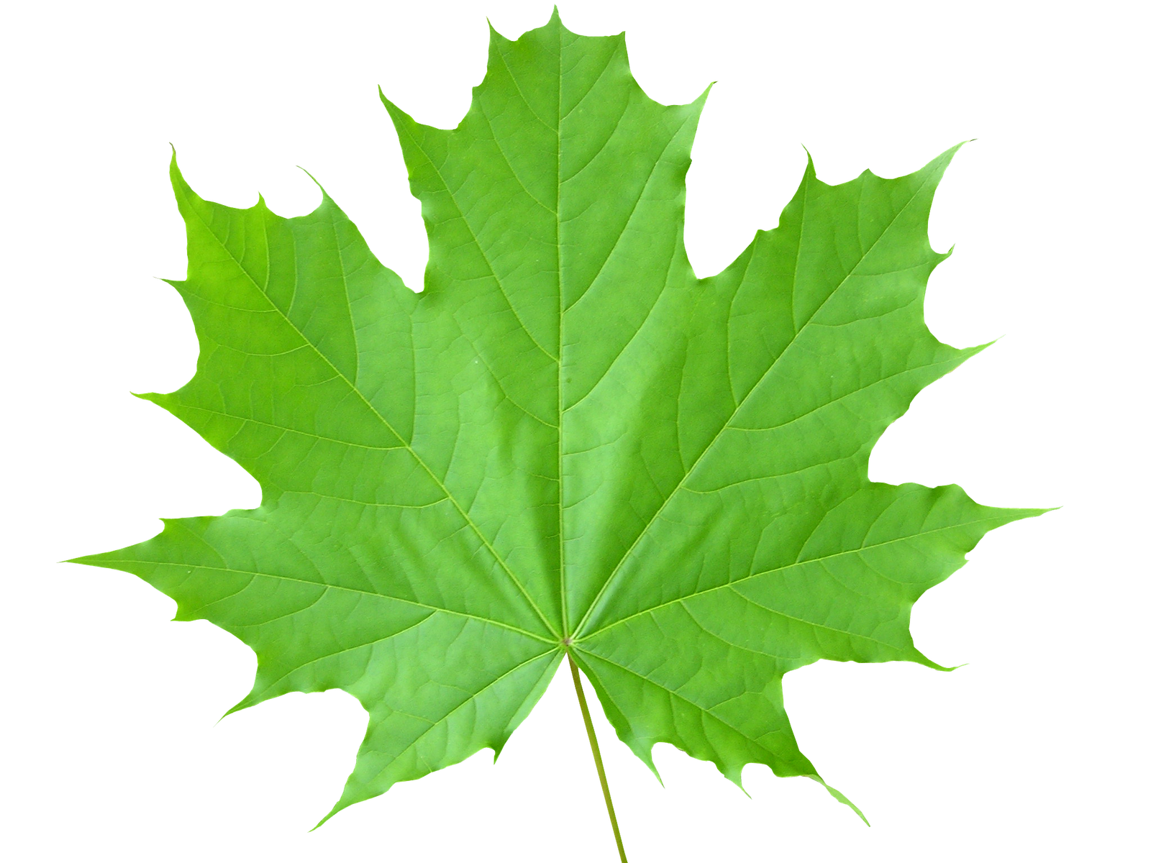
What colours does this reflect?
Pigments are substances that absorb some wavelengths of light and reflect others – therefore appear coloured to us

Slide 12
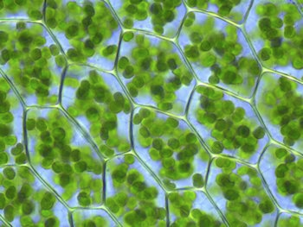
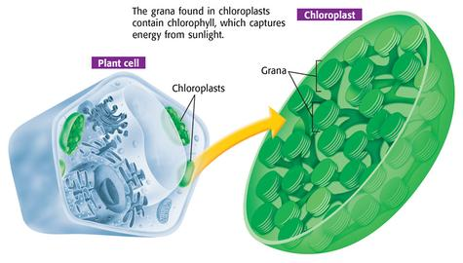
Chlorophyll

Slide 13
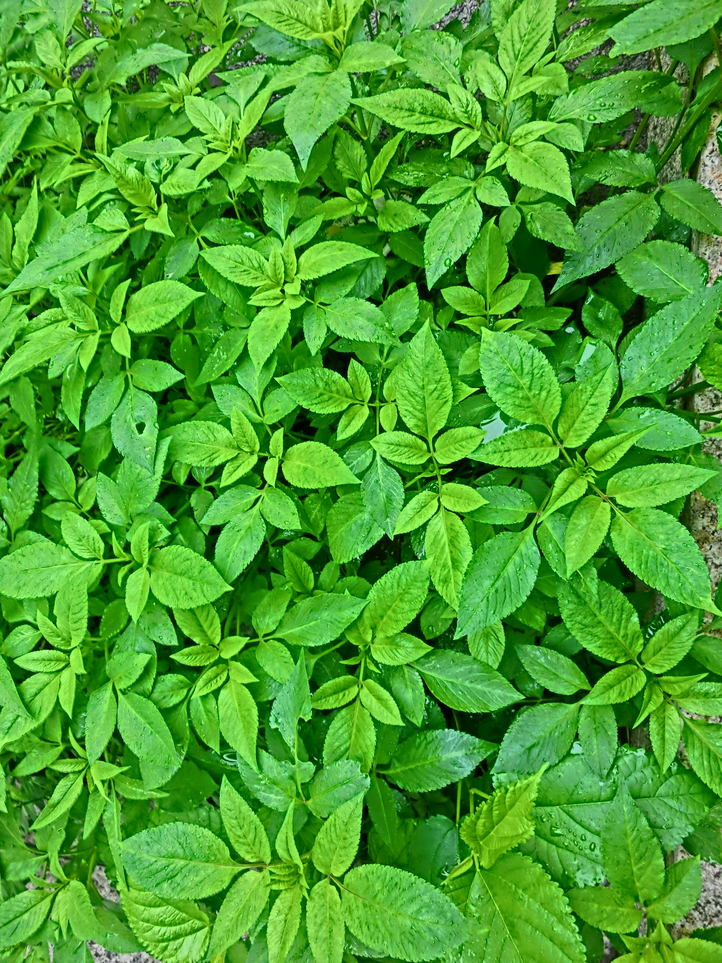
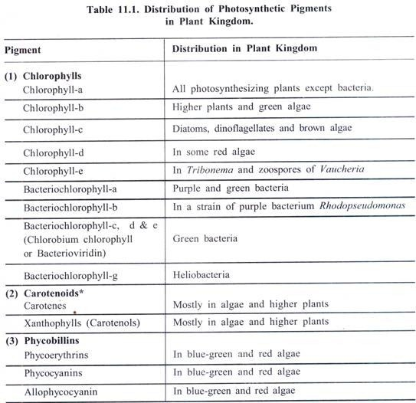
Chlorophyll
There are various forms of chlorophyll but they all appear green to us

Slide 14
What colours does chlorophyll absorb?
Blue and Red

Slide 16
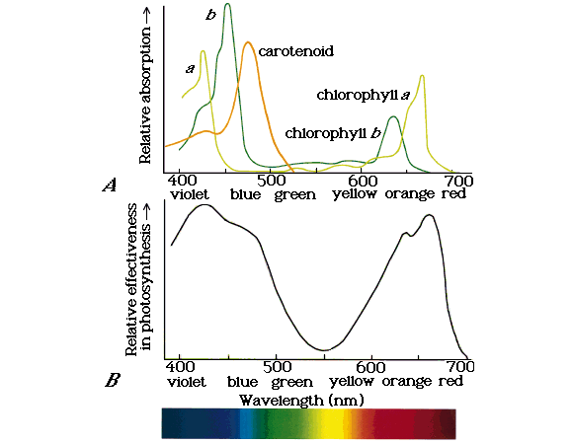
SPECTRA
Absorption
Percentage of light absorbed at each wavelength of each pigment
Action
Shows rate of photosynthesis at each wavelength of light

Slide 17
Rules to draw spectra
Action | Absorption | Both
Y-axis should be used for rate of photosynthesis – often given as a percentage of the maximum rate (0-100%) | Y-axis should be labelled % absorption (0-100%) | Horizontal axis should have label: wavelength (nm) Scale from 400-700 nm for wavelength
Absorption – just chlorophyll
Bring in a leaf

