Slide 1
8.3 Photosynthesis
Understanding:
Light-dependent reactions take place in the intermembrane space of the thylakoids
Reduced NADP and ATP are produced in the light-dependent reactions
Light-independent reactions take place in the stroma
Absorption of light by photosystems generates excited electrons
Photolysis of water generates electrons for use in the light-dependent reactions
Transfer of excited electrons occurs between carriers in thylakoid membranes
Excited electrons from Photosystem II are used to generate a proton gradient
ATP synthase in thylakoids generates ATP using the proton gradient
Excited electrons from photosystem I are used to reduce NADP
In the light-independent reactions a carboxylase catalyses the carboxylation of ribulose bisphosphate
Glycerate 3-phoshpate is reduced to triose phosphate using reduced NADP and ATP
Triose phosphate is used to regenerate RuBP and produce carbohydrates
Ribulose bisphosphate is reformed using ATP
The structure of the chloroplast is adapted to its function in photosynthesis
Nature of science:
- Developments in scientific research follow improvments in apparatus: sources of 14C and autoradiography enabled Calvin to elucidate the pathways of carbon fixation
Skills:
Annotation of a diagram to indicate the adaptations of a chloroplast to its function
Applications:
Calvin’s experiment to elucidate the carboxylation of RuBP

Slide 2
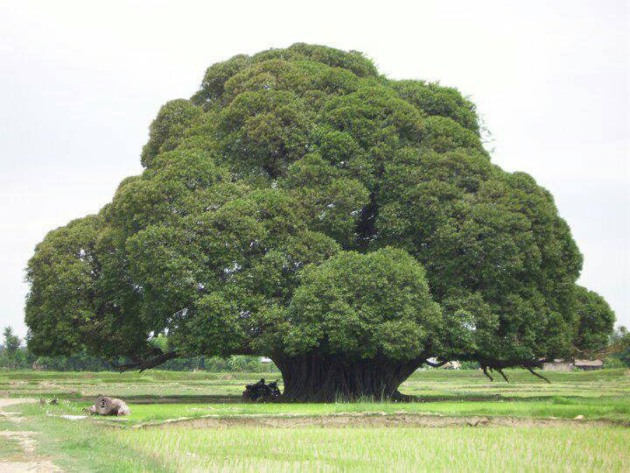
How do you turn a gas, a liquid and some energy into a solid?
PHOTOSYNTHESIS

Slide 3
PHOTOSYNTHESIS
Photosynthesis stores energy in glucose
Basically…....
Energy (light) is used to break the bonds in H₂O. Hydrogen is stored as part of glucose which is formed when the hydrogen reacts with CO₂.
The O₂ formed from the breakdown is released.
The glucose is a store of energy which the plant will use in respiration.
Plants start food chains

Slide 4
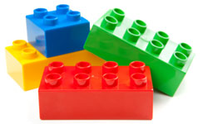
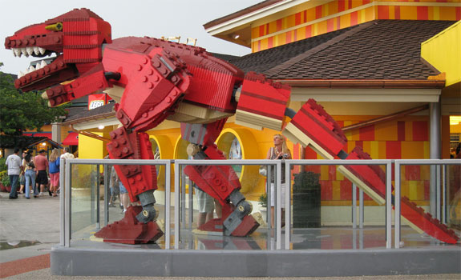
Photosynthesis vs. Respiration
Respiration = catabolism (breaks down molecules
into smaller units to produce energy ATP)
Photosynthesis = anabolism (construct large molecules from smaller units using energy from the sun)

Slide 6
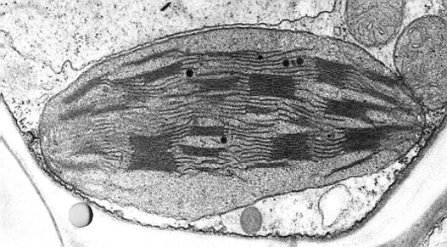
Chloroplast structure
Chloroplasts are adapted to their function
Draw a chloroplast and label the following:
Thylakoid
Granum
Inner membrane
Outer membrane
Stroma
What happens at each of these parts?
Understanding:
The structure of the chloroplast is adapted to its function in photosynthesis
Skills:
Annotation of a diagram to indicate the adaptations of a chloroplast to its function

Slide 7
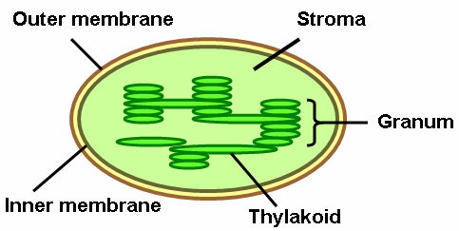
Chloroplast structure
Thylakoid
Lamella
Skills:
Annotation of a diagram to indicate the adaptations of a chloroplast to its function

Slide 8
Chloroplast structure
Thylakoids – Flattened membrane sacs (first step of photosynthesis). Large SA. Contains chlorophyll to absorb light.
Grana – Stacked up thylakoids = more photosynthesis. Linked by bits of thylakoid called lamellae (pl)
Stroma – Fluid outside of the grana. Contains many enzymes and chemicals for photosynthesis.
Understanding:
The structure of the chloroplast is adapted to its function in photosynthesis
Skills:
Annotation of a diagram to indicate the adaptations of a chloroplast to its function

Slide 9
Photosynthesis
1. Light dependent reactions
Needs light
2. Light independent reactions
Does not need light
Meaning?
Understanding:
Light-dependent reactions take place in the intermembrane space of the thylakoids
Light-independent reactions take place in the stroma

Slide 10
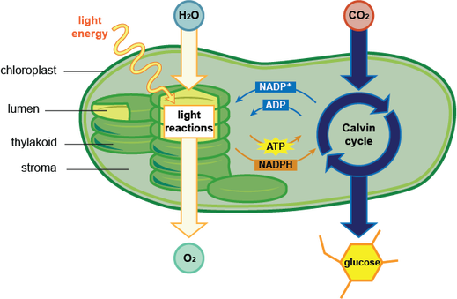
Light Dependent Reactions
Thylakoid membranes
Uses light directly
Pigments (e.g. Chlorophyll a) absorb light
Pigments organised into photosystems (protein and pigments) in thylakoids
Understanding:
Light-dependent reactions take place in the intermembrane space of the thylakoid

Slide 11
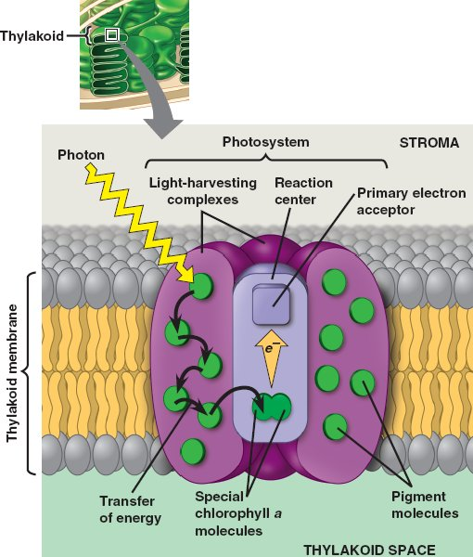
Light Dependent Reactions
Photosystems include:
Chlorophyll a molecules
Accessory pigments (other than chlorophyll a)
Reaction centre containing a primary electron acceptor
The is a photosystem I and II each activated by different wavelengths of light:
Photosystem I: 700nm (P700)
Photosystem II: 680nm (P680)
5. They contain reaction centres
Understanding:
Light-dependent reactions take place in the intermembrane space of the thylakoid

Slide 12
Light Dependent Reactions
Location: Thylakoid space and across the thylakoid membrane
Chlorophyll molecules absorb light energy from photons of light.
Light energy is passed to a Chlorophyll a molecule in the reaction centre.
This excites the chlorophyll a and it is photoactivated.
The chlorophyll a molecule donates an excited electron to the primary electron acceptor – plastoquinine (plastoquinine is reduced).
Two photons = one reduced plastoquinine.
II
1
4
3
2
Understanding:
Light-dependent reactions take place in the intermembrane space of the thylakoid

Slide 13
Electron Acceptor
Just out of interest – you don’t need to know the structure

Slide 14
5. Once plastoquinine collects two electrons it moves from photosystem II into the membrane (it is hydrophobic so it stays in the bilayer). It travels along an electron transport chain to photosystem I.
This is repeated so the chlorophyll a has lost four electrons and two reduced plastoquinine are produced.
5
5
5
Ignore the red numbers

Slide 15
6. Once the plastoquinine in photosystem II is reduced, the chlorophyll a in the reaction centre becomes a powerful oxidizing agent. It causes water molecules to split and give up their elections to replace the ones that the chlorophyll a has lost.
This is called photolysis (photo – Light, lysis – split). Oxygen is the waste product and diffuses away.
2H₂O O₂ + 4H⁺ + 4e⁻
6.
Ignore the red numbers

Slide 16
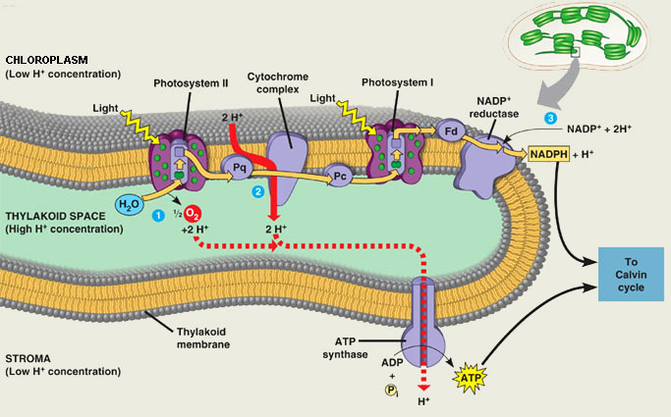
7. Plastoquinine transfers it’s electrons to the electron transport chain. As the electrons pass through they release energy. This is used to pump protons (H⁺) across the thylakoid membrane into the thylakoid space. These protons and the protons from photolysis cause a build up of protons in the thylakoid space – proton gradient.
7
Ignore the blue numbers

Slide 17
Chemiosmosis – The protons pass across the membrane through ATP synthase. The energy produced as protons (H⁺) travel down their concentration gradient synthesises ATP from ADP (just like in the mitochondria)
The ATP will be used in the light independent reaction
8
Ignore the blue numbers

Slide 18
9. When electrons reach the end of the electron transport chain they are passed to plastocyanin (an electron acceptor). Reduced plastocyanin is needed in the next stage of photosynthesis at photosystem I.
9
8
Ignore the blue numbers
We are going to zoom in again now

Slide 19
10. Chlorophyll molecules in photosystem I absorb light energy and pass it to the Chlorophyll a in the reaction centre. This excites the chlorophyll a and it is photoactivated.
11. Excited electron passes from the chlorophyll, out of the photosystem to ferredoxin (a protein) (to form reduced ferrodoxin).
12. Two molecules of reduced ferradoxin are used to reduce NADP to form reduced NADP (NADPH)
13. The de-energised electrons lost from the chlorophyll in photosystem I are always being replaced by electrons that were generated in photosystem II
12
2e⁻
11
Fd
10
13
Ignore the red numbers

Slide 20
The reduced NADP (NADPH) and ATP from the light dependent stage will be used in the light independent stage

Slide 21
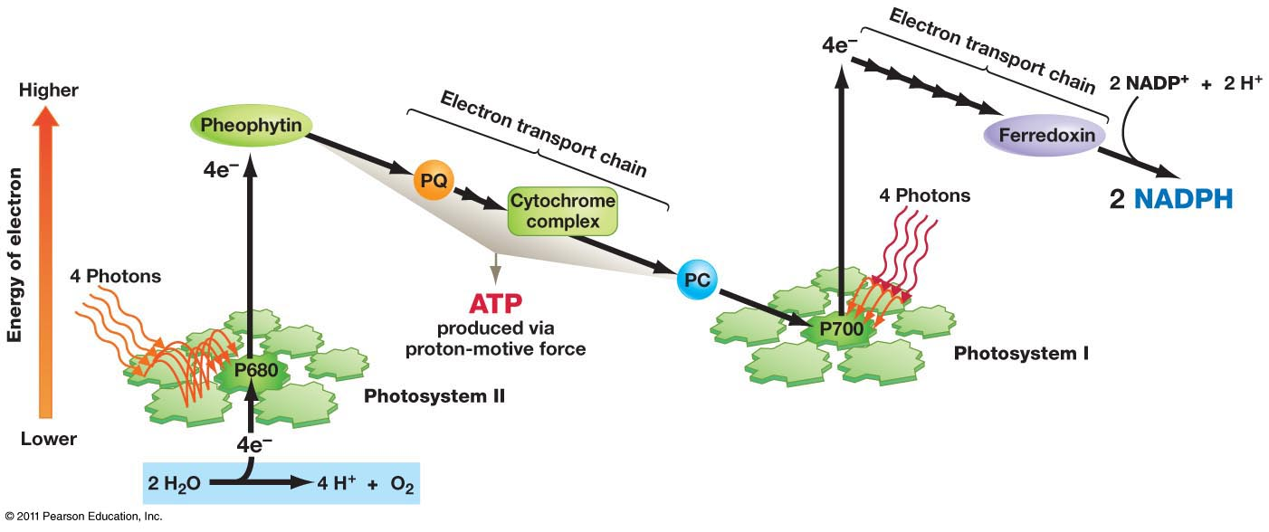
Take note of the energy levels of the electrons
Light Dependent Stage

Slide 22
Light Dependent Reactions
NADPH and ATP are the final products
Supply energy for the light independent reactions to occur
Also where oxygen is released (water splitting in the first few steps)
Understanding:
Reduced NADP and ATP are produced in the light-dependent reactions

Slide 23
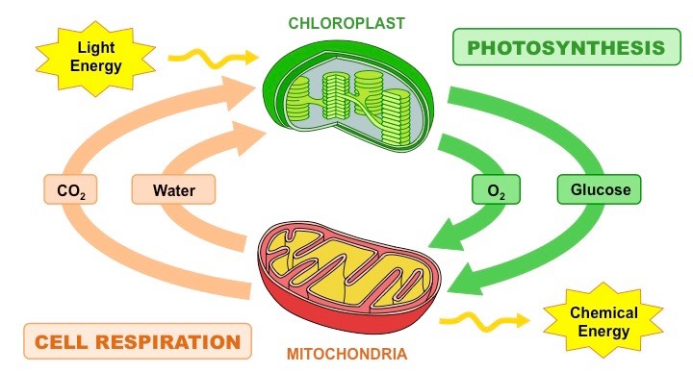
ATP production
ATP production in photosynthesis and respiration are similar
Both use chemiosmosis to phosphorylate ADP to ATP (ATP synthase enzyme)
When it is produced using light = photophosphorylation (photosynthesis)
When using oxidation = oxidative phosphorylation
(respiration)
Understanding:
Reduced NADP and ATP are produced in the light-dependent reactions

Slide 24
Chemiosmosis
Respiration chemiosmosis | Photosynthesis chemiosmosis
Electron transport chain in cristae membranes Energy released when electrons are exchanged from one carrier to another Energy used to pump H+ into intermembrane space H+ ions come from matrix H+ ions diffuse back into matrix through channels of ATP synthase ATP synthase catalyses the phosphorylation of ADP to ATP | Electron transport chain in thylakoid membranes Energy released when electrons are exchanged from one carrier to another Energy used to pump H+ into thylakoid space H+ ions come from the stroma H+ ions diffuse back into stroma through channels of ATP synthase ATP synthase catalyses the photophosphorylation of ADP to ATP
Understanding:
ATP synthase in thylakoids generates ATP using the proton gradient

Slide 25
Light Independent Reactions
Location: In the stroma (contains enzymes)
Uses ATP and NADPH from light dependent reaction
Involves the Calvin cycle (begins and ends with the same substance)
Understanding:
Light-independent reactions take place in the stroma

Slide 26
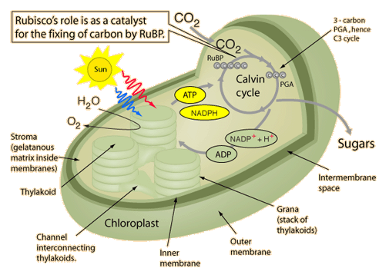
Light Independent Reaction
Understanding:
In the light-independent reactions a carboxylase catalyses the carboxylation of ribulose bisphosphate

Slide 27
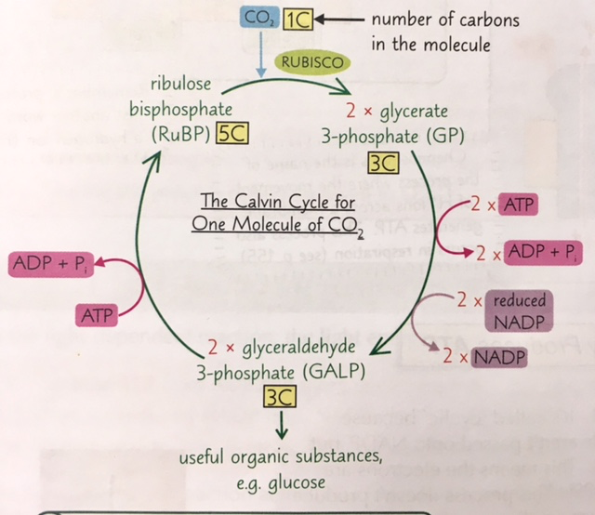
Light Independent Reaction
1. 5-carbon compound Ribulose bisphosphate (RuBP) binds to an incoming carbon dioxide molecule
2. Catalysed by enzyme RUBISCO – results in 2 x glycerate 3- phosphate (GP)
The ribulose bisphosphate is carboxylated
1
2
2 x triose phosphate (TP)
Understanding:
In the light-independent reactions a carboxylase catalyses the carboxylation of ribulose bisphosphate

Slide 28
Light Independent Reaction
3. Each glycerate 3- phosphate is reduced (H atoms added) using reduced NADP (NADPH) with energy from ATP.
Two triose phosphates (TP) are produced
3
2 x triose phosphate (TP)
Understanding:
In the light-independent reactions a carboxylase catalyses the carboxylation of ribulose bisphosphate

Slide 29
Light Independent Reaction
4. Some triose phosphate is used to form organic compounds e.g. glucose
How many turns of the Calvin cycle are needed to form one glucose?
5. The remaining carbons are used to re-synthesise RuBP. ATP required to power these changes
5
6
2 x triose phosphate (TP)
4
Understanding:
In the light-independent reactions a carboxylase catalyses the carboxylation of ribulose bisphosphate

Slide 30
Light Independent Reaction
CARBON FIXATION/CARBOXYLATION
REGENERATION
REDUCTION
2 x triose phosphate (TP)
Understanding:
In the light-independent reactions a carboxylase catalyses the carboxylation of ribulose bisphosphate

Slide 31
The Calvin Cycle
To form one 6 carbon sugar molecule:
6 Carbon dioxide molecules
12 TP molecules
6 RuBP molecules
12 NADPH
18 ATP
So there needs to be 6 turns in the wheel to make a 6-carbon sugar

Slide 32
The Calvin Cycle
Calvin and his team worked out carbon fixation in plants.
Research the lollipop experiment (watch video first)
What is it?
What is the process?
What did he find out?
Light Independent Stage
Applications:
Calvin’s experiment to elucidate the carboxylation of RuBP

Slide 33
The Calvin Cycle
Algae used as experimental specimen
Carbon 14 used as a marker to label carbon dioxide entering cells
Photosynthesis stopped at different points to observe where C14 was
Chromatography to separate out algal cells – x ray film placed on top of chromatogram and C14 developed the film where it was present
Knew concentration and location of C14 but took 10 years to identify the substances carbon became
Applications:
Calvin’s experiment to elucidate the carboxylation of RuBP

Slide 34
Photosynthesis Summary
Light dependent | Light independent
Occurs in thylakoids Uses light energy to form ATP and NADPH Splits water in photolysis to proved replacement e- and H+ and to release oxygen to atmosphere Includes 2 electron transport chains and photosystems I and II | Occurs in the stroma Uses ATP and NADPH to form triose phosphate Returns ADP, inorganic phosphate and NADP to the light dependent reactions Involves the Calvin cycle

Slide 35
Chloroplast structure
Chloroplast structure | Function Allowed
Extensive membrane surface area of the thylakoids
Small space (lumen) within the thylakoids
Stroma region similar to the cytosol of the cell
Double membrane on the outside
Understanding:
The structure of the chloroplast is adapted to its function in photosynthesis

Slide 36
Chloroplast structure
Chloroplast structure | Function Allowed
Extensive membrane surface area of the thylakoids | Increased absorption of light
Small space (lumen) within the thylakoids | Faster accumulation of protons to create a concentration gradient
Stroma region similar to the cytosol of the cell | Area for the enzymes necessary for the Calvin cycle to work
Double membrane on the outside | Isolates the working parts and enzymes of the chloroplast from the surrounding cytosol
Understanding:
The structure of the chloroplast is adapted to its function in photosynthesis

