Slide 1
Nature of Science
Developments in scientific research follow improvements in apparatus – experimental methods for measuring phloem transport rates using aphid stylets and radioactively-labeled carbon dioxide were only possible when radioisotopes became available.
Applications and Skills
Applications: Structure – function relationships of phloem sieve tubes
Skill: Identification of xylem and phloem in microscope images of stem and root
Skill: Analysis of data from experiments measuring phloem transport rates using aphid stylets and radioactively-labeled carbon dioxide.

Slide 2
Understandings
Plants transport organic compounds from sources to sinks
Incompressibility of water allows transport along hydrostatic pressure gradients
Active transport is used to load organic compounds into phloem sieve tubes at the source
High concentrations of solutes in the phloem at the source lead to water uptake by osmosis
Raised hydrostatic pressure causes the contents of the phloem to flow towards sinks

Slide 3
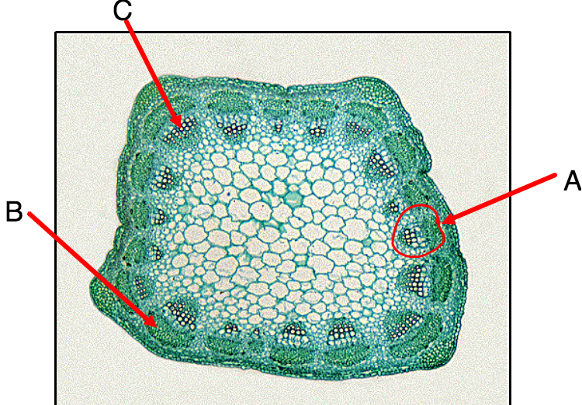
Recap on XYLEM
1. What direction does xylem transport materials?
2. What does the xylem transport?
3. What polymer impregnates the walls of the xylem?
4. What is the force of attraction between the water molecules and the walls of the xylem?
5. What happens to most of the water taken up by the roots?

Slide 4
9.2 Transportation in the Phloem of plants
Plants transport organic compounds from sources to sinks
Active transport is used to load organic compounds into phloem sieve tubes at the source
High concentrations of solutes in the phloem at the source lead to water uptake by osmosis
Raised hydrostatic pressure causes the contents of the phloem to flow towards sinks

Slide 5
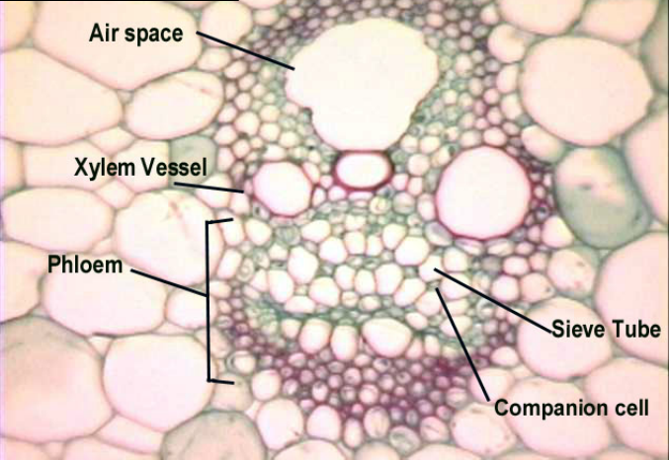

Slide 6
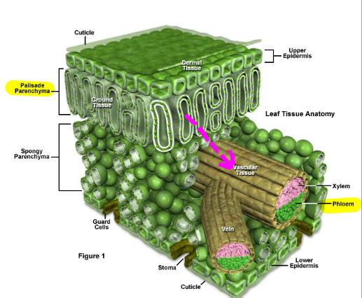
Translocation in the Phloem
Movement of sugars/organic solutes/products of photosynthesis to other parts of the plant
Solutes are transported from the source (where they are made).
What is the source here?

Slide 7
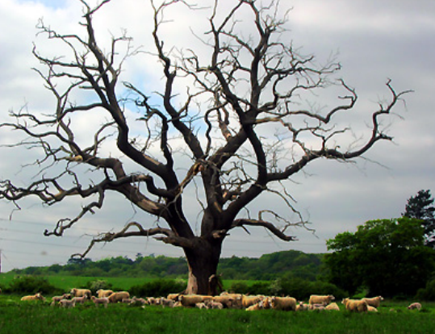
When might the source be somewhere else?

Slide 8
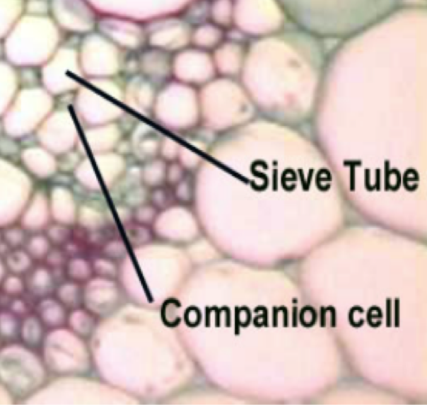
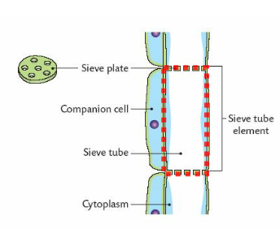
The sieve tube element is a living cell
It has lost all of it’s contents and is one continuous vacuole called the sieve tube
Sieve plates form between sieve tube elements
In what way is it different to a xylem?
What is the function of the companion cell?

Slide 9
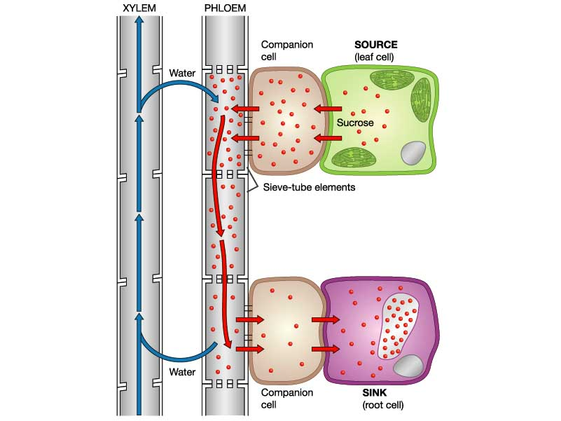
Where does the sucrose travel to?
Why does it move there?
Translocation
How is sucrose transported in the phloem?
Active transport
Osmosis
Pressure
Source
Sink
Xylem
Phloem
Solute concentration

Slide 10
Glucose produced in source cells through photosynthesis.
Converted to sucrose (disaccharide)
Companion cells actively load the sieve tube elements (STE) with sucrose. Sucrose passes from source to companion cell by….....
Increase in solute conc in STE draws water from xylem (osmosis).
Increases hydrostatic pressure.
Movement to lower pressure towards sink.
Sucrose passes into sink tissues.
Growing tissues = passive. Storage = active.
Decrease in solute conc causes water to return to xylem

Slide 12
Phloem Loading
Companion cell
Phloem cell

Slide 13
Phloem structure/function relationship
Pg 415
Phloem sieve tube elements have a living membrane
Need to be able to perform active transport of sucrose
Sieve tube cells are accompanied by companion cells
Sieve tube elements don’t contain many organelles.
Companion cells have many mitochondia
Active transport
Infolding of the membranes of companion cells
Increased SA
Sieve tube cells have rigid cell walls
Withstand pressure changes
Sieve plates contain large holes
Reduce resistance to flow

Slide 14
Data Q - 418

Slide 16
Differences between Xylem and Phloem

