Slide 1
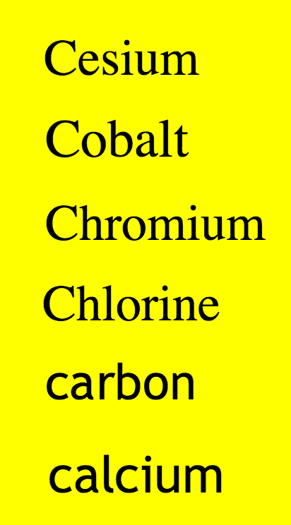

Slide 2
Periodic Table
Identify periods and groups of the periodic table
Identify metals, non metals, alkali metals, halogens and noble gases from the periodic table
Describe the reactivity of group 1 metals and relate to electron configuration

Slide 3
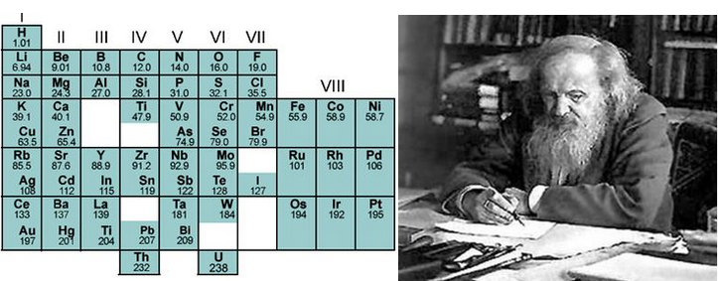
Periodic table research
Periodic Table
Who created the periodic table?
Where was this person from?
When was the periodic table created?

Slide 5
Colour the Alkali Metals red.
Colour the Alkaline Earth Metals blue.
Colour the Transition Metals dark green.
Colour the Halogens orange.
Colour the Noble Gases yellow.
Colour the Inner Transition Metals light green. (Actinide and Lanthanide Series)
Outline the section of Metals in black.
Outline the section of Metalloids in green.
Outline the section of Nonmetals in red.

Slide 7
Groups in the table
Draw the atomic structure of Lithium, carbon and neon.
What do you notice about the group number…..????

Slide 9
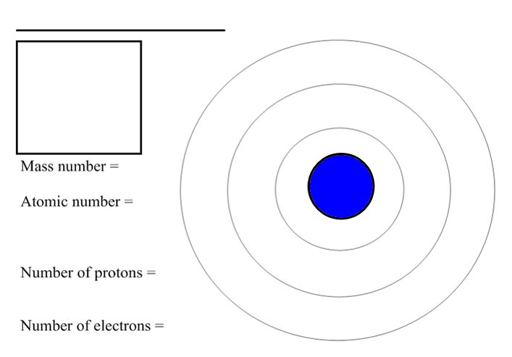
Number of neutrons =

Slide 10
Number of neutrons =

Slide 11
Number of neutrons =

Slide 12
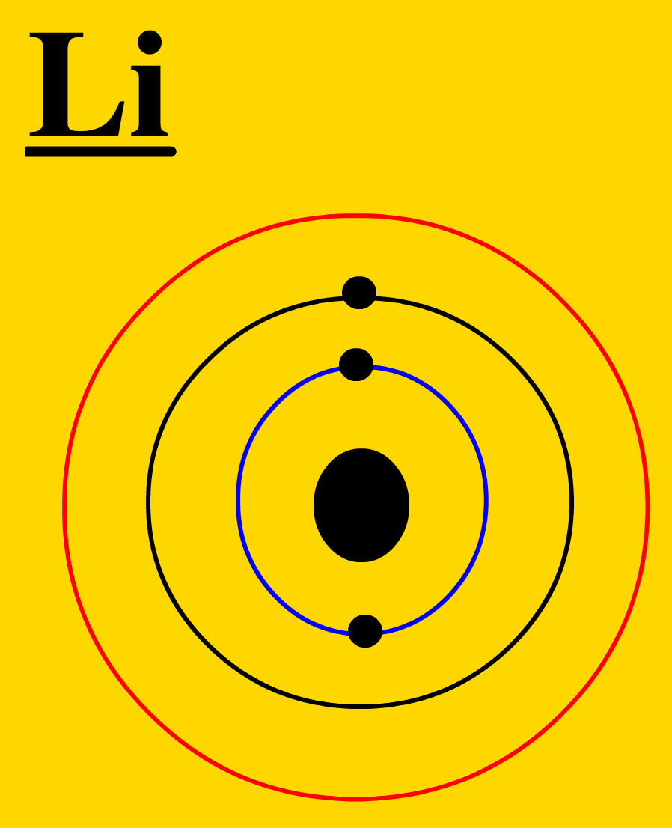
Group 1 metals
Lithium
Observations
Atomic Structure

Slide 13
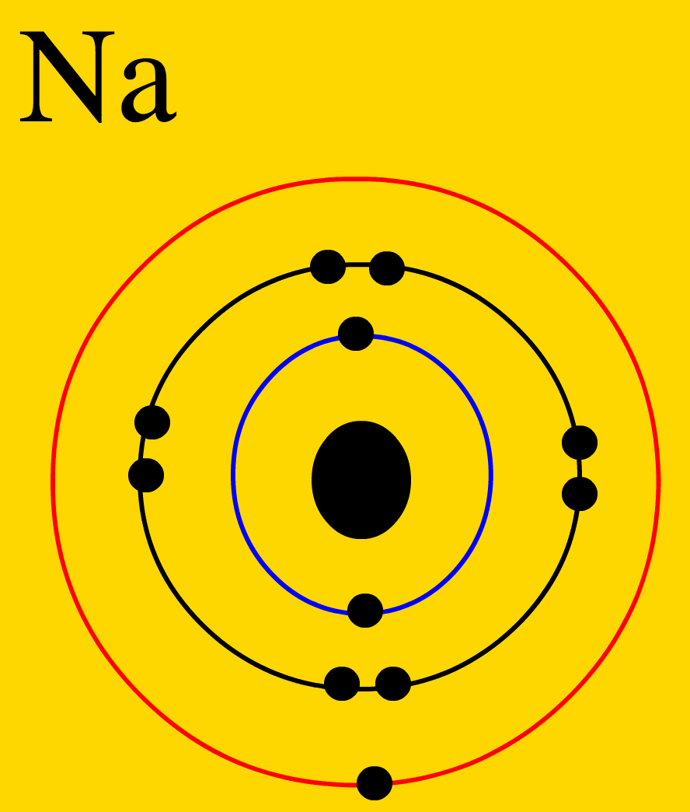
Group 1 metals
Sodium
Observations
Atomic Structure

Slide 14
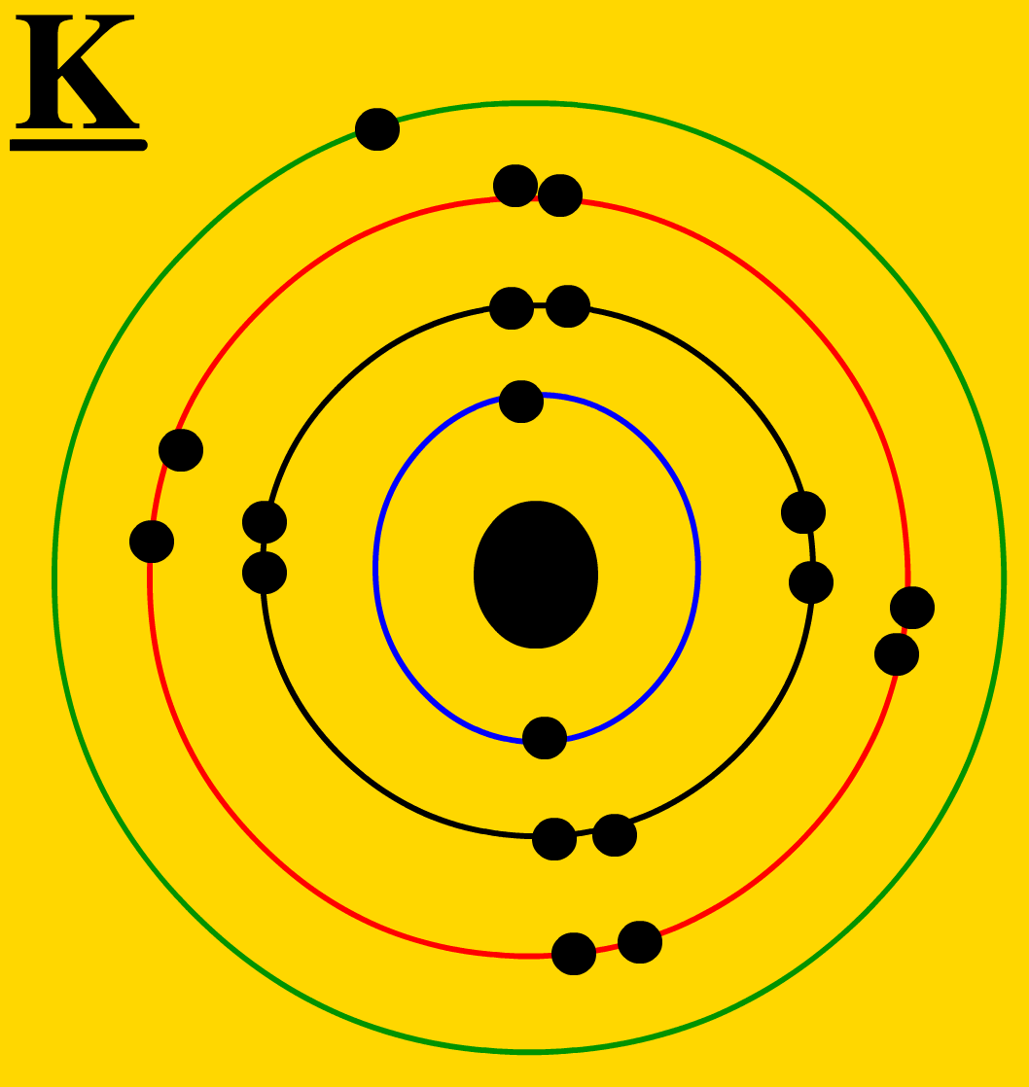
Group 1 metals
Potassium
Observations
Atomic Structure

Slide 15
- Predict what will happen with the next alkali metals
Describe reactivity down group 1
Explain the reactivity down group 1
Alkali Metals

