Slide 1
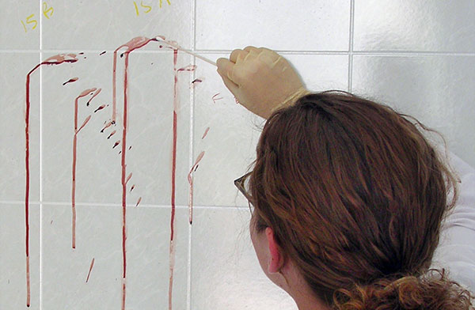
Making more DNA

Slide 2
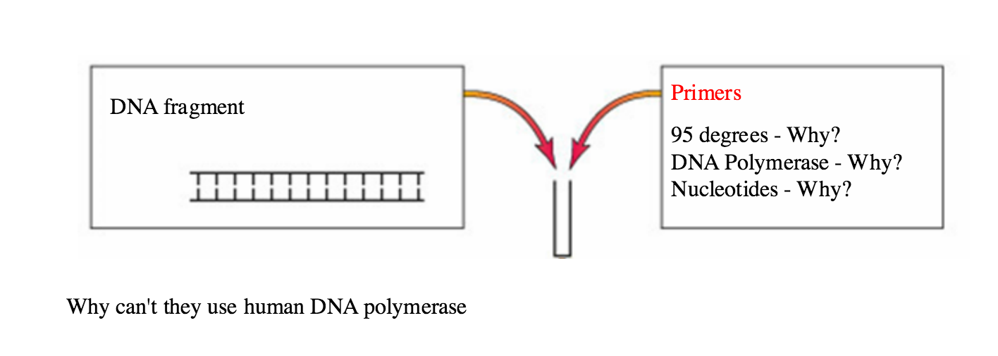
PCR (polymerase chain reaction)

Slide 3
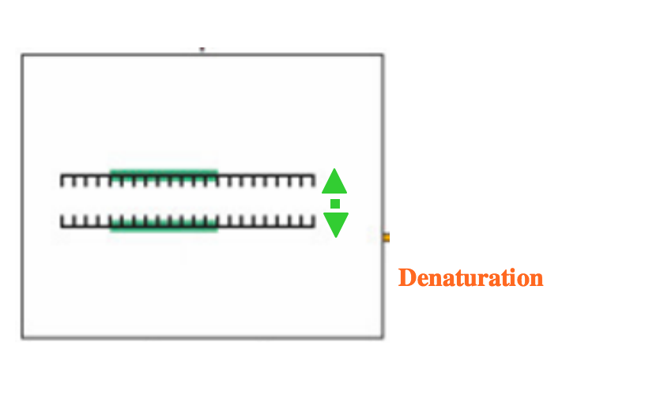
95ºC

Slide 4
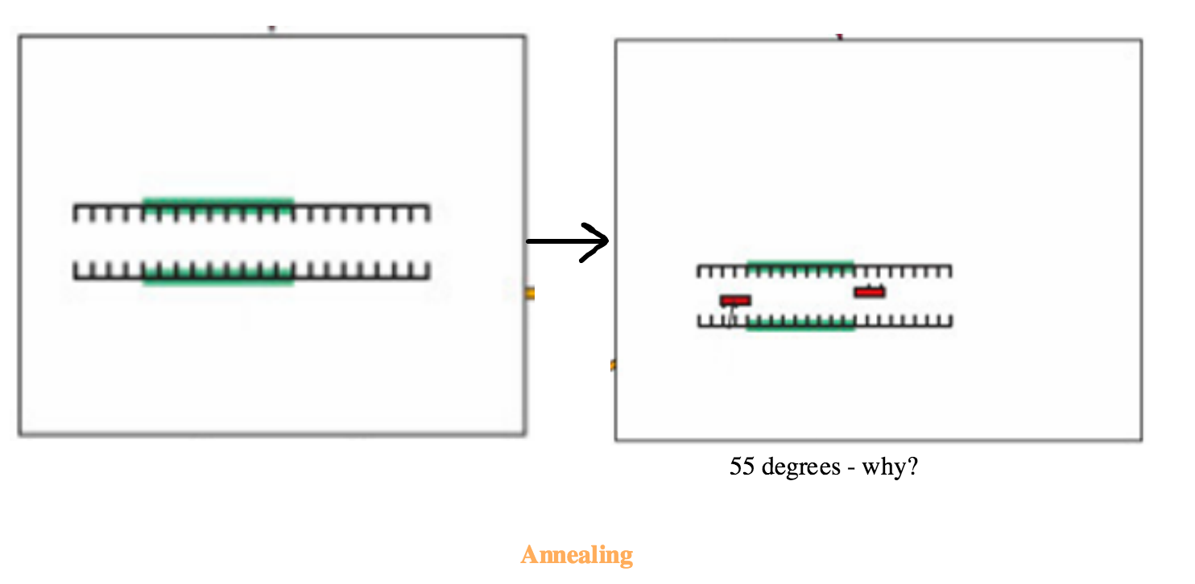

Slide 5
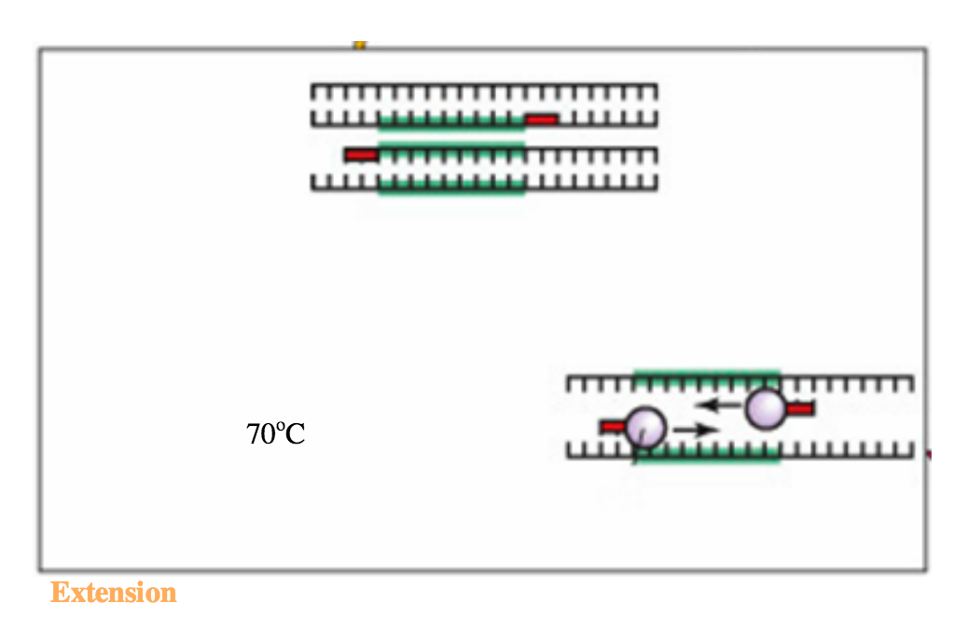
Thermus aquaticus (Taq polymerase)

Slide 6
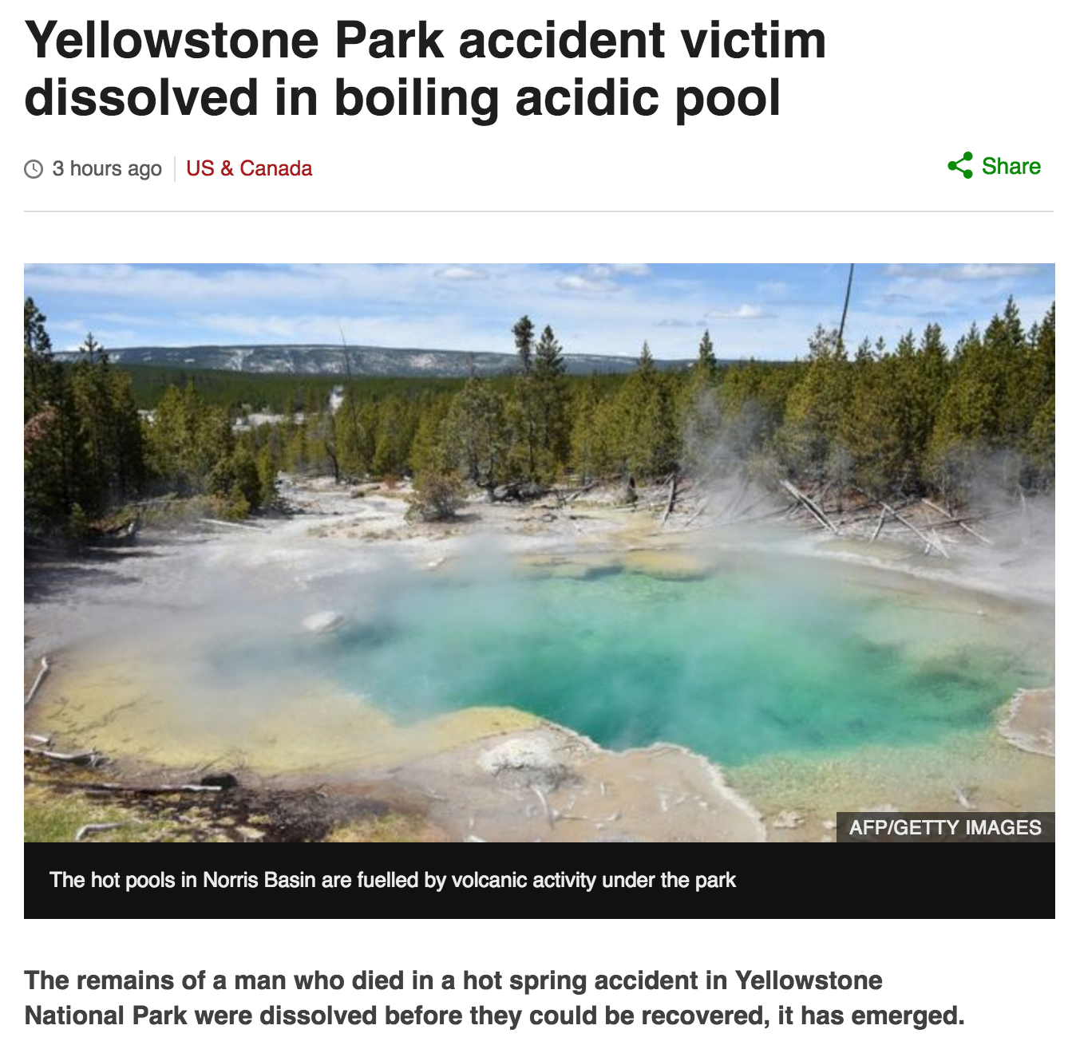

Slide 7
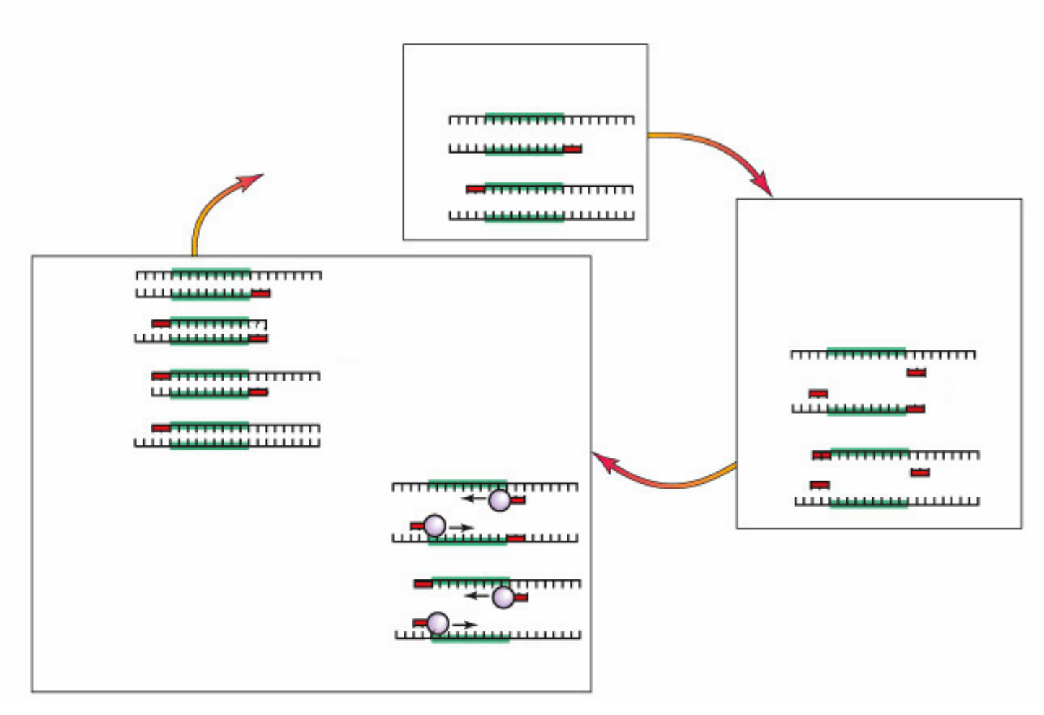
SNAB PCR
PCR

Slide 10
Best song ever!! PCR

