Slide 1
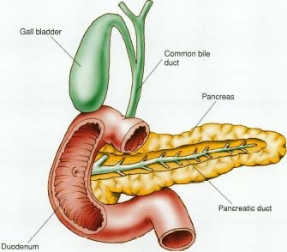
Food enters the small intestine from….
Enzymes enter the small intestine from....

Slide 2
6.1 Digestion and Absorption
Pancreas and enzymes in the small intestine
Applications:
Processes occurring in the small intestine that result in the digestion of starch and the transport of the products of digestion to the liver
Understanding:
The contraction of circular and longitudinal muscle layers of the small intestine mixes the food with enzymes and moves it along the gut
The pancreas secretes enzymes into the lumen of the small intestine
Enzymes digest most macromolecules in food into monomers in the small intestine
Villi increase the surface area of epithelium over which absorption is carried out
Villi absorb monomers formed by digestion as well as mineral ions and vitamins
Different methods of membrane transport are required to absorb different nutrients
Skills:
Production of an annotated diagram of the digestive system
Identification of tissue layers in transverse sections of the small intestine viewed with a microscope or in a micrograph
Nature of science:
Use models as representations f the real world: dialysis tubing can be used to model absorption in the intestine

Slide 3
Enzymes are added to the small intestine from the pancreas.
What enzymes are present in pancreatic juice?
Write 3 equations
Think…
How are the conditions different in the stomach and the small intestine?
What happens to stomach enzymes when they reach the small intestine?

Slide 4
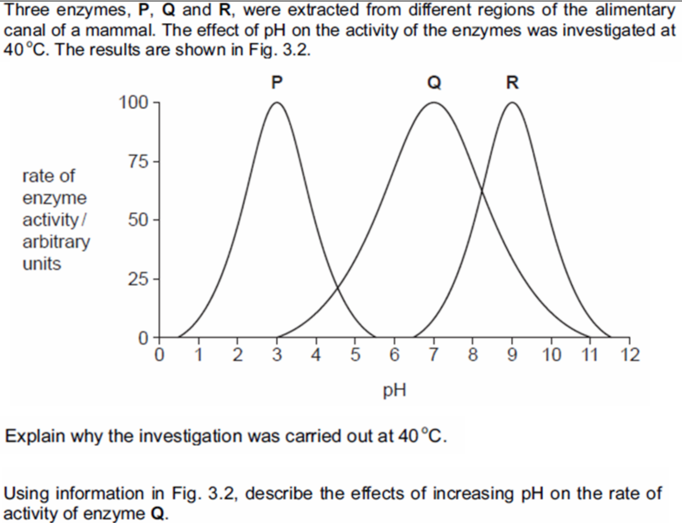
pH and enzyme activity

Slide 5
Qs

