Slide 1
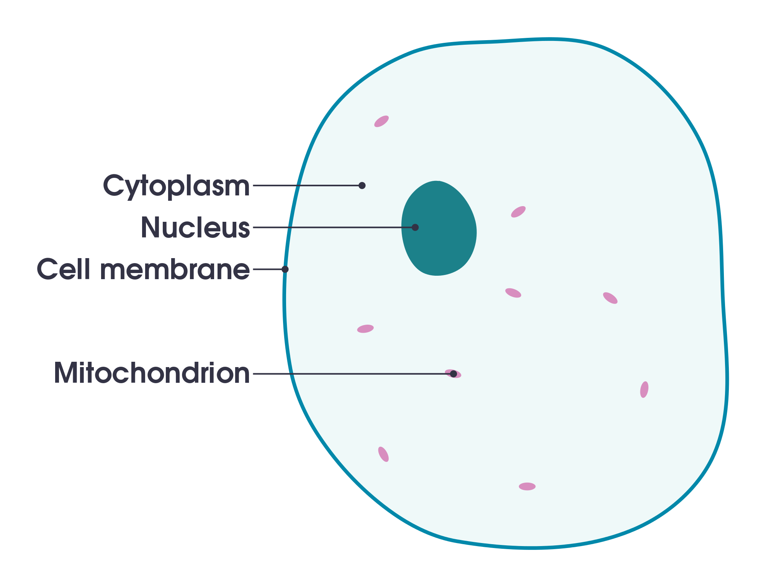

Slide 2
Osmosis
Define osmosis
Predict the movement of water into and out of cells/tissues
Investigate osmosis using potato tissue

Slide 3
What needs to enter the cell? Hint: Think about what needs to enter us

Slide 5
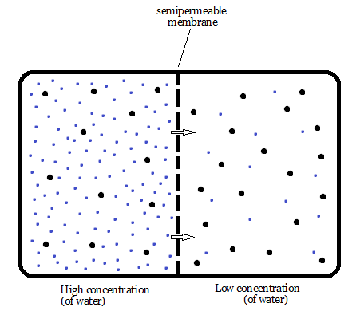

Slide 6
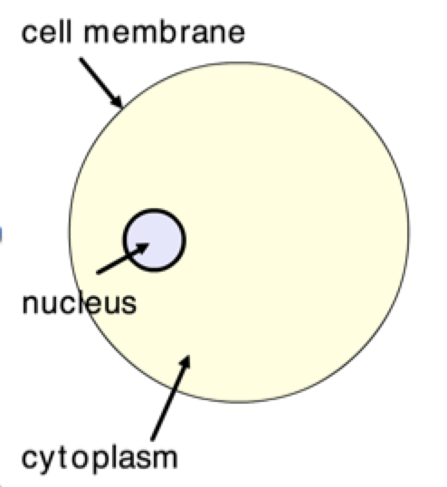

Slide 7
Osmosis
The movement of water from an area of high concentration of water to an area of low concentration of water through a partially permeable membrane

Slide 8
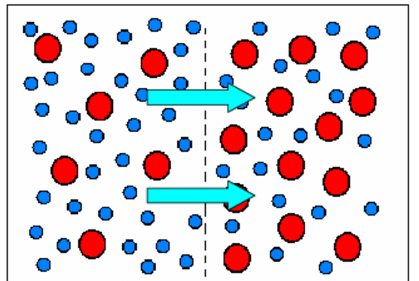
Water
Sugar

Slide 9
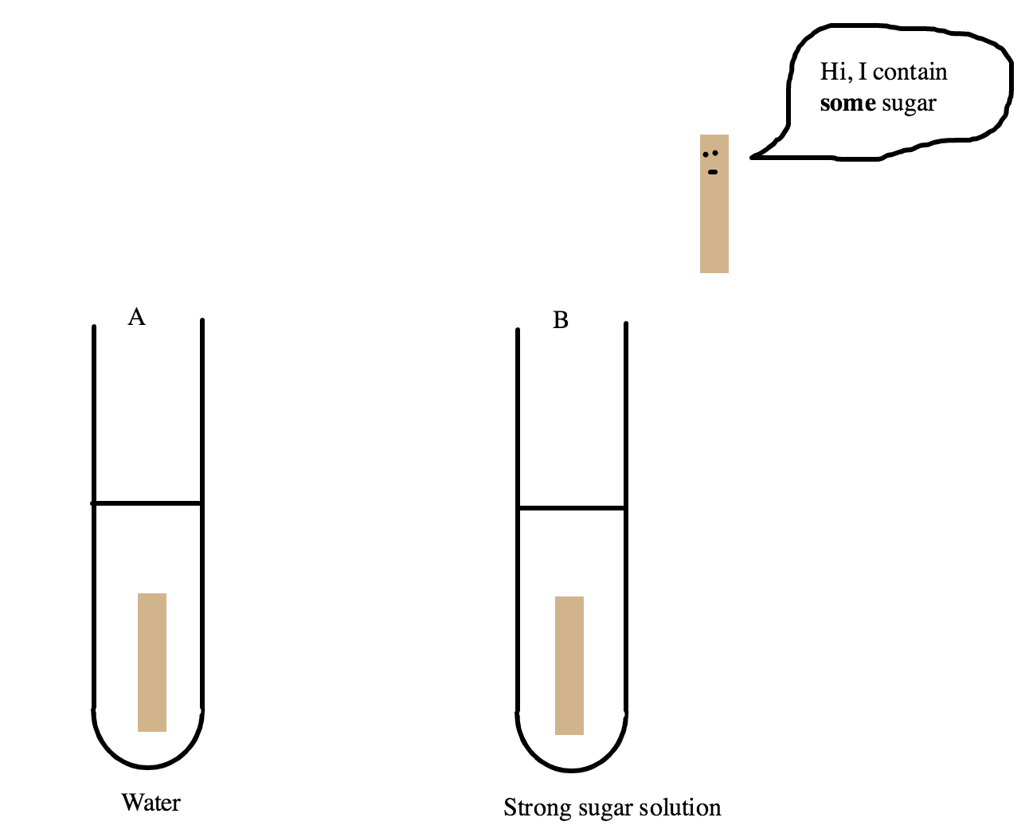

Slide 10
Investigating osmosis in plant cells
Hypothesis
Variables
Method
Results – How will you record your results?

