Slide 1
Origin of Cells
Describe cells as arising from existing cells
Explain Pasteur’s experiments on spontaneous generation
Describe the 4 essential components for the development of life
Explain how endosymbiosis could provide evidence for the origin of eukaryotic cells

Slide 2
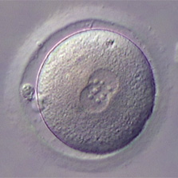
You were once one, now you are trillions. Where do new cells come from?

Slide 3
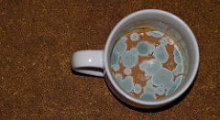
Spontaneous Generation
Spontaneous Generation
How did Pasteur disprove the spontaneous generation theory?

Slide 4
How could we investigate this idea?

Slide 5
Development of Life

Slide 6
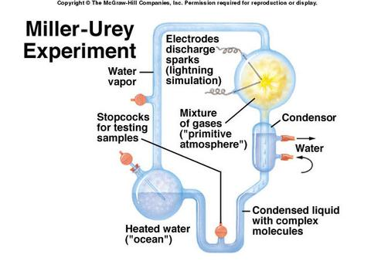
1. Production of carbon compounds (such as carbohydrates and amino acids)

Slide 7
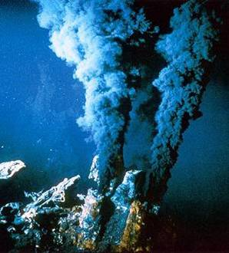
2. Assembly of carbon compounds into polymers using ENERGY
Deep sea vents release a lot of heat and inorganic compounds.
A readily available source of energy to build more complex molecules (organic polymers)

Slide 8
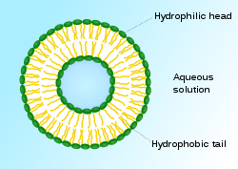
3. Formation of membranes
Amphipathic carbon compounds (phospholipids) form naturally into bilayers

Slide 9
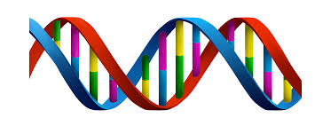
4. Mechanism of inheritance
Living organisms have genes made from DNA and use enzymes at catalysts. Enzymes are needed do replicate DNA.
What’s the problem?
Genes are needed to make enzymes
RNA could have been the first genetic material because it can self replicate and also act as a catalyst.

Slide 10
Endosymbiosis and the formation of eukaryotic cells
What evidence is there for this idea?
First eukaryotic cells

Slide 11
https://vimeo.com/70860703
40 mins

