Slide 1
7.1 DNA structure and replication
Applications:
Rosalind Franklin’s and Maurice Wilkins’ investigation of DNA structure by X-ray diffraction
Tandem repeats are used in DNA profiling
Use of nucleotides containing dideoxyribonucleic acid to stop DNA replication
Understanding:
DNA structure suggested a mechanism for DNA replication
Nucleosomes help to supercoil the DNA
DNA replication is continuous on the leading strand and discontinuous on the lagging strand
DNA replication is carried out by a complex system of enzymes
DNA polymerase can only add nucleotides to the 3’ end of the primer
Some regions of DNA do not code for proteins but have some other important function
Skills:
Analysis of results of the Hershey and Chase experiment providing evidence that DNA is the genetic material
Utilisation of molecular visualisation software to anaylyse the association between proteins and DNA within a nucleosome
Nature of science:
Making careful observations: Rosalind Franklin’s X-ray diffraction provided crucial evidence that DNA is a double helix

Slide 2
Non Coding DNA
State that not all DNA codes for proteins
Describe why non coding sequences are important
Describe repetitive sequences
Describe the use of repetitive sequences in DNA profiling

Slide 4
Coding a non-coding sequences
Only around 2% of our DNA actually codes for proteins (genes/coding sequences). These are unique (occur once in the genome)
Other sequences act as templates for the production of tRNA and rRNA
Most DNA does not code for anything (it seems).

Slide 5
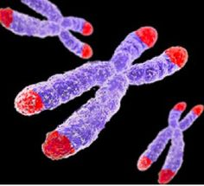
Repetitive Sequences
A lot of DNA is formed of repetitive sequences of bases (e.g. ATCGATCGATCG)
A lot of these are found at the end of chromosomes…
Telomeres
During S phase in interphase the chromosomes can’t copy to the very end. If telomeres were not present then genes would be lost every time DNA replicated.

Slide 6
Repetitive Sequences
These repetitive sequences are often called STRs (short tandem repeats) or VNTRs (variable number tandem repeats)

Slide 7
loci
BUT….

Slide 8
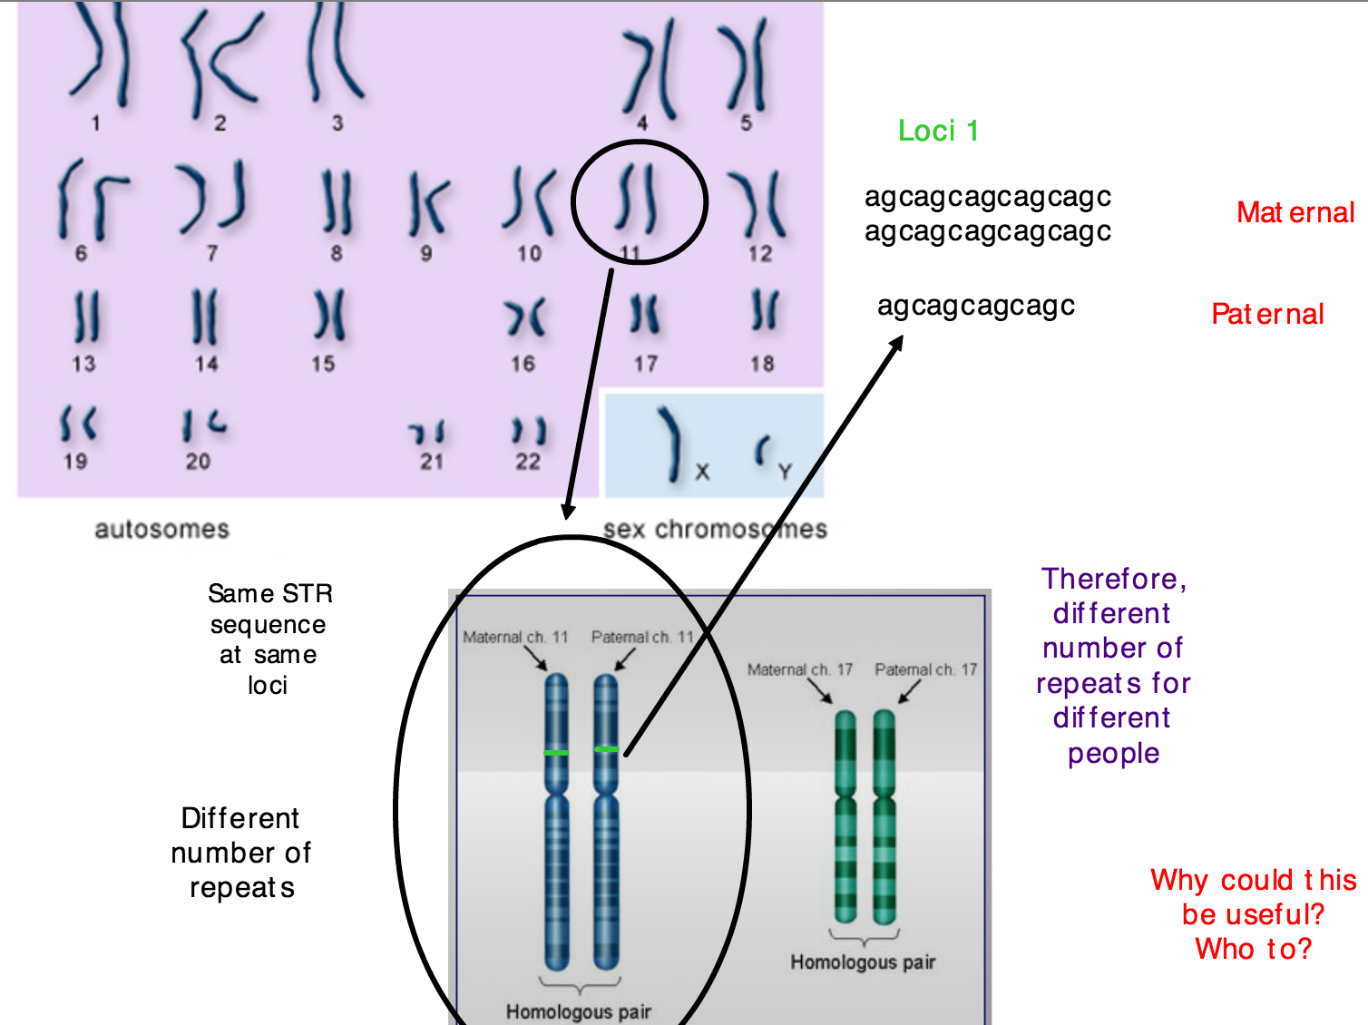

Slide 9
1.
DNA profiling
2.
Gel electrophoresis
Gel electrophoresis is amazing

Slide 10
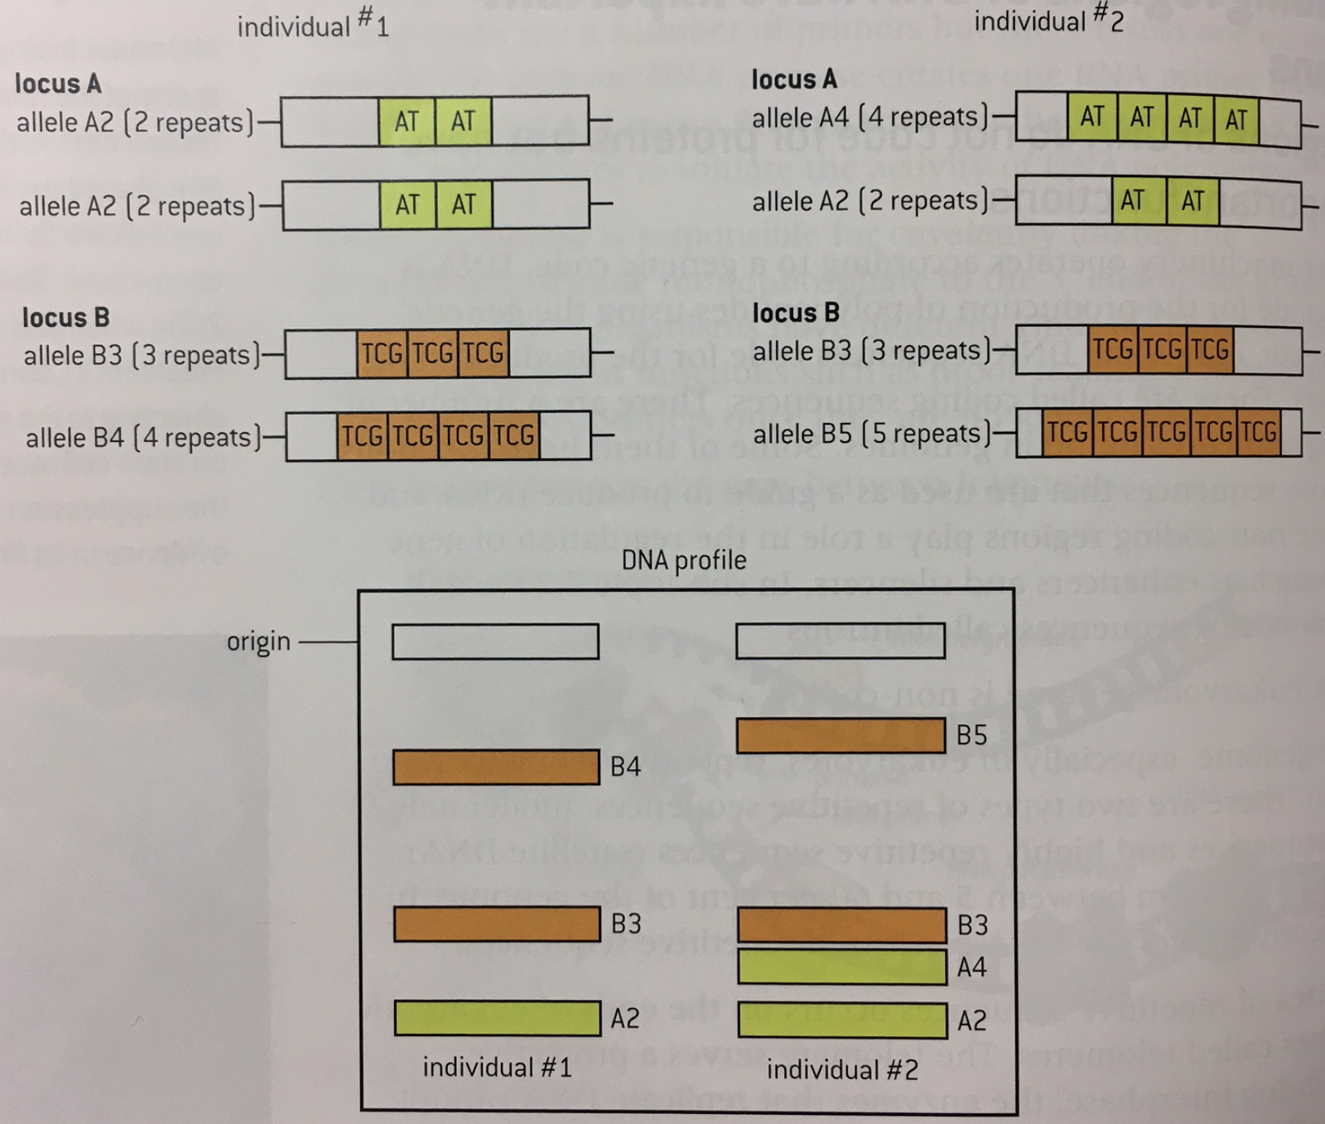
One
chromosome
Another
chromosome

Slide 12
Watch TED talk
HOW DO WE SEQUENCE DNA?
TED

Slide 13
Dideoxynucleotides
DNA sequencing

