Slide 1
Neutralization
Give examples of common acids and alkalis
Write a word equation for a common neutralization reaction
Perform a neutralization reaction
Describe some applications of a neutralization reaction

Slide 2
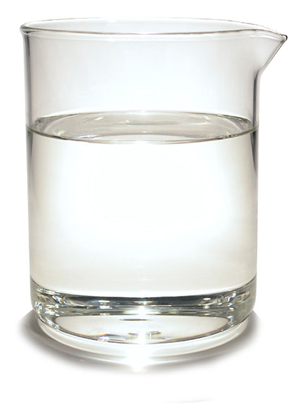
What do these beakers contain?

Slide 4
What if I add an acid to an alkali?
How could I tell if a chemical reaction occurs?
Gas produced (bubbles)
Colour change
Temperature change
New product formed

Slide 5
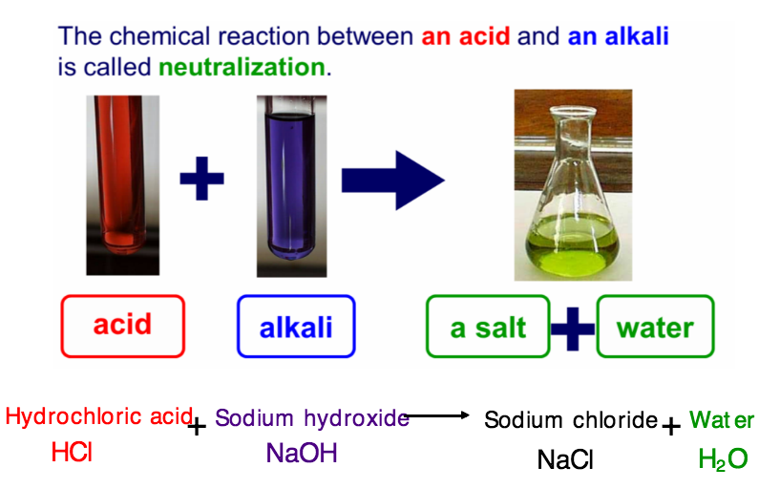
Neutralization reaction
Hydrochloric
acid
+
Sodium
hydroxide
Sodium
chloride
+
water
Acid + Alkali/base Salt + water

Slide 6
What elements?

Slide 10
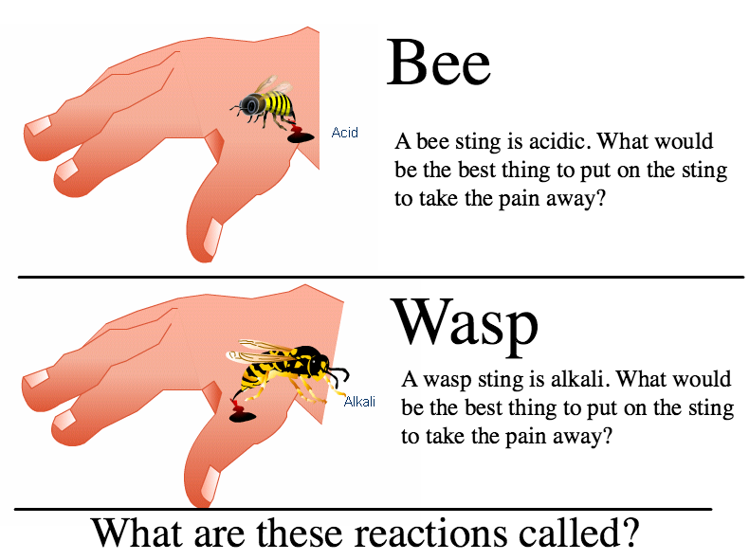

Slide 11
What elements?

Slide 12
Equations
Hydrochloric acid + potassium hydroxide
Sulphuric acid + lithium hydroxide
Nitric acid + sodium hydroxide
Hydrochloric acid + rubidium hydroxide
Sulphuric acid + caesium hydroxide
Nitric acid + lithium hydroxide
Write down the full word equations

Slide 13
Uses of neutralization reactions
Neutralisation

