Slide 2
6.5 – Neurons and Synapses Neurons
Identify the structures in a neuron
State the function of neurons
Describe the structure and function of the myelin sheath
nervous system overview

Slide 3
Stimulus – Response Pathway

Slide 4
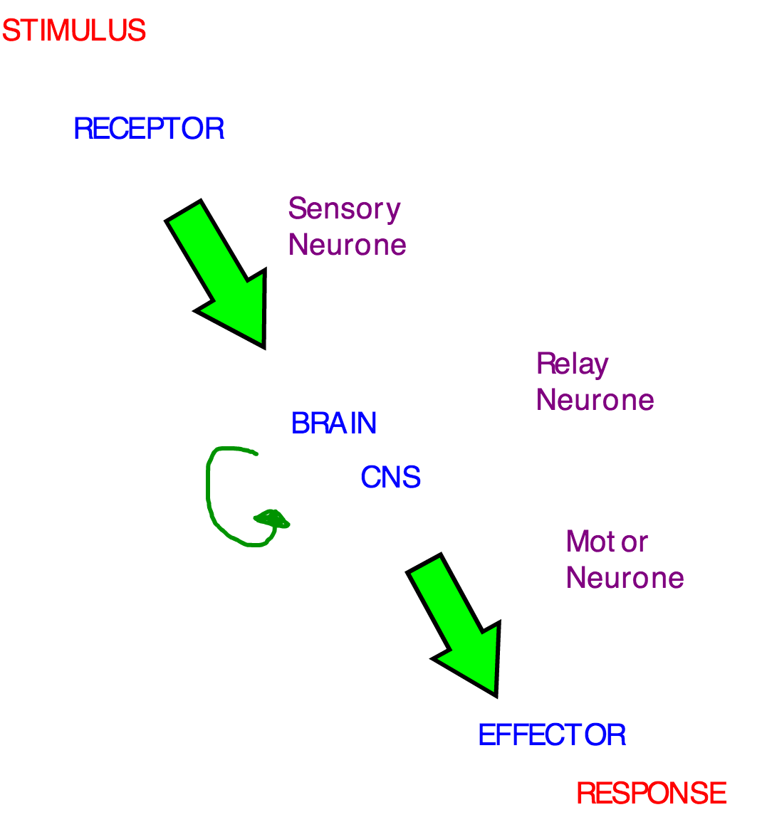

Slide 5
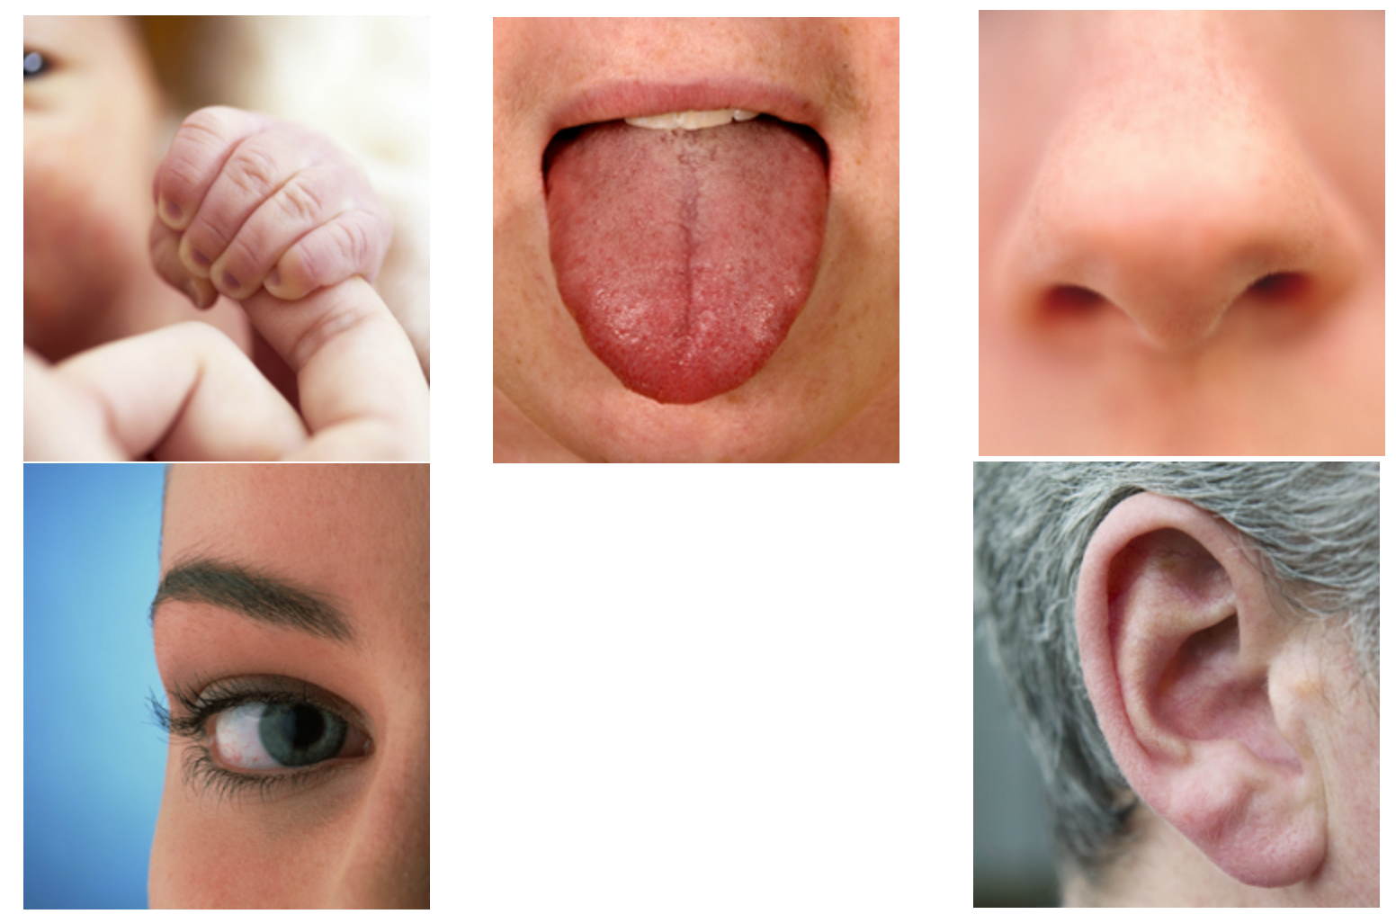

Slide 6
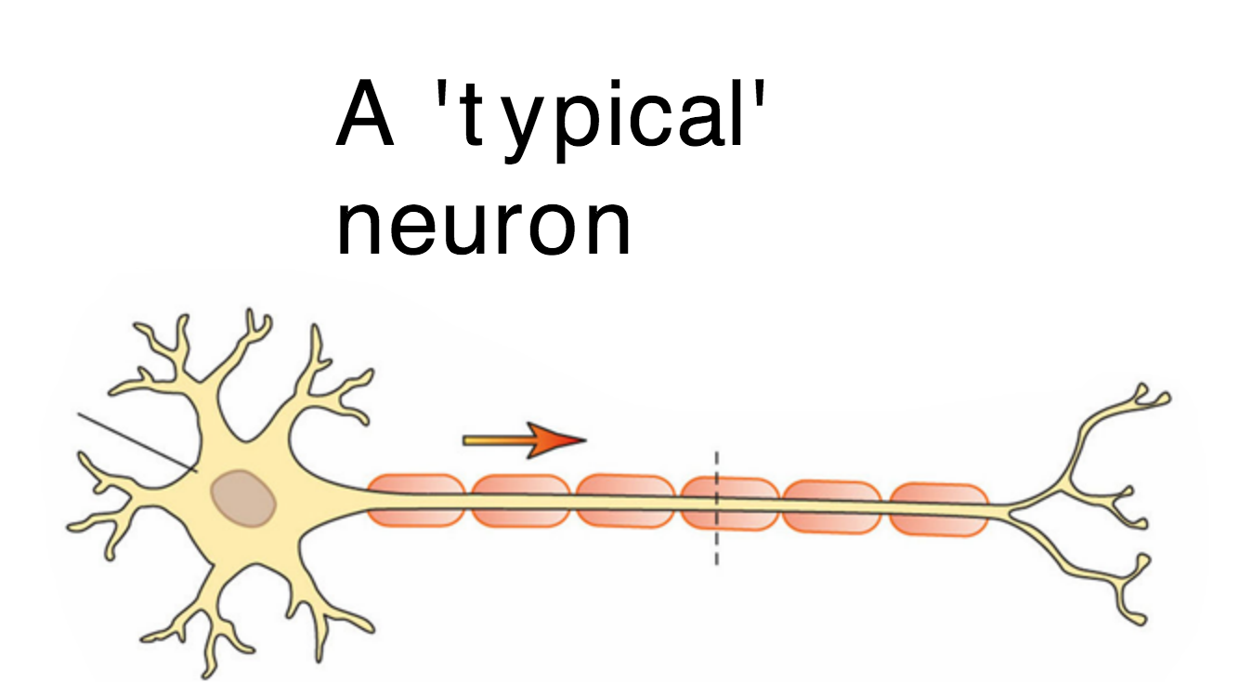

Slide 7
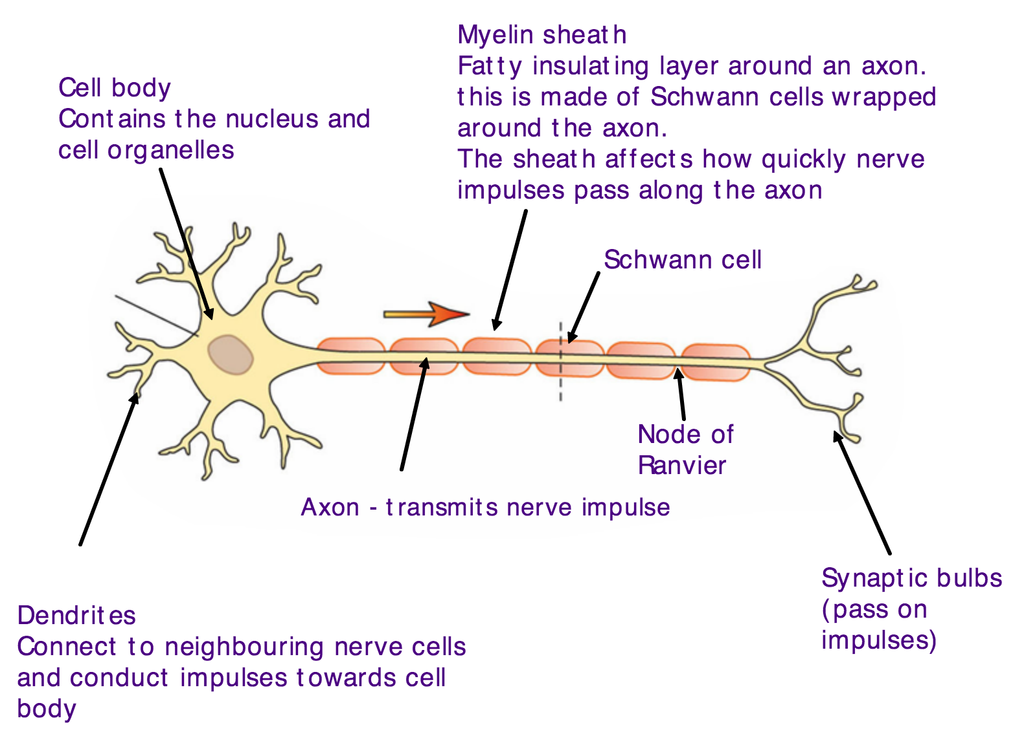

Slide 8
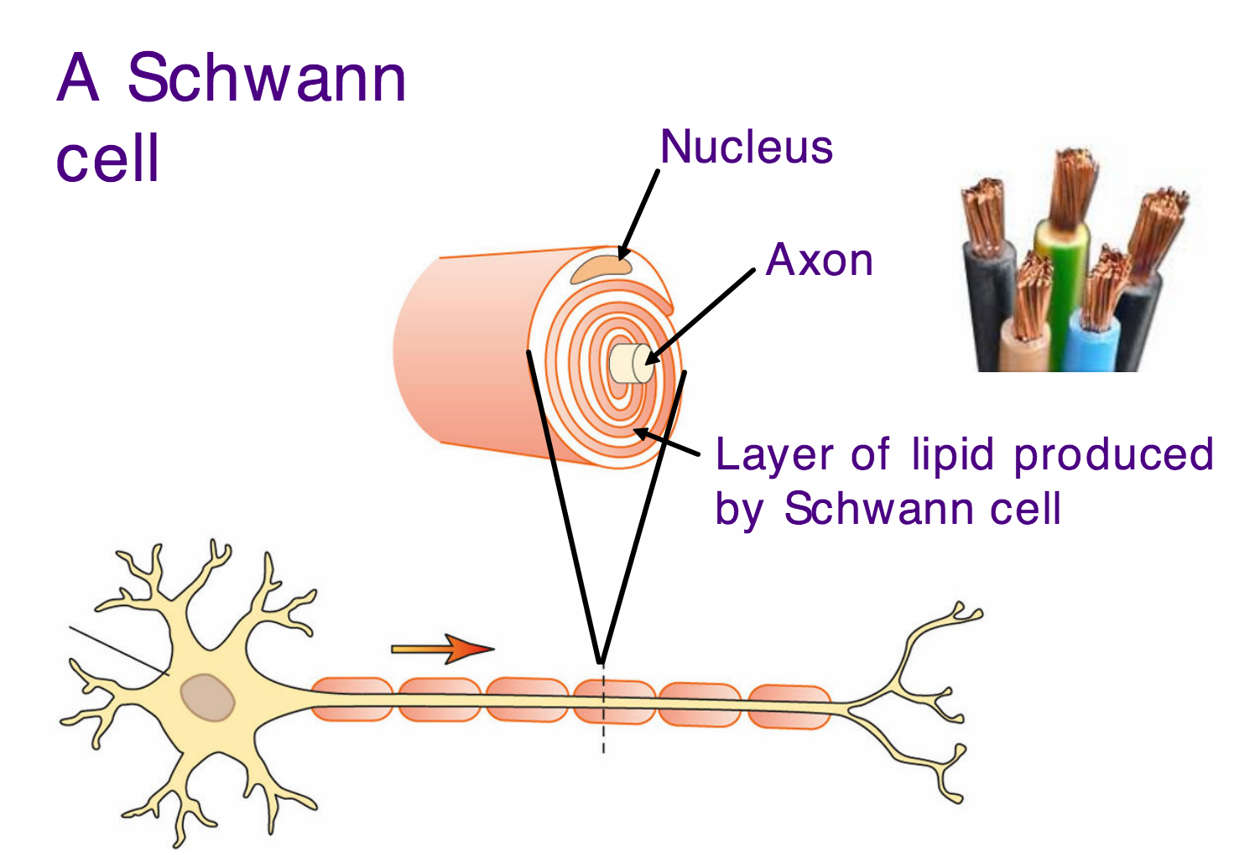
Myelin sheath

Slide 11
