Slide 1
Variation, Natural Selection, Evolution and Speciation
Describe how some organisms are better adapted to their environment
Describe how selection pressures lead to some organisms being selected
Apply natural selection to short term examples of evolution

Slide 2
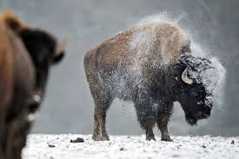
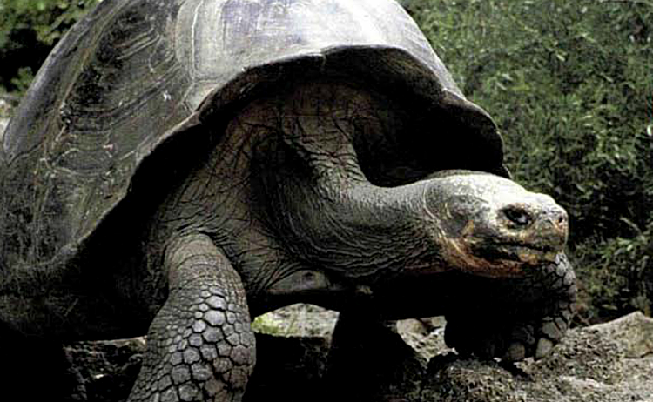
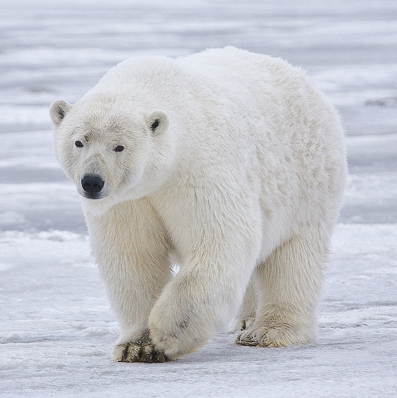
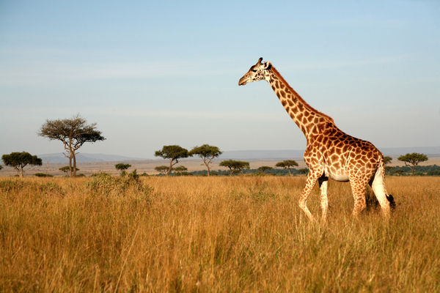
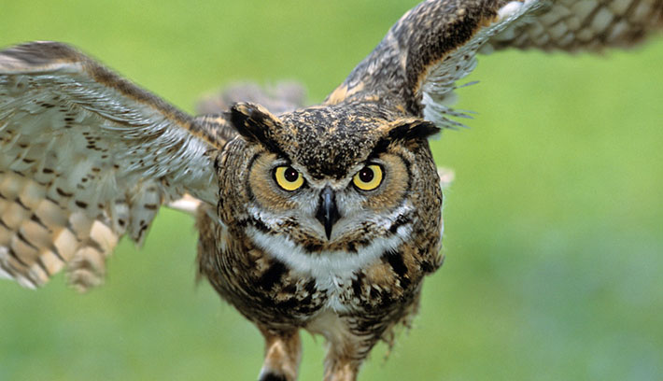
Adaptations
Variation
Giraffe neck

Slide 3
Most species over-produce. Some offspring live and some die.
Which ones survive?
What factors prevent organisms surviving? – Selection pressures

Slide 4
Selection Pressures
Affect survival and reproduction
Competition – food, water, shelter, mates
Predation – being eaten, disease and parasites
Environmental – heat, cold, drought, fire, floods, UV, etc

Slide 5
- The better adapted members of the species are more likely to survive and reproduce
Some are better ADAPTED than others

Slide 6
Pre-industrial
Peppered 70%
Melanic 30%
Post-industrial
Peppered 20%
Melanic 80%

Slide 7
Natural Selection
New variations caused by mutations
A population has variation within the species. Some individuals are better adapted than others
Existing or change in the environment causes a selection pressure
The organisms that are better adapted will survive
The organisms that survive will reproduce
They will pass on their favourable alleles/characteristics to their offspring (inheritance)
These alleles (and characteristics) become more common in the population.
Over many, many generations the species can change. This is evolution by natural selection.

Slide 8
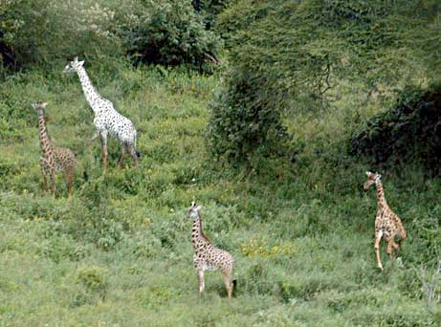
Why are there not many albino giraffes in the wild?
Rats are troublesome pests. A poison called warfarin was developed to kill rats. At first the poison was successful but now populations of warfarin resistant ‘super-rats’ have developed. Suggest how

Slide 9
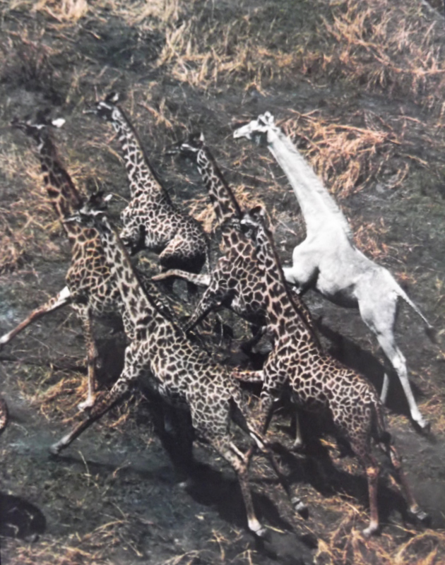
So…
Natural selection increases the number of favourable alleles/characteristics in a population that make individuals better adapted.
Evolution by natural selection

Slide 10
Speciation
Geographical split
Different selection pressures leads to different evolution until the populations can no longer reproduce. They are then different species.

Slide 11
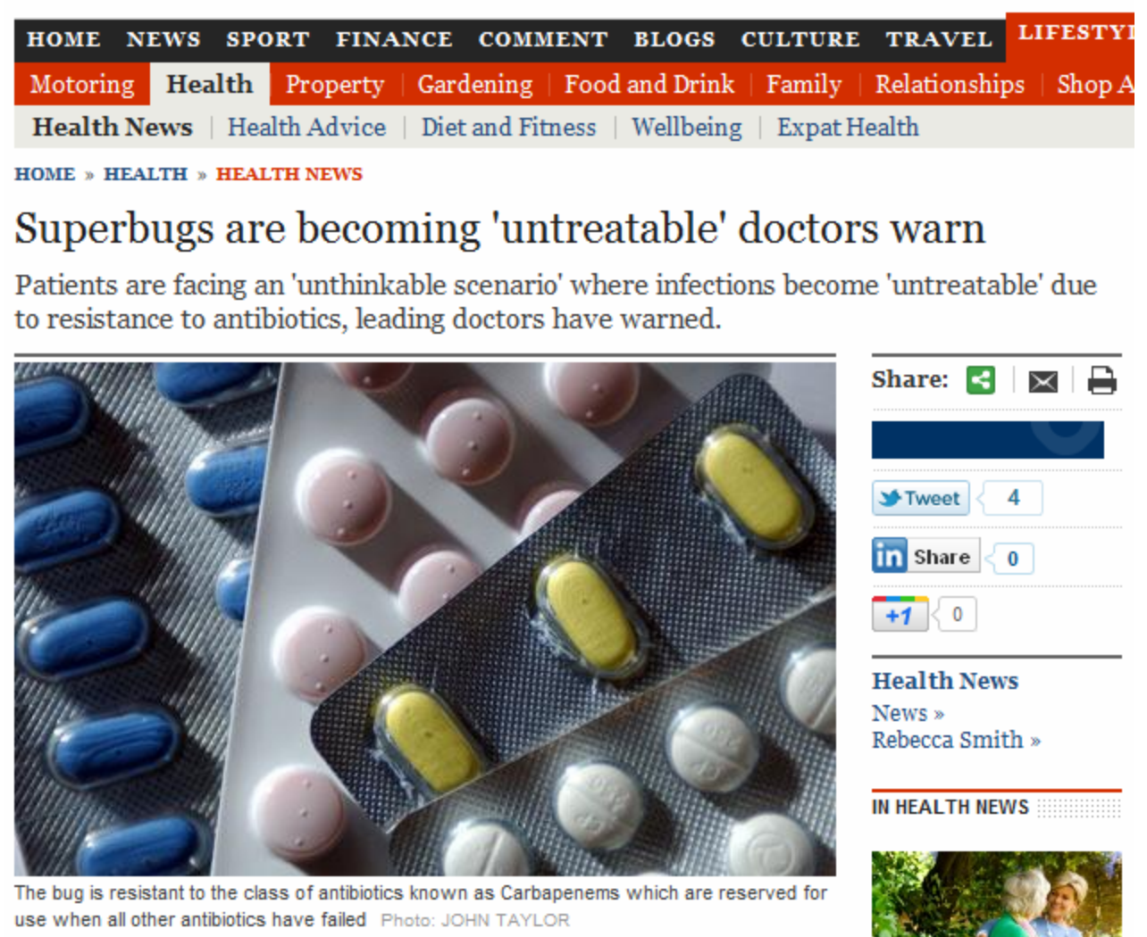

Slide 12
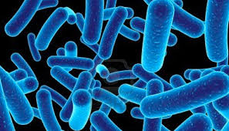
Antibiotic Resistance
Antibiotics are drugs that given to kill bacteria.
Antibiotics provide a selection pressure.
What might happen?

Slide 13
Antibiotic Resistance
SUPERBUGS
Watch the video:
1. How can bacteria evolve to become resistant to antibiotics?
2. What are the dangers of over use of antibiotics?
3. Why does the doctor tell you to finish the whole course of antibiotics?
Antibiotic Resistance

Slide 14
Antibiotics in Farming
Benefits to using antibiotics in farming | Risks of using antibiotics in farming
Antibiotics in Farming

Slide 15
Bacterial Cultures
What could you investigate?
Does handwashing work?
Who’s hands have the most bacteria?
Who’s laptop is most contaminated?

