Slide 1
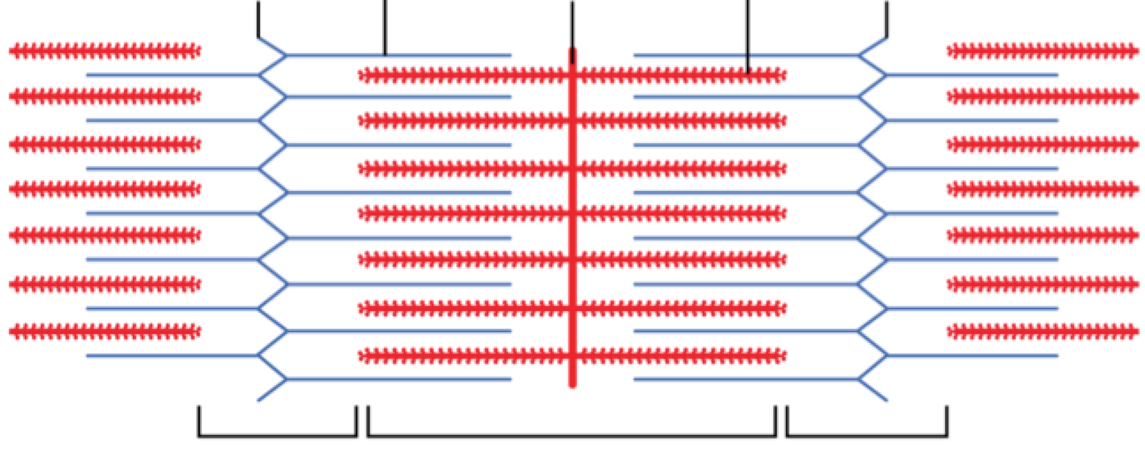
A
B
C
D
E
F
G
H
I

Slide 2
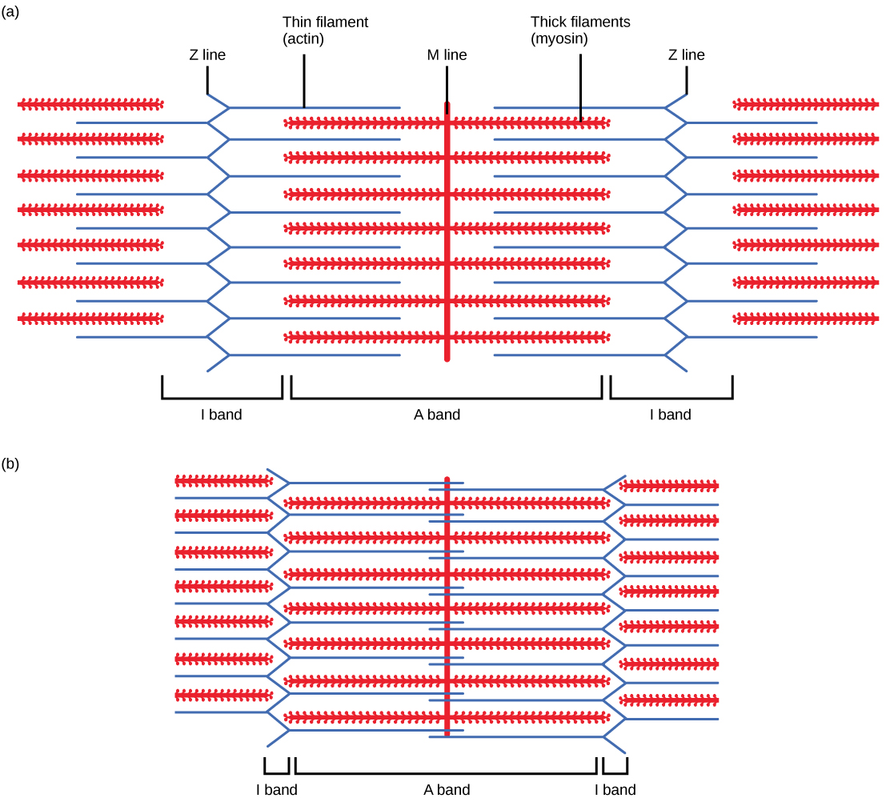
Skeletal muscle contractions
Thick myosin filaments pull the thin actin filaments inwards towards the centre of the sarcomere
Shortens the sarcomere and the overall length of the muscle fibre

Slide 3
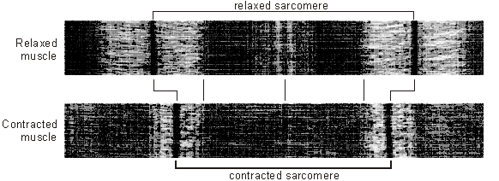
Notes:
Thinner light bands
Light bands closer together
Light part in middle gone (M line)

Slide 4
Muscle Contraction
Describe the roles of troponin, tropomyosin and calcium ions in muscle contraction
Describe the sequence of events that bring about muscle contraction
Muscle contraction

Slide 5
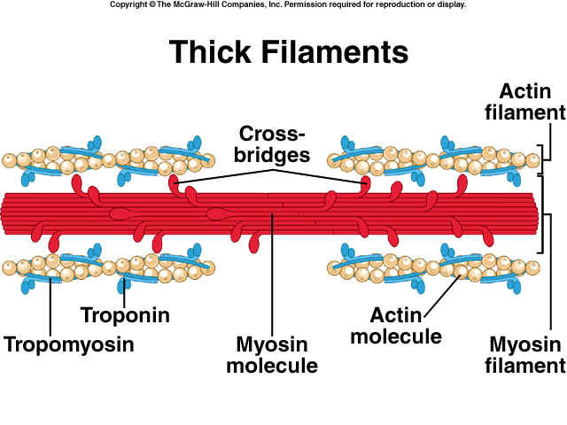
Control of contractions
Contraction of skeletal muscle occurs by the sliding of actin and myosin filaments
Myosin filaments have heads that can bind to special sites on actin filaments, creating cross bridges.

Slide 6
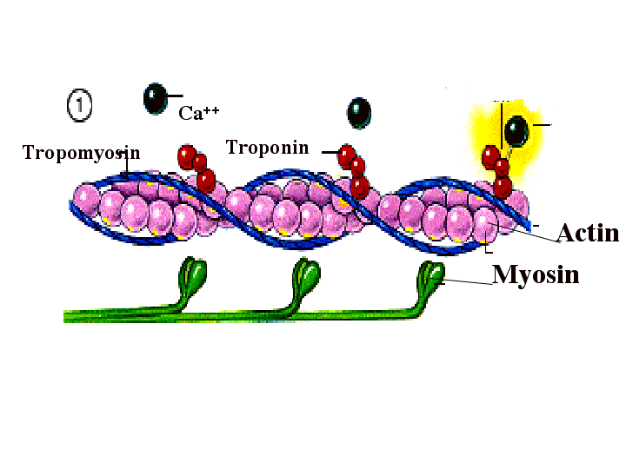
In relaxed muscle tropomyosin blocks the binding sites on actin
When a motor neurone sends a signal for the muscle fibre to contract the sarcoplasmic reticulum releases calcium ions
Calcium ions bind to a protein celled troponin which causes the tropomyosin to move, exposing the binding sites on actin.

Slide 7
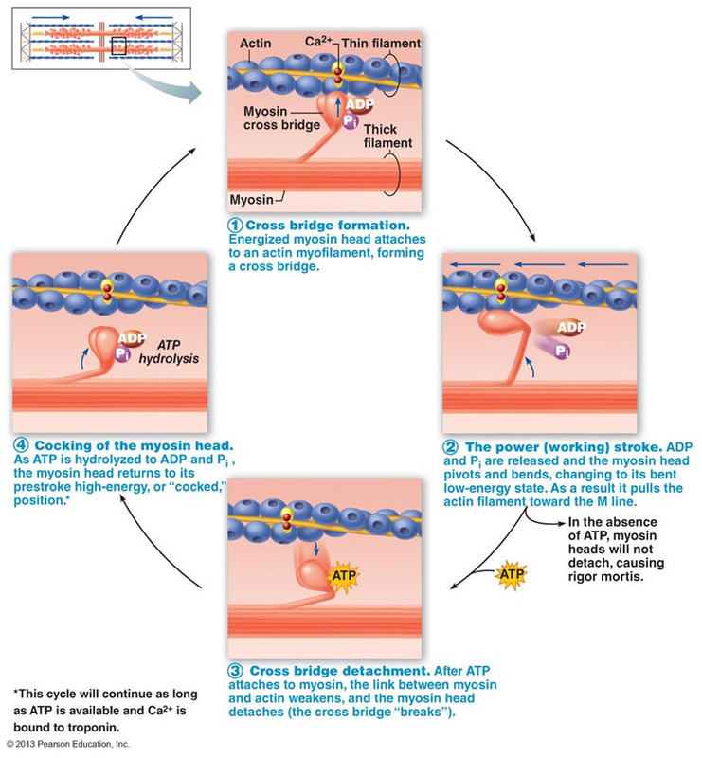
Cocked
Hydrolysed
Power stroke
Slide
Cross bridge
1
4
2
3

Slide 8
Qs
Muscle contraction
Muscle contraction 2

