Slide 1
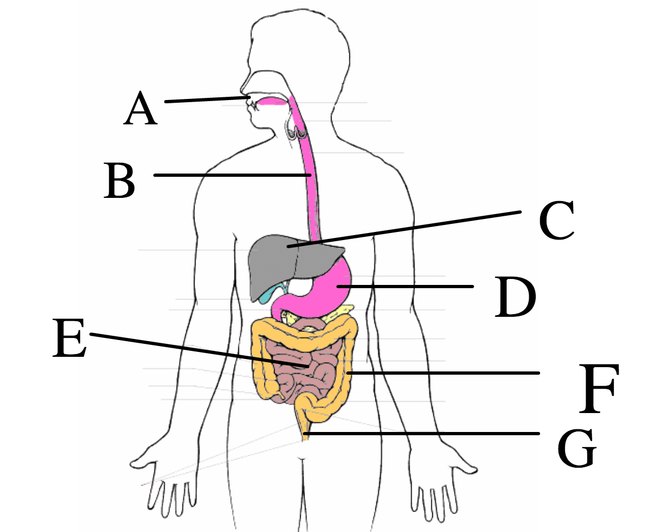

Slide 2
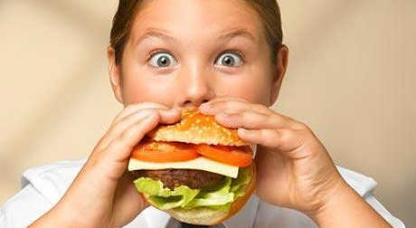
Where does digestion begin?

Slide 3
6.1 Digestion and Absorption
Understanding:
The contraction of circular and longitudinal muscle layers of the small intestine mixes the food with enzymes and moves it along the gut
The pancreas secretes enzymes into the lumen of the small intestine
Enzymes digest most macromolecules in food into monomers in the small intestine
Villi increase the surface area of epithelium over which absorption is carried out
Villi absorb monomers formed by digestion as well as mineral ions and vitamins
Different methods of membrane transport are required to absorb different nutrients
Applications:
Processes occurring in the small intestine that result in the digestion of starch and the transport of the products of digestion to the liver
Skills:
Production of an annotated diagram of the digestive system
Identification of tissue layers in transverse sections of the small intestine viewed with a microscope or in a micrograph
Nature of science:
Use models as representations f the real world: dialysis tubing can be used to model absorption in the intestine

Slide 4
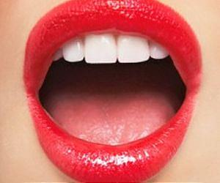
What digestion happens in the mouth?
Chewing (mechanical digestion)
Salivary glands produce saliva
Saliva contains amylase which breaks down starch into maltose

Slide 5
Where next?
Oesophagus

Slide 6
Questions
Why does rice start to taste sweet if you chew it for a long time?
Why is it possible to eat in space
How long is the human alimentary canal?
What does amylase do?
What key word do we use to describe taking food into the mouth?

Slide 7
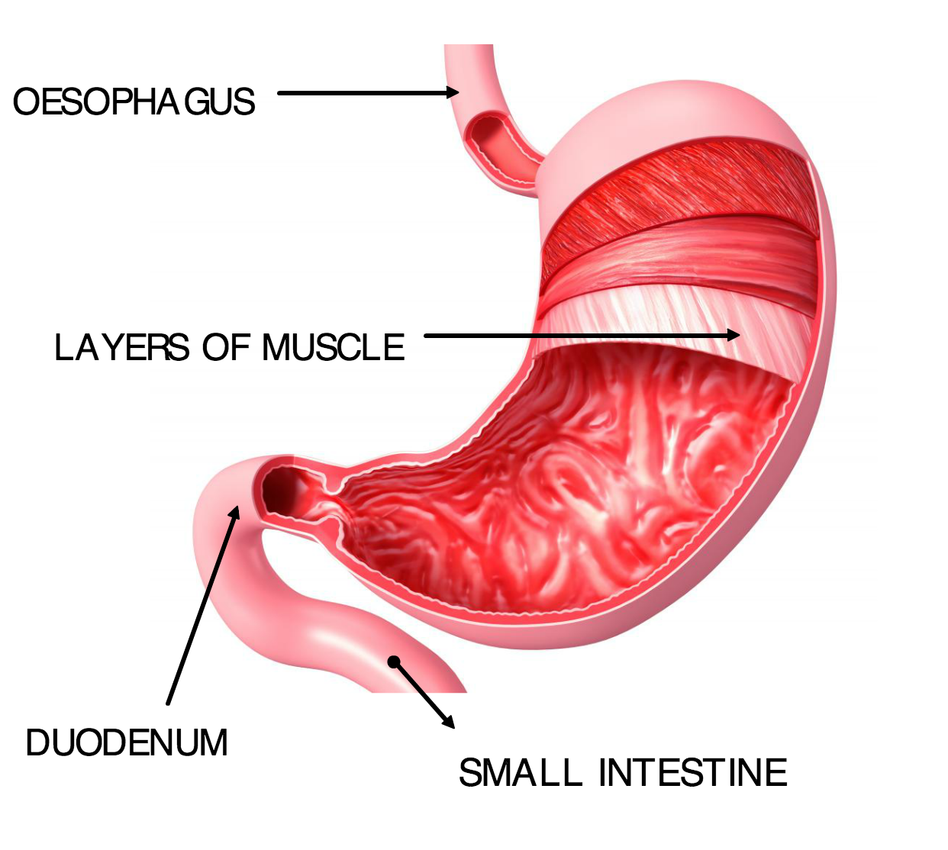

Slide 8
In the stomach
HCl released. Kills bacteria and lowers pH
Protease enzymes released.
Proteins Amino Acids
Why wouldn’t amylase work in the stomach?
Why does your throat hurt when you vomit?

Slide 9
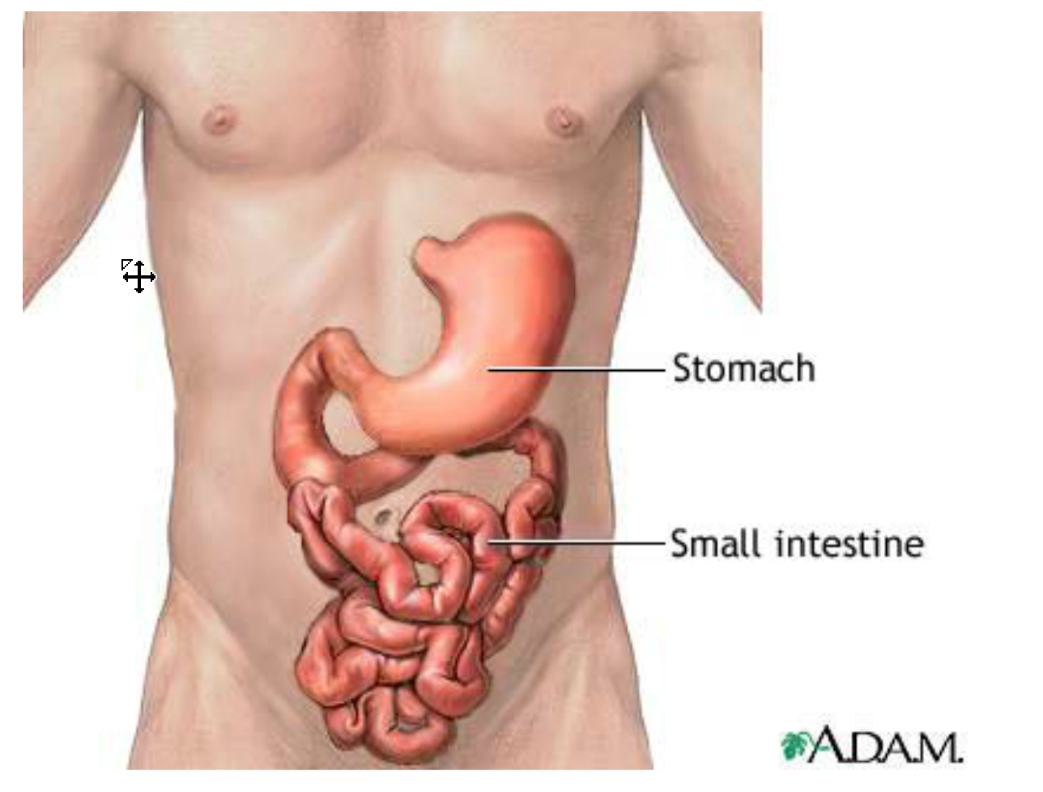
whale intestines
24 mins

Slide 10
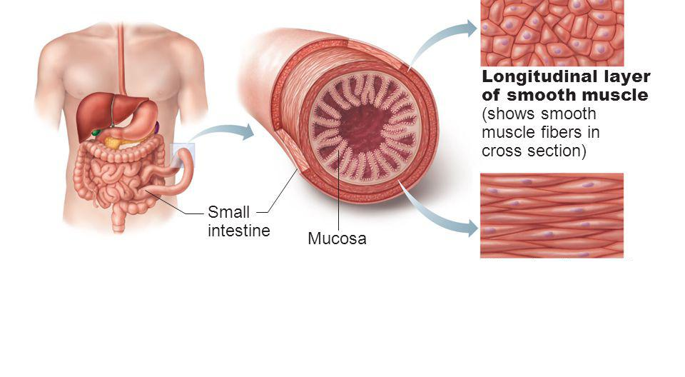
Moving through the digestive system (including the small intestine)
Peristalsis – Contraction of circular and longitudinal muscles to move food through the digestive system
Circular layer of smooth muscle

