Slide 2
Inflammatory Responses
Describe the stages of an inflammatory response
Describe the role of histamine in an inflammatory response

Slide 4
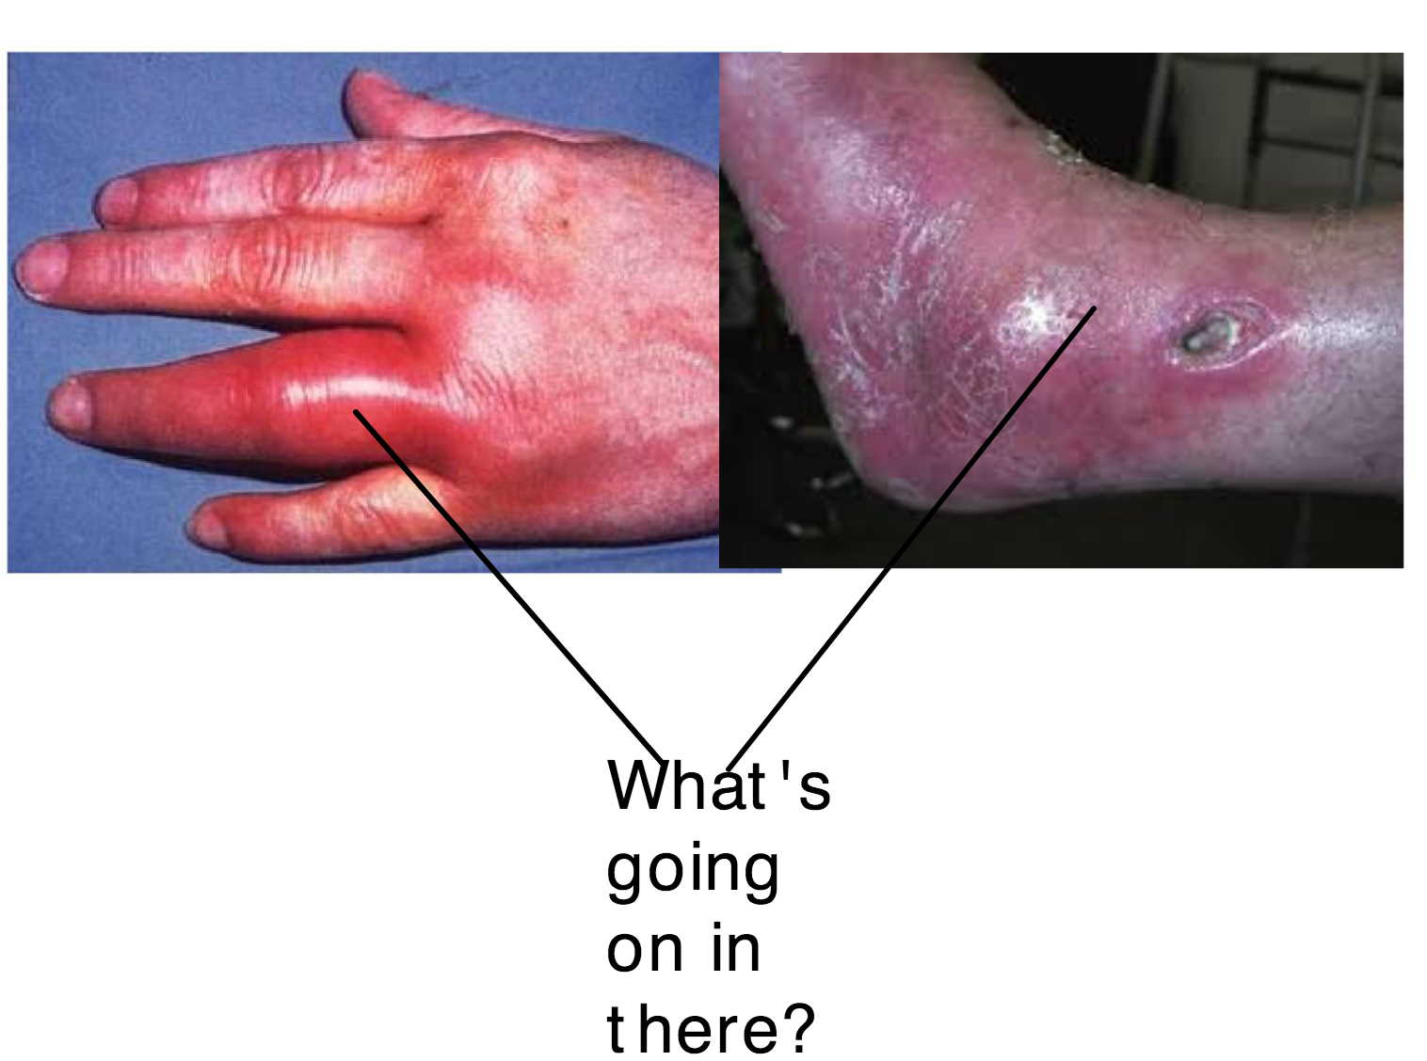

Slide 5
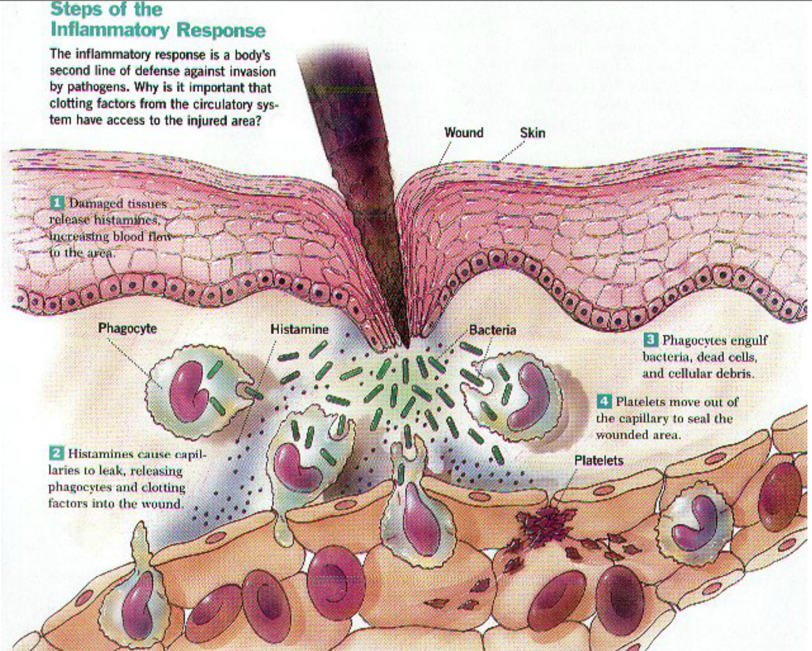

Slide 6
Histamine causes allergic symptoms

Slide 7
Hybridoma Cells and Monoclonal Antibodies
Define antibodies has being specific
Describe how monoclonal antibodies are produced
Discuss uses of monoclonal antibodies

Slide 8
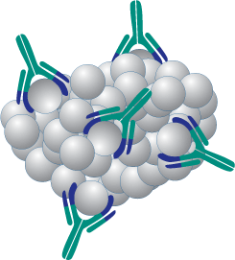
Antibodies are ‘specific’. What does this mean?
Large numbers of antibodies can be manufactured.
They are produced by a clone of cells and are highly specific. Why kind of cell?

Slide 9
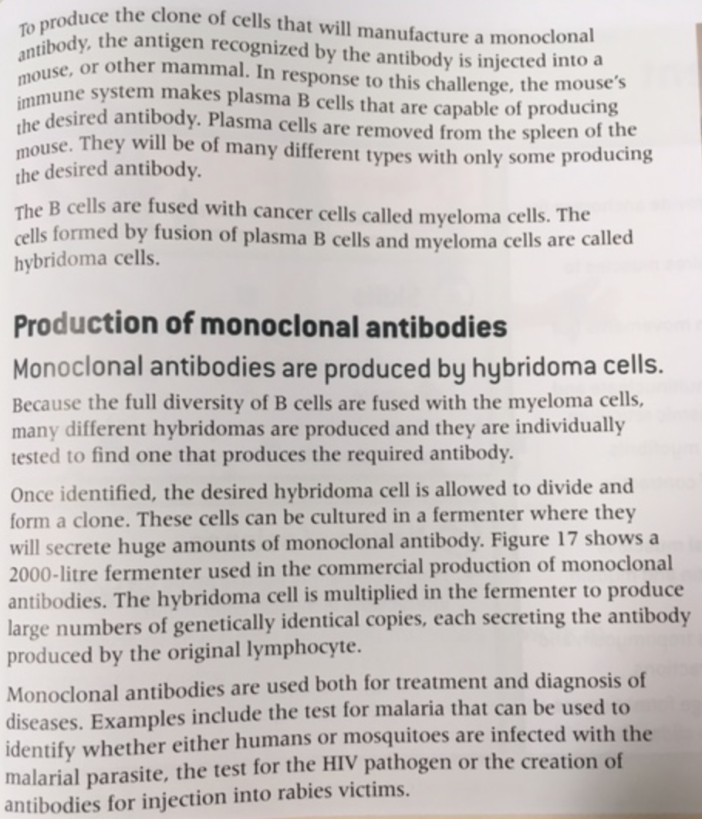
Show in a series
of diagrams

Slide 10
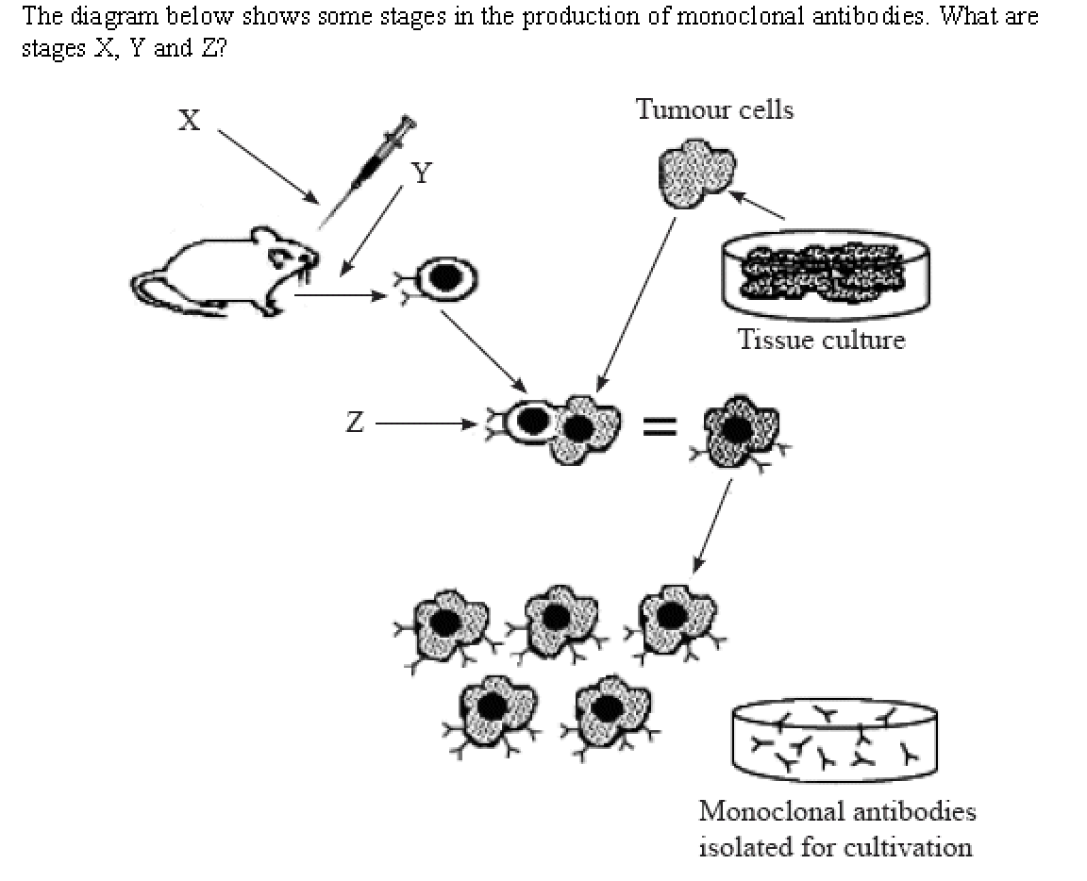
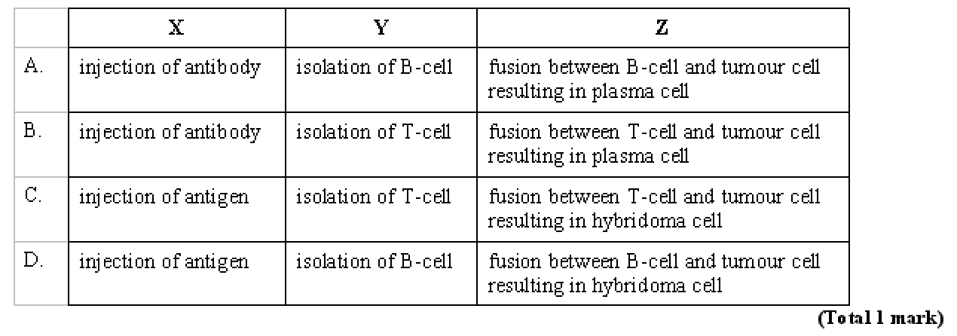

Slide 13
Pregnancy testing kit
Complete ‘Activity’ on page 475

