Slide 1
Mixtures
Identify elements, compounds and mixtures from particle diagrams
Define mixture
State how to separate insoluble solids from liquids

Slide 4
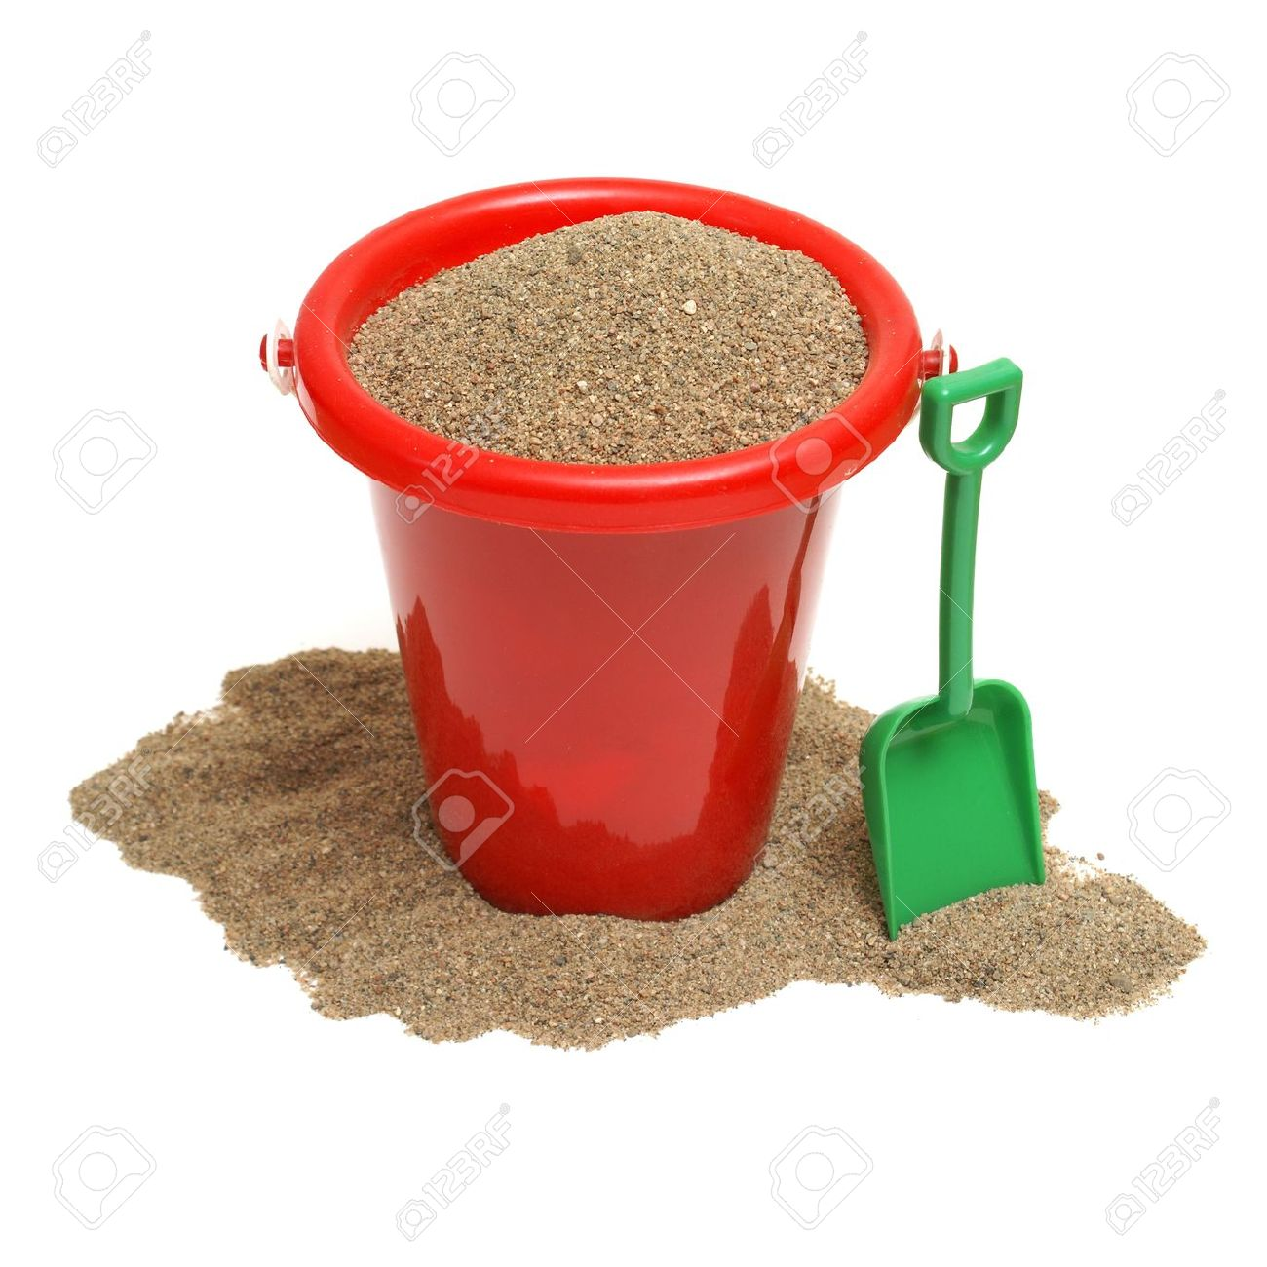
Mixture
Two or more substances mixed together that are not chemically bonded
A metal has been found on the beach. People are cutting their feet.
It is going to be very difficult to separate the mixture of sand and metal.
How could we do it?

Slide 5
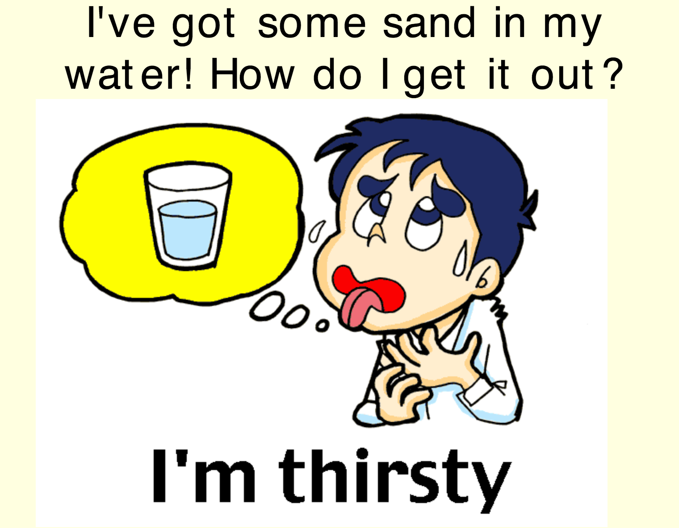

Slide 6
Solutions keywords
Soluble – A solid that dissolves
Insoluble – A solid that does not dissolve
Solution – A solute dissolved in a solvent
Solvent – Liquid where a solute dissolves
Solute – Substance that dissolves

Slide 7
Filtration
What does it separate?
A liquid from an insoluble solid

Slide 8
But what if the solid dissolves?
In a beaker, dissolve 2 spatulas of salt in 50 ml water.
Filter the solution
Does it separate the salt and water?
Why?

Slide 9
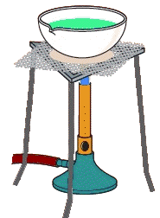
How could we separate salt and water?
Equipment?
Evaporating dish
Wire gauze
Tripod
Bunsen burner
Heat mat

Slide 10
Salt
Sand
Iron
You have today’s lesson to separate this mixture

Slide 11
Magnetism is used to…
Filtration is used to...
Evaporation is used to...

