Slide 1
WARNING During this lesson there will be random pit stops where you will have to make quick decisions. For example…

Slide 2
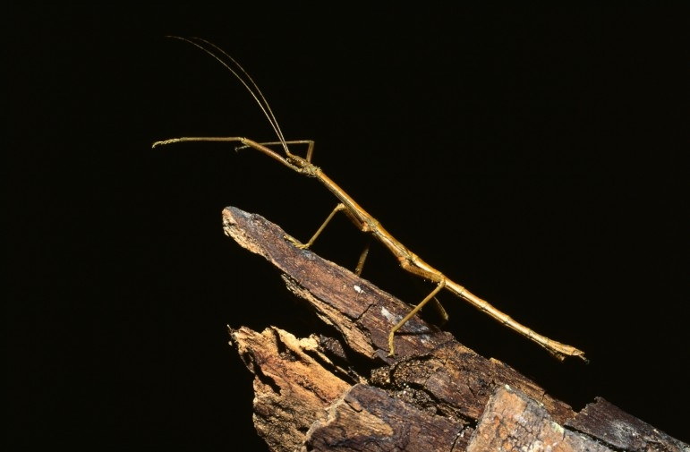
This is a stick insect

Slide 3
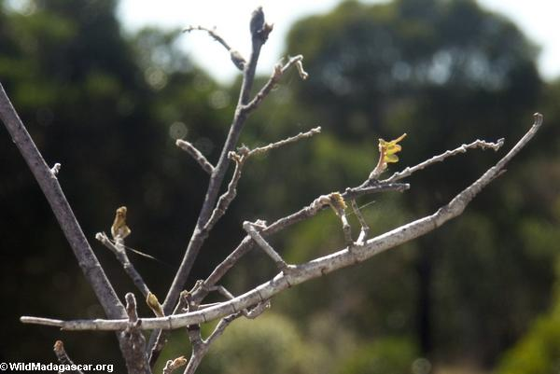
You now have to find him!

Slide 4
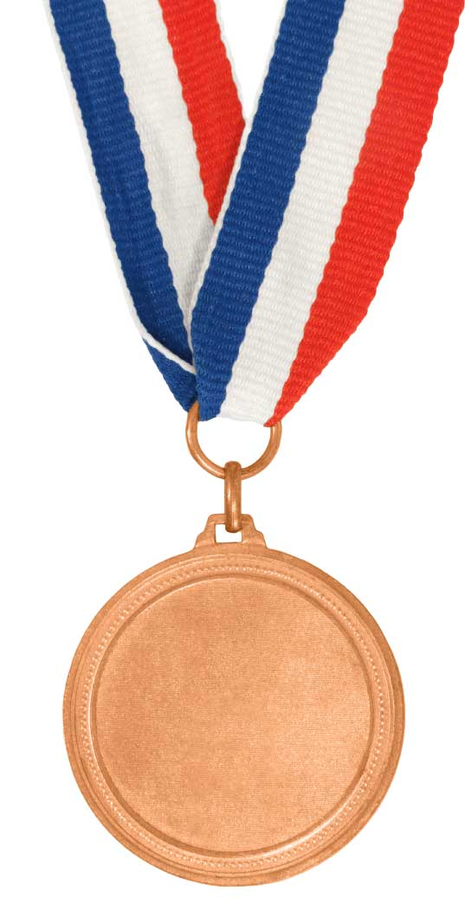
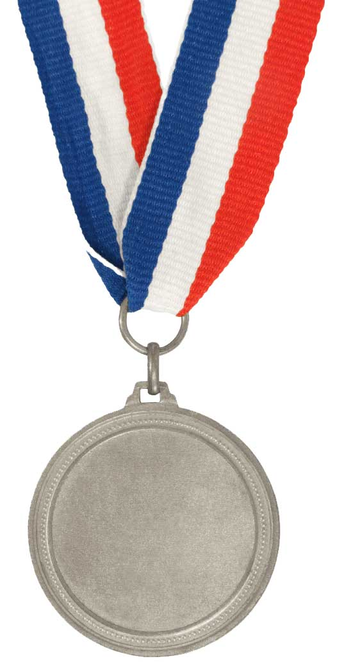
Understand what mimicry is
Define the word mimic
Bronze
State some animals that use mimicry
Silver
Explain why organisms use mimicry
Gold

Slide 5
Mimic…
Copying

Slide 6
Mimicry
Can be copying the surroundings
Can be copying other animals
Why would they do that?

Slide 7
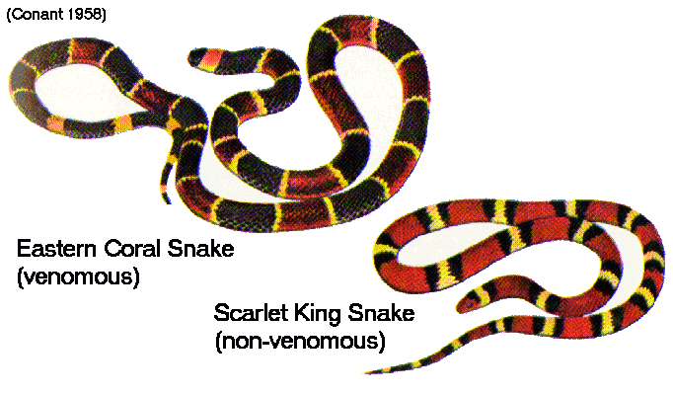

Slide 8
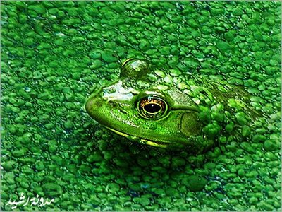
Copying surroundings

Slide 9
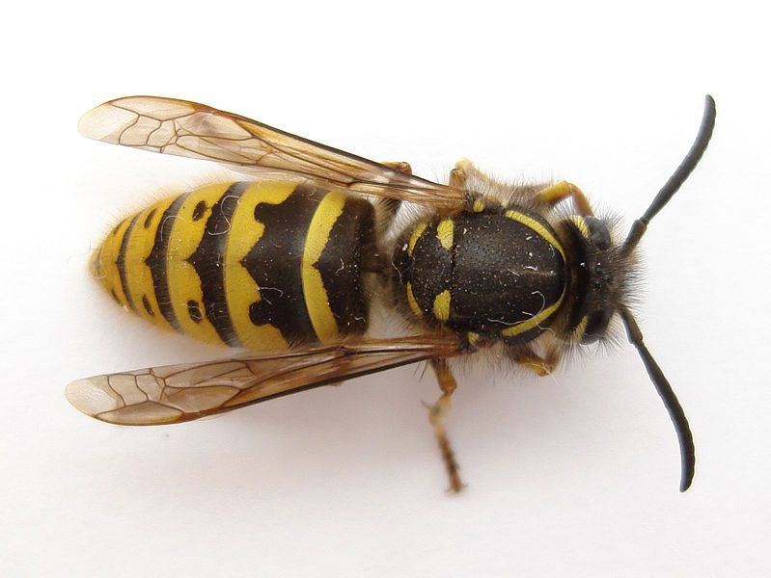
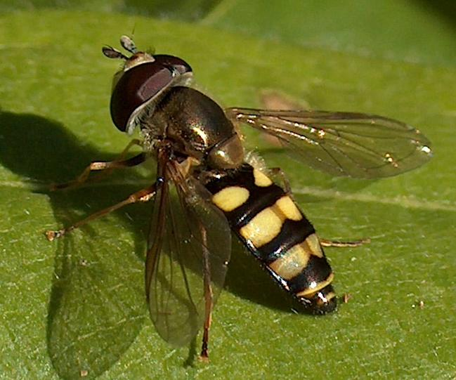
Copying other animals

Slide 10
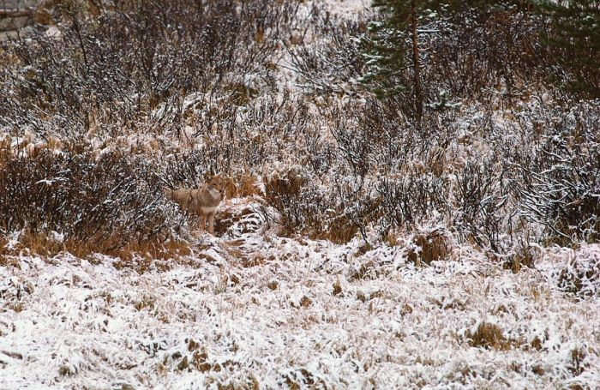
FIND THE FOX

Slide 11
Understand what mimicry is
Define the word mimic
Bronze
State some animals that use mimicry
Silver
Explain why organisms use mimicry
Gold

Slide 12
Which animals mimic?
On your tables create a list of animals that either
Mimic their surroundings
Mimic other animals
Surroundings | Other animals

Slide 13
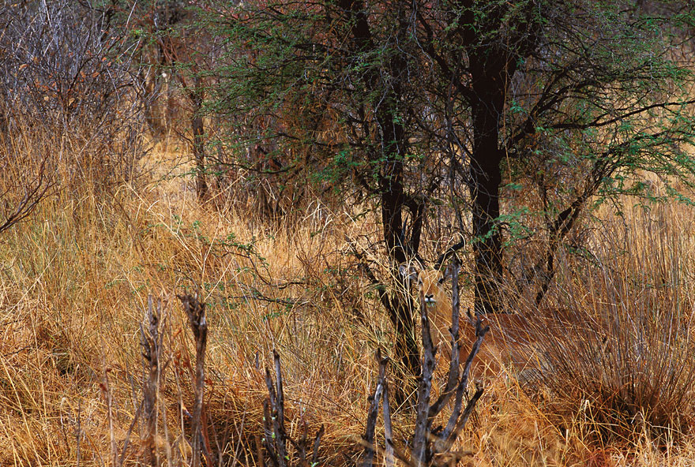
WHAT IS HIDING HERE?

Slide 14
Understand what mimicry is
Define the word mimic
Bronze
State some animals that use mimicry
Silver
Explain why organisms use mimicry
Gold

Slide 15
Octopus
Cuttlefish - 20 mins

Slide 16
Create a poster for the public
Animals that mimic…
State what mimic means
Give an example of an animal that copies it’s surrounding
Explain why it would do this
Give an example of an animal that copies another animal
Explain why it would do this
DEADLINE

Slide 17
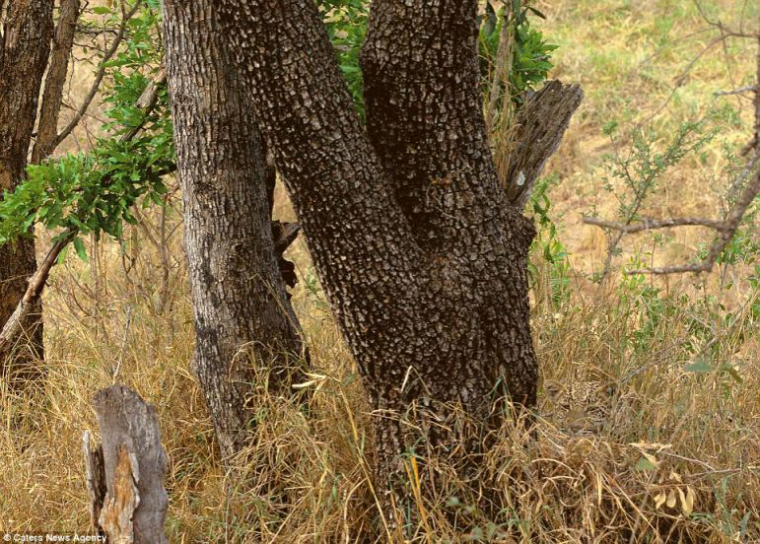
WHERE’S THE LEOPARD

Slide 18
PEER MARK
BRONZE
State that mimic means an animal is copying something
SILVER
Give an example of an animal that uses camouflage
Give an example of an animal that copies another animal’s looks or behaviour
GOLD
Explain why animals use camouflage
Explain why one animal would copy another
Give a medal – then write down:
WWW: What they did well in their poster
EBI: What they need to do to get a higher level

Slide 19
Understand what mimicry is
Define the word mimic
Bronze
State some animals that use mimicry
Silver
Explain why organisms use mimicry
Gold

