Slide 1
8.1 Metabolism
Understanding:
Metabolic pathways consist of chains and cycles of enzyme-catalysed reactions
Enzymes lower the activation energy of the chemical reactions that they catalyse
Enzyme inhibitors can be competitive or non-competitive
Metabolic pathways can be controlled by end-product inhibition
Applications:
End product inhibition of the pathway that converts threonine to isoleucine
Use of databases to identify potential new anti-malarial drugs
Skills:
Distinguishing different types of inhibition from graphs at specified substrate concentration
Calculating and plotting rates of reaction from raw experimental results
Nature of science:
Developments in scientific research follow improvements in computing: developments in bioinformatics, such as the interrogation of databases, have facilitated research into metabolic pathways.

Slide 2
TREAD
BREAD
BREED
BLEED
BLEND
BLIND
BLINK

Slide 3
Metabolism
Metabolic pathways consist of chains and cycles of enzyme-catalysed reactions
Enzymes lower the activation energy of the chemical reactions that they catalyse
Enzyme inhibitors can be competitive or non-competitive
Metabolic pathways can be controlled by end-product inhibition

Slide 4
Metabolism
Metabolism
Chemical changes that take place in living cells.
“Metabolism (from Greek: μεταβολή metabolē, "change") is the set of life-sustaining chemical transformations within the cells of living organisms”
Huge range of changes catalysed by over 5,000 enzymes.

Slide 5
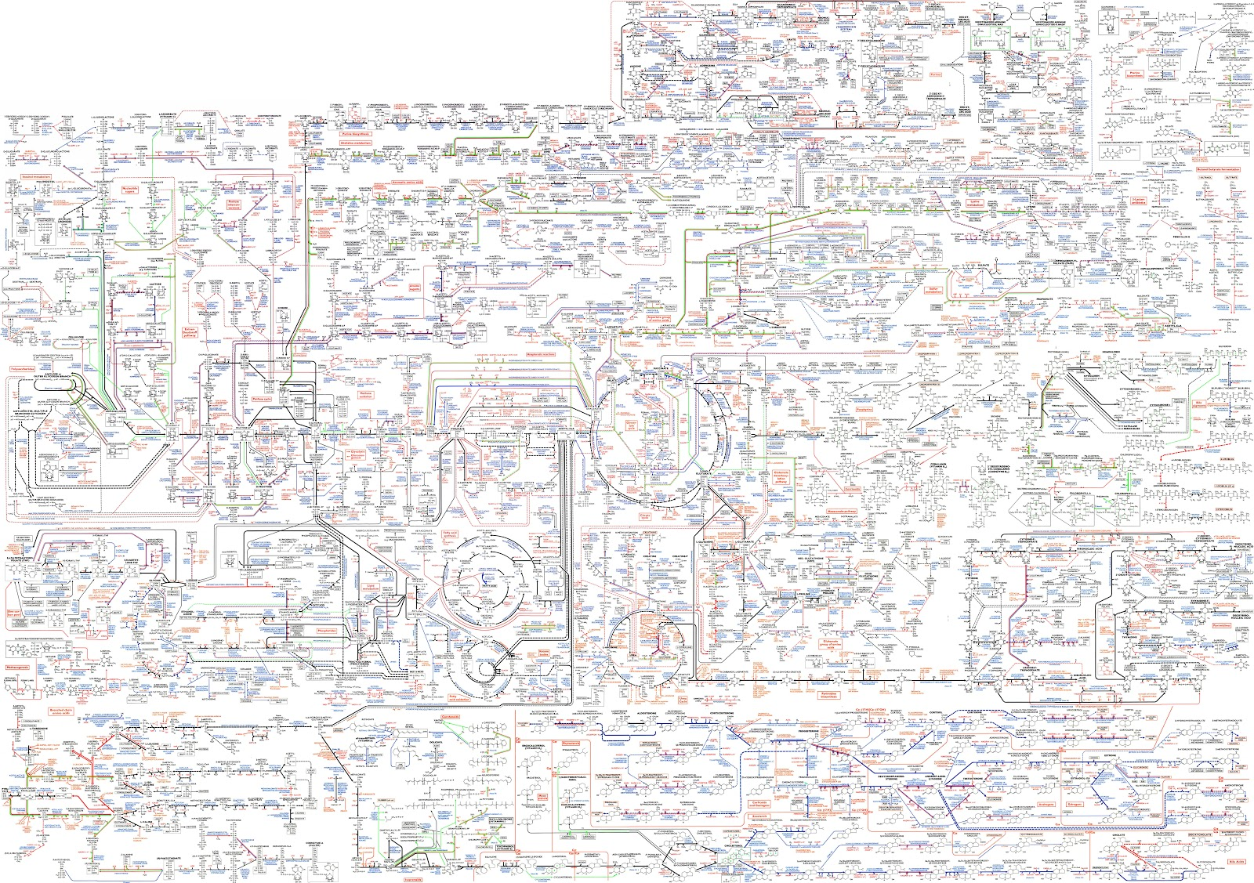

Slide 6
Metabolism
1. Most chemical changes happen in a sequence of small steps – forming a metabolic pathway.

Slide 7
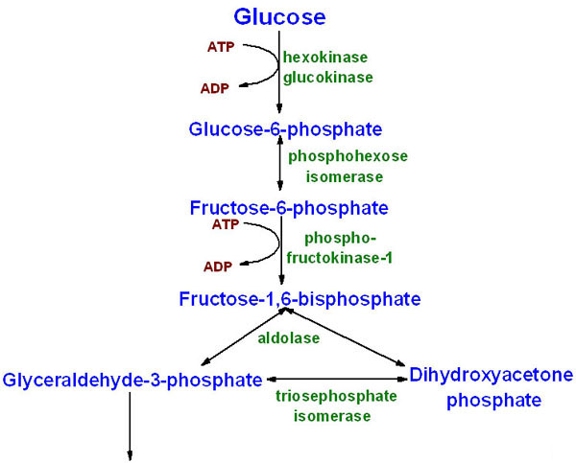
Metabolism
2. Most pathways involve a chain of reactions.

Slide 8
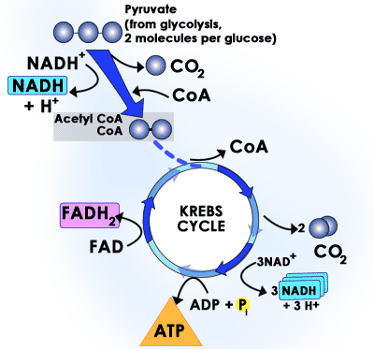
Metabolism
Some form a cycle rather than a chain.
(part of aerobic
respiration)

Slide 9
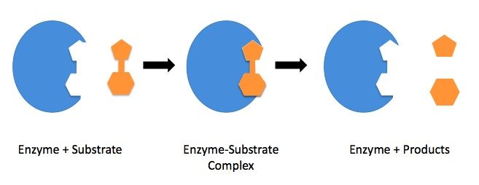
Enzymes – prior knowledge
To measure the rate of reaction of an enzyme you measure the ‘amount’ of product gained, or the amount of substrate lost
Proteins that work as a catalyst.
Speed up chemical reactions without being altered themselves.

Slide 10
Enzymes
Substrates must pass through a transition state before being converted into a product.
Energy is required to get to this transition state. (ACTIVATION ENERGY) must break bonds.

Slide 11
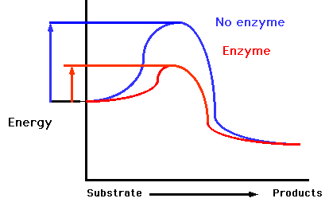
Enzymes
Lower the activation energy of the reactions they catalyse.
So the rate of
reaction is
increased
How could you reach AE without an enzyme?
Any problems with this?

Slide 12
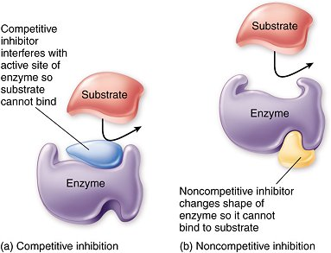
Enzyme Inhibitors
Chemical substances bind to enzymes and reduce their activity.
Competitive (binds to active site)
Non competitive/allosteric (binds elsewhere on enzyme)
Allosteric site
Inhibition (before 3 after 6)

Slide 13
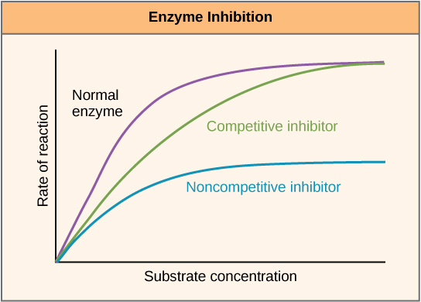

Slide 14
Effects of enzyme inhibitors
Normal enzyme has no inhibitor – shows the rate of reaction increasing and then leveling off as all enzyme active sites are filled.
Competitive inhibitor – When substrate concentration exceeds inhibitor concentration, maximum rate of the enzyme can be achieved as the substrate outcompetes the inhibitor. Takes a higher concentration of substrate than uninhibited enzyme.
Non-competitive inhibitor – Enzyme does not reach maximum rate as these inhibitors prevent the enzymes from reacting regardless of substrate concentration. The active site is changed so no enzyme substrate complexes can be formed.

Slide 15
End product inhibition
Enzymes can be regulated by substances that bind to enzyme away from active site (on ALLOSTERIC SITES)
The product can become the non-competitive inhibitor
The end product becomes the inhibitor.
Can produce lots to completely switch off a reaction or less to make the rate increase – acts as a regulator.

Slide 16
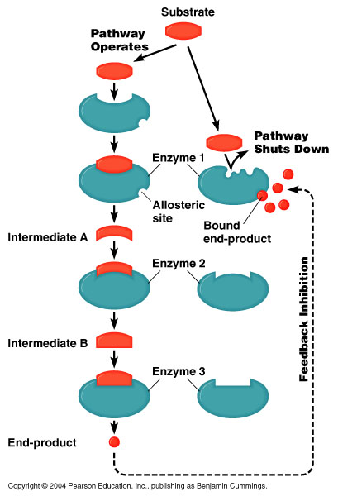

Slide 17
End product inhibition
Initial substrate = threonine
End product = isoleucine
Isoleucine produced
Too much made and not used = end product inhibition
Active site cannot now bind to threonine

Slide 18
Bioinformatics - Chemogenomics
What is meant by ‘bioinformatics’?
What is chemogenomics?
How is chemonogenomics applied to malaria drug?

Slide 19
Computers
Improvements in computing has helped develop scientific research.
Scientists can
Organise
Store
Retrieve
Analyse
Add to
Multiple research groups can collaborate their work.

Slide 20
Summary
What is metabolism?
What 3 things do you need to remember about metabolism?
What do enzymes do?
What are the two types of inhibitors? Describe them.
What is end product inhibition

