Slide 1
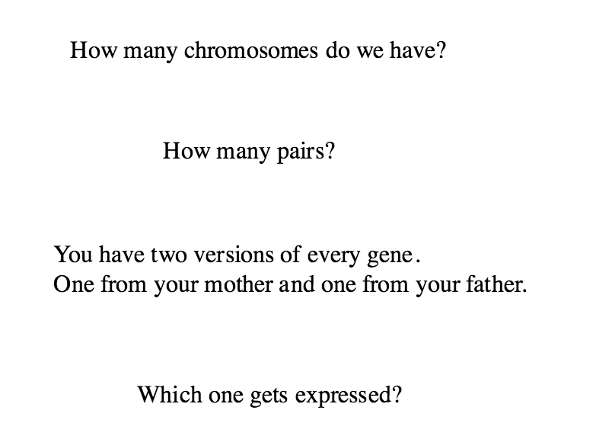

Slide 2
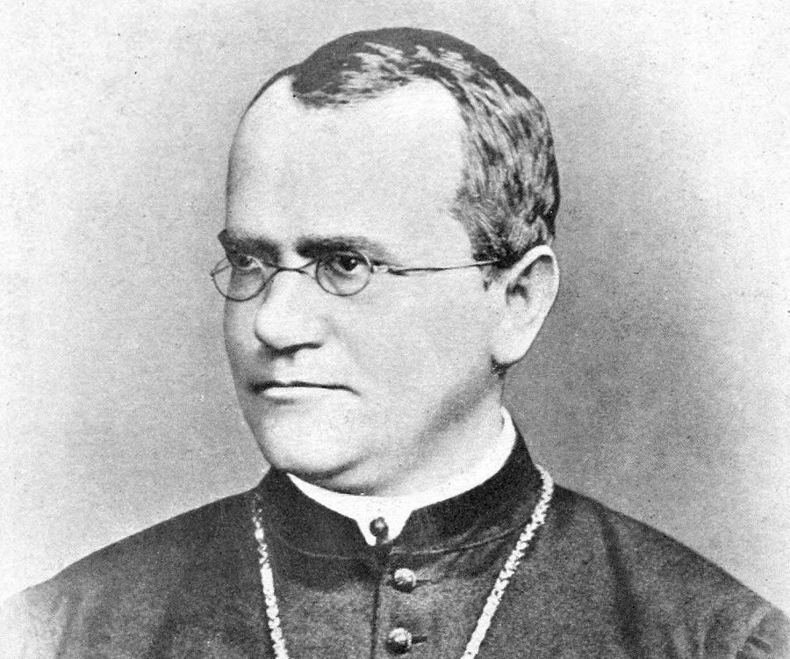

Slide 3
Mendel and Monohybrid inheritance
Describe the work of Gregor Mendel
Describe monohybrid inheritance using punnett square diagrams

Slide 4
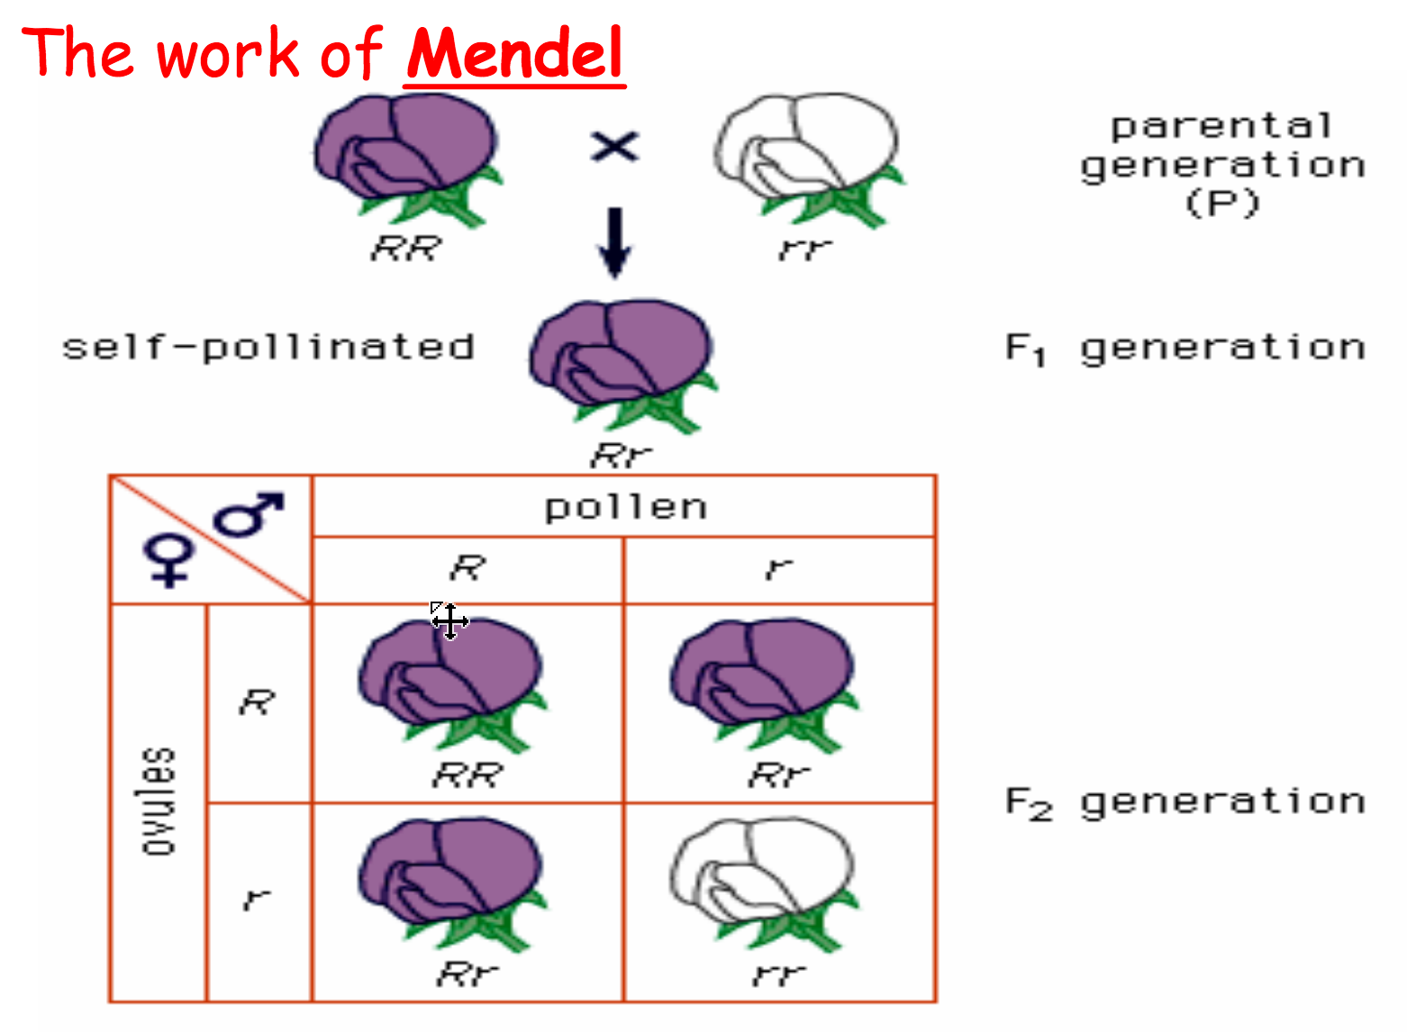
Mendel

Slide 5
Glossary
Allele
Dominant
Recessive
Genotype
Phenotype
Homozygous
Heterozygous

Slide 7
Allele for Brown eyes
e.g. 18
Allele for Blue eyes

Slide 8
Glossary
Allele – different form of the same gene
Dominant
Recessive
Genotype
Phenotype
Homozygous
Heterozygous

Slide 9
Mendel

Slide 10
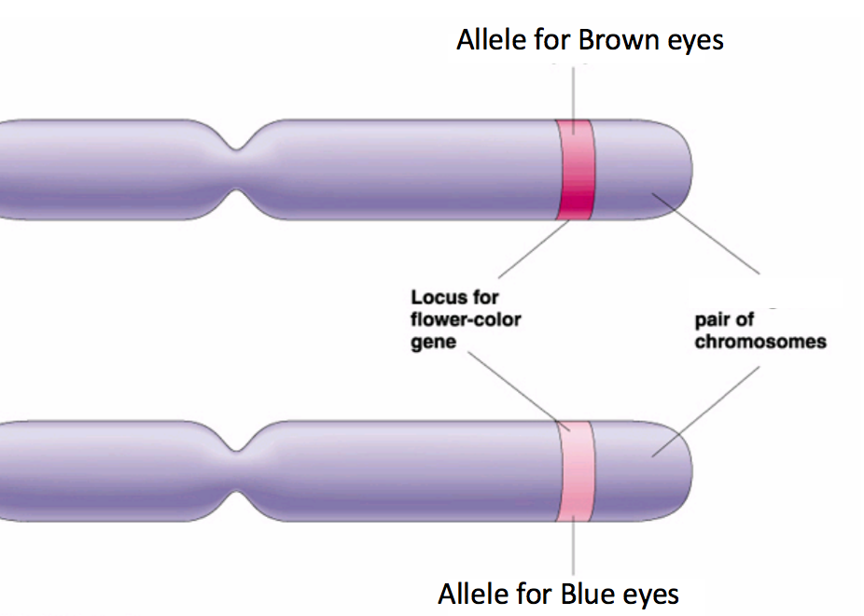
Genotypes and Phenotypes
Genotype refers to the genes that you have.
We use letters..
BB – Brown eyes
Bb – Brown eyes
bb – blue eyes
Eye colour is the phonotype (the characteristic)
B
b
Which allele is dominant?

Slide 11
Glossary
Allele – different form of the same gene
Dominant – The allele/gene that is expressed
Recessive – Only expressed if there is no dominant allele
Genotype – The alleles/genes that you have
Phenotype – the characteristics that you have
Homozygous
Heterozygous

Slide 13
Glossary
Allele – different form of the same gene
Dominant – The allele/gene that is expressed
Recessive – Only expressed if there is no dominant allele
Genotype – The alleles/genes that you have
Phenotype – the characteristics that you have
Homozygous – Both alleles are the same
Heterozygous – Alleles are different

Slide 14
Homozygous dominant woman and heterozygous man have a baby. What are the chances (%) of having a baby with blue eyes? My mum has blue eyes and my dad has brown eyes. Show how I ended up with blue eyes. What was the % chance

Slide 15
In domestic cats black fur is dominant over grey fur. The mother is homozygous recessive and the father is homozygous dominant. What is the % chance of having a kitten with grey fur?

Slide 16
In pea plants, yellow seed color is dominant to green seed color. If a heterozygous pea plant is crossed with a plant that is homozygous recessive for seed colour, what is the % probability that the offspring will have green seeds?

Slide 17
When Mendel bred flowers together he found that he was getting purple flowers 75% of the time and white flowers 25% of the time. What were the genotypes of the parent plants. Show how this happened.

Slide 18
Red eyes (R) in fruit flies are dominant over white eyes (r). Using genetic diagrams, find the possible eye colors of the offspring if the mother was heterozygous and the father was homozygous recessive.

Slide 19
Huntington’s disease is a genetic disorder which can include psychiatric problems and difficulties with behaviour, feeding, communication and movement. It is caused by a mutation on the dominant allele of a gene on chromosome 4.
What is meant by ‘mutation’?
How do mutations lead to genetic disorders?
A homozygous female sufferer of Huntington’s is planning to have a child with a male non sufferer. What is the % chance they will have a child with Huntington’s

Slide 20
Sex Determination
What chromosomes determine your sex?
What do males have? What do females have?
What are the chances you are a boy or a girl?
Show how this works using a punnett diagram…......

Slide 21
Why wouldn’t this get you full marks in an exam?

Slide 22
Recessive Disorders

Slide 23
Sickle cell is a recessive disorder that reduces the ability of the blood to carry oxygen.
What is meant by ‘recessive disorder’?
A homozygous recessive male had a child with a heterozygous female. What are the % chances the child was a sufferer of Sickle cell?

Slide 24
Cystic fibrosis is a recessive genetic disorder causing a persistent cough that produces thick mucus.
Two people who did not suffer from cystic fibrosis had a child with the disorder. Show how this could have happened.

Slide 25
Tay-Sachs syndrome is a recessive disorder that causes deafness, progressive blindness and decreased muscle strength.
A female carrier had a child with a male homozygous dominant male. What is the ratio of phenotypes they could see in their offspring?

Slide 26
Thalassemia is a blood disorder passed down through families (inherited) in which the body makes an abnormal form of hemoglobin. It is caused by a mutation in the recessive allele.
What is function of haemoglobin?
A sufferer (male) of Thalassemia had a child with a carrier (female). What are the % chances they will have a child who does not suffer from Thalassemia?

Slide 27
Phenylketonuria (PKU) is an inherited disorder that increases the levels of a substance called phenylalanine in the blood.
Two homozygous parents had children and they were all carriers. Show how this could have happened.

Slide 29
Haemophilia is a recessive disorder. A heterozygous male had a child with a homozygous female with haemophilia. What are the chances their child would be a carrier?

Slide 30
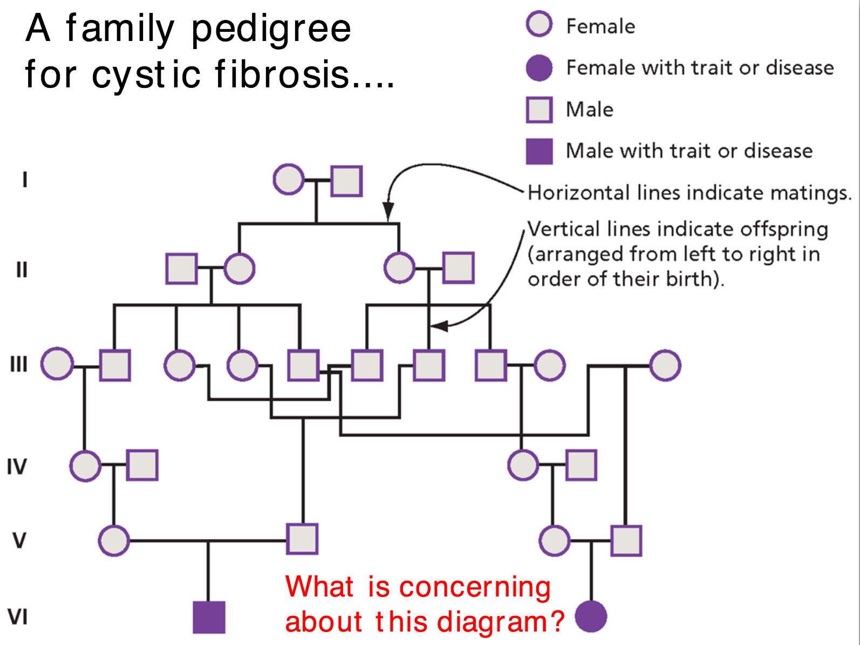
Family Pedigree

Slide 31
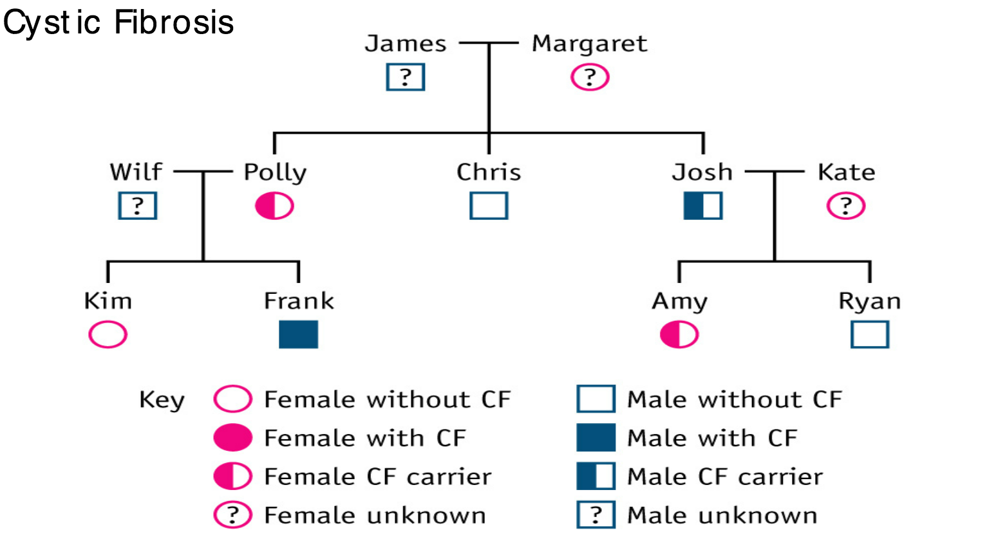
State the missing phenotypes
Show how frank inherited CF

Slide 32
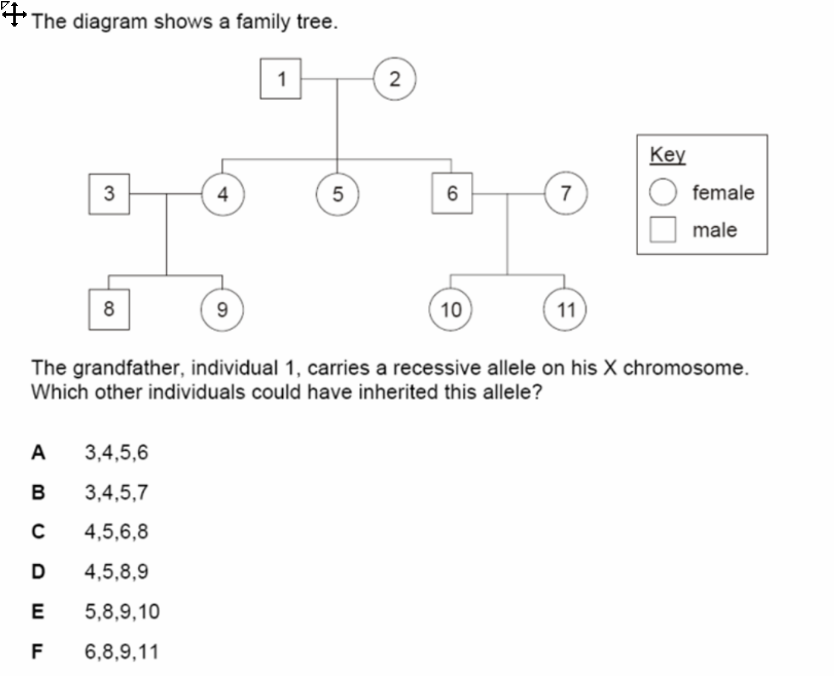

Slide 33
Inheritance of blood groups (Co-dominace)
There is one gene that codes for your blood group.
There are three alleles of the ABO blood group gene.
A person has two of these alleles.
There are two dominant alleles – I^{A} and I^{B}
And one recessive allele – i
I^{A} = A
I^{B} = B
i = O
I^{A} I^{A} =
I^{B} I^{B} =
I^{A} I^{B} =
I^{A} i =
I^{B} i =
ii =

Slide 34
Co-dominance
phenotype | genotype(s)
A | I^{A}I^{A} I^{A}i
B | I^{B}I^{B} I^{B}i
AB | I^{A}I^{B}
O | i i

Slide 35
A woman is homozygous for blood group A. She has a child with a man who has blood group O.
What is the % chance their child has blood group O?
Write one for your partner

Slide 36
Which blood group is the universal donor? – can give to to anybody
Which blood group is the universal recipient? – can receive any blood group?

Slide 37
4. A homozygous recessive male has a child with a homozygous female with blood group A. Show the possible phenotypes of the offspring
5. A heterozygous dominant female has a child with man with blood group O. What are the chances of having a baby with blood group AB?

Slide 38
Blood groups
Are parents able to have 4 children each with a different blood group?
How?
I^{A}i ^{X} I^{B}i

Slide 39
Produce a wall chart for a hospital including..
What blood contains
What are the 4 main blood groups? (don’t discuss rhesus)
What does this actually mean?
What is a blood transfusion?
What happens if you give someone the wrong blood group?
What are universal donors and recipients (who can give and receive which blood group?)
How are blood groups inherited?

