Slide 1
Evidence for the fluid mosaic model

Slide 4
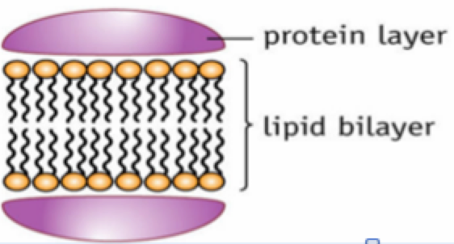
Davson-Danielli Model
Read pages 26 (bottom), 27, 28 (top) and answer the questions on page 28

