Slide 1
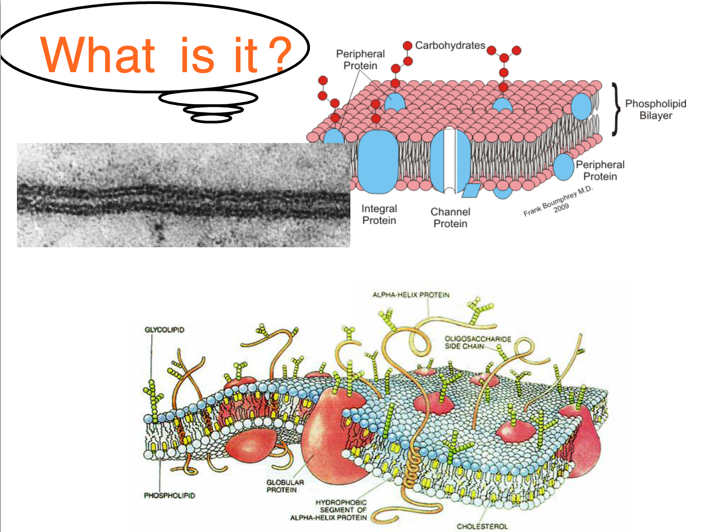

Slide 2
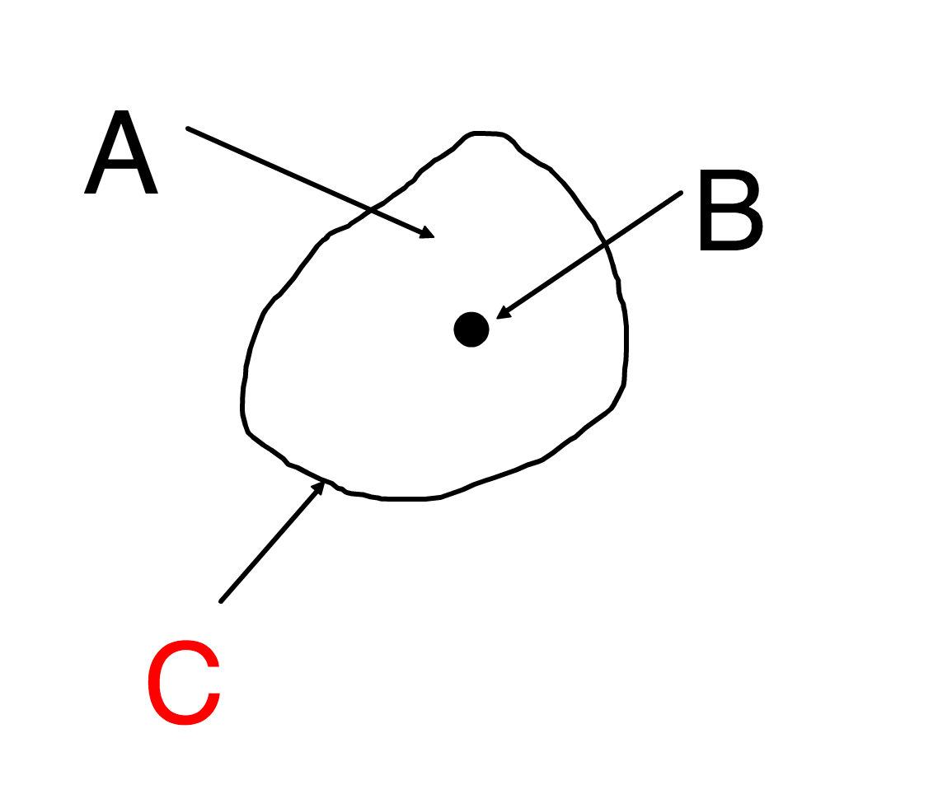

Slide 6
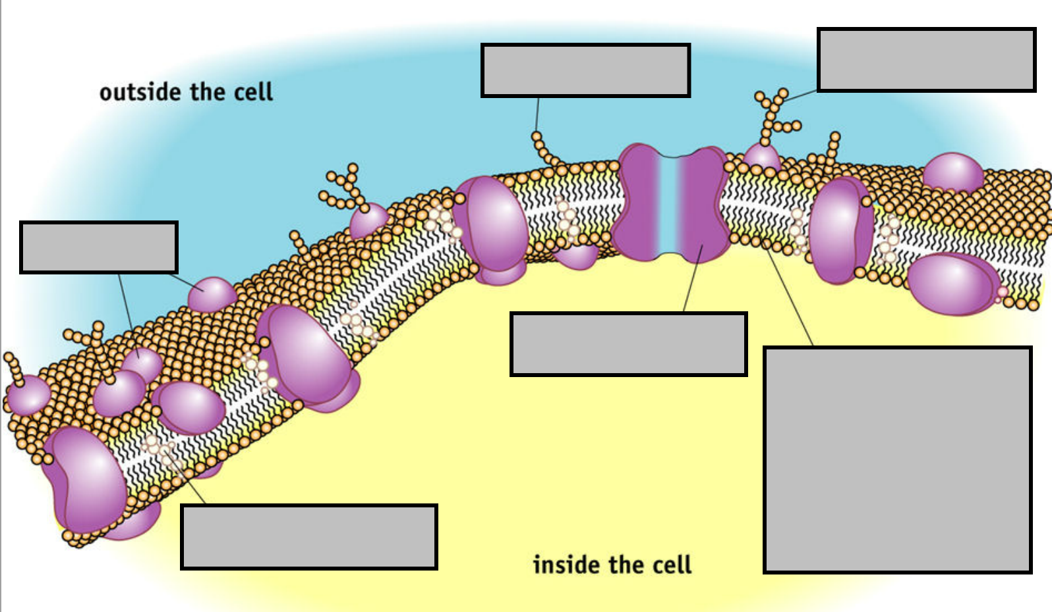

Slide 7
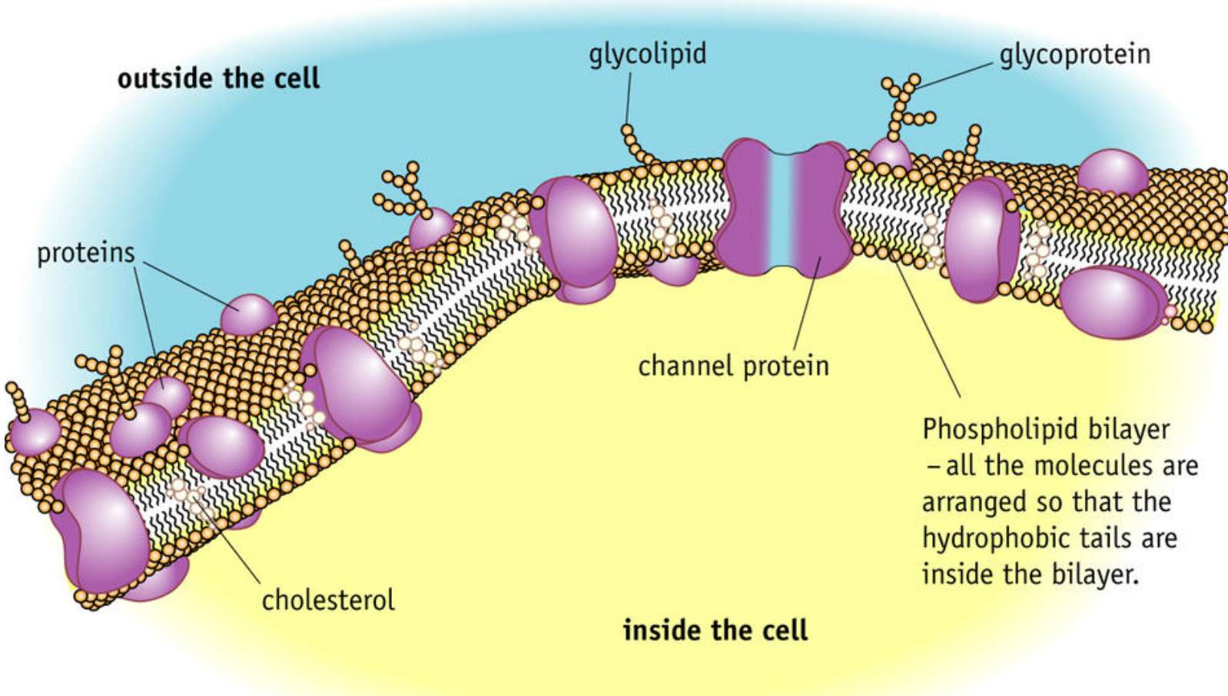
Integral and Peripheral Proteins

Slide 8
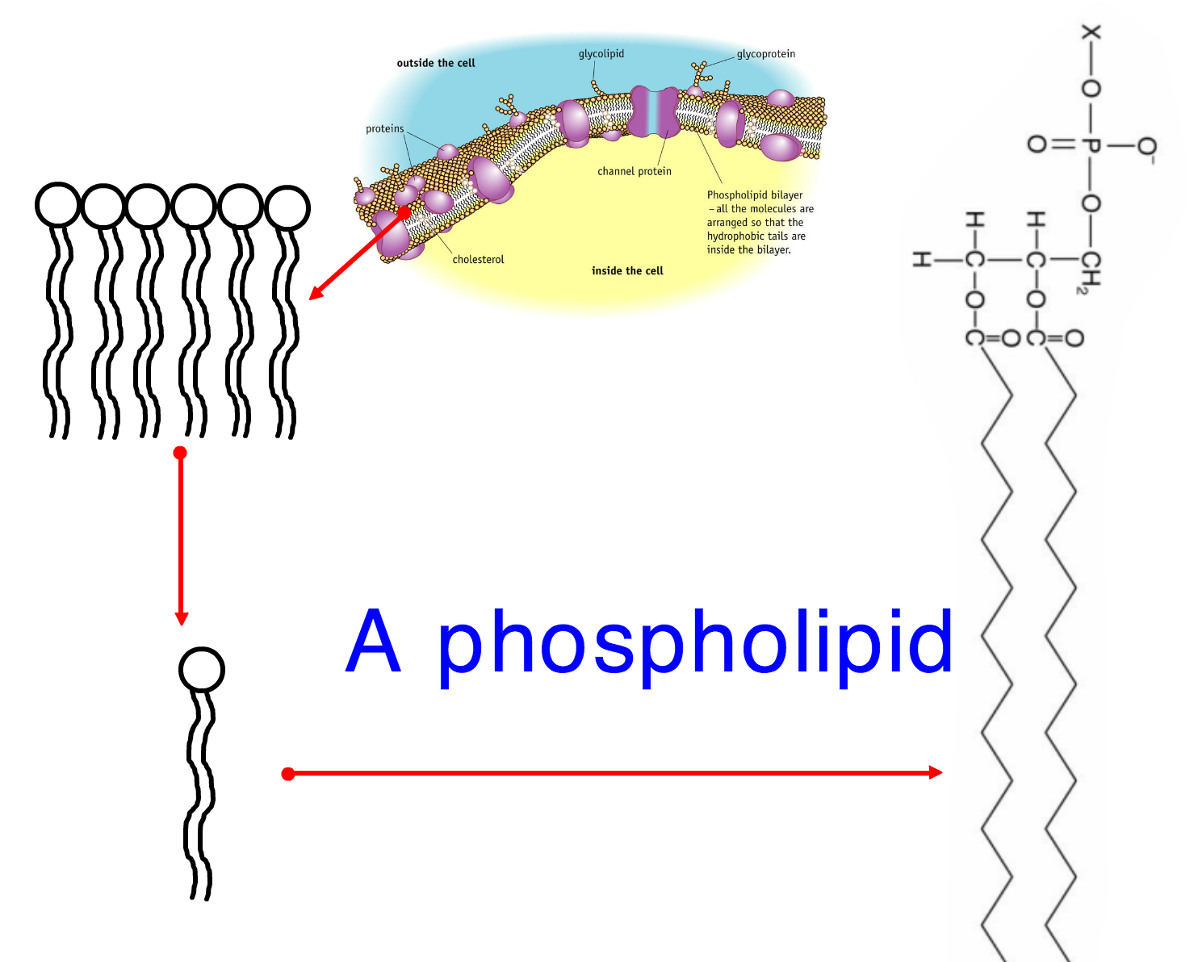

Slide 10
amphipathic

Slide 13
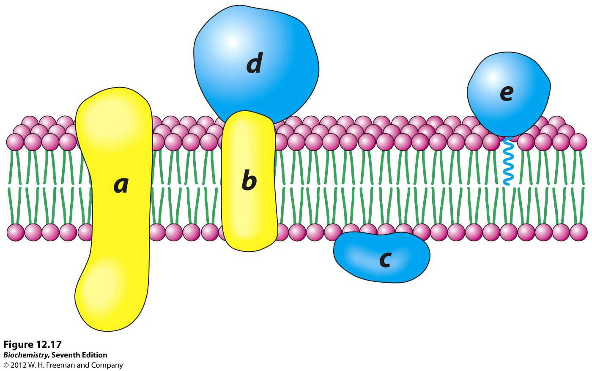
Integral proteins
Hydrophobic parts embedded in hydrocarbon chains
Many are trans-membrane with hydrophilic parts projecting next to phosphate heads

Slide 14
Peripheral proteins
Hydrophilic
Not embedded in the membrane
Attached to an integral protein or outside of membrane (anchored with a hydrocarbon chain)

Slide 15
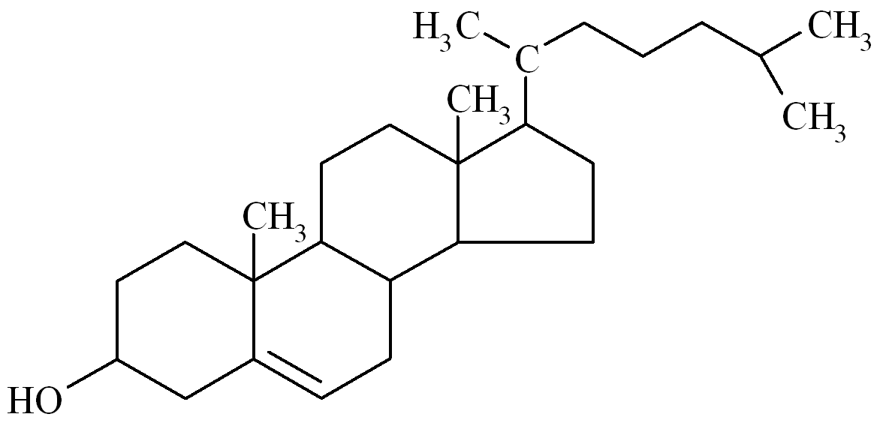
Cholesterol
Animal cell membranes also contain cholesterol as well as phospholipids and proteins
Type of lipid belonging to steroids
Mostly hydrophobic
Hydroxyl group is hydrophilic
Positioned between phospholipids in the membrane

Slide 16
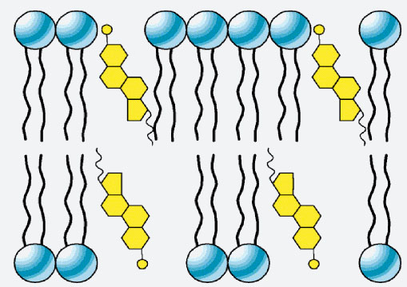
Cholesterol

Slide 17
Fluid mosaic model
Draw your own fluid mosaic model
Include
Phospholipid bilayer
Integral proteins x4 (1 x transmembrane)
Peripheral proteins x2 (one attached to an integral protein
Cholesterol x 2
Take your time
Do in 2D not 3D
Page 31 has a good simple version

Slide 18
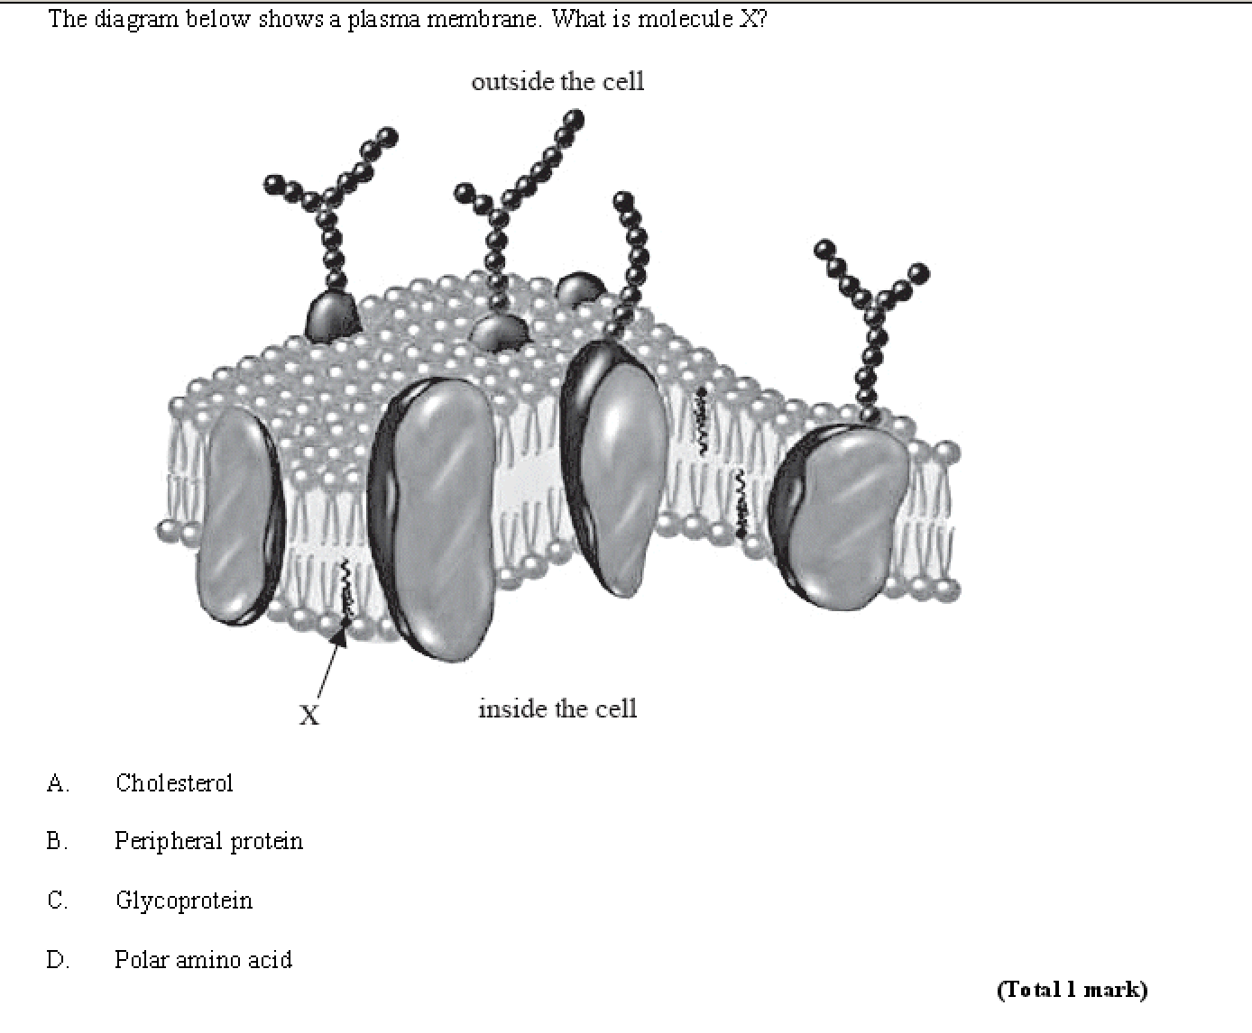

Slide 19
