Slide 1
Malnutrition!!!!!!!!!!
A level 7 powerpoint on
By: Jerry Kat Nat

Slide 2
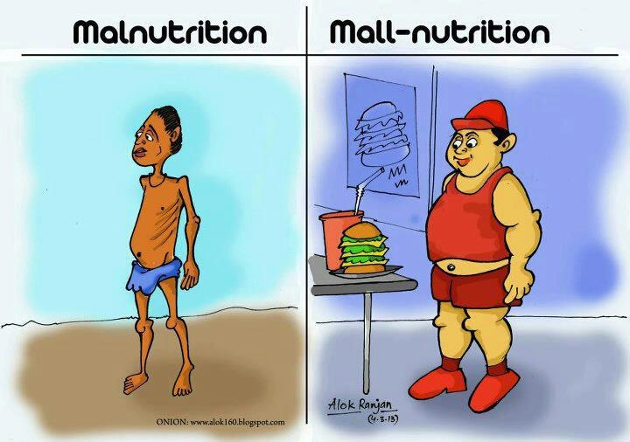
What is malnutrition?
Deficiency, imbalance or excess of nutrients in diet.
Outcome of poor diet
Failure to provide essential nutrients
Often associated with poverty
Example of cause: anorexia (don’t wanna eat) (heart muscle deteriorate)

Slide 3
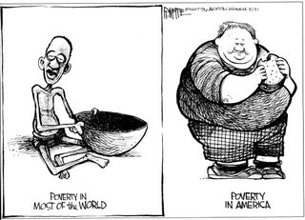
What are the different types?
DEFICIENCY
Starvation
EXCESS
Obesity

Slide 4
What is starvation?
Consequence of a diet lacking in adequate protein and carbohydrates
Lack of intake of essential and non-essential nutrients

Slide 5
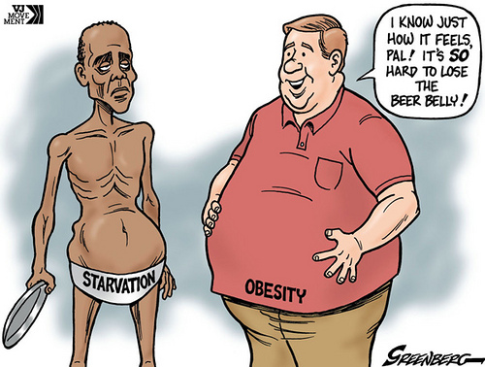
What are some of the consequences of malnutrition and starvation?
OBESITY
Hypertension (high blood pressure) Coronary heart disease -- Atherosclerosis
Type 2 Diabetes
STARVATION
Breakdown of body tissues

