Slide 1
How are fats/lipids transported in the blood?

Slide 3
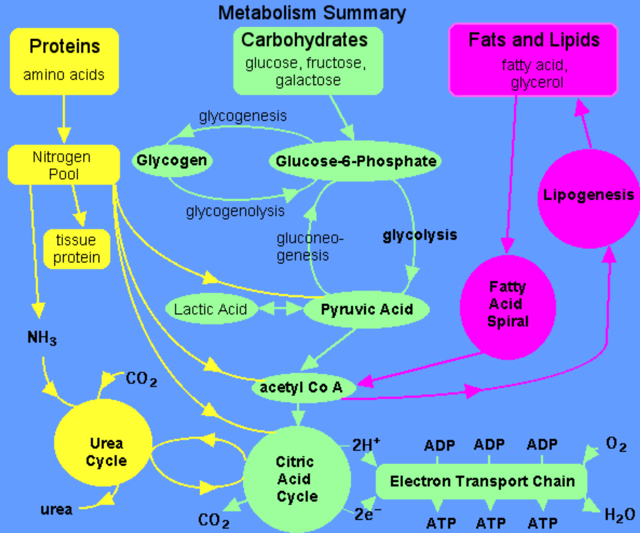

Slide 4
acid

Slide 9
More on fatty acids
Use your textbook (82) to identify the fatty acids on the sheet. Label them A,B,C etc. Stick the sheet in and justify how you have identified them.
A is a …..... because........
unsaturated
cis
trans
saturated

Slide 10
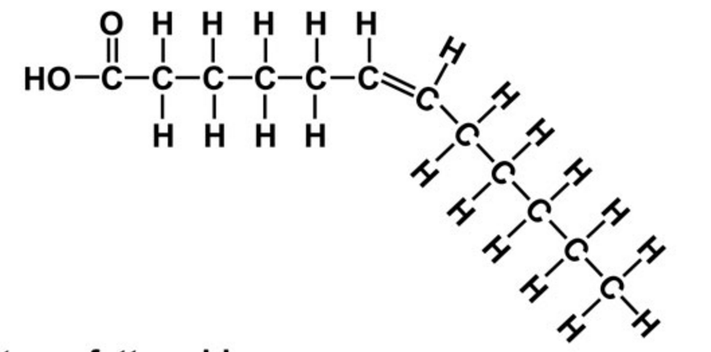
Saturated
Monounsaturated
Trans
Monounsaturated
Cis

Slide 11
Why are lipids more suitable as an energy store than carbohydrates? (78)

Slide 12
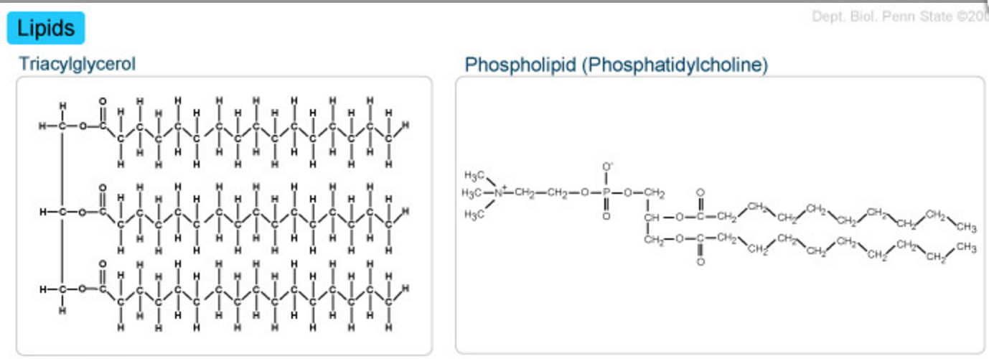
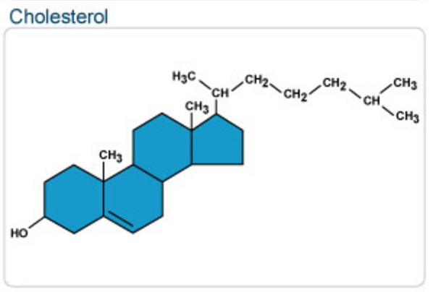

Slide 13
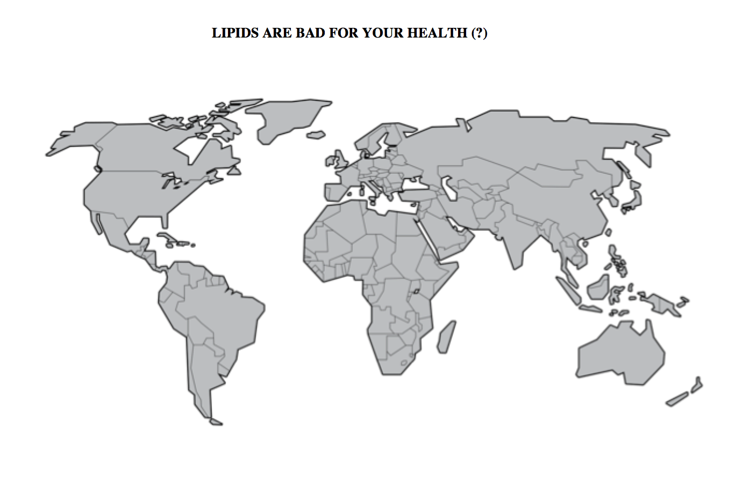
Read page 83
Annotate the map to discuss the above question
Find other examples of countries which support/do not support the statement

Slide 14
BMI and a risk factor for CHD
Body Mass Index can be used as a measure of being underweight or over weight.
Read page 80
Calculate your BMI
Answer questions on page 81

Slide 15
Lipids and Health Claims
People who eat a lot of olive oil have a lower risk of heart disease
Does this mean olive oil lowers heart disease?

Slide 16
Lipids and Health Problems

