Slide 1
1. C
[1]
2. C
[1]
3. D
[1]
4.
skeletal muscle fibres are larger / have many nuclei / are not typical cells;
fungal hyphae are (sometimes) not divided up into individual cells;
[2]

Slide 2
The biggest cell in the human body….

Slide 3
Limitations to cell size
Calculate surface area, volume and SA:Vol
Define diffusion
Explain how SA:Vol influences rate of diffusion and cell size

Slide 4
How does the paramecium get nutrients in and waste out?

Slide 5
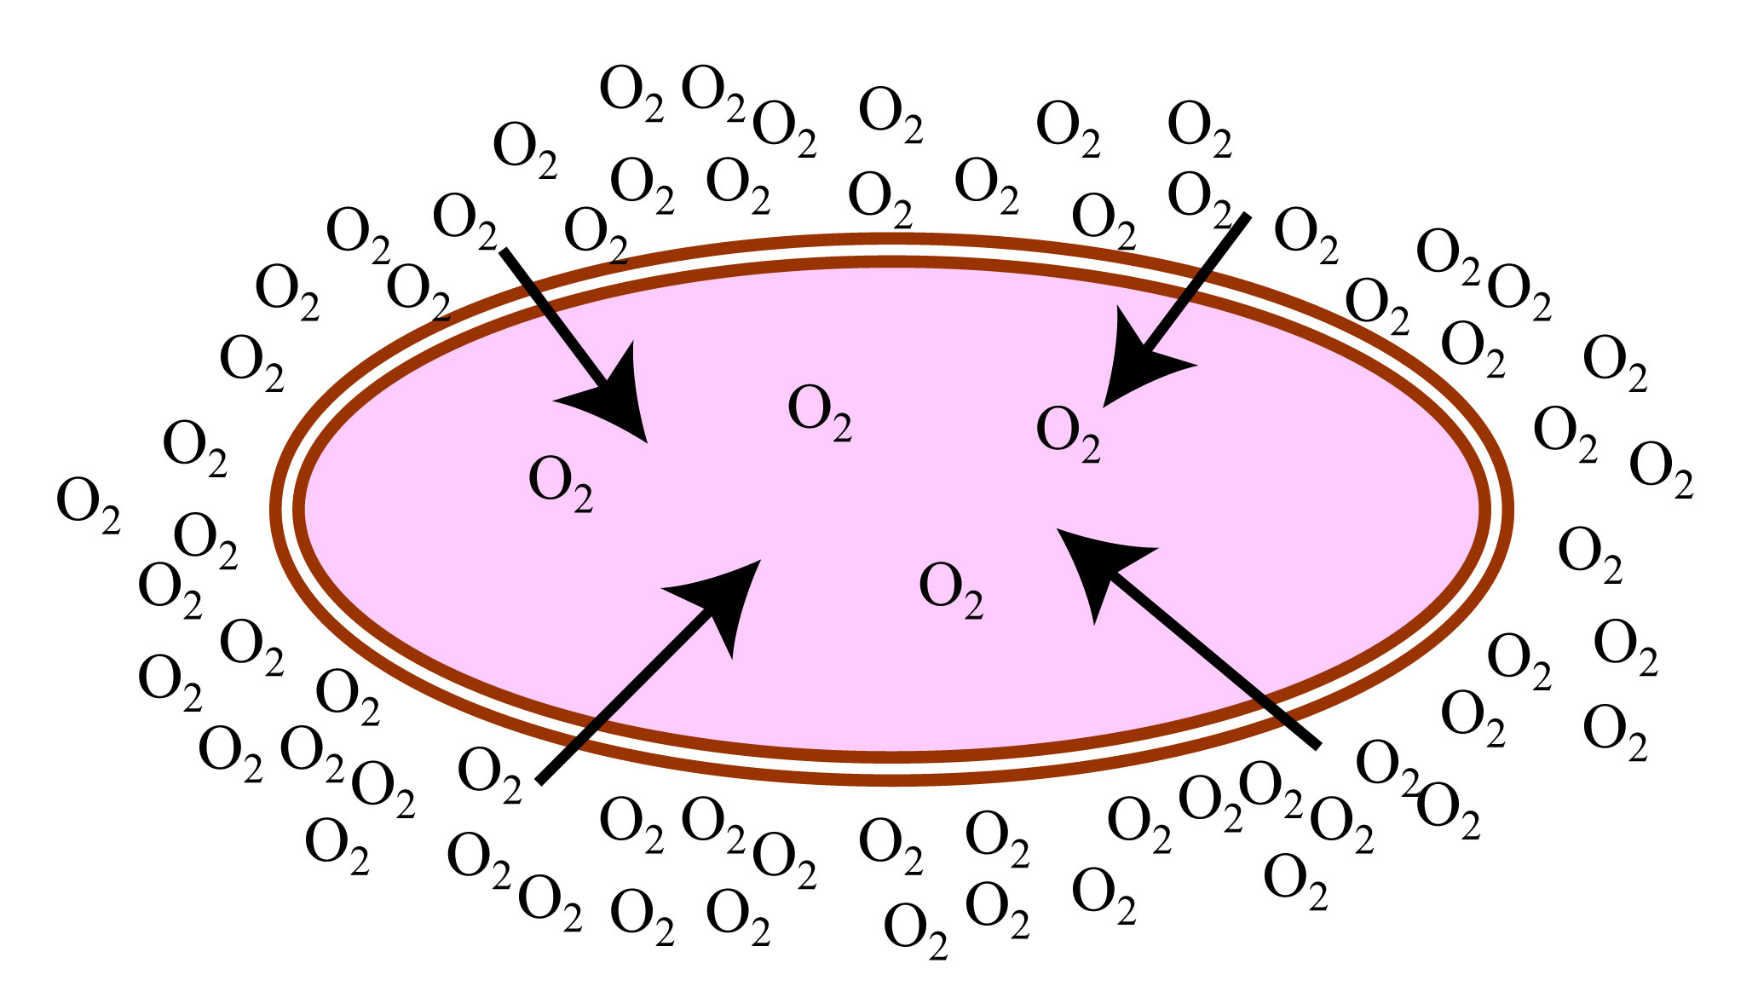
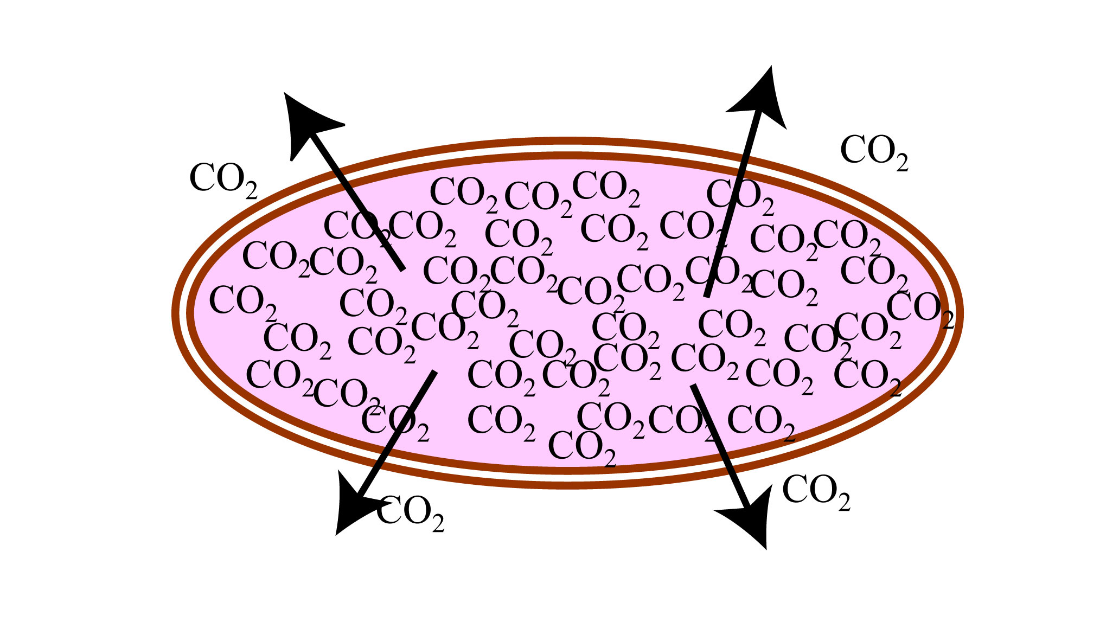
Diffusion
high
concentration
substances
low
movement
Movement of particles from an area of high concentration to low concentration

Slide 6
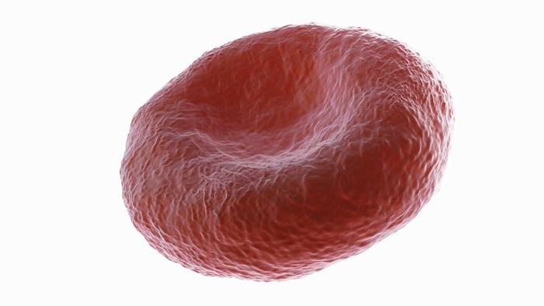
What else does the cell release?
Metabolism creates heat. This also needs to be lost

Slide 7
What is the problem if cells gets too big???

Slide 8
FACT:
As surface area to volume ratio of a cell increases the rate of diffusion into and out of the cell increases
We will prove this next lesson (hopefully)
Complete the calculations to answer this question…..
What is the problem if cells are too big??

Slide 9
Calculate surface area, volume and surface area to volume ratio (SA:vol) for each cell
What is the problem if cells are too big??
Small cell
Big cell

Slide 10
C

