Slide 1
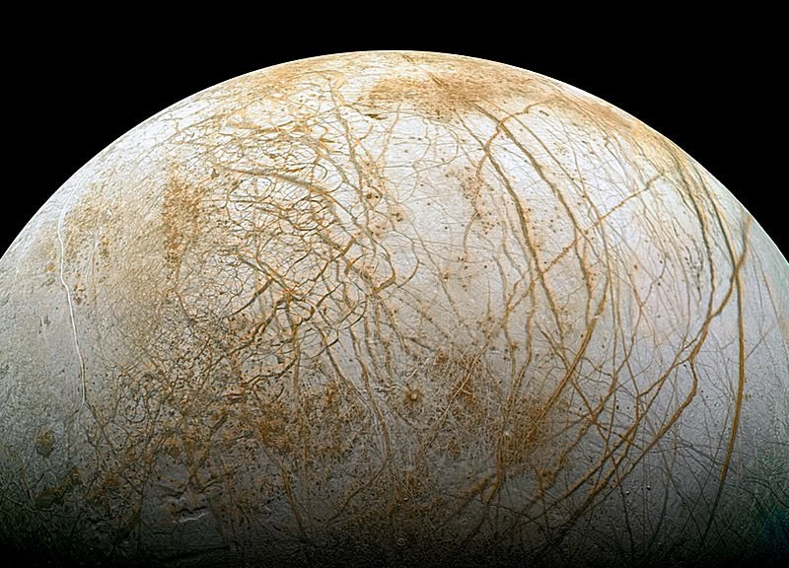
Life in the Solar System

Slide 2
Life in the Solar System
Titan
Europa
Enceladus
Mars
Venus
Ganymede and Callisto
Weird life on earth
Where is it? Is it a moon or a planet?
Size?
Features – what is it made from? Solid/liquid? atmosphere?
Why do scientists think there is a possibility there is life there?
What might life look like if it exists there?
What is an extremophile?
What are some good examples of extremophiles on earth?
Why might this give evidence for life elsewhere in the solar system?

Slide 3
Aliens - wonders of the solar system

