Slide 1
Draw a simple animal and plant cell

Slide 2
Levels of organisation and Prokaryotic vs Eukaryotic Cells
1.2 Ultrastructure of Cells
Describe the levels of organisation in multicellular organisms
Distinguish between prokaryotic and eukaryotic cells
Draw and label a prokaryotic cell

Slide 3
No so simple…

Slide 4
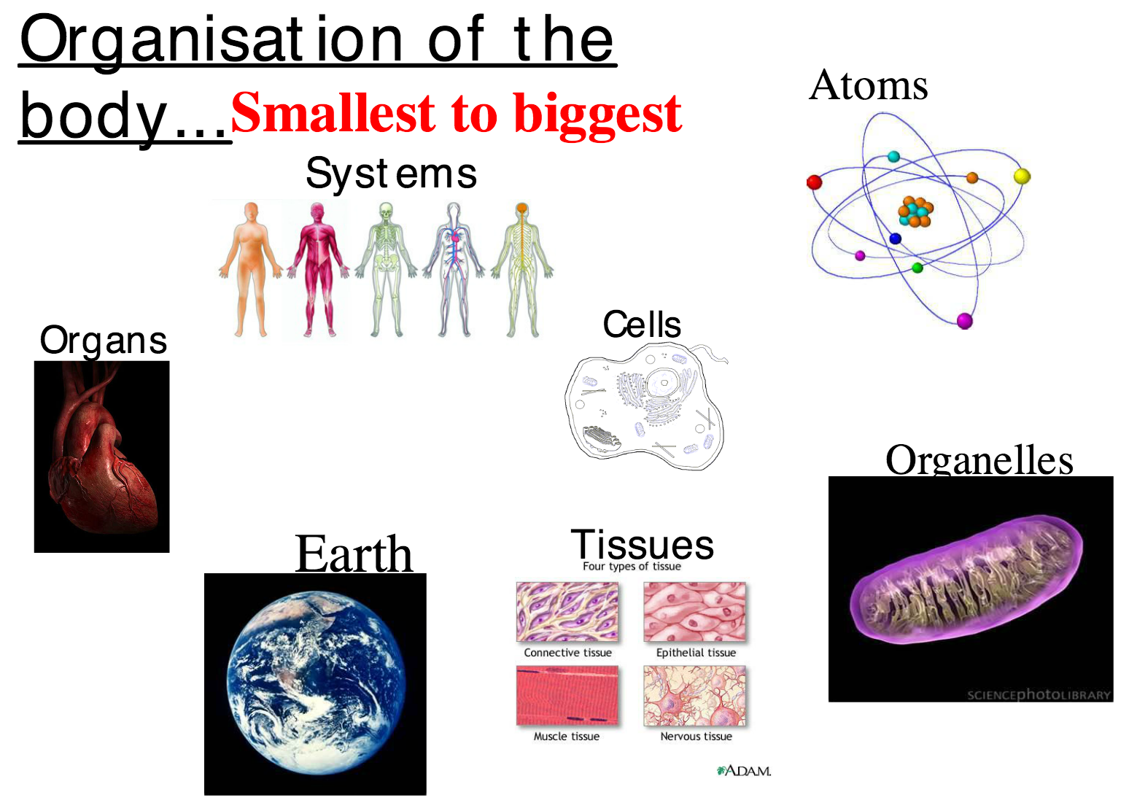

Slide 5
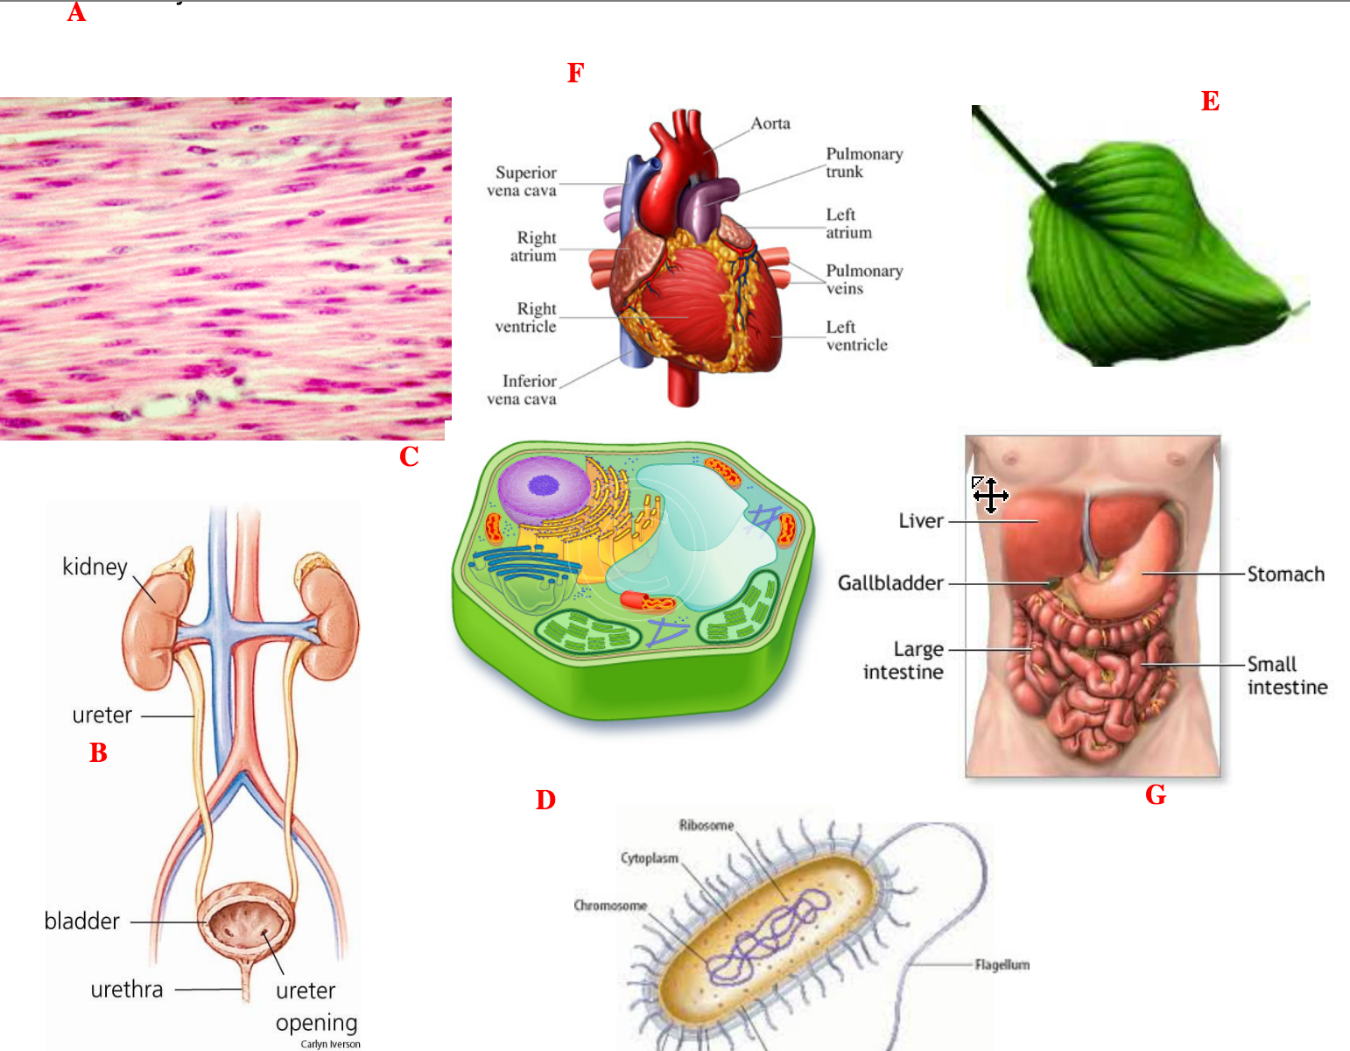

Slide 6
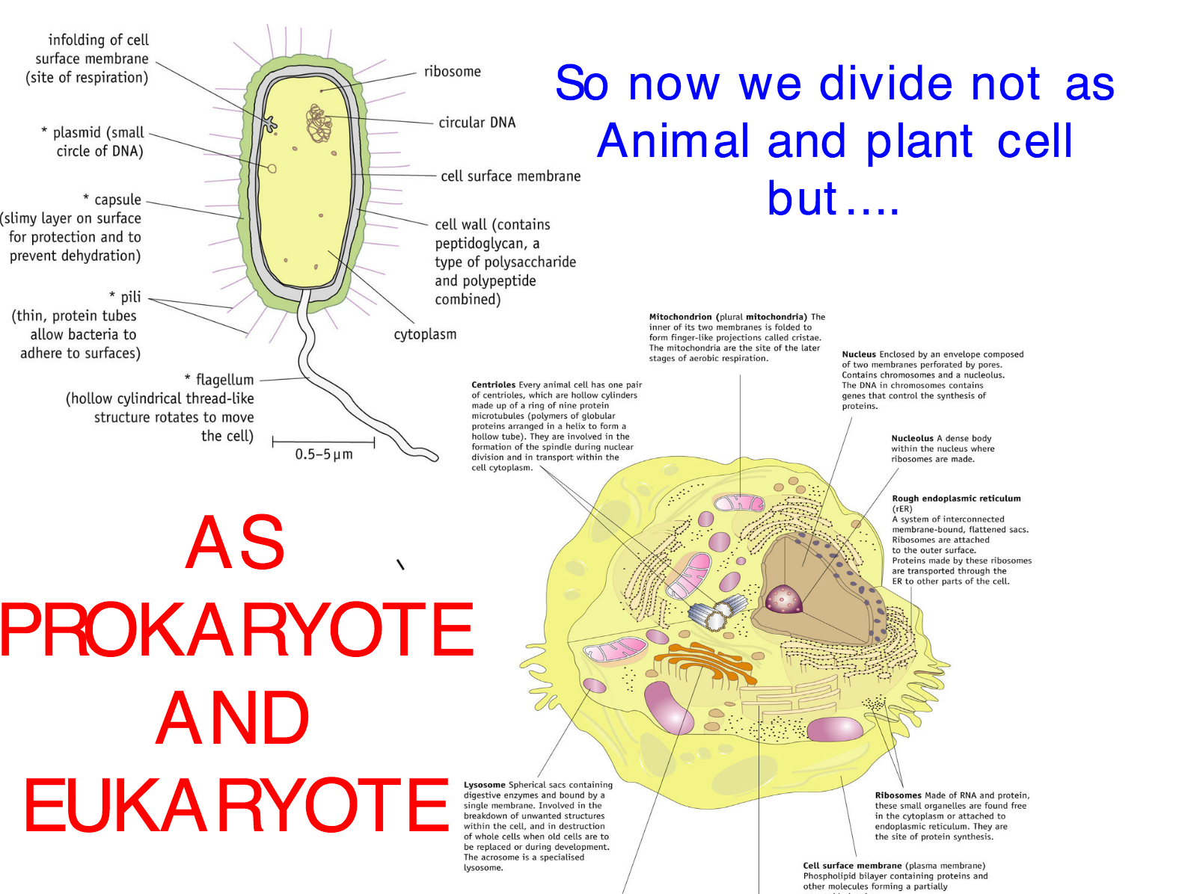

Slide 7
Miscoscopes

Slide 8
Electron microscopes have a higher resolution –
The ability to distinguish between separate parts
Your eye can see 0.1mm
With a light microscope you can see 0.2um
With electron microscopes you can see 0.001um (1nm)
Electron microscopes are needed to see the ultrastructure of cells and viruses too.

Slide 9
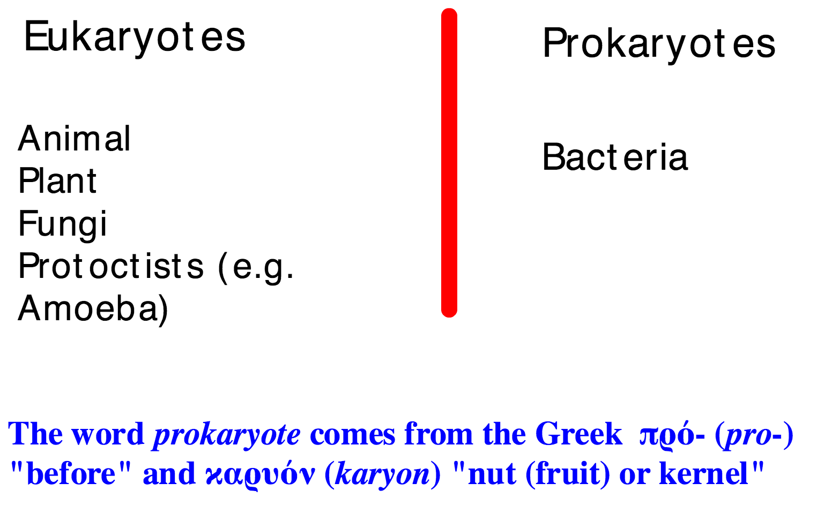
Pro vs Euk
What are the key differences?

Slide 10
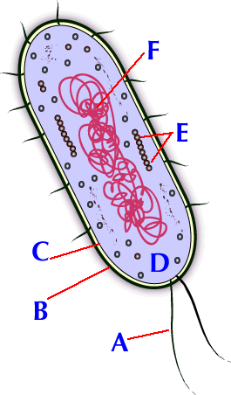
Drawing a prokaryotic cell (E.coli)
1. Watch the video
How to draw a prokaryotic cell
2. Draw and label the prokaryotic cell (make sure yours is neater than the video
3. Describe the functions of the cell parts
Close your books
Name the structures A - F
A prokaryote does not have compartments (organelles)

Slide 11
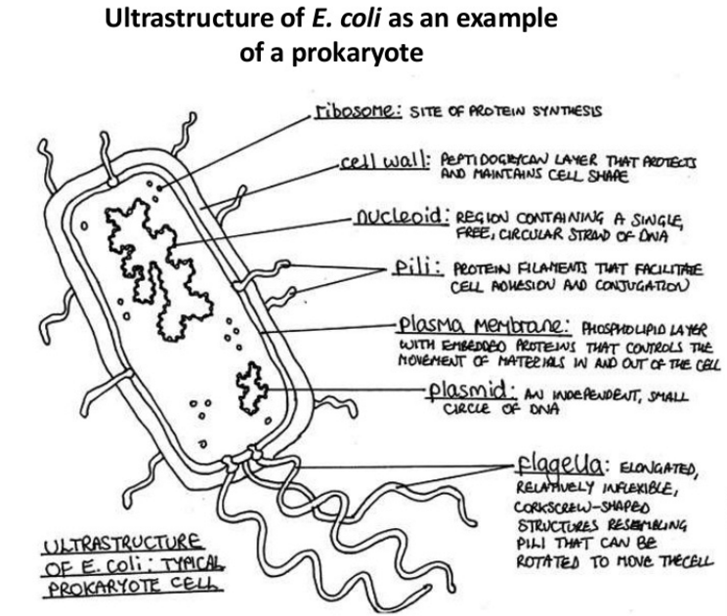

Slide 12
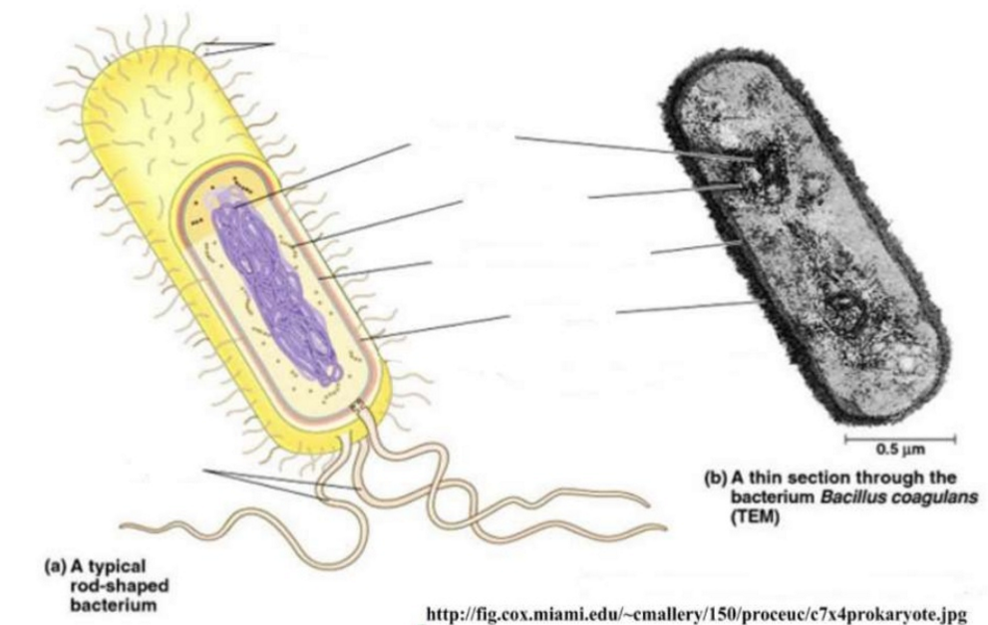
WARNING - If you are asked to draw from a micrograph you have to draw what you can see.
Do not add structures that you know are there if you cannot see them (see page 19)

Slide 13
Cell Division – Binary Fission

