Slide 1
11.3 The Kidney and Osmoregulation
Distinguish between osmoregulators and osmoconformers
Describe the Malpighian tubule system in insects
Label the human urinary system
Draw and label a human kidney

Slide 2
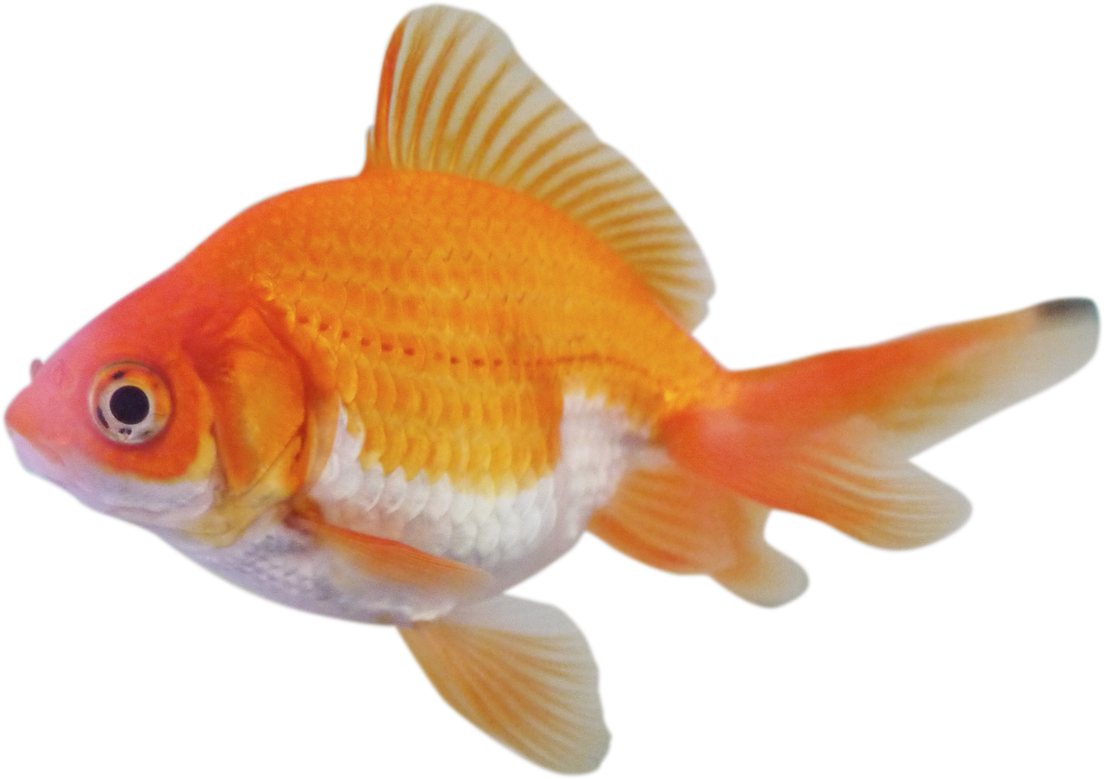
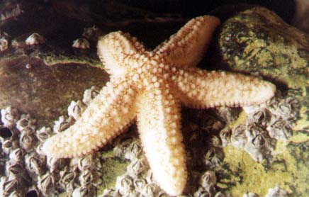
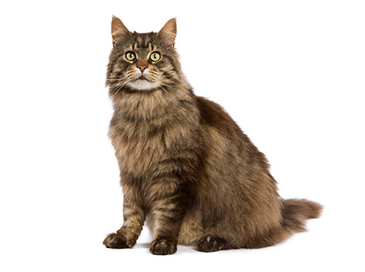
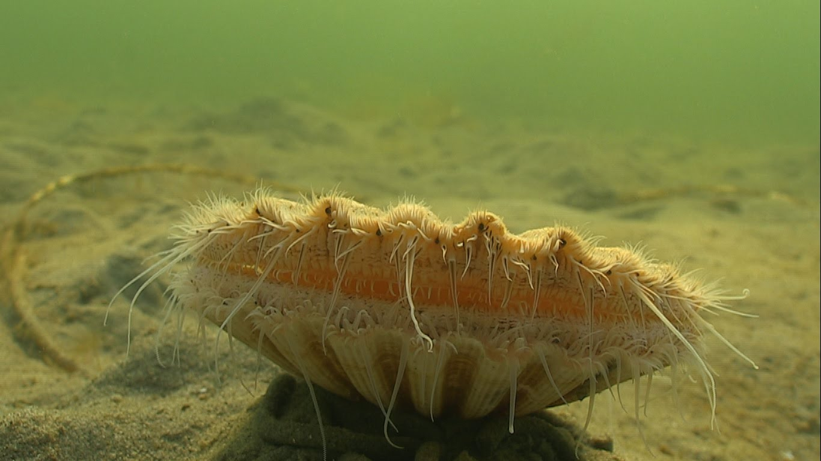
Osmolarity
Osmolarity refers to the solute concentration of a solution. Some organinisms are osmoregulators and some are osmoconformers
Organisms where their internal solute concentration is the same as the external environment
Maintain a constant internal solute concentration

Slide 3
Data Question – pg 486

Slide 4
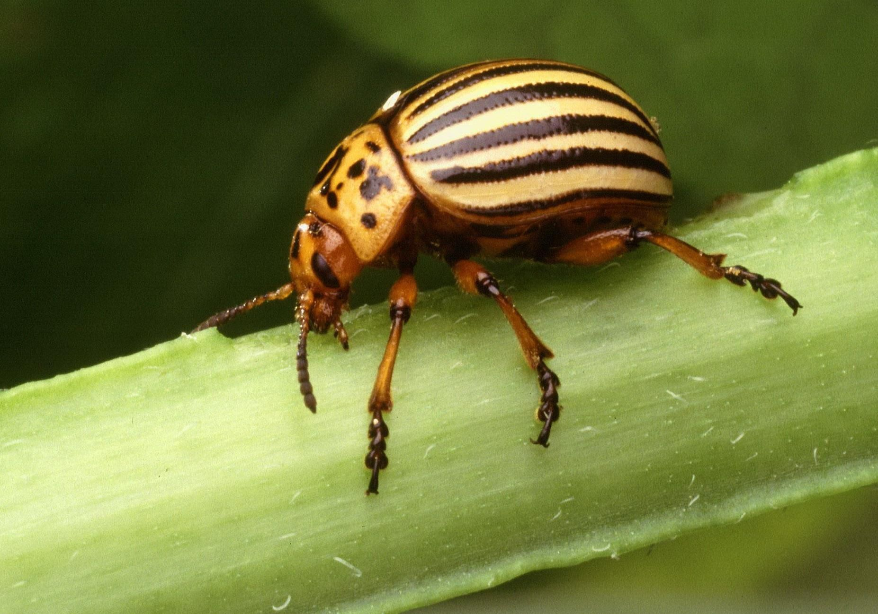
Removal of nitrogenous waste
When animals break down amino acids, the nitrogenous waste product is toxic and needs to be excreted.
Mammals
Waste: urea
System: Kidney
Insects (arthropods)
Waste: uric acid
System: Malpighian tubules
Mammals have blood in closed tubes.
The blood concentration needs to be maintained
Insects have haemolymph in closed tubes.
The haemolymph concentration needs to be maintained

Slide 5
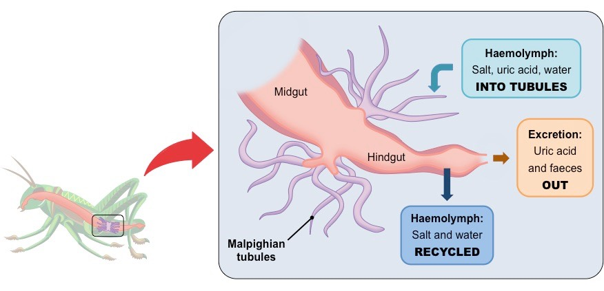
Malpighian Tubule System

Slide 6
Uric acid

Slide 7
Mammalian Urinary System

Slide 8
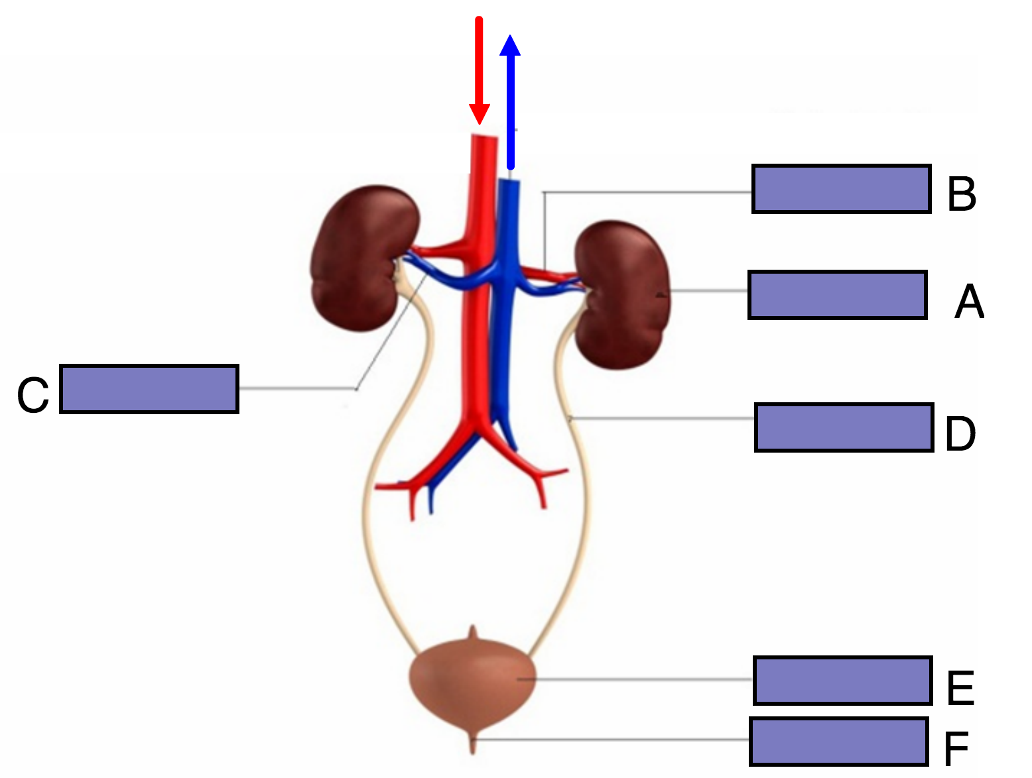

Slide 9
Drawing a Kidney

Slide 10
