Slide 1
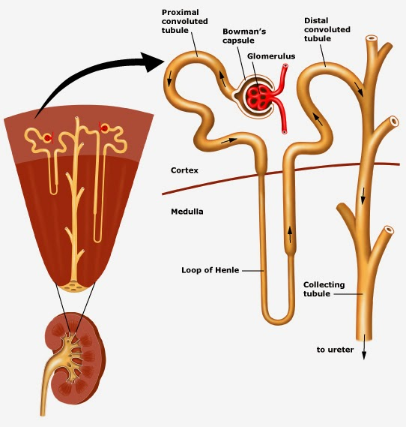
Ultrafiltration
Selective reabsorption

Slide 2
Kidney – Loop of Henle, DCT and Collecting Duct
Explain how osmolarity is reduced in the loop of Henle
Describe the countercurrent multiplier system
Explain the role of ADH n osmoregulation at the collecting duct

Slide 3
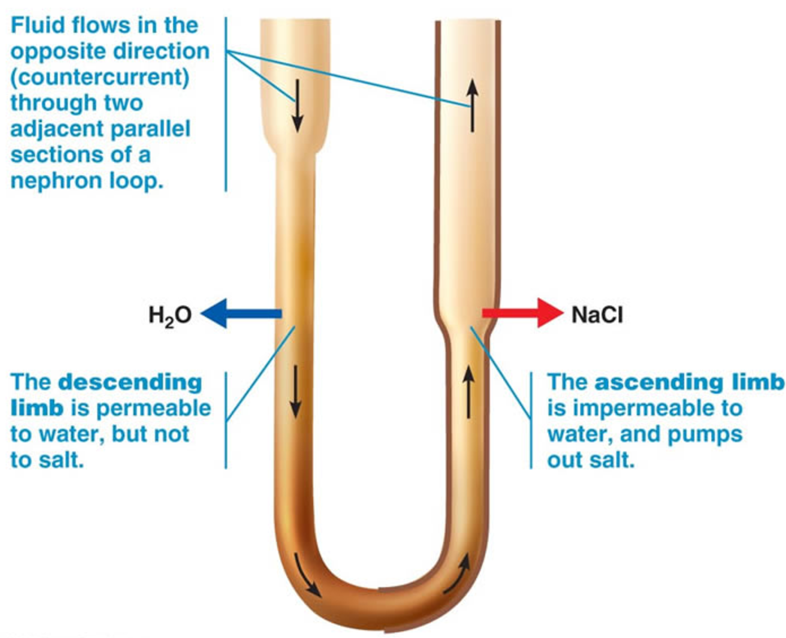
A
B
Osmolarity (mOsm) is the measure of the solute concentration
300 mOsm
100
mOsm
What do you think has been removed between A and B?

Slide 4
The job of the loop of henle is to create a salty environment in the medulla.
This will allow water to leave the collecting duct by osmosis

Slide 5
Loop of Henle

Slide 6
Key Points
Sodium is pumped out of the ascending limb to restore gradients to 200 mOsm.
Water leaves the decending limb to reach equalibrium.
Fluid moves around.
Repeat.
The interstitial fluid in the medulla becomes very salty (high osmolarity) the fluid in the nephron has a reduced osmolarity of 100 mOsm
Countercurrent multiplier system

Slide 7
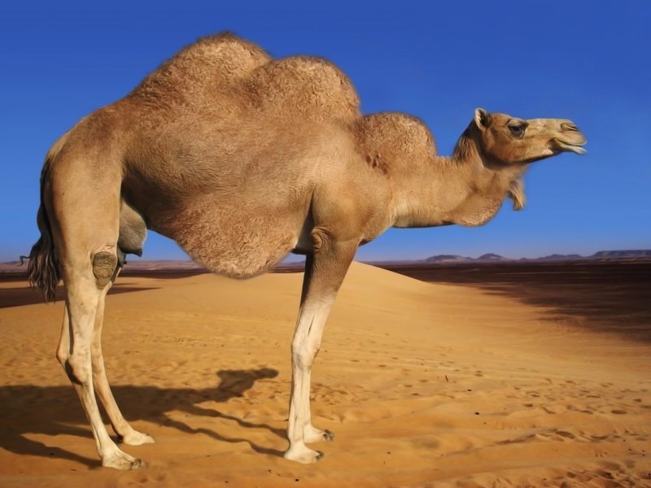
Desert Adaptations
Suggest why desert animals have a long loop of Henle

Slide 8
Distal Convoluted Tubule and Collecting Duct
Normally fairly impermeable to water. If the solute concentration is high in the blood the body needs to get more water in the blood to regain regular osmolality.

Slide 9
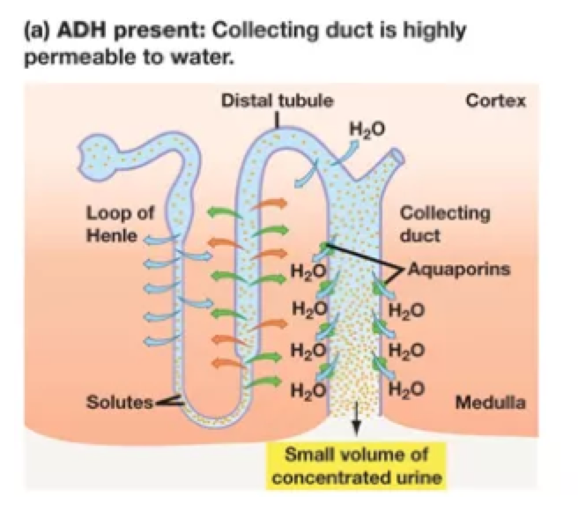
High blood solute concentration
Detected by the hypothalamus in the brain.
Hypothalamus sends a message to the pituitary gland.
Pituitary gland releases ADH (antidiuretic hormone)
ADH travels in blood to kidney
Increases the permeability of the collecting duct and DCT to water.
Water moves into blood through the walls of the CD and DCT by osmosis.
Normal blood osmolality restored
Small volume of concentrated urine produced

Slide 10
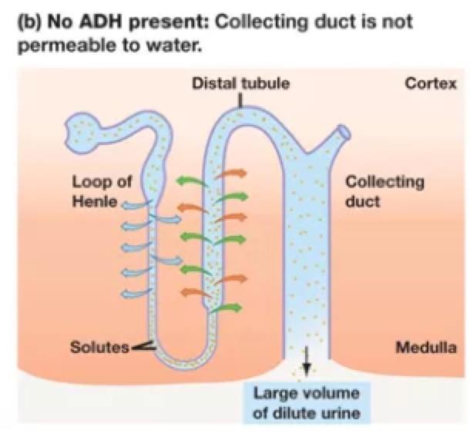
Low blood solute concentration
Detected by the hypothalamus in the brain.
Hypothalamus sends a message to the pituitary gland.
Pituitary gland stops ADH (antidiuretic hormone) production
Decreases the permeability of the collecting duct and DCT to water.
Water remains in the nephron
Large volume of dilute urine produced

Slide 11
You have been exercising on a hot day with little water
What are the consequences in terms of ADH and concentration of urine produced?
You have drunk a lot of water
You have a high salt diet

Slide 12
Nitrogenous waste
*
Animals need to remove nitrogenous waste from the metabolism of amino acids.
The type of nitrogenous waste removed depends on their environment and evolutionary history.

Slide 13
Fish
Fish excrete nitrogenous waste as ammonia; this is unusual because ammonia is highly toxic therefore storage in the body can pose a risk.
However, fish are able to cope due to their environment – the large volumes of water they reside in allow them to continuously excrete ammonia (without the need for storage) directly into the water, diluting the ammonia to non-toxic levels.

Slide 14
Terrestrial mammals (land based) *and aquatic mammals
These will use energy to convert ammonia to urea (less toxic) so it can be stored.
Due to their evolutionary history aquatic mammals also produce urea.

Slide 15
Birds and Reptiles
Birds release uric acid. It takes a lot of energy to convert ammonia to uric acid.
But, there is an advantage…
Uric acid is not water soluble so does not require water to be released.
Not having to carry water around for excesion means les energy is needed for flight

Slide 16
B

Slide 17
D

Slide 18
B

Slide 19
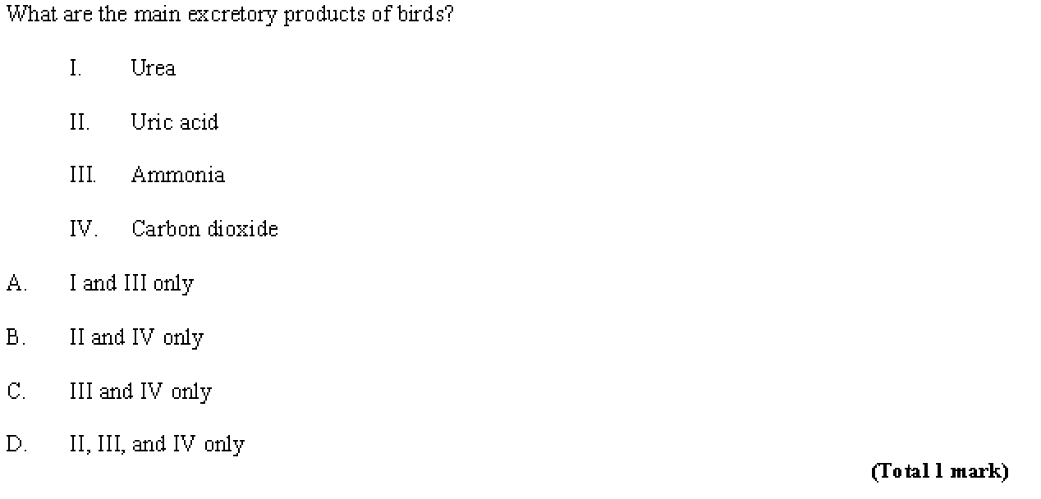
B

Slide 20
Dehydration and Overhydration
Too little water in the blood
Exercise, insufficient water
Water needed to excrete metabolic waste. If you can’t get rid of this waste it can lead to tiredness and deceased muscle function
Decrease in blood pressure due to reduced blood volume
Increased heart rate
Temperature regulation affected due to an inability to sweat
Over-consumption of water
Dilutes blood solutes
Makes body fluids hypotonic and could result in the swelling of cells as there would be a lower osmolarity in the body fluids

Slide 21
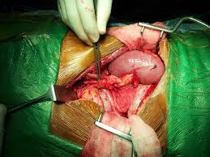
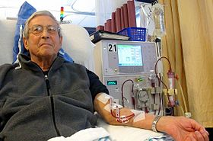
Kidney failure
Transplant
Dialysis
You can survive with one kidney so it is possible to donate whilst you’re still alive
Risk: rejection

Slide 22
Selectively permeable membrane
Blood and dialysis fluid is always moving to maintain concentration gradients
Dialysis fluid creates a diffusion gradient to extract waste from the blood
+ waste
Waste products pass through membrane from blood into dialysis fluid

Slide 23
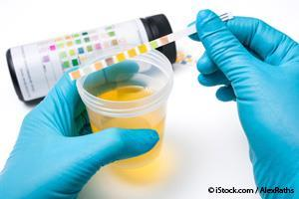
Urinalysis
Can be used to test for the presence of drugs, excessive proteins or excessive glucose.
What could be the issue if there is excessive glucose in the blood?
Why would you not normally see protein in the urine?

