Slide 1
Action of Antibodies
Agglutination | Activation of complement | Opsonization | Neutralisation

Slide 3
Compare antibody production between primary and secondary immune responses
Number of antibodies

Slide 4
Immunity and Vaccinations
Explain how vaccinations can lead to immunity
Describe how smallpox was eradicated
Analyse data on polio vaccination programs

Slide 5
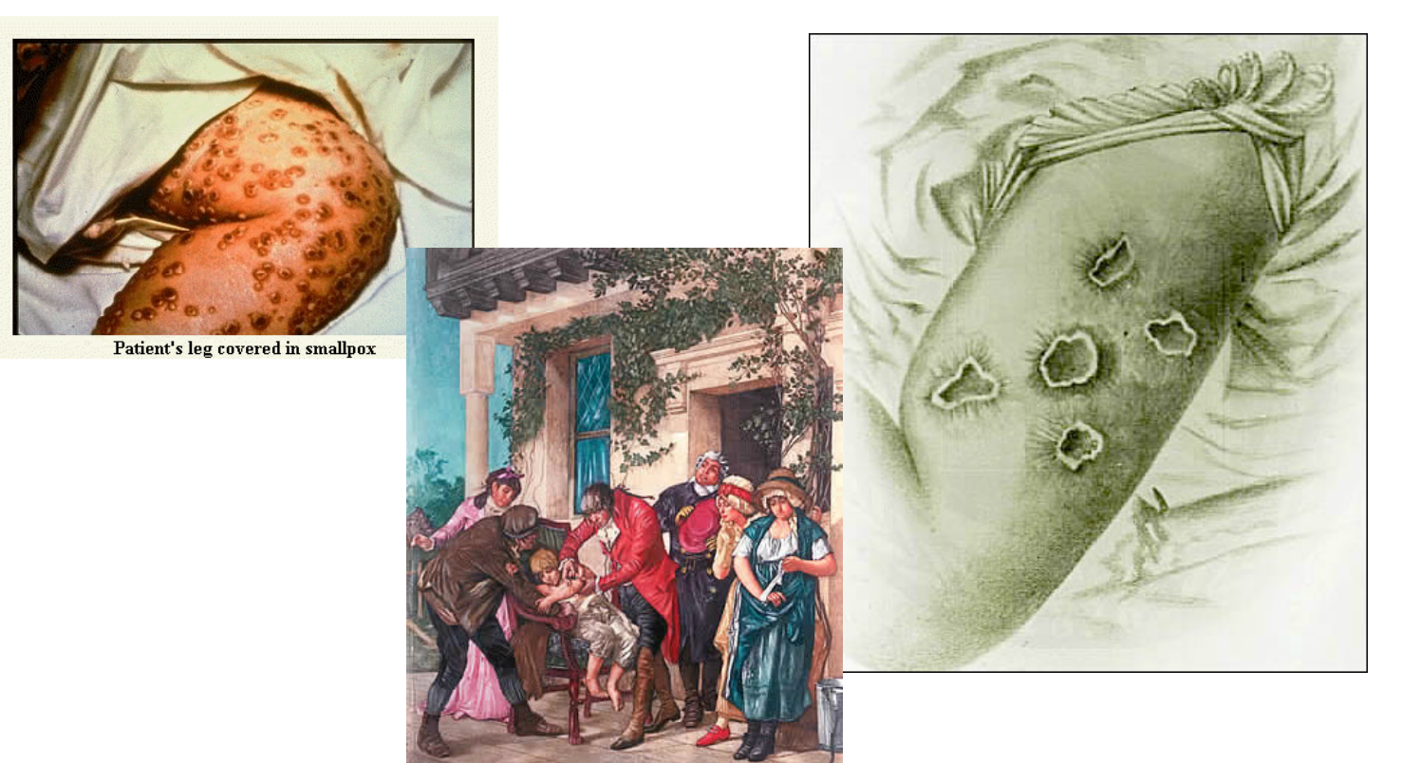
Smallpox vaccine
How did the smallpox vaccine work?
Why was smallpox easy to eradicate?
Smallpox

Slide 6
What is in the needle?
How does it stop me from getting the disease?

Slide 7
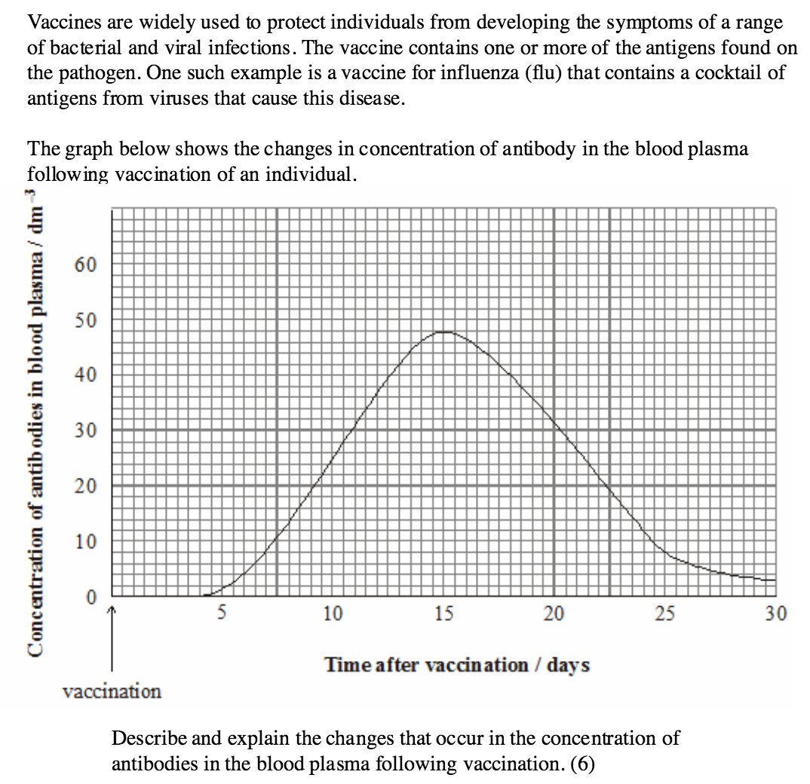

Slide 8
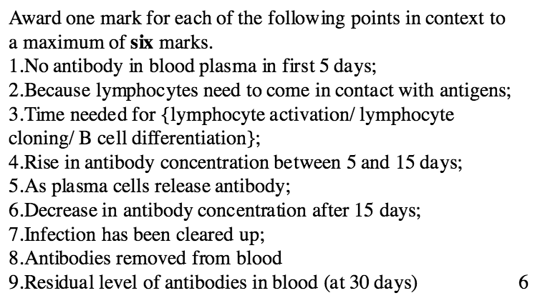

Slide 9
Polio
Polio
Answer data questions on page 473

Slide 10
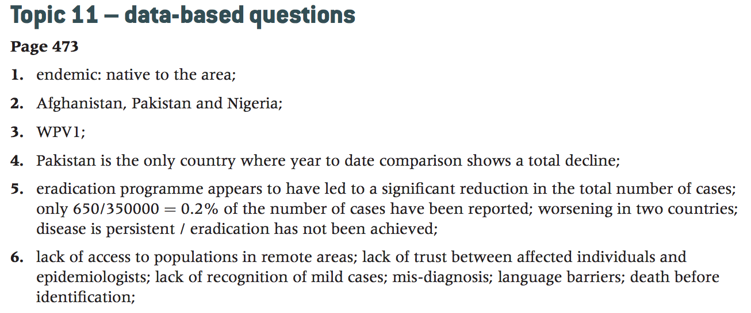

Slide 11
Zoonosis
A pathogen which can cross a species barrier.
Smallpox is was only found in humans
Lyme disease is caused by a zoonosis pathogen and can infect many mammals

